Slide 1
BF528 - Microarrays

Slide 2
Acknowledgement
This lecture was, in part, designed to be consistent with lecture material from Johns Hopkins University. Please see the link below for more information.
http://www.ams.jhu.edu/~dan/550.435/notes/COURSENOTES435.pdf

Slide 3
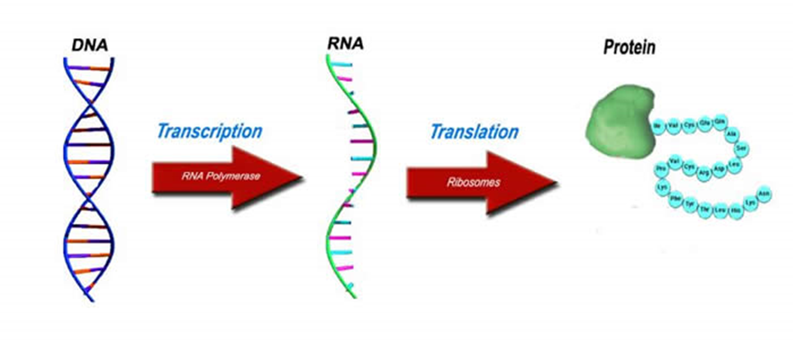
Central Dogma of Biology
Microarrays are a tool that help figure out why, when, and to what extent genes are transcribed

Slide 4
Definitions
Gene expression == mRNA abundance
Increased expression == induced, or up-regulated
Decreased expression == down-regulated
Difference in expression == differential expression

Slide 5
Research Questions
Which genes are expressed in a given context?
Which genes are expressed differently between different contexts?
Which genes’ expression correlate with a variable of interest?
What do the (differentially) expressed genes tell us about the biological processes of the system?

Slide 6
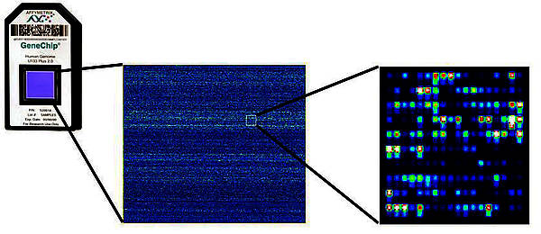
What Is A Microarray?
“A collection of microscopic DNA spots attached to a solid surface”

Slide 7
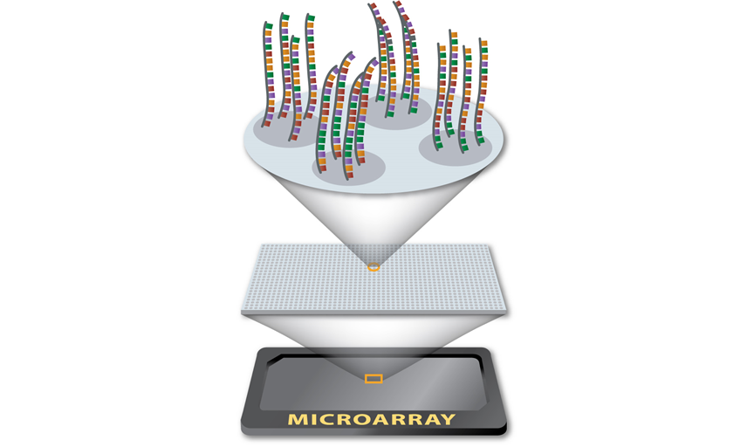
What Is A Microarray?

Slide 8
Microarray Experiments
Experimental questions:
Disease vs Normal tissue Changes in expression over time Before and after drug treatment | Before and after toxin exposure Different tumor subtypes
Data driven questions:
Which genes are differentially expressed?
Which genes are co-expressed?
Given gene expression, can we predict a condition?

Slide 9

Impact of Microarrays
~100k publications in PubMed
Breast cancer prognosis tool
Breast cancer predicts chemotherapy response
Colon cancer assay predicts risk of recurrence
Prostate cancer assay predicts risk of progression

Slide 10


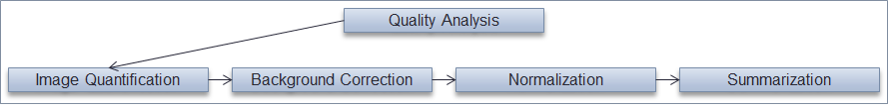

Microarray Study Design
Biological Question
1. Setup
2. Data pre-processing
3. Data
analysis
4. Interpretation

Slide 11
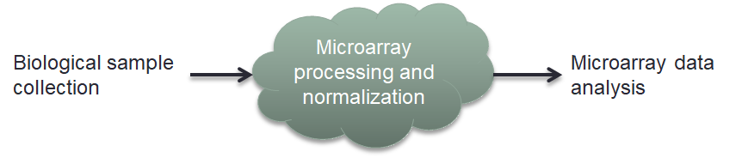
Two Types of Microarrays
Spotted arrays
High density oligonucleotide arrays

Slide 12
Oligo Arrays (in situ)
Also called Affy arrays (orig. Affymetrix)
Probe - a unique, short cDNA sequence
Probes synthesized on the chip
Terminology:
  probe - an individual 25nt sequence
  probe cell - millions of copies of a probe placed together
  probe set - a set of unique probes for a given gene

Slide 13
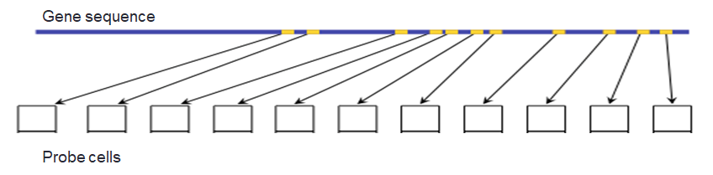
Oligo Arrays (in situ)
Each gene is represented by a set of probes
Probe sets
  Unique to each gene
  Multiple probe cells tiled across exons

Slide 14
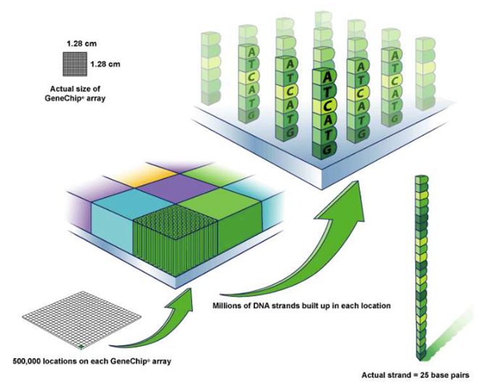
Oligo Arrays (in situ)

Slide 15
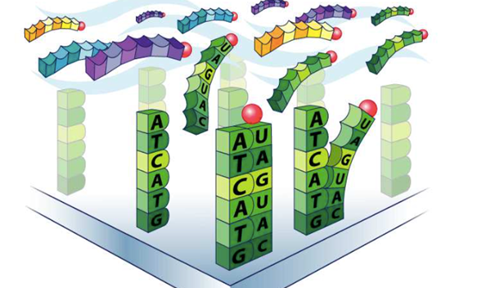
Oligo Arrays - Labeling & Scanning
Sample cDNA tagged w/ fluorescent marker
Sample washed over flowcell
Unbound cDNA washed away
Luminescence quantified in a scanner

Slide 16
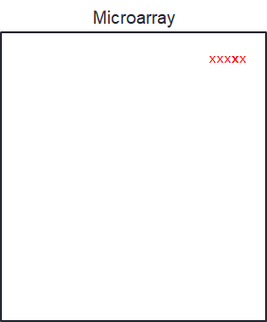
Oligo Arrays - Older Technologies
Affymetrix U133A & B
Probe cells grouped together, led to biases and artifacts

Slide 17
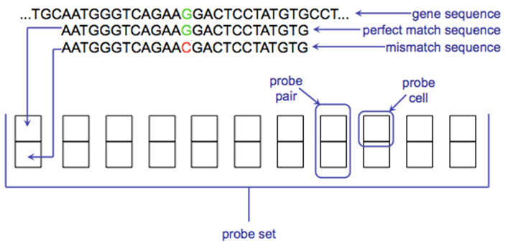
Oligo Arrays - Older Technologies
Used perfect match and mismatch probes
Mismatch probes contain...mismatch in probe sequence to account for non-specific binding

Slide 18
Oligo Arrays - Technology Update
U133 Affy arrays designed against 2001 draft human genome
Mismatch probes didn’t work well
Genome reference improved, more genes needed to be profiled
Gene ST array created and current

Slide 19
Oligo Arrays - Current Technology
Several chips:
3’ IVT - gene expression, measures 3’ UTR
Gene - gene expression, tiled sequence
Exon - DNA sequence, exon sequences only
Tiling - DNA sequence, tiled across genome

Slide 20
Microarray Analysis Methods

Slide 21
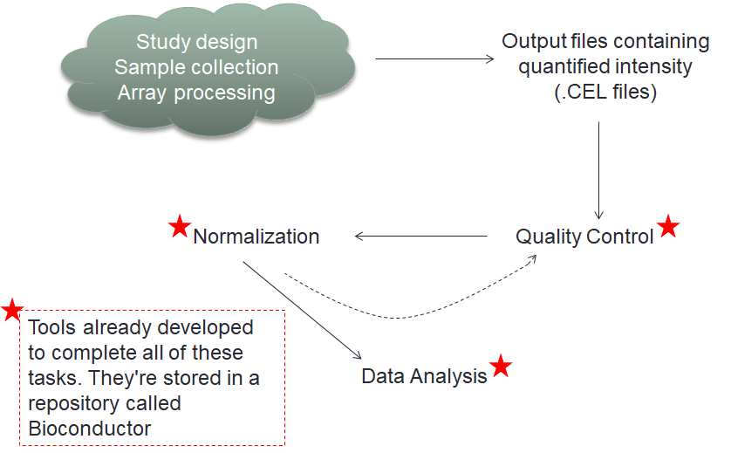
Typical Processing Steps

Slide 22
Normalization
Statistically adjust a set of expression matrices so they are comparable
Includes:
  Background correction - remove artifacts/noise
  Data normalization - adjust probe distributions across arrays to ensure comparability
  Probe summarization - combine probe intensities within probeset to gene-level

Slide 23
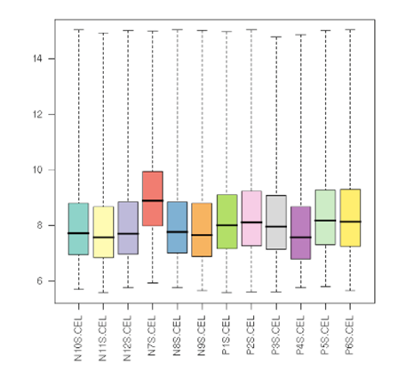
Normalization

Slide 24
Old Normalization Method: MAS5
Measured value = Noise + Probe Effects + Signal
Background correction
Intensity adjustment
  Examine perfect/mismatch probe ratio
  Calculate % present
  AUC
The good - usable with single chip, p-value for gene expression
The bad - uses mismatch probes, very complicated

Slide 25
State of the Art Normalization: RMA
Robust Multi-array Average (RMA)
Background correction - kernel density estimation based
Normalization - quantile normalization across batch of arrays
Summarization - linear additive model controlling for probe effects, gene expression, and error

Slide 26
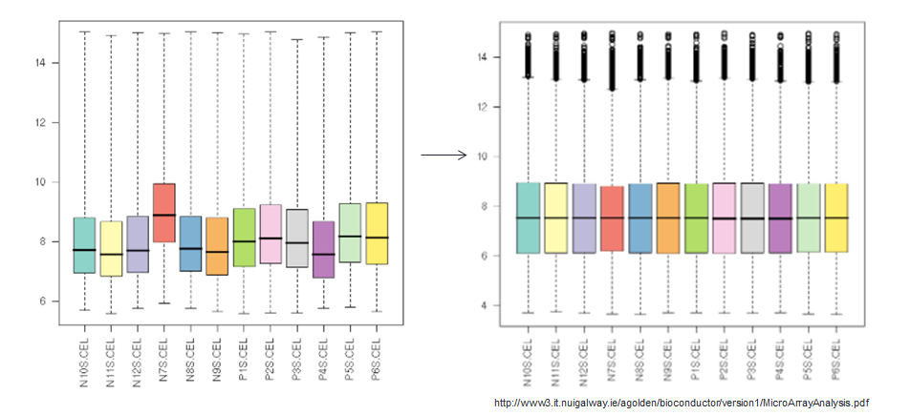
RMA Normalization

Slide 27
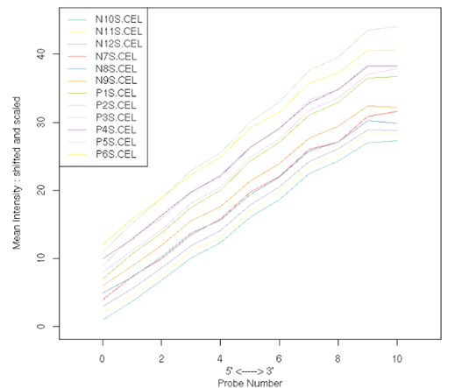
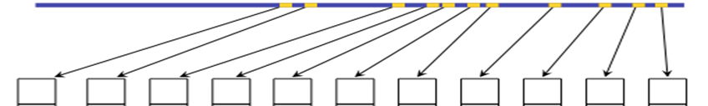
Quality Control - RNA Quality
RIN - RNA Integrity Number
Ranges 0-9
RNA Degradation Plot
RNA degrades 5’ -> 3’
Probe intensity tends to increase accordingly
Slope >2 may indicate poor RNA quality

Slide 28
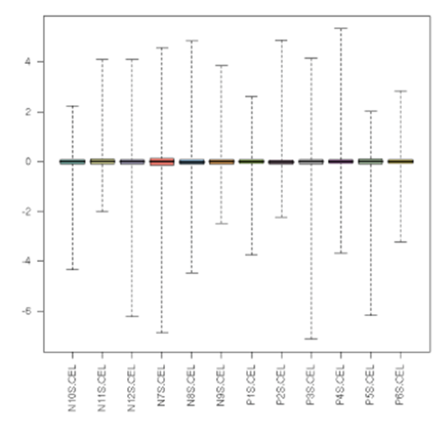

Quality Control - RLE
Relative Log Expression
Subtract median intensity across all arrays from each probe
Median RLE != 0 -> number of up/down genes not the same
Large IQR means many genes are differentially expressed

Slide 29
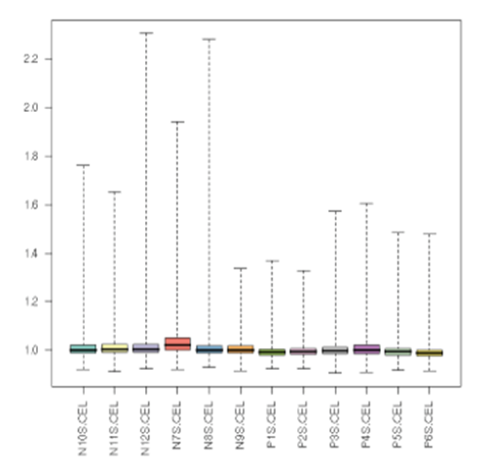
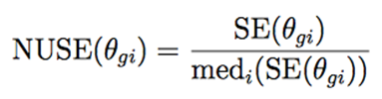
Quality Control - NUSE
Normalized Unscaled Standard Error
Arrays w/ large IQR or median NUSE > 1 may be poor quality

Slide 30
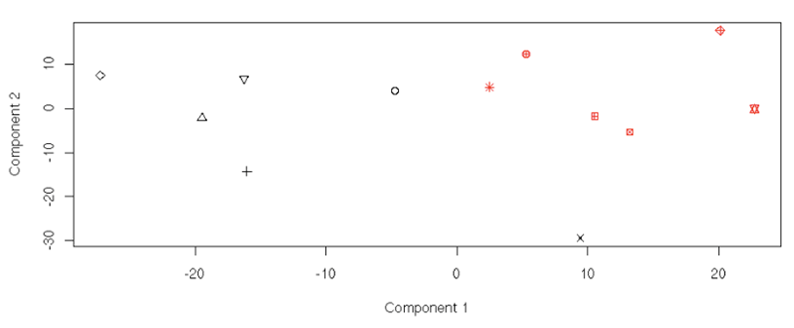
Quality Control - PCA
Principal Component Analysis
Data dimensionality reduction technique
Identifies “directions of variance”

Slide 31
Quality Control Rules of Thumb
RLE, NUSE, RNA Degradation, and PCA
No single metric is indicative of poor quality
Flagged samples should be examined before omission
Make decisions based on multiple criteria
Rule of thumb - filter if all three:
Median RLE > 0.10, Median NUSE > 1.05, RIN < 4.0

Slide 32
Correcting for Batch Effects
Batch effects - variation in data due to technical effects:
  Arrays processed on different days
  The technician who ran the arrays
  Sample collection site
  Variance in reagent type/quality
Confounding - when batch effects are correlated with condition of interest
ComBat - R package to correct batch effects

Slide 33
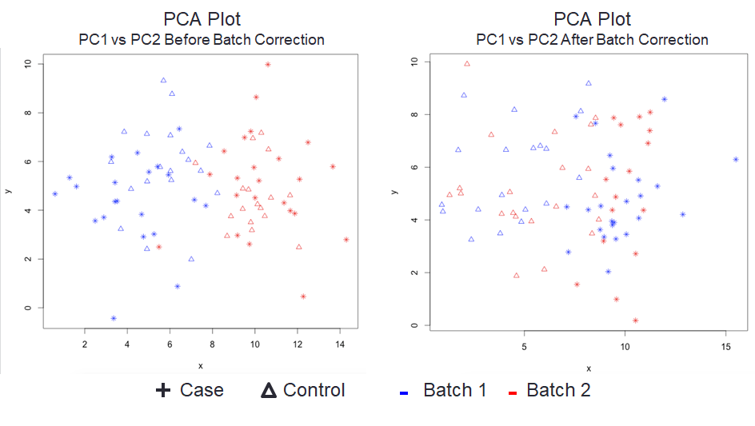
Correcting for Batch Effects

