Slide 1
BF528 - Applications in Translational Bioinformatics
Computational Skills Primer

Slide 2

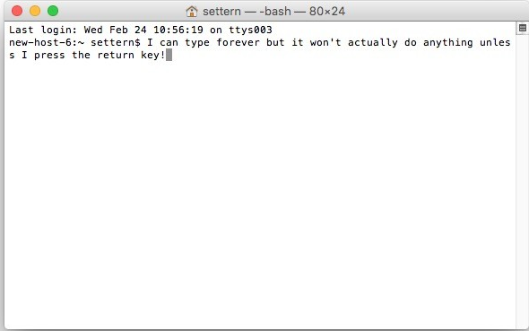
Computer was born in the mind of man,
not the other way around!!
Goal of this lecture:
Overcome the fear of black screen (if you have one !!)
Learn techniques for working on SCC you will need
Introduce shared computing concepts you will use

Slide 3
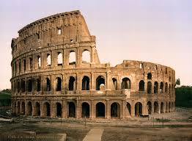
Prerequisites
Patience with self and with each other
Keep an open mind
Attitude of collaboration
It’s OK to not know - we will learn together
Rome ne s'est pas faite en un jour !!!

Slide 4


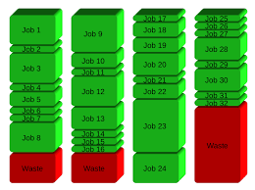
What is SCC ?
Shared Computing Cluster (SCC)
Shared: Multi-user environment.
Computing: Calculation, file manipulation, etc
Cluster: Many individual computers connected together working in coordination

Slide 5
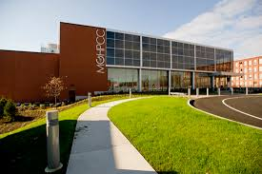
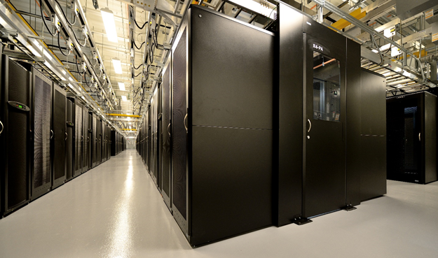





Massachusetts Green High Performance Computing Center
Notes:
State-of-the-art data center in Holyoke, MA.
MGHPCC provides physical infrastructure (i.e. space, power, cooling), not computing systems.
Individual universities or consortiums provide their own computing and support

Slide 6
Terminology
Cluster - connected set of computers
Node - a single computer (on a rack)
  Head/login node - “gateway” computer to cluster
  Compute node - single computer where jobs run
terminal - program used to interact with a computer using text commands
ssh - secure shell, how we connect to cluster
  NB: both a noun and a verb, e.g. “use ssh to ssh into scc1…”

Slide 7
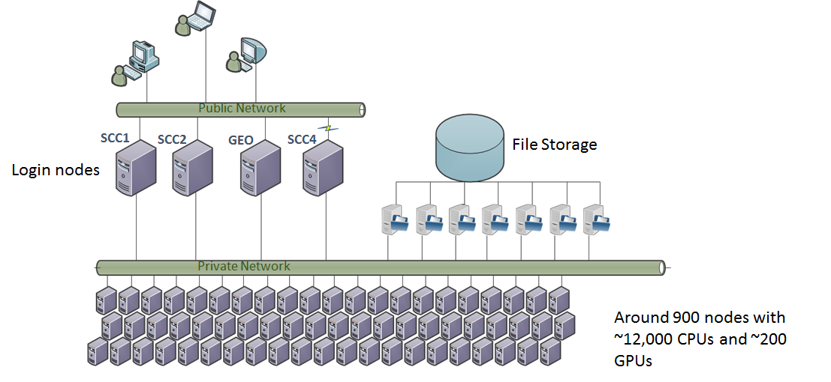
SCC Architecture

Slide 8
Why use SCC? I have a laptop!
Collaborate on projects
Run code exceeding workstation capability
Secured Network
Fast and easy data sharing
Analyze protected data (e.g. dbGaP)
Run code that runs for long periods of time
Perform many computations in parallel

Slide 9
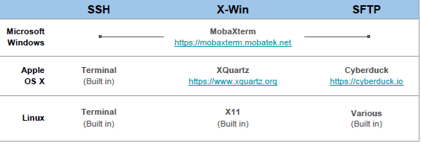
Software to Access SCC
SSH
SCC OnDemand
https://scc-ondemand.bu.edu

Slide 10
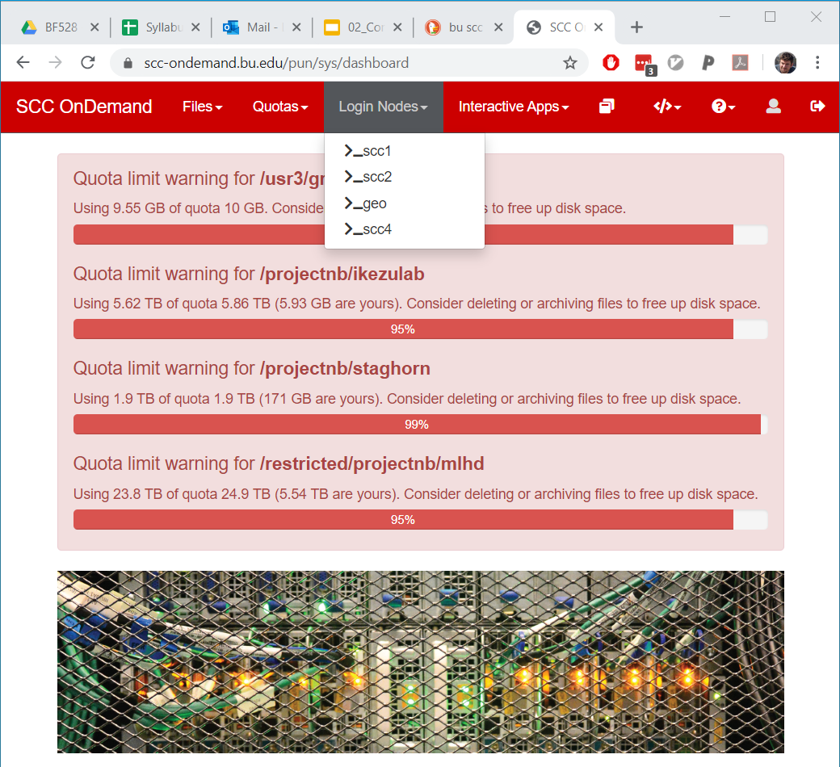
How to connect with SCC OnDemand

Slide 11
SCC OnDemand Demonstration: Connecting

Slide 12
Navigation
Essential navigation commands:
pwd - print current working directory
ls - list files
cd - change directory
The “address” of a file/directory in linux is called a path:
Absolute path - starts with /
Relative path - does not start with /

Slide 13
List of useful commands - Part I
Useful options for the “ls” command:
◦ls -a List all files, including hidden files beginning with a period “.”
◦ls -ld * List details about a directory and not its contents
◦ls -F Put an indicator character at the end of each name
◦ls –l Simple long listing
◦ls –lR Recursive long listing
◦ls –lh Give human readable file sizes
◦ls –lS Sort files by file size
◦ls –lt Sort files by modification time (very useful!)

Slide 14
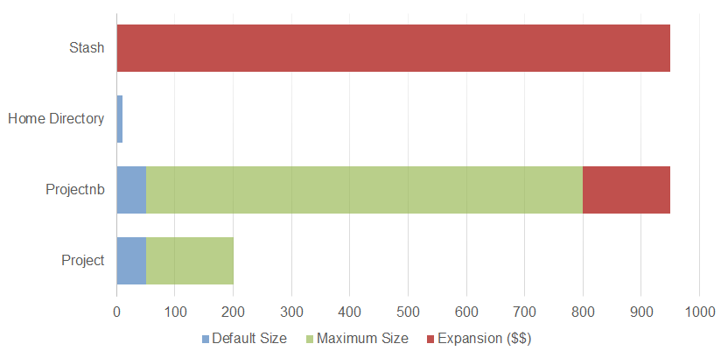
Storage (GB)
~/ - Home directory, your personal space (10 GB max)
/project – Source code, files you can’t replace.
/projectnb – Output files, downloaded data sets
Available from all head nodes (scc1, scc2, etc)
Restricted data (protected data, e.g. dbGaP)
/restricted/project
/restricted/projectnb
Only accessible through scc4.bu.edu and compute nodes.
Notes:
§Research projects are by default granted 50GB of backed-up spaced (/project/PROJNAME) and 50GB of not-backed-up space (/projectnb/PROJNAME). These numbers can be increased for free to 200GB/800GB.
§Project groups can either purchase or “rent” additional storage.
§All users have a Home Directory with a 10GB quota.

Slide 15
Permissions
Files Access Control:
Every file has an owner
Every file belongs to a group
Every file has “permissions” controlling access to it:
  r - read
  w - write
  x - execute
[kkarri@scc4 ~]$ ls -l newdir
drwxr-xr-x 3 kkarri waxmanlab 512 Jan 21 16:03 newdir

Slide 16

chmod
Change the permissions on the directory “newdir” so that members of your group can write to it:
[kkarri@scc4 ~]$ ls -l newdir
drwxr-xr-- 3 kkarri waxmanlab 512 Jan 21 16:03 newdir
Members of my group don’t have access to this file, change that:
[kkarri@scc4 ~]$ chmod g+w newdir
[kkarri@scc4 ~]$ ls -l newdir
drwxrwxr-- 3 kkarri waxmanlab 512 Jan 21 16:03 newdir

Slide 17
SCC OnDemand Demonstration: Navigation

Slide 18
List of useful commands
cp [file1] [file2] copy file
mkdir [name] make directory
rmdir [name] remove (empty) directory
mv [file] [destination] move/rename file
rm [file] remove (-r for recursive)
file [file] identify file type
less [file] page through file
head -n [file] display first n lines
tail -n [file] display last n lines
ln –s [file] [new] create symbolic link
cat [file] [file2…] display file(s)
tac [file] [file2…] display file in reverse order

Slide 19
Additional Reading
Assignment: familiarize yourself with the material on basic command line usage found here:
Workshop 0. Basic Linux and Command Line Usage
For in-depth understanding of these concepts go through the following modules on cluster computing and advance command line text editors:
Cluster Computing Tutorial
Advanced CLI Tutorial

