Slide 1
BF528 - Biological Data Formats

Slide 2
Introduction
Many different types of data
Standard formats exist for many of them
Always use/extend standard formats
Don’t save data in non standard formats when standards are available - No .xslx!
For complete list of formats see: https://genome.ucsc.edu/FAQ/FAQformat.html

Slide 3
Nucleotide/amino acids sequences
Any sequence of nucleotides/amino acids is saved in FASTA format.
>sequence_header [comments]
sequence_line1
sequence_line2
sequence_line3
...
Lower case letters means they have been masked.

Slide 4
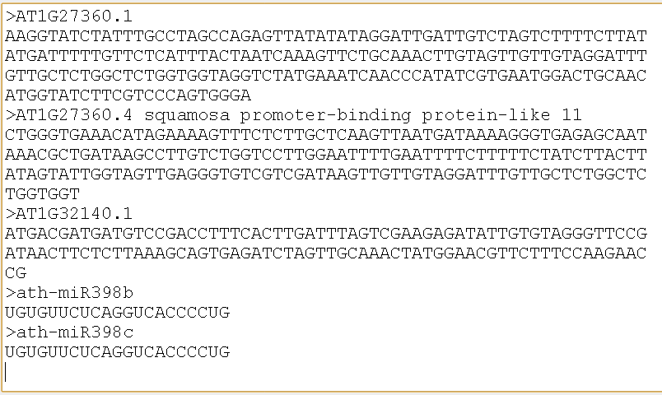
FASTA format

Slide 5
Sequencing reads: FASTQ
Each read/read pair should have an unique name.
A read has the sequence and the quality of each nucleotide sequences.
@read_name [comments]
sequences_nucleotides
+read_name [comments]
quality_of_each_nucleotide_in_ASCII

Slide 6
FASTQ format: single end
fastq_SRR1997469.fastq
@SRR1997469.1 1 length=36
CAGTCTTCTTAGAAATATCCACTTCGGAATAAAAGA
+SRR1997469.1 1 length=36
BBBBBFFFFF<FFFFFFFFFFFFFBFFFFFFFFFFF
@SRR1997469.2 2 length=36
ACAGTTGAACGATCCTTTACAGANAGNAGNCTNGTA
+SRR1997469.2 2 length=36
<BBBBFFFBBF<BFF/<FFFFFF#############
...

Slide 7
FASTQ format: paired end/mates
fastq_SRR1997469_1.fastq
fastq_SRR1997469_2.fastq
@SRR1997469.1 1 length=36
CAGTCTTCTTAGAAATATCCACTTCGGAATAAAAGA
+SRR1997469.1 1 length=36
BBBBBFFFFF<FFFFFFFFFFFFFBFFFFFFFFFFF
@SRR1997469.2 2 length=36
ACAGTTGAACGATCCTTTACAGANAGNAGNCTNGTA
+SRR1997469.2 2 length=36
<BBBBFFFBBF<BFF/<FFFFFF#############
...
@SRR1997469.1 1 length=36
AGATAAGATGGTAATCTTTGATGGAGAACATTAAGA
+SRR1997469.1 1 length=36
BBBBBFFFFFFFFFFFFFFFFFFFFFFFFFFFFFFF
@SRR1997469.2 2 length=36
ACTGGGAANCCTTCTGTCTAGCCTTATATGAAAAAA
+SRR1997469.2 2 length=36
BBB/BFFB#BB/FFFF/FFFFFFBBFFFFFFFFFBF
...

Slide 8
Read alignments
Alignments are kept in SAM format
SAM is sorted and compressed into BAM or CRAM
One line per alignment
Use samtools to view, sort, merge, concatenate, index, get statistics, … on alignment files.

Slide 9
SAM/BAM/CRAM - header
The header lines start with @
@HD → header definition
@SQ → a sequence in the reference file you used, followed by how long it was and it’s comment (from the reference file)
@RG → read groups you assigned while mapping the reads
@PG → programs used to obtain this bam, in order

Slide 10
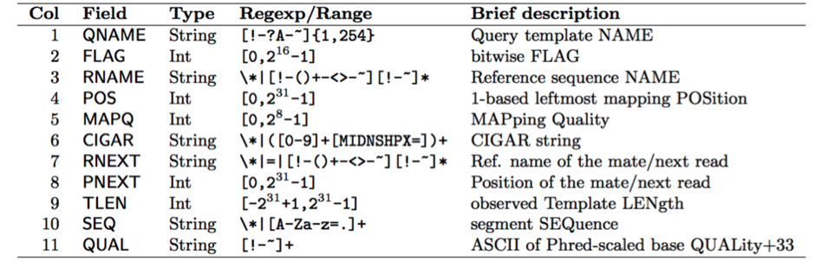
SAM/BAM/CRAM - body
Each line keeps an alignment.
Each alignment has 11 mandatory fields:

Slide 11
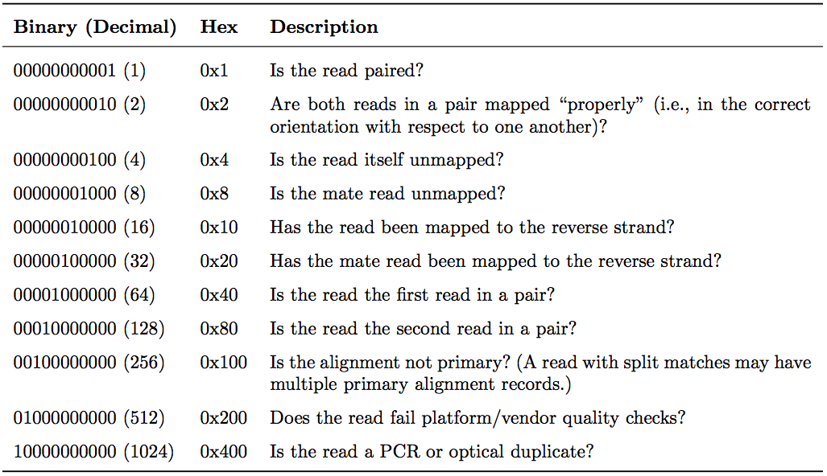
SAM/BAM/CRAM - flag
The flag is the summation of the following binary attributes:
Example flags:
Single end read mapped to + strand: 0 (no flags apply)
Single end read mapped to - strand: 16
Unmapped, paired end first mate read with unmapped mate: 69 = 1 + 4 + 8 + 64

Slide 12
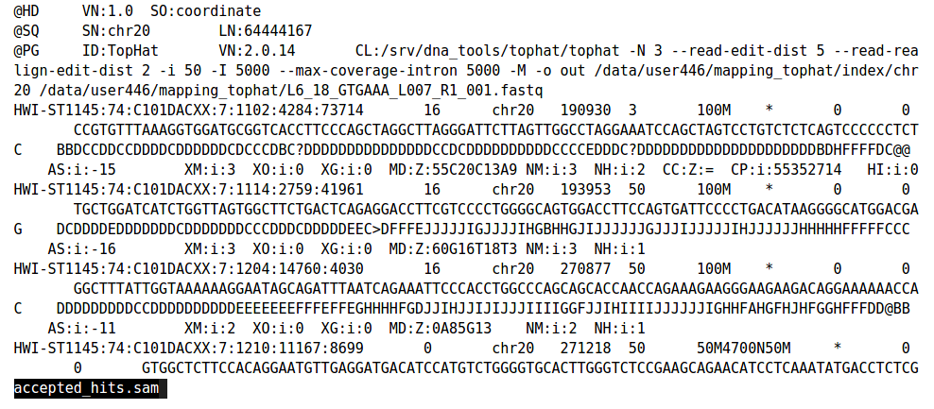
SAM/BAM/CRAM format

Slide 13
SAM/BAM/CRAM format
Use samtools view to see the content of a SAM/BAM/CRAM file.
Always sort and index them
Use samtools view -f (include) and -F (exclude) to filter by flags
Use samtools view -q to filter by quality.

Slide 14
Convert BAM to FASTQ
Some public datasets are provided in BAM format
Need to extract the reads to process the raw data
BAM (usually) contains all information from FASTQ
samtools:
samtools bam2fq [-nO] [-s <outSE.fq>] <in.bam>

Slide 15
Standard format for keeping tables
field1 | field2 | field3 | ...
... | ... | ... | ...
Fields (columns) separated by a character on each line:
Comma (or Character) Separated Vector (CSV)
Tab Separated Vector (TSV)
Some interpreters take any space (space or tab) as a separator (such as awk, cut).
Some have column name as first row (header), some don’t

Slide 16
Genomic variants
Save them in VCF format
VCF: Variant Call Format
Current version: 4.0
http://www.internationalgenome.org/wiki/Analysis/vcf4.0/
Tab separated

Slide 17
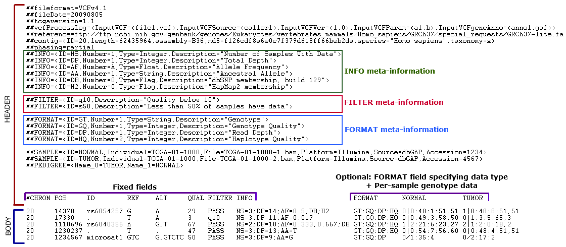
VCF format - header
Mandatory header lines: information about the fields (columns) starting with ##INFO
Extra: filtering, metadata, tools, ...

Slide 18
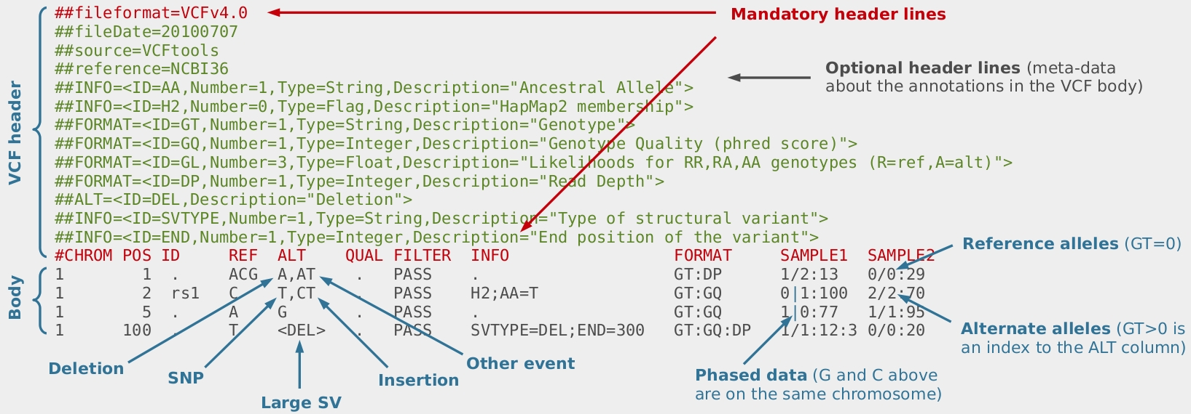
VCF format - body
REF and ALT fields contain nucleotides in case of SNP and indels
In case of large structural variants: <DEL> <INS> <DUP> <INV>

Slide 19
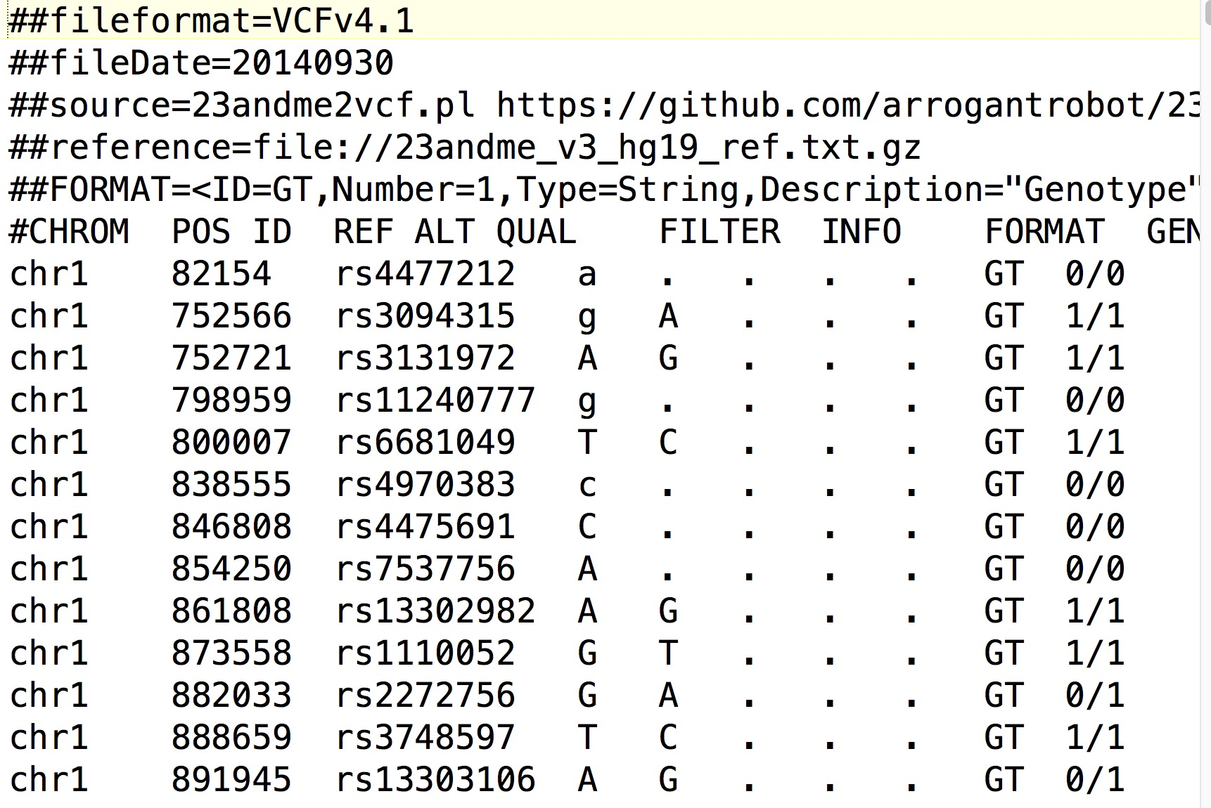
VCF format - example

Slide 20
Genomic regions
A region is defined by three required fields
  sequence name (e.g. chromosome)
  start coordinate
  end coordinate
Define regions of interest: introns, exons, genes, etc.
Additional information saved as fields after the first three.
Three standard tab-separated formats: BED, GFF, GTF
No headers

Slide 21
BED format
Mandatory fields:
chrom - Name of the chromosome/scaffold/reference sequence
chromStart - 0-based starting position of the feature on chrom
chromEnd - Ending position of the feature in the chromosome or scaffold.
The chromEnd base is not included in the display of the feature.
For example, the first 100 bases of a chromosome are defined as:
  chromStart=0
  chromEnd=100
  span the bases numbered 0-99

Slide 22
BED format
Optional fields:
4. Name
5. Score
6. Strand
7-12. Display options (thick starts and end, color, blocks…) to control the view on the genome browser

Slide 23
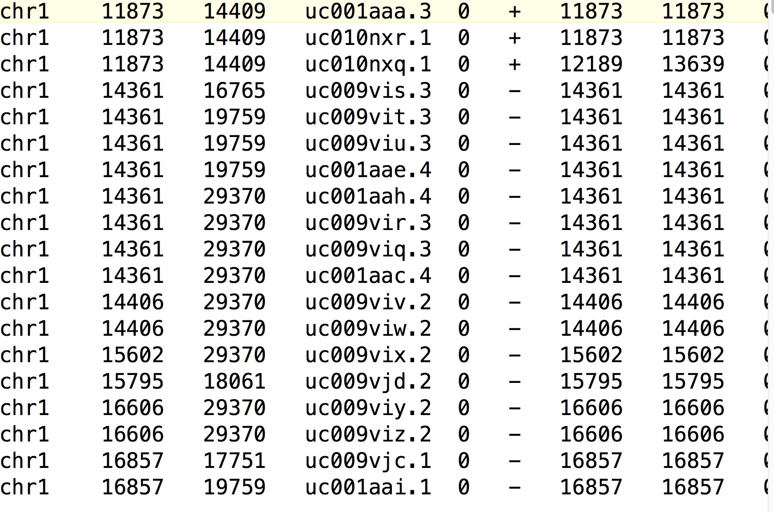
BED format

Slide 24
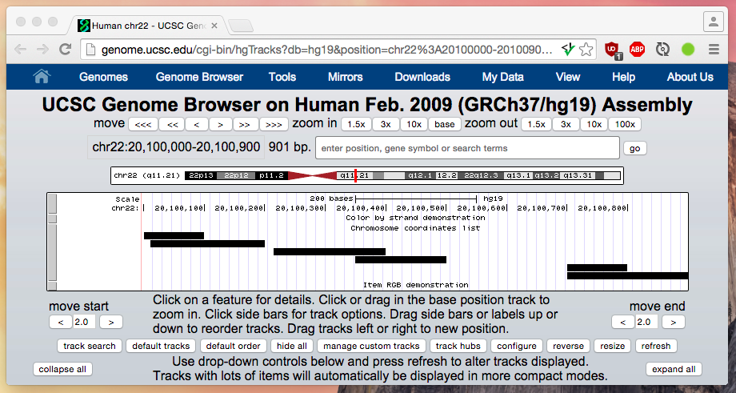
BED file records are intervals
start

Slide 25
bedtools
http://bedtools.readthedocs.io/
sort (sort bed files)
Intersect (get intersections of bed files)
merge
coverage
overlap
substract
...

Slide 26
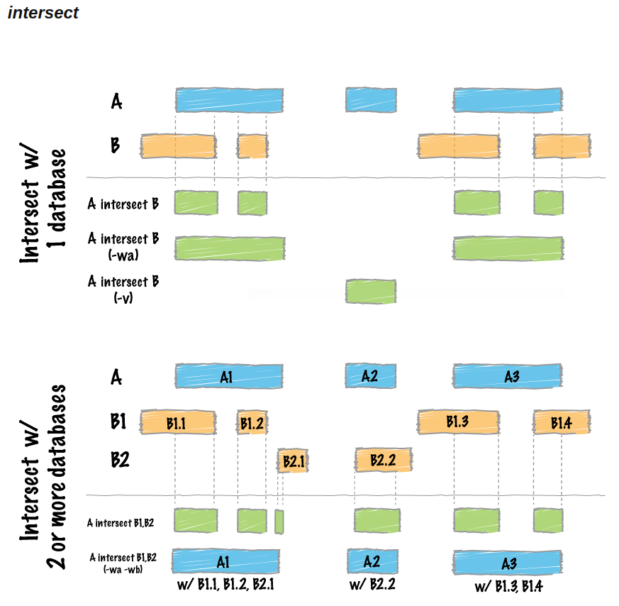
bedtools - intersect

Slide 27
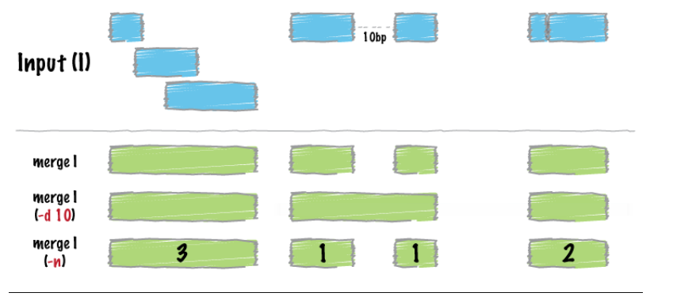
bedtools - merge

Slide 28
General features
9 mandatory fields, tab separated
seqname - The name of the sequence. Must be a chromosome or scaffold.
source - The program that generated this feature.
feature - The name of this type of feature (e.g. gene, exon, etc).
start - The starting position of the feature in the sequence (1-based)
end - The ending position of the feature (inclusive).
score - A score between 0 and 1000.
strand - Valid entries include "+", "-", or "." (for don't know/don't care).
frame - If the feature is a coding exon, frame should be a number between 0-2 that represents the reading frame of the first base. If the feature is not a coding exon, the value should be ".".
group - All lines with the same group are linked together into a single item.

Slide 29
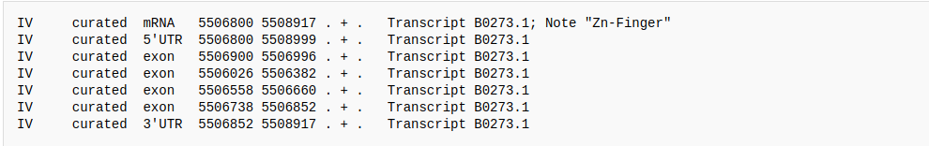
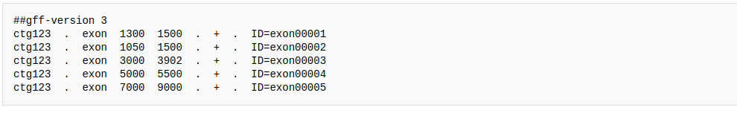
General Feature Format (GFF) format
GFF2:
GFF3:

Slide 30
Gene information
GTF (Gene Transfer Format, GTF2.2)
Extension to GFF2, backwards compatible
First eight GTF fields are the same as GFF
feature field is the same as GFF, has controlled vocabulary:
  gene, transcript, exon, CDS, 5UTR, 3UTR, inter, inter_CNS, and intron_CNS, etc
group field expanded into a list of attributes (i.e. key/value pairs)
The attribute list must begin with the one mandatory attribute:
gene_id value - A globally unique identifier for the genomic source of the sequence

Slide 31
GTF
##description: evidence-based annotation of the human genome (GRCh38), version 27 (Ensembl 90)
##provider: GENCODE
##contact: gencode-help@sanger.ac.uk
##format: gtf
##date: 2017-08-01
chr1 HAVANA gene 923928 944581 . + . gene_id "ENSG00000187634.11"; gene_type "protein_coding"; gene_name "SAMD11"; level 2; havana_gene "OTTHUMG00000040719.10";
seqname: chr1
source: HAVANA
feature: gene
start: 923928
end: 944581
score: . (no score)
strand: +
frame: . (not coding feature)
attributes:
  gene_id: ENSG00000187634.11
  gene_type: protein_coding
  gene_name: SAMD11
  level: 2
  havana_gene: OTTHUMG00000040719.10

Slide 32
GFF/GTF encodes relationships
Features are hierarchical, e.g.:
  A gene has 1 or more transcripts
  A transcript has 1 or more exons
  An exon is a coding sequence (CDS)
Relationships encoded in attributes
##description: evidence-based annotation of the human genome (GRCh38), version 27 (Ensembl 90)
##provider: GENCODE
##contact: gencode-help@sanger.ac.uk
##format: gtf
##date: 2017-08-01
chr1 HAVANA gene 923928 944581 . + . gene_id "ENSG00000187634.11"; gene_type "protein_coding"; gene_name "SAMD11"; level 2; havana_gene "OTTHUMG00000040719.10";
chr1 HAVANA transcript 923928 939291 . + . gene_id "ENSG00000187634.11"; transcript_id "ENST00000420190.6"; gene_type "protein_coding"; gene_name "SAMD11"; transcript_type "protein_coding"; transcript_name "SAMD11-203";
chr1 HAVANA exon 923928 924948 . + . gene_id "ENSG00000187634.11"; transcript_id "ENST00000420190.6"; gene_type "protein_coding"; gene_name "SAMD11"; transcript_type "protein_coding"; transcript_name "SAMD11-203"; exon_number 1; exon_id "ENSE00001637883.2";
chr1 HAVANA CDS 924432 924948 . + 0 gene_id "ENSG00000187634.11"; transcript_id "ENST00000420190.6"; gene_type "protein_coding"; gene_name "SAMD11"; transcript_type "protein_coding"; transcript_name "SAMD11-203"; exon_number 1; exon_id "ENSE00001637883.2";

Slide 33
Example
Align reads to the reference, sort and index, call SNPs, extract the SNPs on chromosome Y overlapping with all the Alu elements.

Slide 34
Example
Align reads to the reference, sort and index, call SNPs, extract the SNPs on chromosome Y overlapping with all the Alu elements.
FASTQ format

Slide 35
Example
Align reads to the reference, sort and index, call SNPs, extract the SNPs on chromosome Y overlapping with all the Alu elements.
FASTA format

Slide 36
Example
Align reads to the reference, sort and index, call SNPs, extract the SNPs on chromosome Y overlapping with all the Alu elements.
save in BAM format

Slide 37
Exaple
Align reads to the reference, sort and index, call SNPs, extract the SNPs on chromosome Y overlapping with all the Alu elements.
VCF format

Slide 38
Example
Align reads to the reference, sort and index, call SNPs, extract the SNPs on chromosome Y overlapping with all the Alu elements.
Read from GTF/GFF/BED

Slide 39
Example
Align reads to the reference, sort and index, call SNPs, extract the SNPs on chromosome Y overlapping with all the Alu elements.
BWA/BOWTIE2

Slide 40
Example
Align reads to the reference, sort and index, call SNPs, extract the SNPs on chromosome Y overlapping with all the Alu elements.
samtools

Slide 41
Example
Align reads to the reference, sort and index, call SNPs, extract the SNPs on chromosome Y overlapping with all the Alu elements.
samtools / GATK

Slide 42
Example
Align reads to the reference, sort and index, call SNPs, extract the SNPs on chromosome Y overlapping with all the Alu elements.
samtools view

Slide 43
Example
Align reads to the reference, sort and index, call SNPs, extract the SNPs on chromosome Y overlapping with all the Alu elements.
bedtools intersect

Slide 44
Summary
format | data | tool(s)
FASTA | sequence of nucleotides | samtools faidx
FASTQ | sequenced reads | -
SAM/BAM/CRAM | aligned reads | samtools
VCF | variant calls | vcftools bedtools
BED / BED-PE | genomic regions | bedtools
GFF | general features | -
GTF | gene features | -

Slide 45
Summary
format | data | tool(s)
FASTA | sequence of nucleotides | samtools faidx
FASTQ | sequenced reads | -
SAM/BAM/CRAM | aligned reads | samtools
VCF | variant calls | vcftools bedtools
BED / BED-PE | genomic regions | bedtools
GFF | general features | -
GTF | gene features | -
Contains sequences of ACTG

Slide 46
Summary
format | data | tool(s)
FASTA | sequence of nucleotides | samtools faidx
FASTQ | sequenced reads | -
SAM/BAM/CRAM | aligned reads | samtools
VCF | variant calls | vcftools bedtools
BED / BED-PE | genomic regions | bedtools
GFF | general features | -
GTF | gene features | -
Contains positions: chromosome, start and end

Slide 47
Summary - data formats
Always use standard data formats
view/edit the data with standard tools.
Cite the tools you used, along with the version, to make your work reusable.
If you find a bug:
  Make sure it’s a bug!
  If it’s actually a bug, politely report it to the author

