Slide 1
Microbiome:
16S rRNA Sequencing

Slide 2
Microbiome
Microbiome: the microorganisms that live in an environment
Includes:
  Bacteria
  Archaea
  Fungi
  Viruses

Slide 3
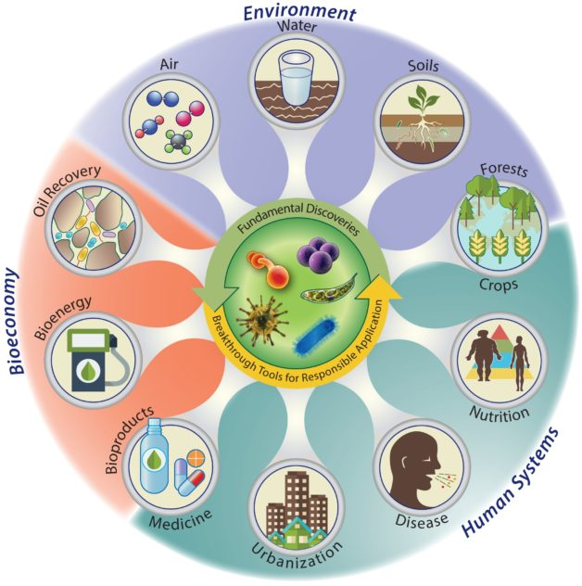
Every Earth Environment Has A Microbiome
https://newscenter.lbl.gov/2016/05/13/national-microbiome-initiative/

Slide 4
Human Microbiome Project
Launched 2008, Finished (phase 1) 2012
  Second phase is ongoing
Championed culture-independent methods
  16S rRNA Sequencing
  Whole Genome Sequencing
    Created reference genomes!
Not the first study to survey microbiomes
  Just the first to survey the human microbiome large-scale
https://hmpdacc.org/
https://commonfund.nih.gov/hmp/

Slide 5
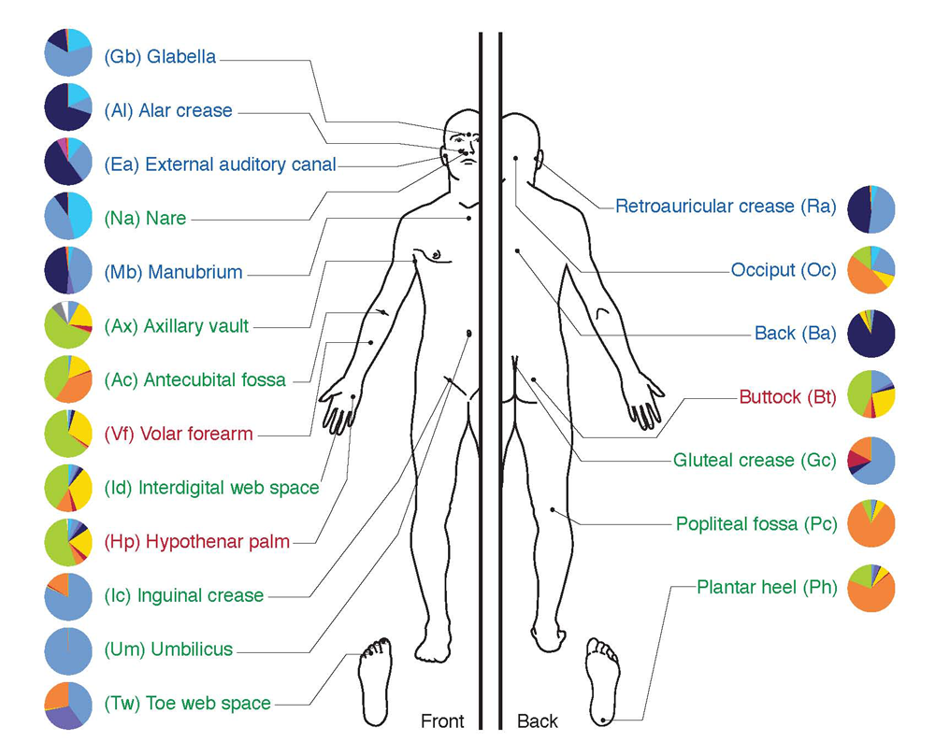
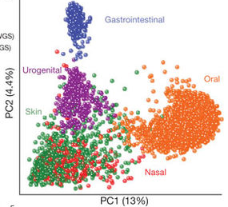
Human Body Microenvironments
Different microbes colonize different body areas
(Credit: Darryl Leja, NHGRI)

Slide 6
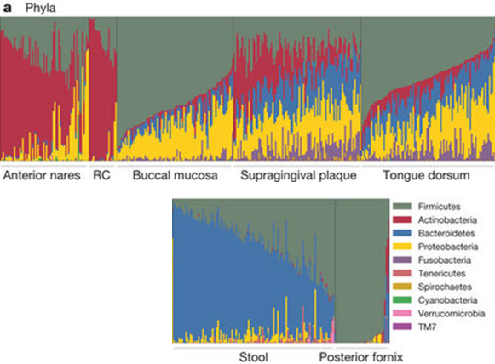
Human Microbiome Composition
Lots of variation between individuals
The Human Microbiome Project Consortium. (2012). Structure, function and diversity of the healthy human microbiome. Nature

Slide 7
Microbiome
Not all microbes are bad
  Still trying to understand microbe-microbe and microbe-host interactions
Earlier approaches rely on isolating microbes
  We are unable to culture many microbial species
→ Need to directly sequence

Slide 8
Studying the Microbiome
Want to understand community:
Structure: species diversity
  “Who is there?”
  Studied with 16S ribosomal RNA (rRNA) Sequencing
Function: genes + metabolic pathways
  “What can/do they all do?”
  Studied with metagenomics approaches

Slide 9
Ribosomal RNA
Essential molecules for life
  Every organism has them
Form 60% of ribosomal mass
Life is organized by which subunits present:
  Prokaryotes: 5S, 23S, 16S
  Eukaryotes: 5S, 5.8S, 28S, and 18S
S = “Svedberg”
  Svedberg = unit of molecular size

Slide 10
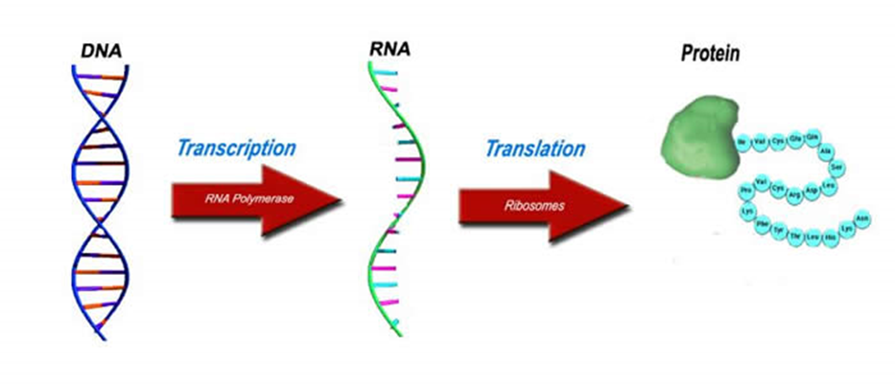
Why rRNA?
(Almost) all known life is driven by proteins
Translation requires ribosomes…
…ribosomal RNA (rRNA) encode ribosomes

Slide 11
Why rRNA?
Highly conserved
Relatively short (~1.5 kb)
  Short = cheap
Generally different between species
  smaller (variable) regions == cheap
Woese & Fox (1977). Phylogenetic structure of the prokaryotic domain: the primary kingdoms. PNAS
Lane, Pace, Olsen, Stahl, Sogin, & Pace (1985). Rapid determination of 16S ribosomal RNA sequence for phylogenetic analyses. PNAS
Notes:
Is found in all organisms
Component of self-replicating systems
Is readily isolated
Is highly conserved
Probably because it is critical to cell function
Has a low rate of horizontal gene transfer and recombination
Has sufficient genetic information to differentiate closely-related organisms
it is relatively small (~1.5 kb), it has a high enough level of sequence conservation between microbial species to permit reliable alignments, and it possesses sufficient variation to infer evolutionary relationships.
Got “hot” in the 1990s
“Comparative analysis of molecular sequences has become a powerful approach to determining evolutionary relationships.”
“To determine relationships covering the entire spectrum of extant living systems, one optimally needs a molecule of appropriately broad distribution…ribosomal RNA [fits this requirement].”
“It is a component of all self-replicating systems; it is readily isolated; and its sequence changes but slowly with time – permitting the detection of relatedness among very distant species.”

Slide 12
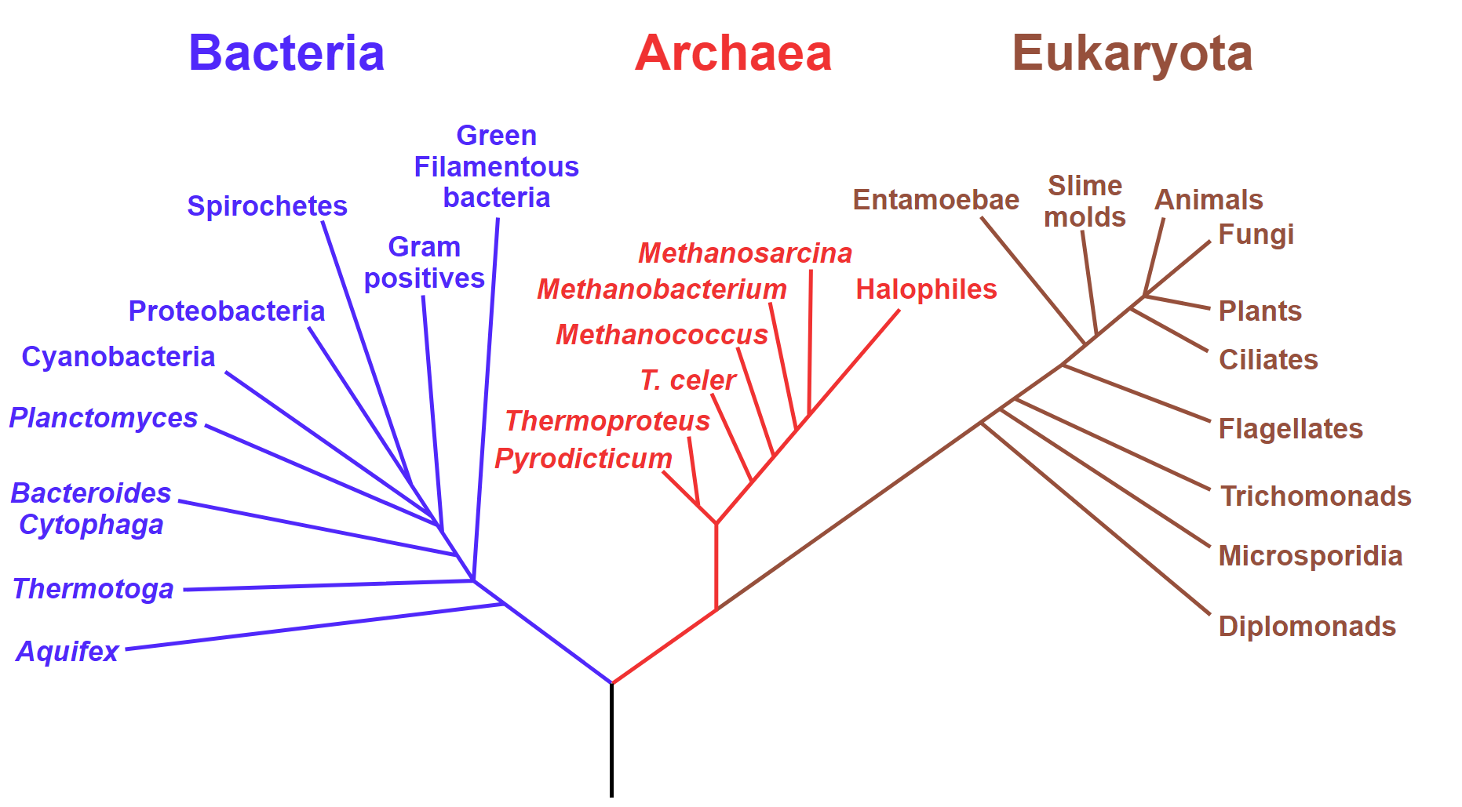
Phylogenetics

Slide 13
rRNA Genes as a Marker
16S rRNA
18S rRNA
Woese used rRNA to classify life into three domains
Woese, Kandler, & Wheelis (1990). Towards a natural system of organisms: proposal for the domains Archaea, Bacteria, and Eucarya. PNAS

Slide 14
Microbiome
Metagenomic/
Whole Genome Shotgun
Sequencing
Bacteria
+
Archaea
+
Fungi
+
Viruses
16S rRNA Sequencing
18S rRNA Sequencing

Slide 15
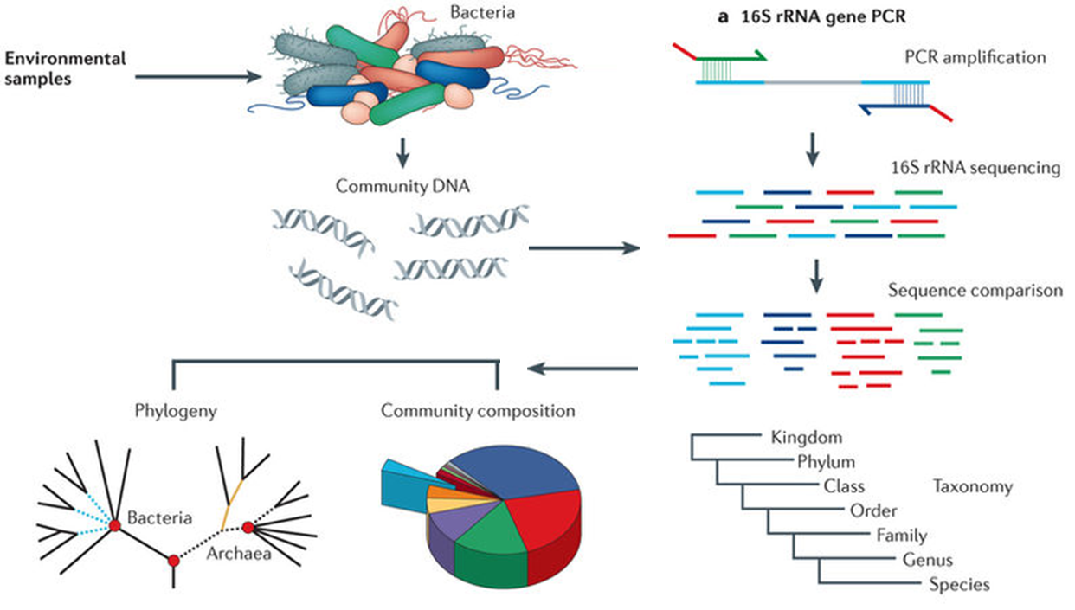
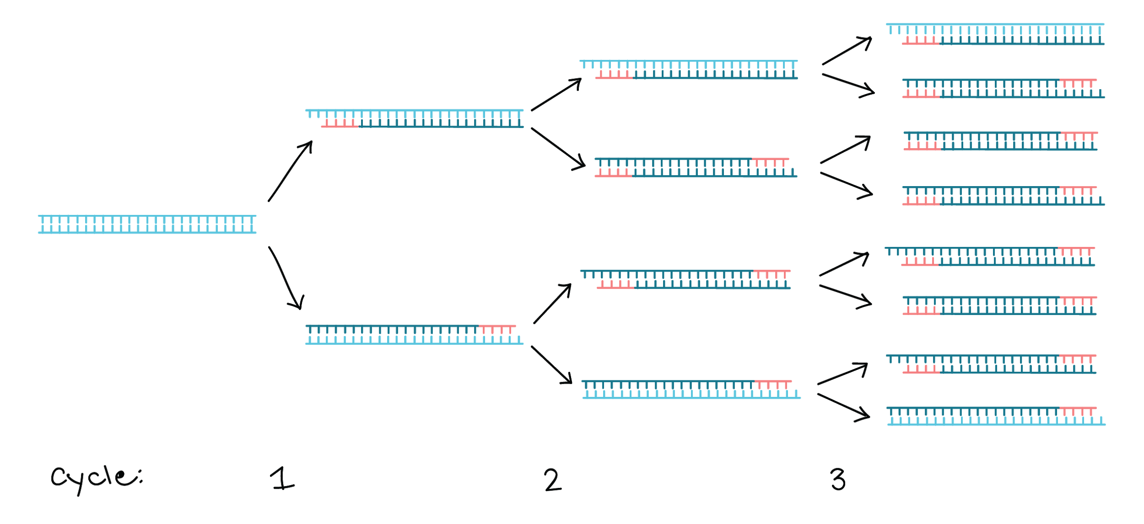
PCR
Forward primer
PCR: Polymerase Chain Reaction
  “Molecular photocopying”
  Technique to amplify/copy small segments of DNA
How do you know you discovered something important?
  Win Nobel Prize
  Have people stop citing your work
Reverse primer
Primers and sequence between are copied
Each time process repeats, the number of copies doubles
https://www.khanacademy.org/science/ap-biology/gene-expression-and-regulation/biotechnology/a/polymerase-chain-reaction-pcr

Slide 16
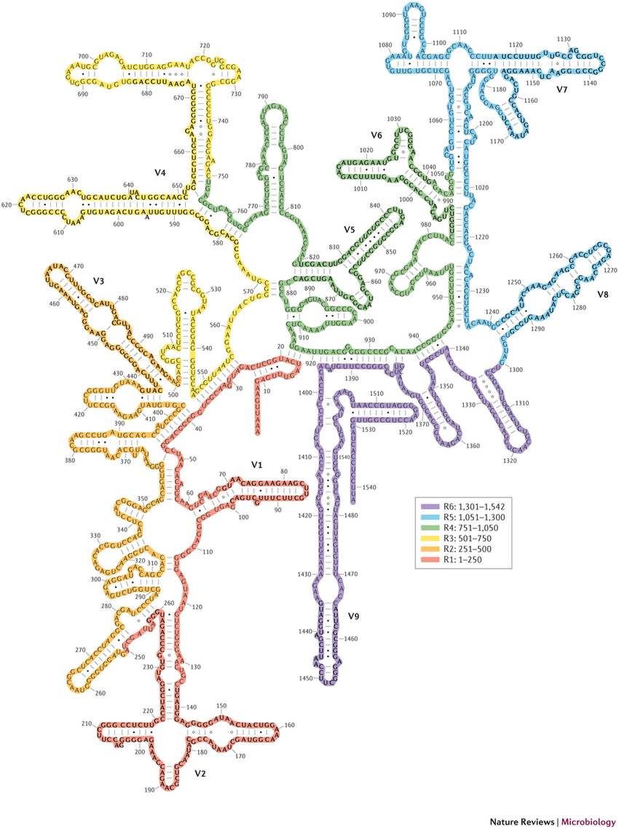
16S rRNA Gene
V5&V6
Ribosomal RNA gene
  Encodes the 30S small subunit
10 universal/constant regions
  Used to create primers
9 variable interstitial regions
  Used as signatures to determine phylogeny
  Choose which region(s) to sequence
V4
V7&V8
V3
V9
V1&V2

Slide 17
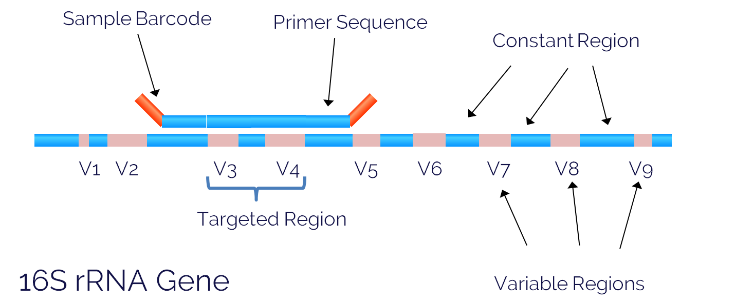
Using Constant Regions
https://www.lcsciences.com/discovery/applications/genomics/16s-mobile/

Slide 18
16S rRNA Sequencing
Sanger sequencing (only for single isolate)
High-throughput sequencing
  Sequence PCR product
  Sample contains many different species
  Very few (50-100k) reads required to identify species
  Compare with 30-80M for typical human RNA-Seq

Slide 19
16S rRNA Sequencing
Survey:
Who’s there?
Taxonomic
Classification
16S rRNA
Sequencing
Sample
Population
Analysis
Alpha diversity
Beta diversity
Over/under-representation

Slide 20
Basic Workflow
Notes:
Sample microbiome
Harvest gDNA
Amplify 16S rRNA gene (or region)
Sequence
Taxonomic Classification
Population analysis
Alpha diversity
Beta diversity
Over/under representation

Slide 21
Preprocessing & Alignment
Quality Assessment & Trimming
  Remove adapters, PCR primers, and low-quality bases
  Demultiplex using barcodes, discard reads without a barcode
Each read (pair) is an rRNA sequence
Collapse to unique reads
Align against rRNA database (e.g. Silva)
Cluster sequences by similarity

Slide 22
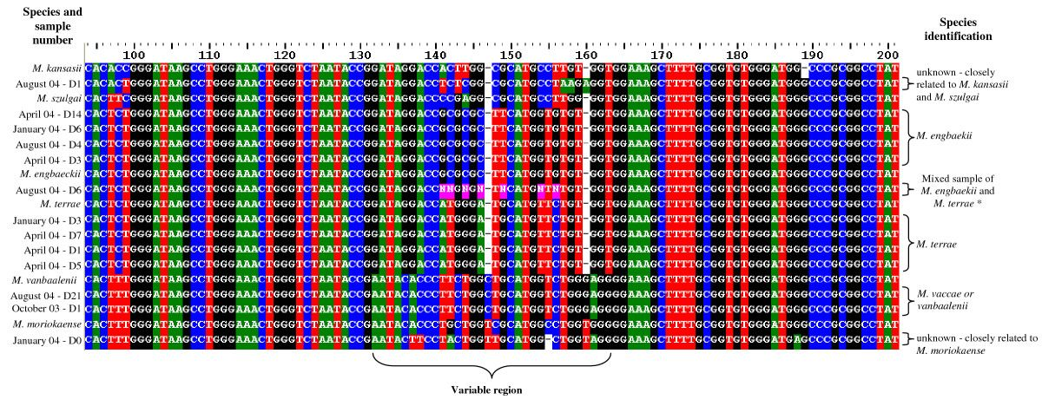
rRNA Sequence Encodes Relatedness
Michel, Anita L., et al. 2007. “Bovine Tuberculosis in African Buffaloes: Observations Regarding Mycobacterium Bovis Shedding into Water and Exposure to Environmental Mycobacteria.” BMC Veterinary Research 3 (September): 23.

Slide 23
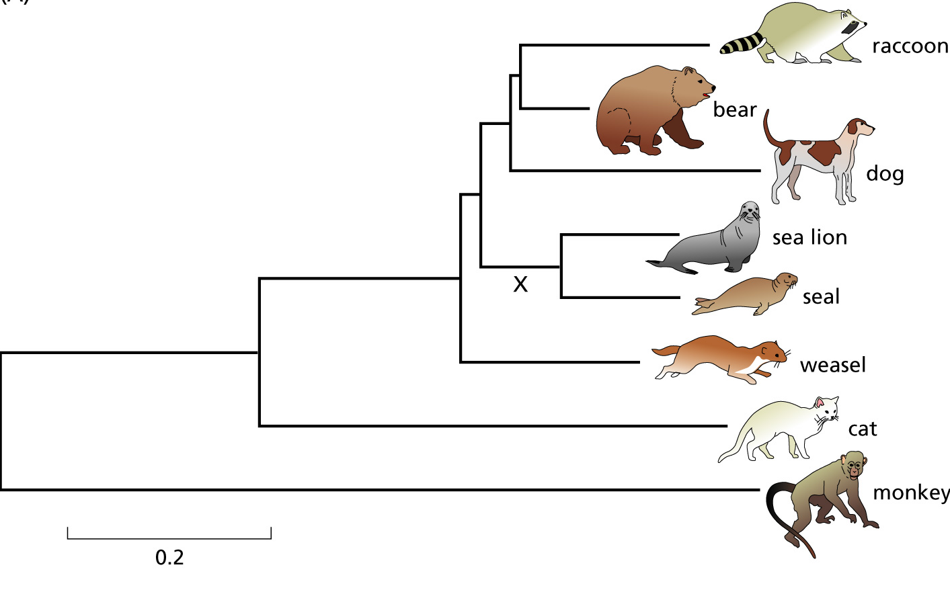
Phylogenetic Tree Terminology
clade
Taxon
(OTU)
Branch
(lineage)
Internal Node
(shared ancestor)
Terminal node
Root
outgroup
Branch Length (time)
Notes:
Can anyone guess what the Root represents in this context?
Branch length is some measure of time (differs depending on context)
So in this example, monkey is the most distant evolutionarily
Each separation from an internal node represents a speciation event
Can you guess which is the most recent speciation event?
If we’re looking at genes instead of species (gene paralogs for example), what would each branch separation indicate?

Slide 24
Binning
OTU: Operational Taxonomic Unit (also “phylotype”)
  A group of sequences clustered together based purely on similarity and an arbitrary threshold (e.g. 90% identical, 95%...)
  May or may not be equivalent to taxonomical entities (species, genera, etc.)
Can cluster based on similarity to a reference database or de novo (compared to each other)
  Can also cluster de novo and then assign taxonomy

Slide 25
(Linnaean) Taxonomy
Domain
Kingdom
Phylum
Class
Order
Family
Genus
Species
Eukaryota
Animalia
Chordata
Mammalia
Primates
Hominidae
Homo
Homo sapiens
Bacteria
Bacteria
Proteobacteria
Gammaproteobacteria
Enterobacteriales
Enterobacteriaceae
Escherichia
Escherichia coli

Slide 26
Taxonomic Resolution
Domain
Kingdom
Phylum
Class
Order
Family
Genus
Species
16S/18S rRNA does not yield species-level information
→ genus-level, at best, but usually higher
  Closely-related species have a high sequence similarity across the 16S gene
  Typically don’t sequence the whole gene, just 1(+) variable regions

Slide 27
Population Measurements
Alpha Diversity: Diversity within a sample
Beta Diversity: Diversity between samples
Evenness: Distribution of taxa
Richness: Number of taxa

Slide 28
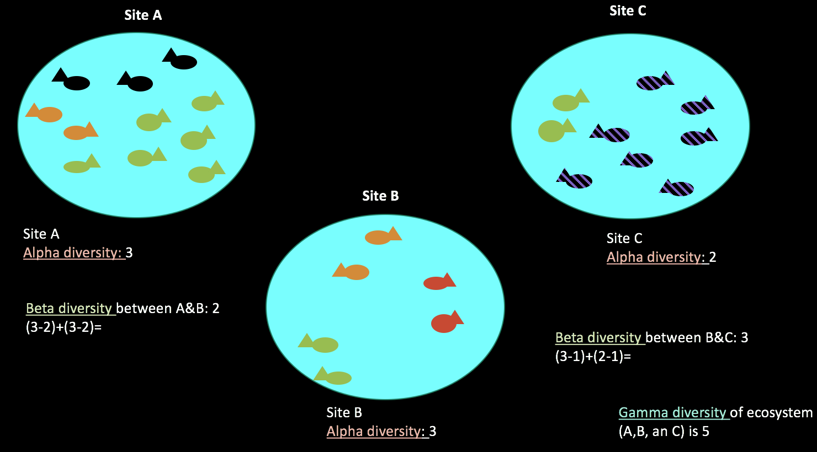
Alpha and Beta Diversity
https://socratic.org/questions/what-are-alpha-beta-and-gamma-diversity

Slide 29
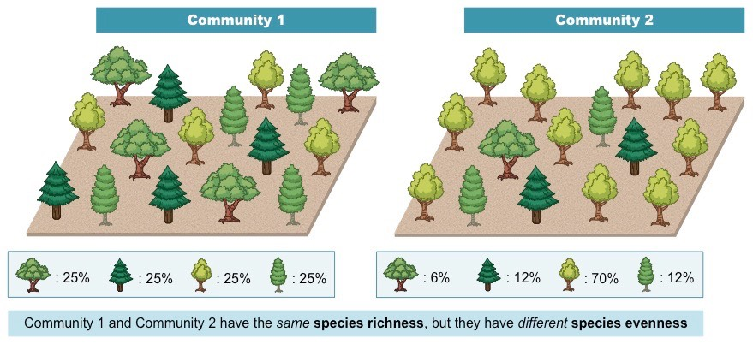
Evenness vs Richness
http://ib.bioninja.com.au/options/option-c-ecology-and-conser/c4-conservation-of-biodiver/biodiversity.html

Slide 30
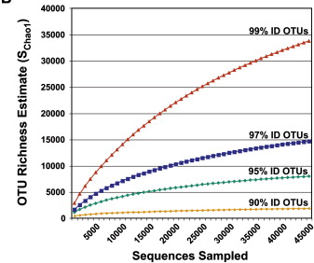
Richness: Rarefaction Curves
Cutoffs: What percent sequence identity should you use?
→ Will depend on the error rate, etc.

Slide 31
Things to Keep in Mind
Sequencing platform
  Error rate, biases, read length, noise
Choice of variable region(s)
Amplification process
  Error rate, biases, choice of primer, DNA template concentration, PCR cycle number, introduction of chimeras
Coverage/Depth

Slide 32
Software Packages
mothur (your project)
QIIME (“chime”)
bioBakery* (PICRUSt)
CloVR*
*Not currently on the SCC, except for specific projects

Slide 33
Taxonomy Databases
Greengenes - 16S rRNA database (older)
MG-RAST - Metagenomic database
NCBI - Microbial genome & gene database
RDP - 16S & 18S Ribosomal Database
SILVA - 16S/18S/23S/28S rRNA Database
*A different database may give you different taxonomic results

Slide 34
Notes
16S rRNA Sequencing analysis is qualitative
  Surveying who is there
PCR depends on the a priori knowledge assumption of universal primers
  May yield an altered/incomplete estimation of diversity
  Also, uneven primer annealing, uneven amplification, etc…
Are converting either to binary data (presence/absence) or normalizing (relative abundance)
  Make sure you are using the appropriate statistical/analysis tools for binary and normalized data!

Slide 35
Notes
Taxonomic classification will depend on
  The resolution which variable region of the 16S rRNA gene is used
  The primers used for PCR
  Which database is used
  Which software package is used
  What cutoff is used
  Sequence coverage/depth
  Sequencing platform
  The species composition in the community being analyzed
  When you perform the analysis
  …

Slide 36
Considerations
Define the question as precisely as possible.
  What controls do you need?
What sequencing platform will you use?
  Illumina is the typical platform (right now)
What region of the 16S rRNA gene will you amplify?
  V4 usually yields genus-level
How many reads do you need per sample?
  Coverage/Depth
What are hidden technical issues?
  Example: Chimeras
What analysis tool will you use? How will you display your data? How will you compare your results with other published studies?

