Slide 1
BF528 - 2nd (Next) Generation Sequencing

Slide 2
Introduction
Methods for obtaining nucleotide sequence information:
Sanger sequencing (i.e. 1st generation)
  sensitive, slow, low-throughput, expensive
Microarray (not sequencing technology)
  cheap, high-throughput, fast, known sequences only
We want to obtain information on many sequences
quickly, cheaply, with high confidence, and
without knowing those sequences beforehand

Slide 3
High-throughput Sequencing
High-throughput: many nucleotides very quickly
Sequencing: determine the linear sequence of nucleotides
Use biochemical or biophysical approaches
Current technologies vary by:
  Number of individual sequences generated
  Length of sequences
  Confidence in sequences

Slide 4
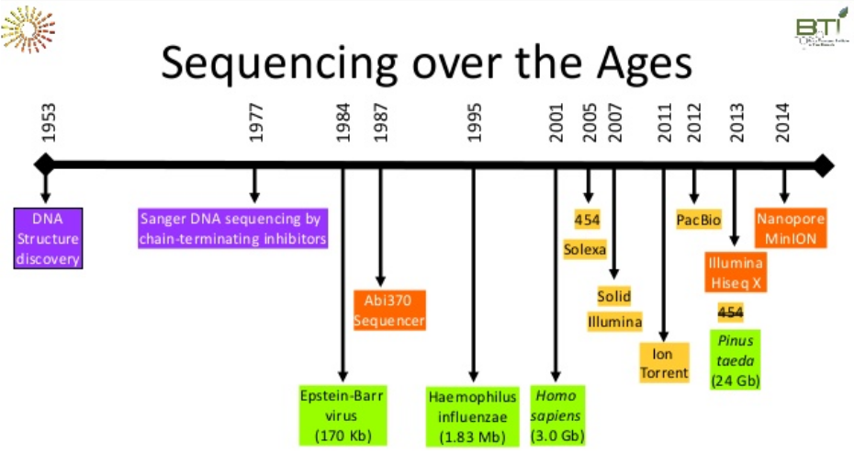
Evolution of NGS
Surya Saha, Boyce Thompson Institute, Ithaca, NY (BTI plant bioinformatics course)

Slide 5
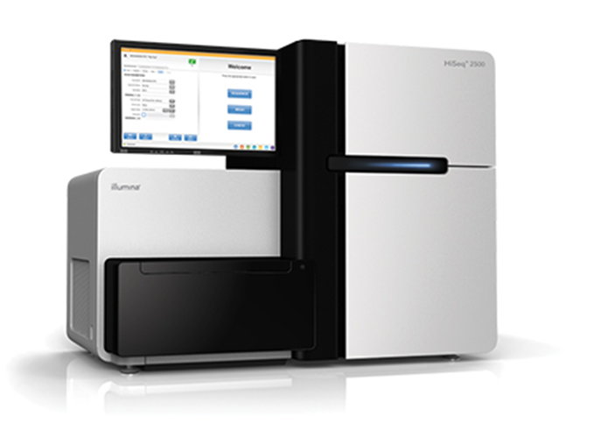
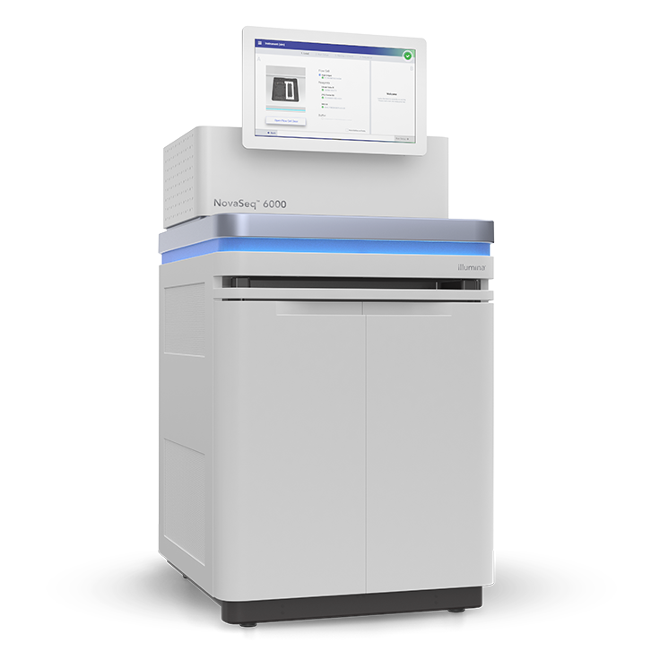
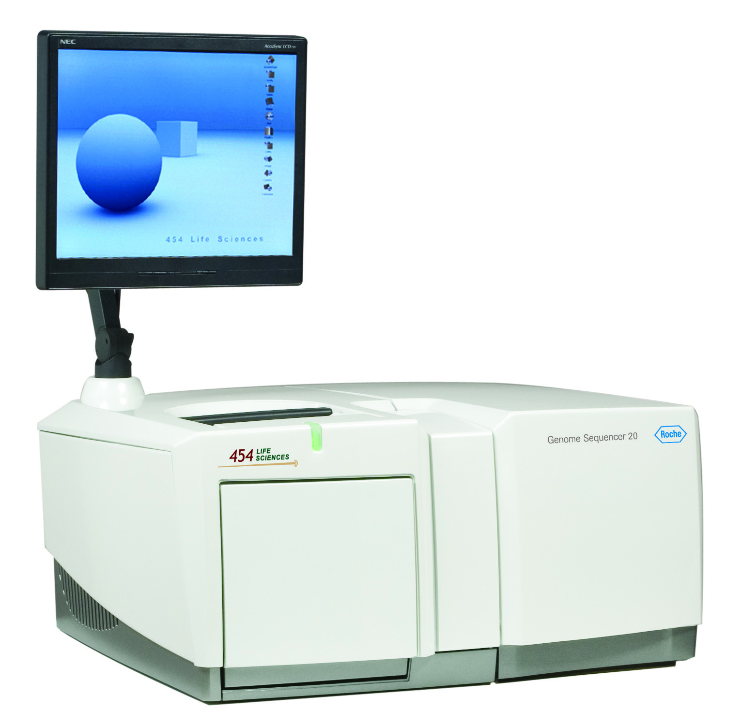
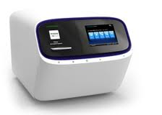
Sequencing machines
Expensive to purchase (hundreds of thousands $USD)
Expensive to operate (e.g. reagents, flow cells)
You can sequence your genome at 30X depth for <$1000 USD.
Roche 454
Ion Torrent
Illumina HiSeq 2500
Illumina NovaSeq 6000

Slide 6
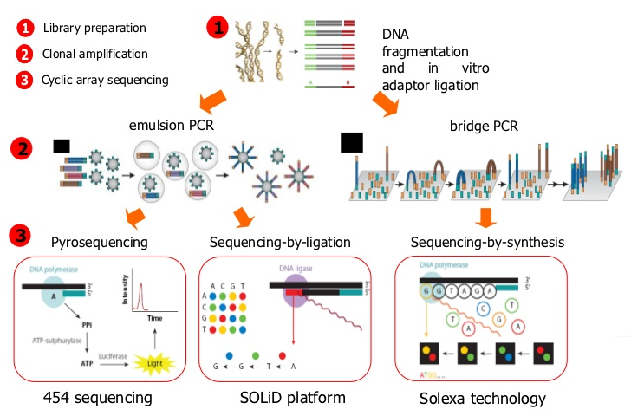
Experiment
Alex Sanchez, Statistics and Bioinformatics Research Group, Statistics Department, Universitat de Barcelona

Slide 7
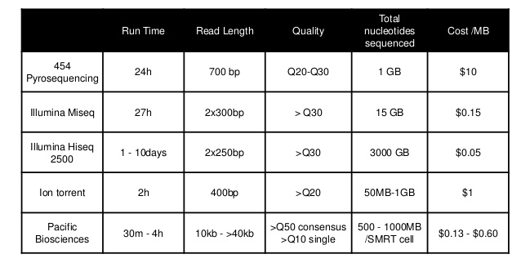
Comparison
Quail, Michael A., et al. "A tale of three next generation sequencing platforms: comparison of Ion Torrent, Pacific Biosciences and Illumina MiSeq sequencers." BMC genomics13.1 (2012): 341.

Slide 8
Illumina Sequencing
Most common sequencing technology today
Sequences any DNA
Sequencing by synthesis method
Sequences (reads) are short (<300bp)
2 gigabases - 6 terabases per run
Hours to days to complete one run

Slide 9
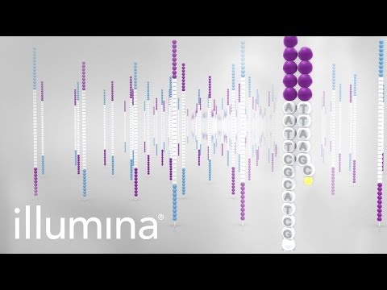
Illumina Sequencing Process
https://www.youtube.com/watch?v=fCd6B5HRaZ8

Slide 10
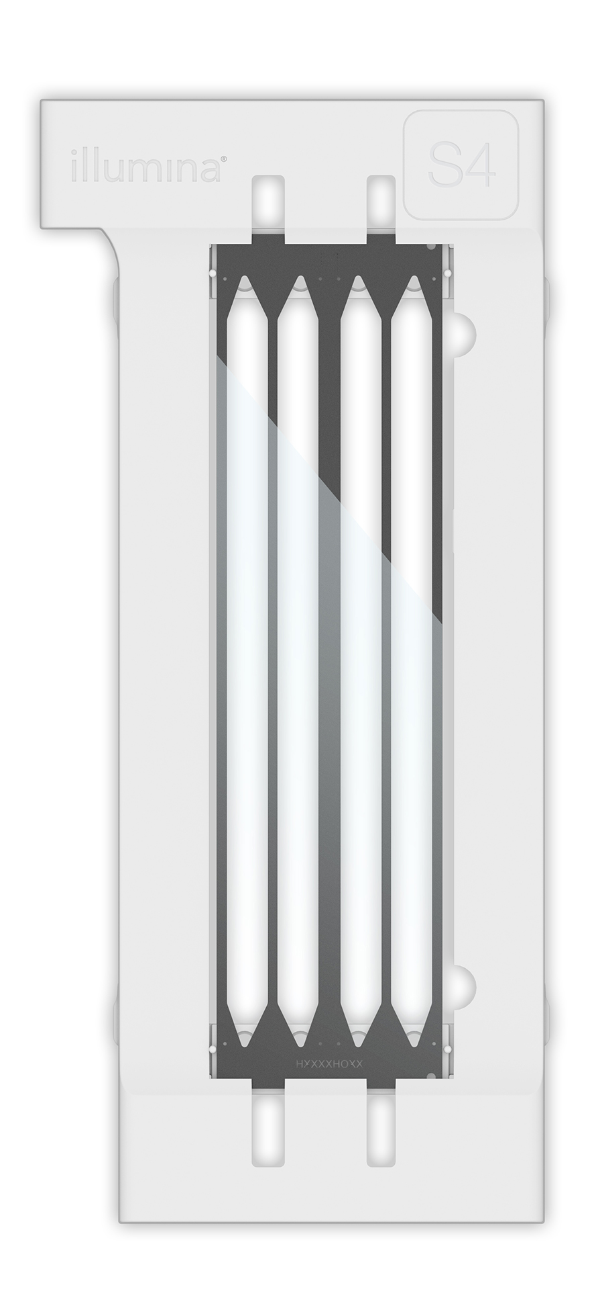
Illumina Sequencing Properties
Sequencing occurs on a flow cell
Each flow cell has 1 to 8 lanes
Number of reads for overall flow cell varies
Length of reads is fixed (e.g. 250 bp)
Read format:
  Single end - one read per molecule
  Paired end - two reads per molecule
Multiplexing: sequence many samples at once using molecular barcodes
NovaSeq Flowcell
Courtesy of Illumina, Inc.

Slide 11
Sequencing Library Generation Workflow
Sequencing Library: DNA prepared for sequencing
Workflow:
  Extract RNA/DNA from sample
    If RNA, reverse transcribe to cDNA
  Size select using gel cut or random shearing
  PCR amplify DNA if concentration is low
  Add sequencing adapters
    If multiplexing, use barcoded adapters
  Pool samples, load across flow lanes for sequencing
Typically only perform 1, sequencing cores do the rest

Slide 12
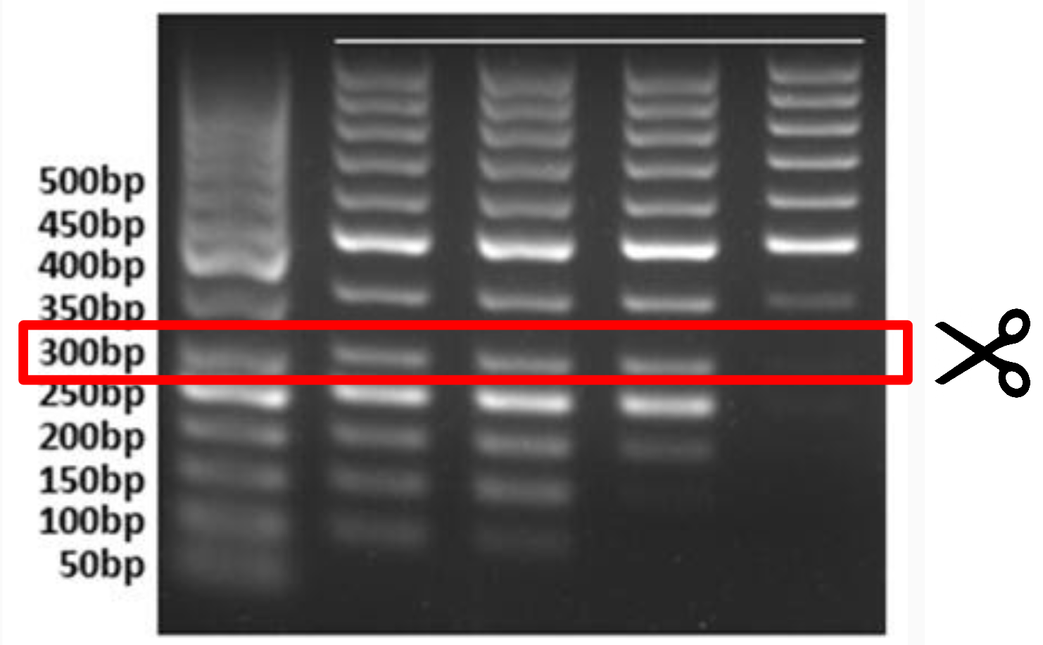
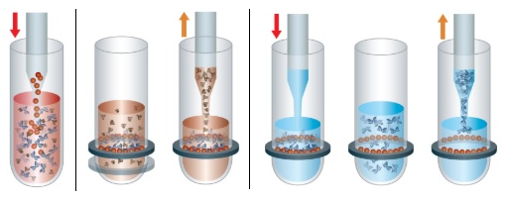
Design Choice: Fragment Length
Illumina sequencers can only sequence DNA fragments up to ~300nt long
DNA must be size-selected, by one of:
Gel cut (old method):
  ~200-300nt band cut, purified, prepared for sequencing
  Fragment length follows a normal distribution around target cut size
SPRI Beads (current method)

Slide 13
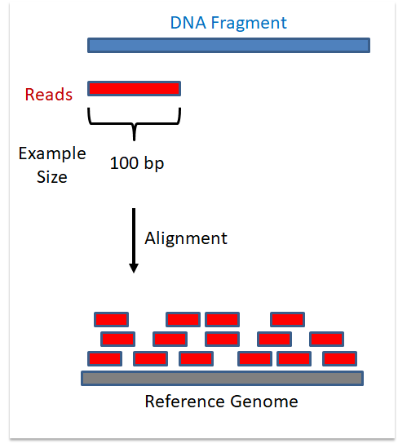
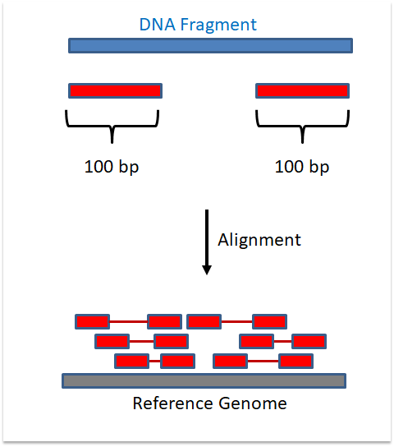
Design Choice: Single End vs Paired End
Single End
Paired End

Slide 14
Design Choice: Number of Reads
Each sequencing run generates a # of total reads
# of reads/sample ~= # total reads/number of samples
# of reads for one sample: library size
Choose target library size based on:
  Desired depth
  Desired coverage
For more see https://genohub.com/recommended-sequencing-coverage-by-application/

Slide 15
Critical Concept: Read Mapping
Question:
“Given a read and a reference sequence, where, if anywhere, in the reference does the read sequence occur?”
E.g. chr3:2,358,092-2,358,193
More on this next lecture

Slide 16
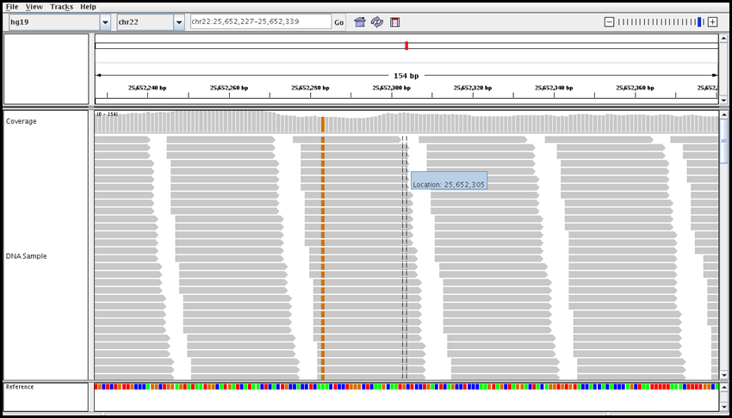
Mapped Read Terminology
Genome Locus
Depth: number of sequenced bases that map to a given location
Mapped or
Aligned reads
Coverage: fraction of genomic locus covered by at least one read

Slide 17
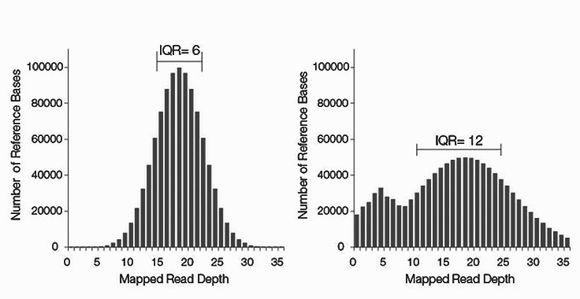
Coverage - Whole Genome Sequenceing
Calculate distribution
Genome wide
Good coverage
Bad coverage

Slide 18
Sequence Data Format: fastq
Sequence reads provided in fastq format
For each read there are 4 lines:
@read_header comment
read_sequence
+[quality_header]
phred_quality_scores
Phred scores estimate the probability that a base is called incorrectly

Slide 19
fastq format
start new read
@SRR1997412.1 1 length=125
NTTGTAGCTGAGGAAACTGAGGCTCAGGAGGACAAGTGGCCTGCCAAAGGTACCAGCACTCAGATGGAATGGTTTTGAACTCAGTCCA
+SRR1997412.1 1 length=125
#<<BBFFFFFFFFFFFFFFFFFFFFFFFFFFFFFFFFFFFFFFFFFFFFFFFFFFFFFFFFFFFFFFFFFFFFFFFFFFFFFFFFFFF
@SRR1997412.2 2 length=125
GTATTTAGTCATGTAAGACTCCTTAACCAGCTAACTTAAGAAAGACTTCTAGGACAGAATAGGTTACACTAGTTATAATTTTNNNNNN
+SRR1997412.2 2 length=125
BFFFFFFFFFFFFFFFFFFFFFFFFFFFFFFFFFFFFFFFFFFFFFFFFFFFFFFFFFFFFFFFFFFFFFFFBFBBFBBBFF######

Slide 20
fastq format
unique read header
@SRR1997412.1 1 length=125
NTTGTAGCTGAGGAAACTGAGGCTCAGGAGGACAAGTGGCCTGCCAAAGGTACCAGCACTCAGATGGAATGGTTTTGAACTCAGTCCA
+SRR1997412.1 1 length=125
#<<BBFFFFFFFFFFFFFFFFFFFFFFFFFFFFFFFFFFFFFFFFFFFFFFFFFFFFFFFFFFFFFFFFFFFFFFFFFFFFFFFFFFF
@SRR1997412.2 2 length=125
GTATTTAGTCATGTAAGACTCCTTAACCAGCTAACTTAAGAAAGACTTCTAGGACAGAATAGGTTACACTAGTTATAATTTTNNNNNN
+SRR1997412.2 2 length=125
BFFFFFFFFFFFFFFFFFFFFFFFFFFFFFFFFFFFFFFFFFFFFFFFFFFFFFFFFFFFFFFFFFFFFFFFBFBBFBBBFF######

Slide 21
fastq format
comments separated by space, could be anything
@SRR1997412.1 1 length=125
NTTGTAGCTGAGGAAACTGAGGCTCAGGAGGACAAGTGGCCTGCCAAAGGTACCAGCACTCAGATGGAATGGTTTTGAACTCAGTCCA
+SRR1997412.1 1 length=125
#<<BBFFFFFFFFFFFFFFFFFFFFFFFFFFFFFFFFFFFFFFFFFFFFFFFFFFFFFFFFFFFFFFFFFFFFFFFFFFFFFFFFFFF
@SRR1997412.2 2 length=125
GTATTTAGTCATGTAAGACTCCTTAACCAGCTAACTTAAGAAAGACTTCTAGGACAGAATAGGTTACACTAGTTATAATTTTNNNNNN
+SRR1997412.2 2 length=125
BFFFFFFFFFFFFFFFFFFFFFFFFFFFFFFFFFFFFFFFFFFFFFFFFFFFFFFFFFFFFFFFFFFFFFFFBFBBFBBBFF######

Slide 22
fastq format
Sequence of the read
@SRR1997412.1 1 length=125
NTTGTAGCTGAGGAAACTGAGGCTCAGGAGGACAAGTGGCCTGCCAAAGGTACCAGCACTCAGATGGAATGGTTTTGAACTCAGTCCA
+SRR1997412.1 1 length=125
#<<BBFFFFFFFFFFFFFFFFFFFFFFFFFFFFFFFFFFFFFFFFFFFFFFFFFFFFFFFFFFFFFFFFFFFFFFFFFFFFFFFFFFF
@SRR1997412.2 2 length=125
GTATTTAGTCATGTAAGACTCCTTAACCAGCTAACTTAAGAAAGACTTCTAGGACAGAATAGGTTACACTAGTTATAATTTTNNNNNN
+SRR1997412.2 2 length=125
BFFFFFFFFFFFFFFFFFFFFFFFFFFFFFFFFFFFFFFFFFFFFFFFFFFFFFFFFFFFFFFFFFFFFFFFBFBBFBBBFF######

Slide 23
fastq format
start quality line
@SRR1997412.1 1 length=125
NTTGTAGCTGAGGAAACTGAGGCTCAGGAGGACAAGTGGCCTGCCAAAGGTACCAGCACTCAGATGGAATGGTTTTGAACTCAGTCCA
+SRR1997412.1 1 length=125
#<<BBFFFFFFFFFFFFFFFFFFFFFFFFFFFFFFFFFFFFFFFFFFFFFFFFFFFFFFFFFFFFFFFFFFFFFFFFFFFFFFFFFFF
@SRR1997412.2 2 length=125
GTATTTAGTCATGTAAGACTCCTTAACCAGCTAACTTAAGAAAGACTTCTAGGACAGAATAGGTTACACTAGTTATAATTTTNNNNNN
+SRR1997412.2 2 length=125
BFFFFFFFFFFFFFFFFFFFFFFFFFFFFFFFFFFFFFFFFFFFFFFFFFFFFFFFFFFFFFFFFFFFFFFFBFBBFBBBFF######

Slide 24
fastq format
repeat read header and comment, not required, often blank
@SRR1997412.1 1 length=125
NTTGTAGCTGAGGAAACTGAGGCTCAGGAGGACAAGTGGCCTGCCAAAGGTACCAGCACTCAGATGGAATGGTTTTGAACTCAGTCCA
+SRR1997412.1 1 length=125
#<<BBFFFFFFFFFFFFFFFFFFFFFFFFFFFFFFFFFFFFFFFFFFFFFFFFFFFFFFFFFFFFFFFFFFFFFFFFFFFFFFFFFFF
@SRR1997412.2 2 length=125
GTATTTAGTCATGTAAGACTCCTTAACCAGCTAACTTAAGAAAGACTTCTAGGACAGAATAGGTTACACTAGTTATAATTTTNNNNNN
+SRR1997412.2 2 length=125
BFFFFFFFFFFFFFFFFFFFFFFFFFFFFFFFFFFFFFFFFFFFFFFFFFFFFFFFFFFFFFFFFFFFFFFFBFBBFBBBFF######

Slide 25
fastq format
Quality sequence of the read, in ASCII
@SRR1997412.1 1 length=125
NTTGTAGCTGAGGAAACTGAGGCTCAGGAGGACAAGTGGCCTGCCAAAGGTACCAGCACTCAGATGGAATGGTTTTGAACTCAGTCCA
+SRR1997412.1 1 length=125
#<<BBFFFFFFFFFFFFFFFFFFFFFFFFFFFFFFFFFFFFFFFFFFFFFFFFFFFFFFFFFFFFFFFFFFFFFFFFFFFFFFFFFFF
@SRR1997412.2 2 length=125
GTATTTAGTCATGTAAGACTCCTTAACCAGCTAACTTAAGAAAGACTTCTAGGACAGAATAGGTTACACTAGTTATAATTTTNNNNNN
+SRR1997412.2 2 length=125
BFFFFFFFFFFFFFFFFFFFFFFFFFFFFFFFFFFFFFFFFFFFFFFFFFFFFFFFFFFFFFFFFFFFFFFFBFBBFBBBFF######

Slide 26
fastq format
@SRR1997412.1 1 length=125
NTTGTAGCTGAGGAAACTGAGGCTCAGGAGGACAAGTGGCCTGCCAAAGGTACCAGCACTCAGATGGAATGGTTTTGAACTCAGTCCA
+SRR1997412.1 1 length=125
#<<BBFFFFFFFFFFFFFFFFFFFFFFFFFFFFFFFFFFFFFFFFFFFFFFFFFFFFFFFFFFFFFFFFFFFFFFFFFFFFFFFFFFF
@SRR1997412.2 2 length=125
GTATTTAGTCATGTAAGACTCCTTAACCAGCTAACTTAAGAAAGACTTCTAGGACAGAATAGGTTACACTAGTTATAATTTTNNNNNN
+SRR1997412.2 2 length=125
BFFFFFFFFFFFFFFFFFFFFFFFFFFFFFFFFFFFFFFFFFFFFFFFFFFFFFFFFFFFFFFFFFFFFFFFBFBBFBBBFF######
Next read

Slide 27

Sequence Quality Score - Phred
Each read base has a corresponding quality score
Score indicates probability of base being wrong
Scores quantized to integers, e.g. [-3,41]
  e.g. e = 0.0123, Q = 19.1 = 19
Q then mapped to ASCII space by adding offset
  e.g. 19+64 = 83, 83 == ‘S’ in ASCII
For more info: https://en.wikipedia.org/wiki/FASTQ_format

Slide 28
Public data and platforms
NCBI (https://www.ncbi.nlm.nih.gov/sra)
Illumina basespace (https://basespace.illumina.com/home/index)
Google genomics cloud (https://console.cloud.google.com/genomics/)
Genome In A Bottle (GIAB) (http://jimb.stanford.edu/giab/)
REPOSITIVE (https://discover.repositive.io/datasets/)
GDC (https://portal.gdc.cancer.gov/)
Seven Bridges (https://igor.sbgenomics.com/)

Slide 29
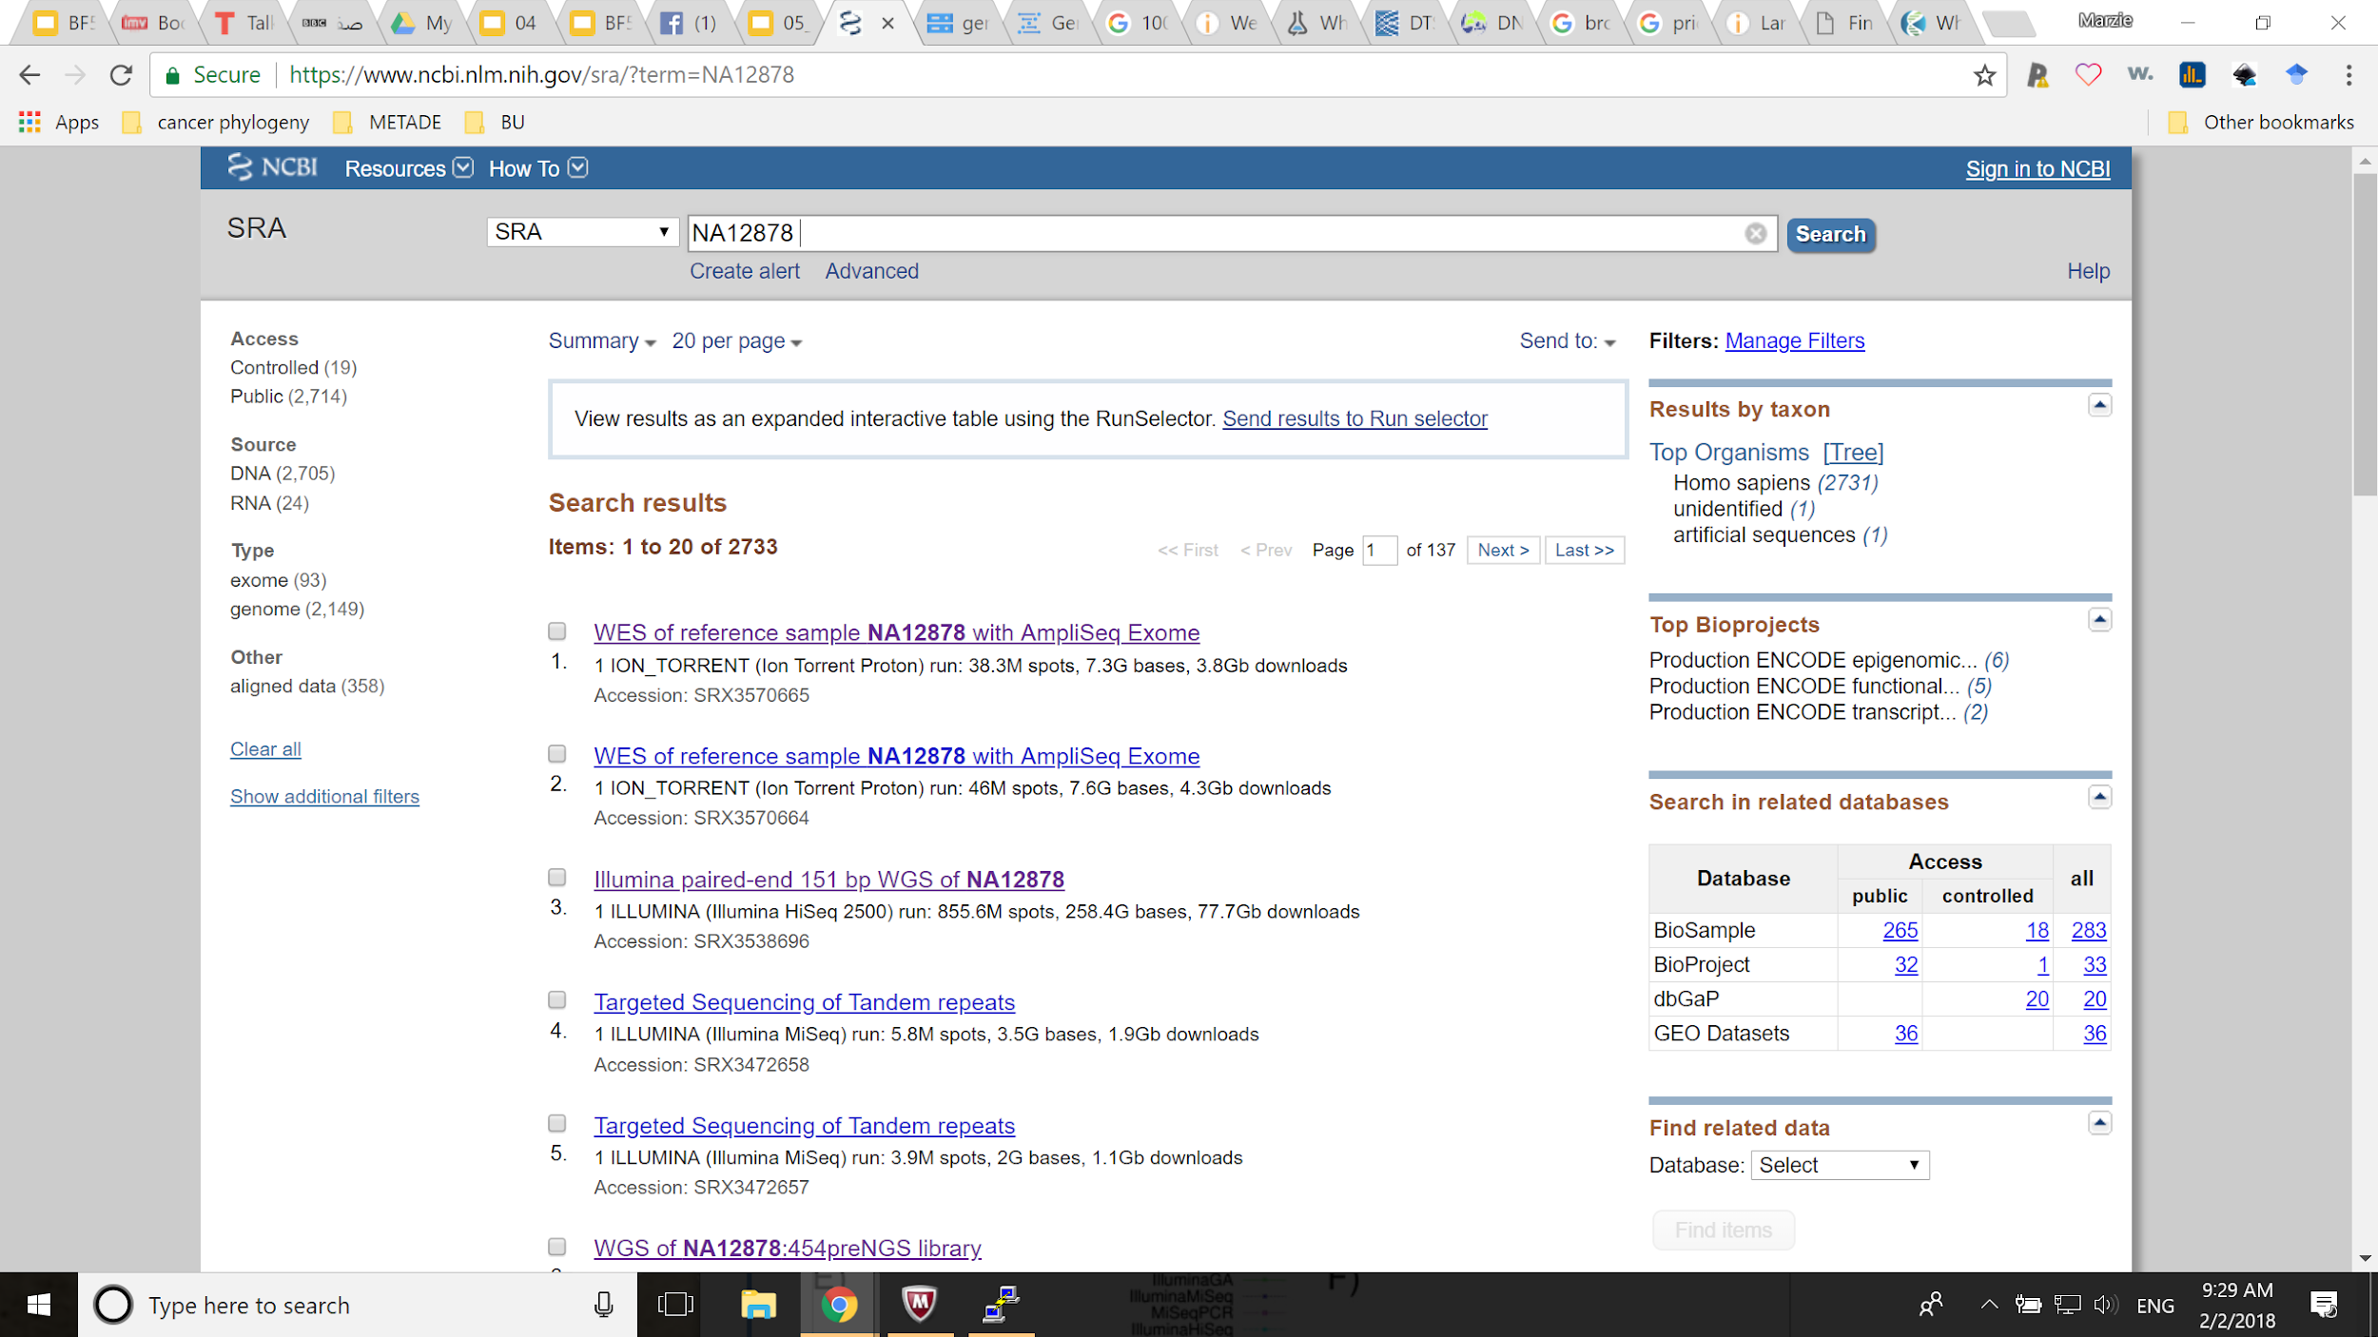
NCBI SRA portal

Slide 30
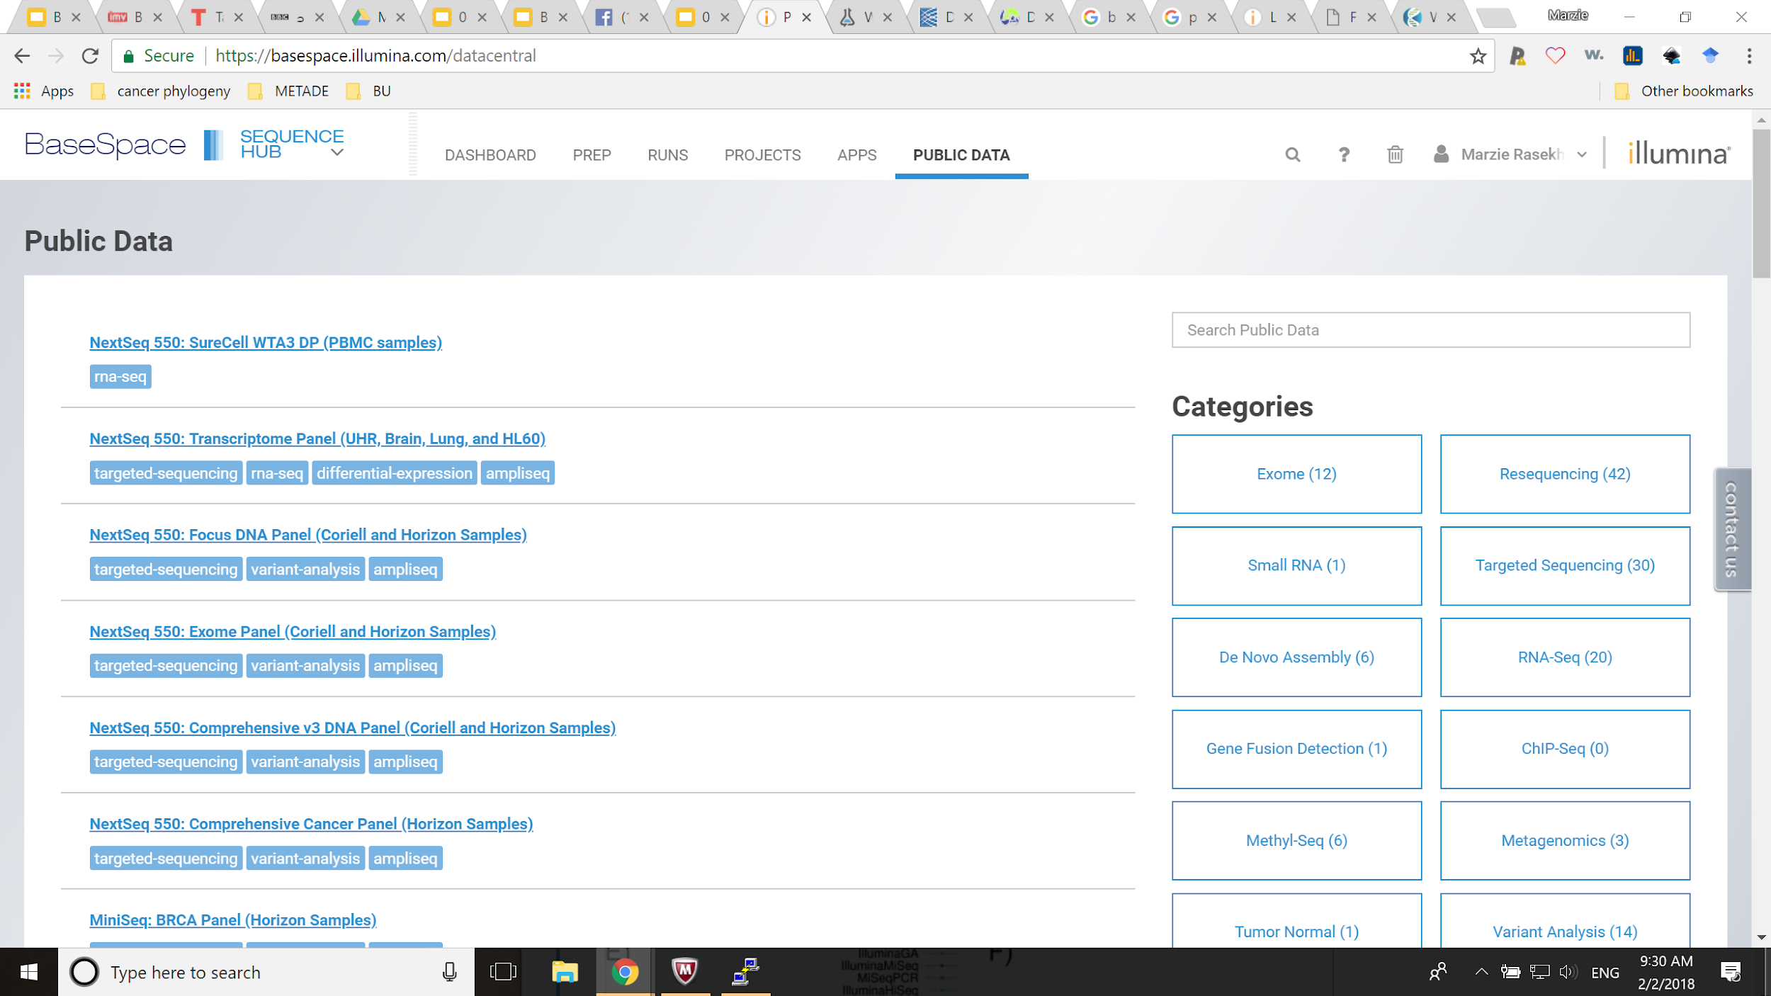
Illumina BaseSpace

Slide 31
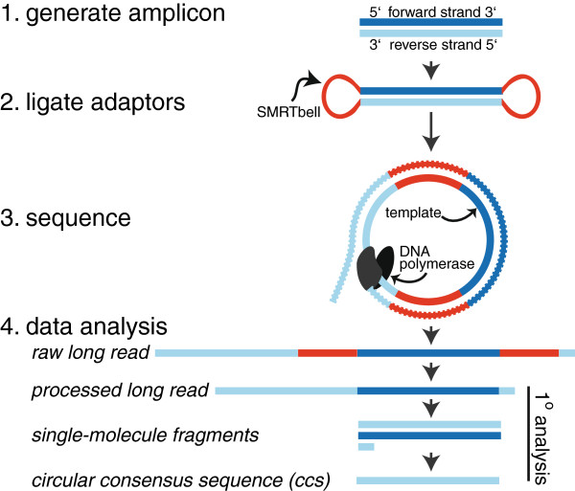
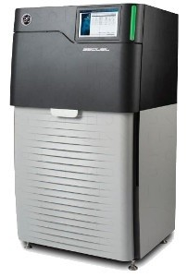
3rd Generation Sequencing: PacBio
Pacific Biosciences (PacBio)
“Long read”
“Single molecule”
SMRT

Slide 32
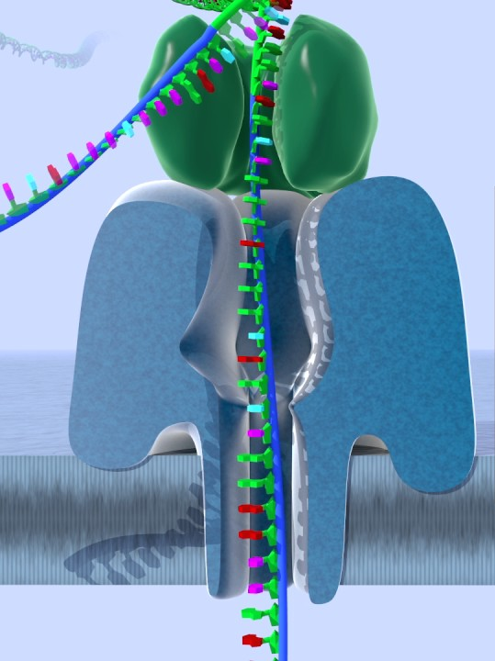
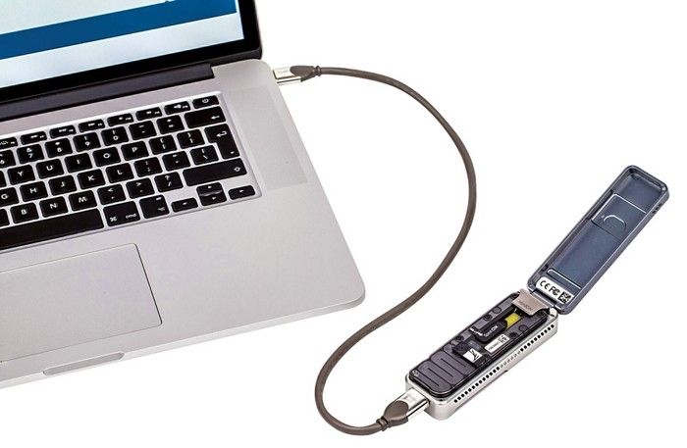
3rd Gen Sequencing: Oxford Nanopore
“Real time single molecule”
https://www.youtube.com/watch?v=GUb1TZvMWsw

