Slide 1
Sequence Visualization

Slide 2

Tutorials and References
Tutorials:
IGV 🡪 Griffith Lab Tutorials (https://github.com/griffithlab/rnaseq_tutorial/)
Broad Institute of MIT & Harvard (http://software.broadinstitute.org/software/igv/)
Additional Reading:
Notes:
Oldies but goodies

Slide 3
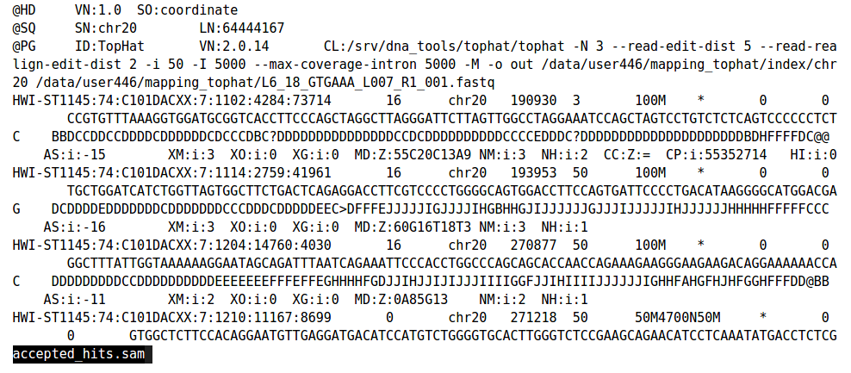
Sequence Visualization - Motivation
High-throughput genomics – daunting at first
Files contains millions of reads – go through each one?
Our favorite file formats are easy for machines to read, not us

Slide 4

Google Maps Comparison
Would google maps be effective if it just spat out minimally formatted sets of coordinates?
The map to the left is a human-centered visual summary of how to get from LSEB to SED
Additional layers beyond start, stop, and directions provide additional context
Genome browsers (like IGV) provide a human-centered visual summary of one/many sequencing experiments
Notes:
I guess mapquest is the equivalent to just receiving a set of coordinates

Slide 5
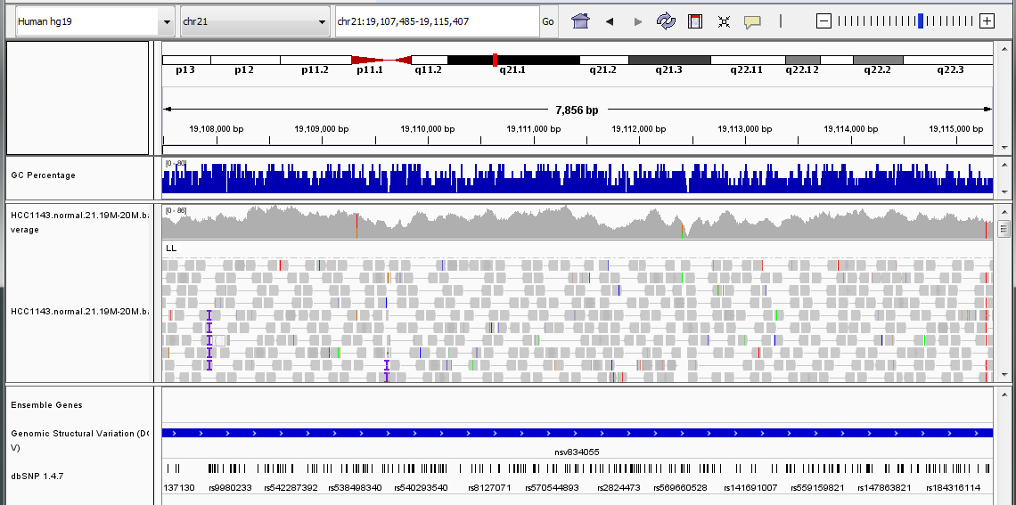
Integrative Genomics Viewer
Genomic ”address”

Slide 6
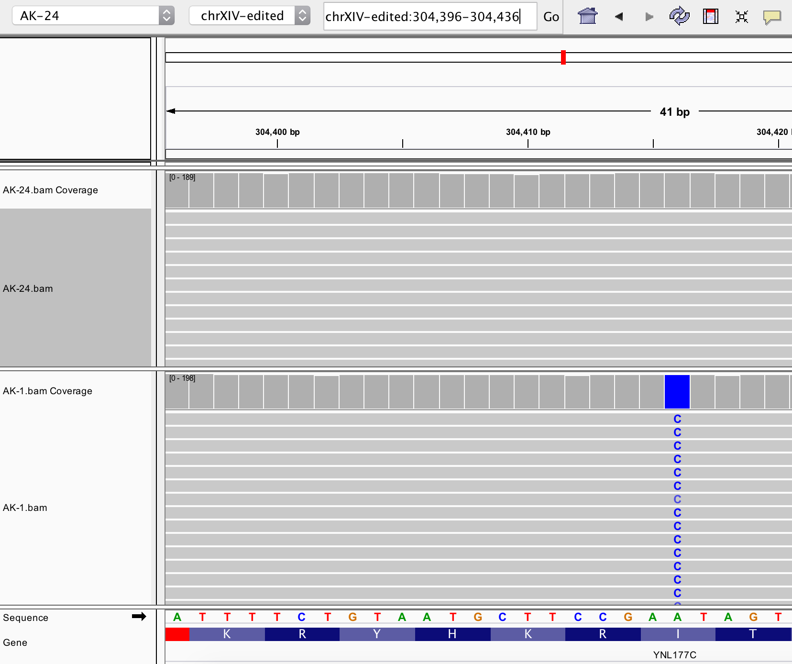
Why use a genome browser?
Visually confirm phenomena from sequencing experiments (seeing is believing)
  Left: Visualization of a SNP identified in a lab-evolved strain of yeast
Integration of multiple experiments on the same coordinate system – collapsing several files
Communication of key findings from sequencing experiments
Notes:
What’s better? Handing your boss a list of SNPs or showing them a few examples of the SNPs and comparing them visually to other genomic loci?
Ward et al. (2013) – Latent regulatory potential of human-specific repetitive elements
TE – transposable element. Encompasses several classes of human genetic elements with viral origin. These elements have integrated into our genome and settled over time

Slide 7
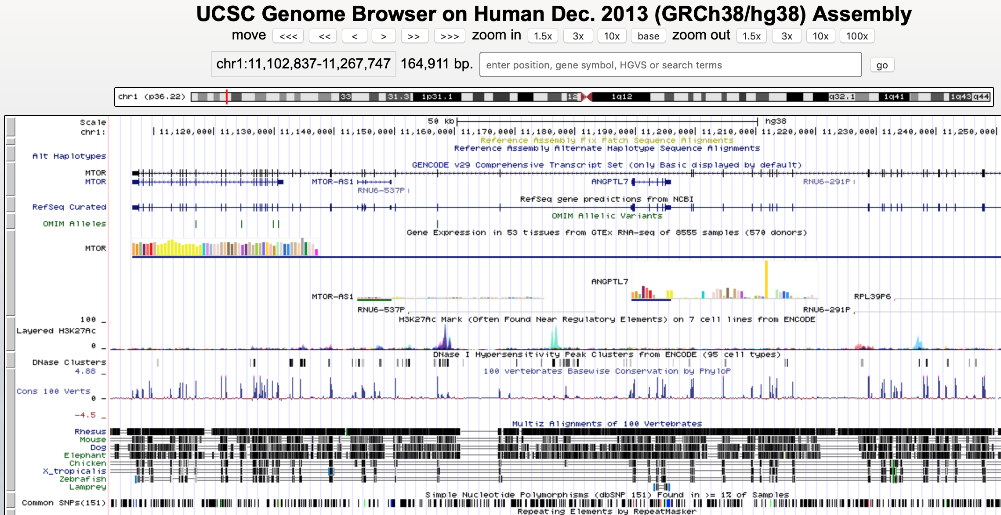
Commonly Used Genome Visualization Tools
Integrative Genomics Viewer
http://software.broadinstitute.org/software/igv/
UCSC Genome Browser
https://genome.ucsc.edu

Slide 8
Goals for this Lecture
Visualize a variety of genomic data
Quickly navigate around the genome
Learn how to be able to visualize your own read alignments
Learn how to recognize SNPs and structural rearrangements

Slide 9
Integrative Genomics Viewer (IGV)
Notes:
For sequence visualization, there’s not really any important theory to go through (unless you’re interested in how coverage is calculated and stuff like that)
These browsers are TOOLS. You get to know how to use a tool by taking it out for a spin. It’s really the best way to familiarize yourself with something completely new
That’s why I had you do the tutorial ahead of time.
Much better than having me up here trying to lead a live demo or just drone on about certain examples without you having seen them before
We can also take the time now to clarify anything that may not have been clear in the tutorial. Some of the instructions were indeed lacking.

Slide 10
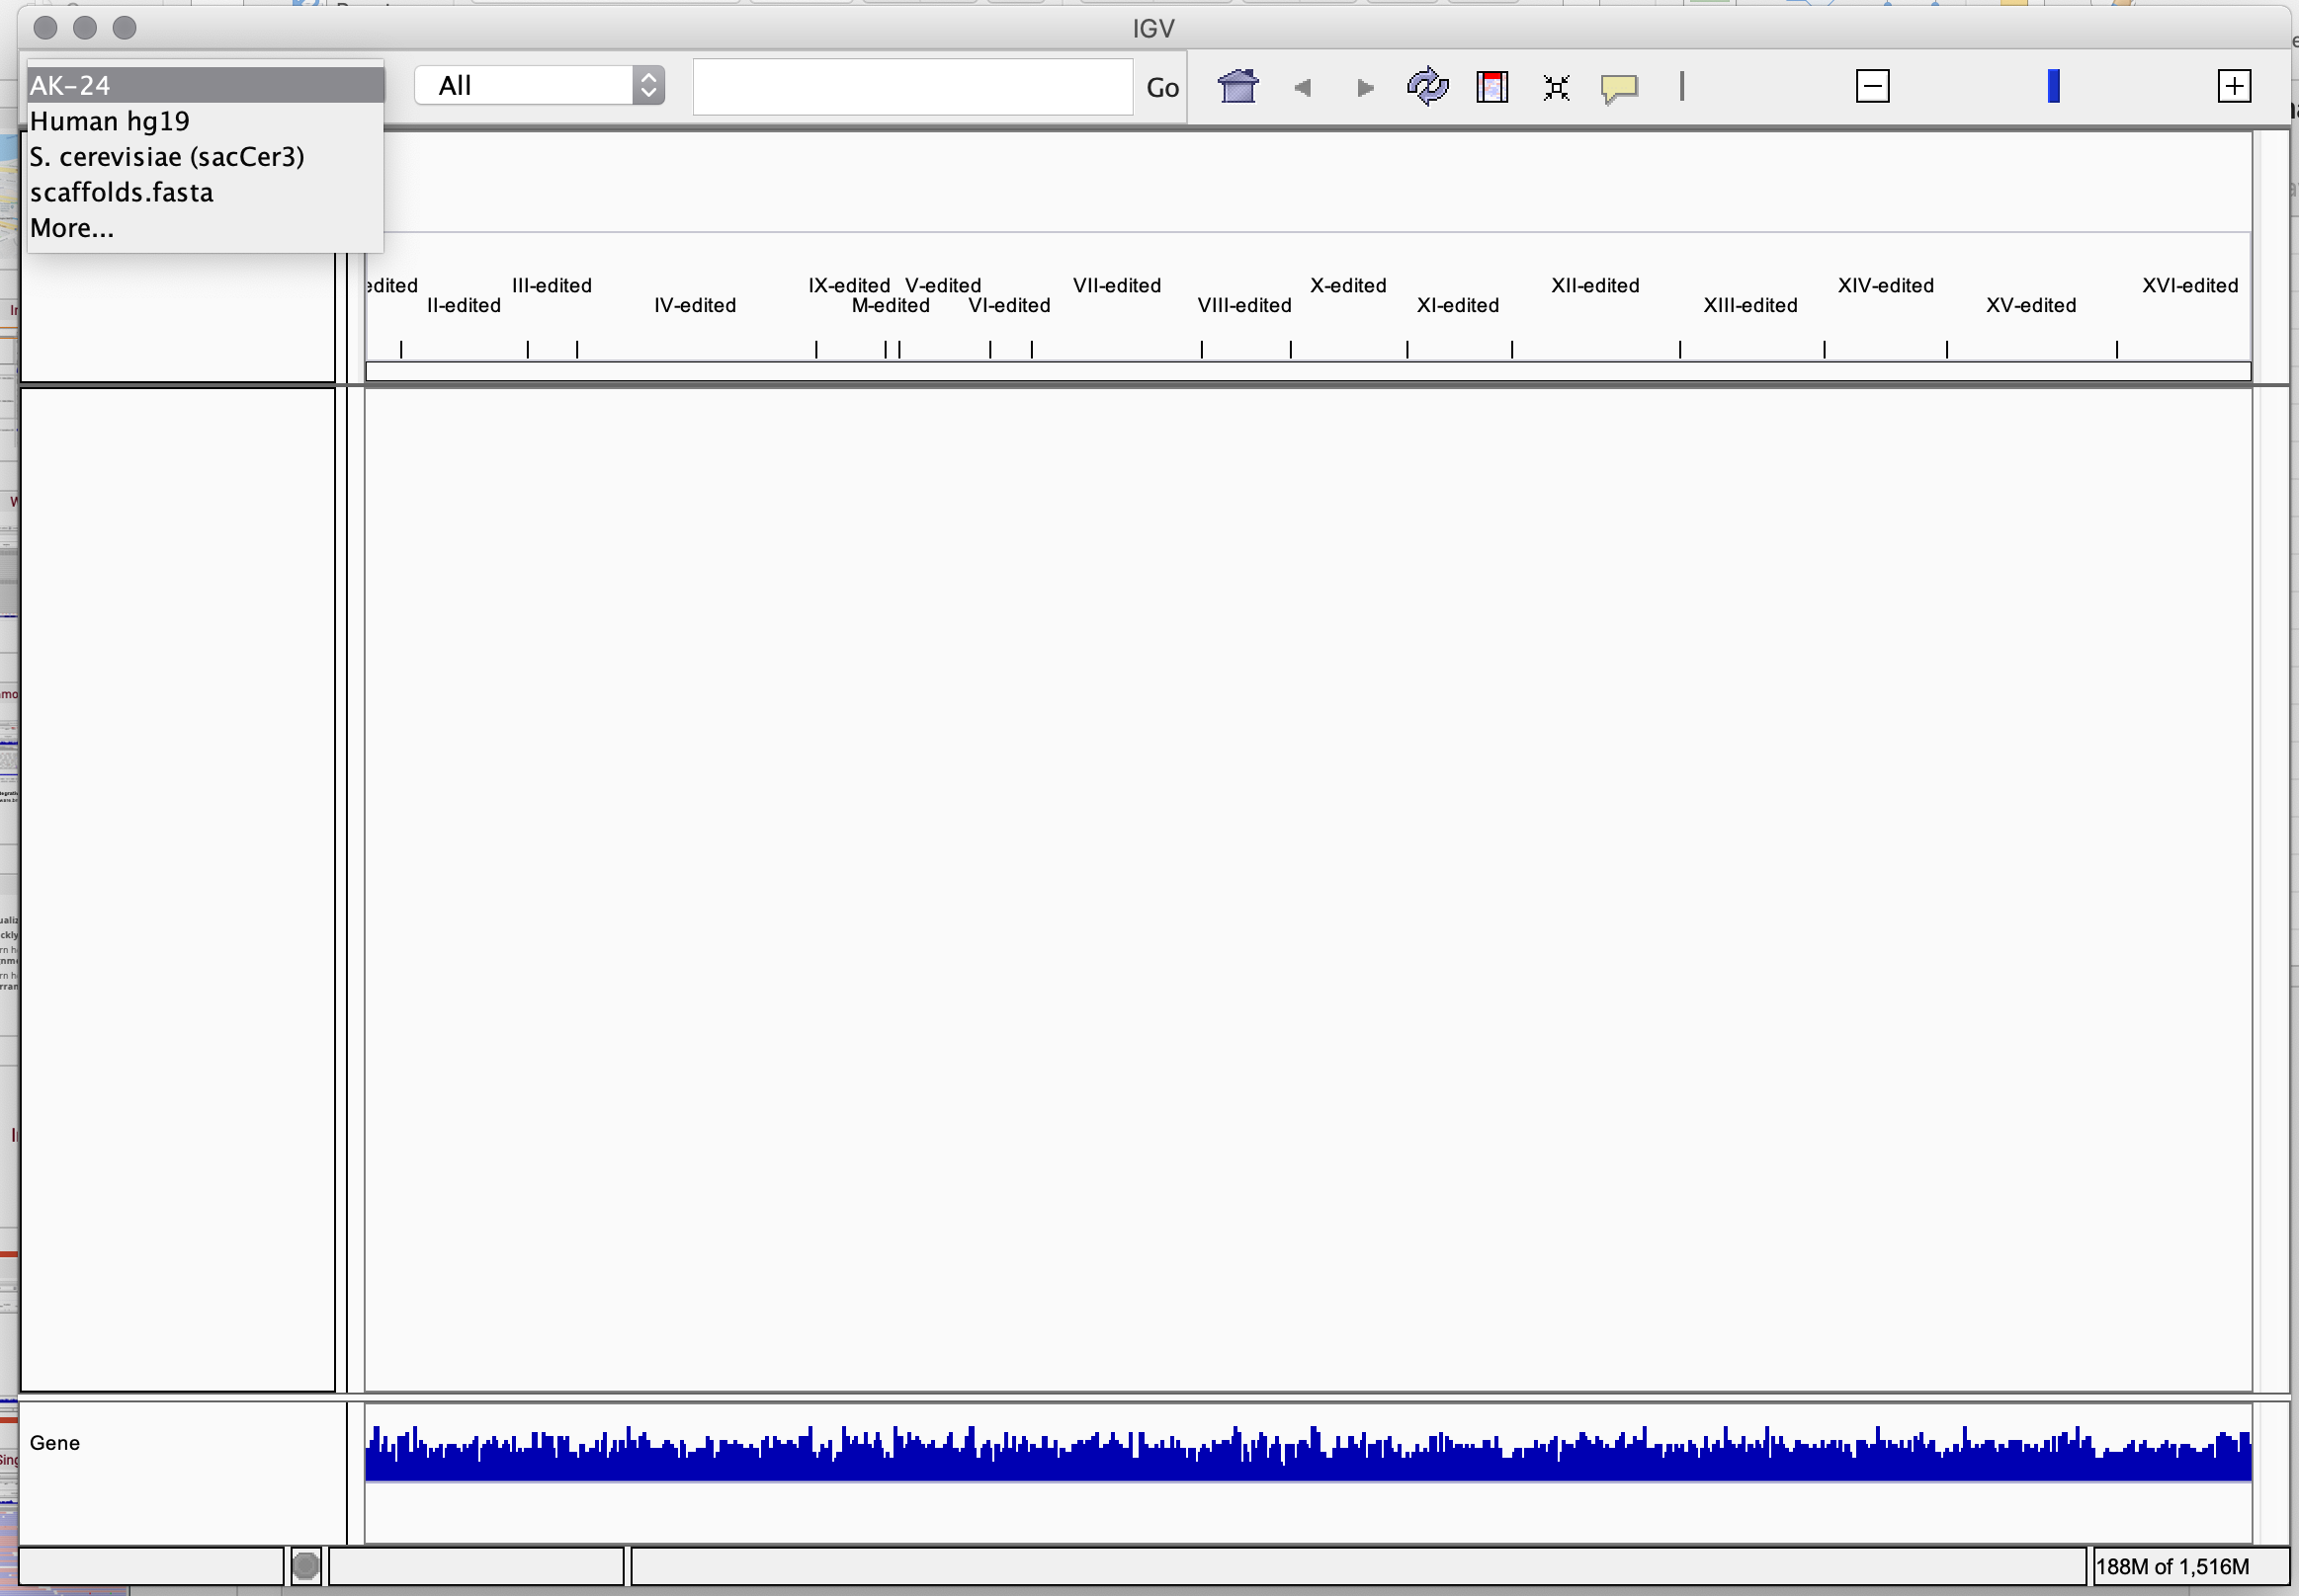
IGV: Introduction to Usage
Download software from: http://software.broadinstitute.org/software/igv/download
Open up the application
Choose genome (e.g. Hg38, Mm10, or a custom genome)
Drop down menu to select genome
Notes:
There’s a lot of information here presented in a way that makes sense to humans
Once you get used to how the information is presented, it starts to make sense to you
The tracks there are just the ones they had in the tutorial. You can add any bam, bed, etc. track from any experiment as long as it is mapped to the same reference
There’s different phenomena kind of peppered in here as well. Different color SNPs corresponding to different nucleotides relative to the reference. The purple “I” looking character which shows insertions. You can look at the coverage histogram to determine whether a SNP is homozygous or heterozygous
You can zoom in and out, navigate within a local regions by dragging, input a new region of your choice

Slide 11
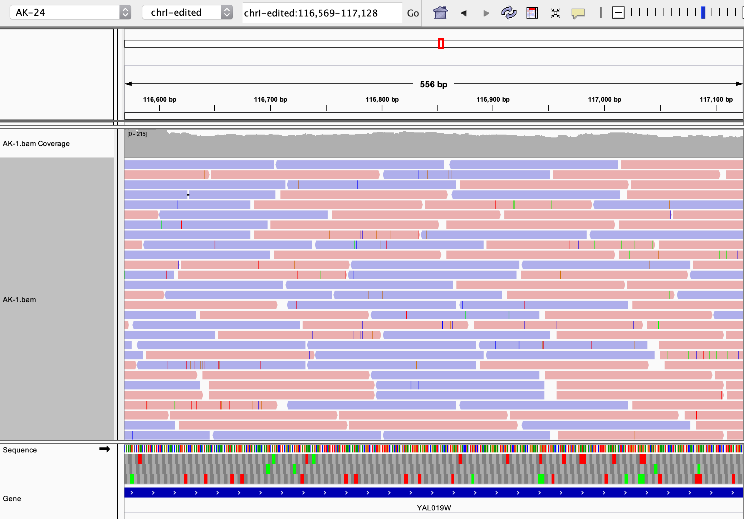
IGV: Introduction to Usage
Download software from: http://software.broadinstitute.org/software/igv/download
Open up the application
Choose genome (e.g. Hg38, Mm10, or a custom genome)
Load alignment file(s)
Visualize alignments:
Coverage plot shows distribution of alignment
Each elongated pentagon is a read
Colored lines = differences from reference
Reference sequence, amino acid sequences, and gene
Notes:
There’s a lot of information here presented in a way that makes sense to humans
Once you get used to how the information is presented, it starts to make sense to you
The tracks there are just the ones they had in the tutorial. You can add any bam, bed, etc. track from any experiment as long as it is mapped to the same reference
There’s different phenomena kind of peppered in here as well. Different color SNPs corresponding to different nucleotides relative to the reference. The purple “I” looking character which shows insertions. You can look at the coverage histogram to determine whether a SNP is homozygous or heterozygous
You can zoom in and out, navigate within a local regions by dragging, input a new region of your choice

Slide 12
SNPs
reference: AA-TACGGACGGACTTTA
read1: AACTACGG-CGGACTTTA
read2: AACTACGG-CGGACTTTA
read4: AACTACGG-CGGACTTGA
read5: AACTACGG-CGGACTTGA
samtools mpileup -u -v -r chr22:29268316-29300343 -d 150 -f ../06/ref/chr22.fa NA12878_phased_chr22.bam > NA12878_chr22_samtools_EWSR1.vcf
gatk HaplotypeCaller \
-L chr22:29268316-29300343 \
-R ../06/ref/chr22.fa \
-I NA12878_phased_chr22.bam \
-O NA12878_chr22_gatk_EWSR1.vcf.gz \
-ERC GVCF # BP_RESOLUTION
INsertion DELetion SNP

Slide 13
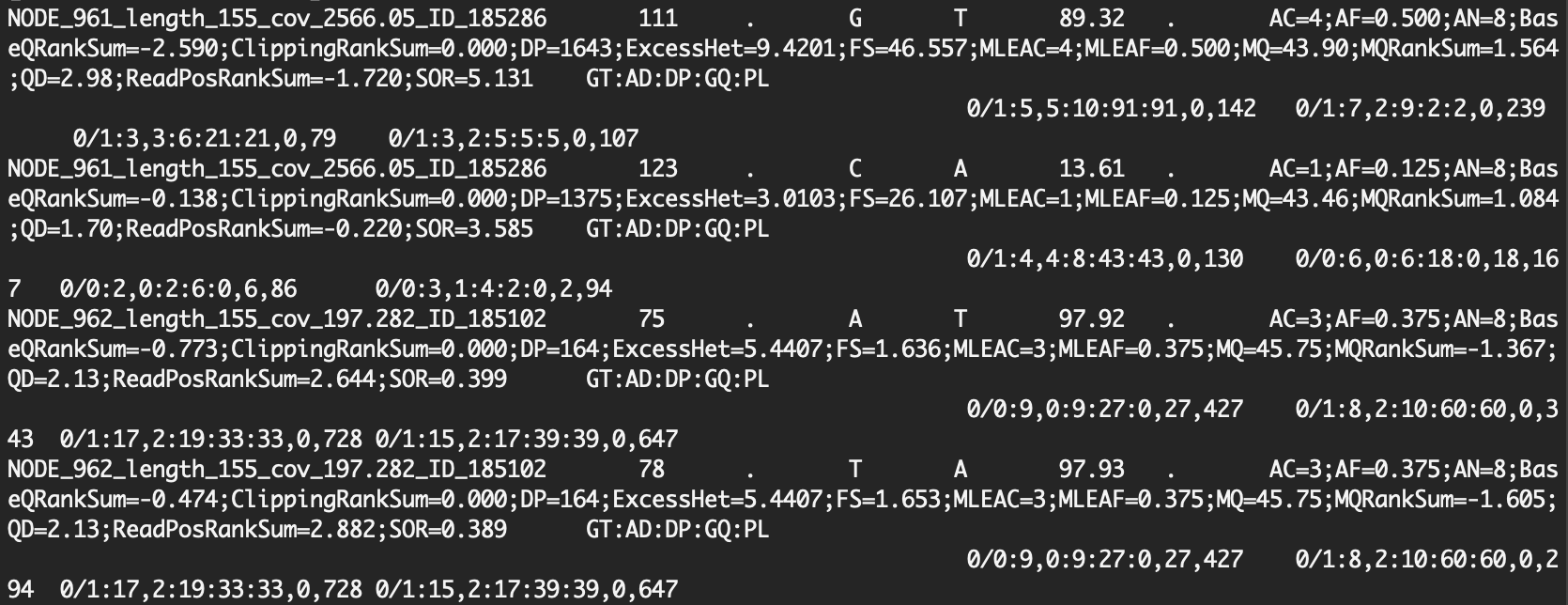
IGV: Visualize SNPs Identified From Variant Calling
How do we go from a set of labelled coordinates to a human-centered visual summary?
(e.g. a VCF file)

Slide 14
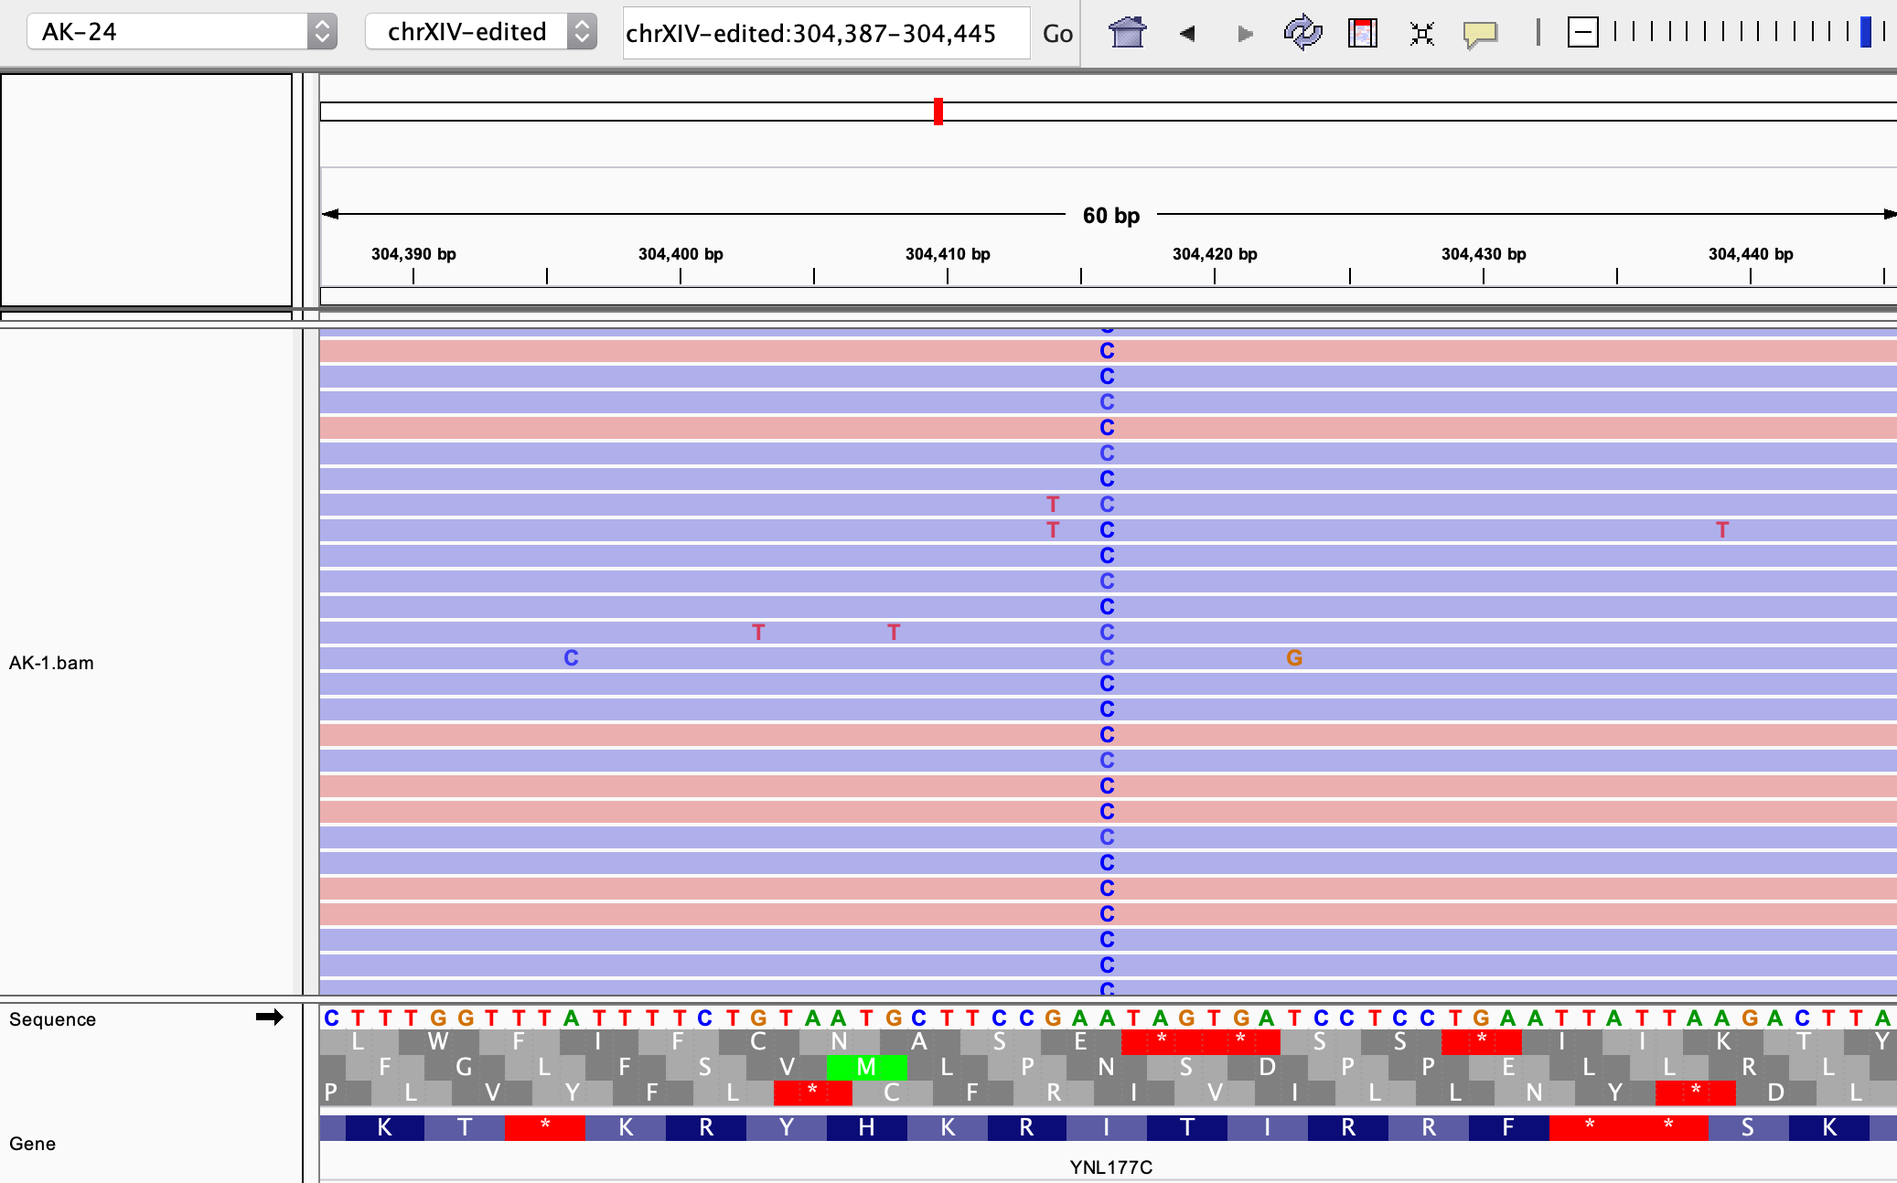
IGV: Visualize SNPs Identified From Variant Calling
Load tracks (.BAM files, .VCF files, etc.). Here: Alignment file for 1 sample
Zoom into locus of interest. Here: chrXIV of our custom genome
Set visualization parameters (colors, shading, etc.). Here: paired-end reads colored by forward (red) or reverse (blue) read
Use annotation (.GTF file) to identify which gene SNP is in
SNP

Slide 15
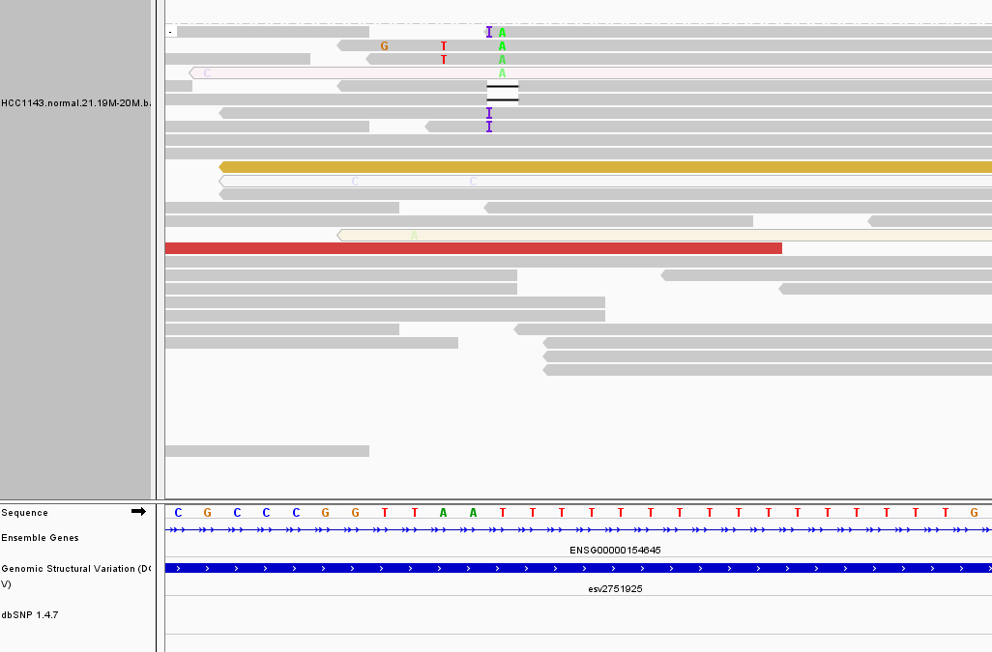
IGV: A Homopolymer Run
A long stretch consisting of a single base
You want to be looking at the sequence here (all those Ts)
Difficult to map against, particularly at ends of reads
Notes:
Here we see things that the aligner thought were insertions or deletions in this homopolymer region

Slide 16
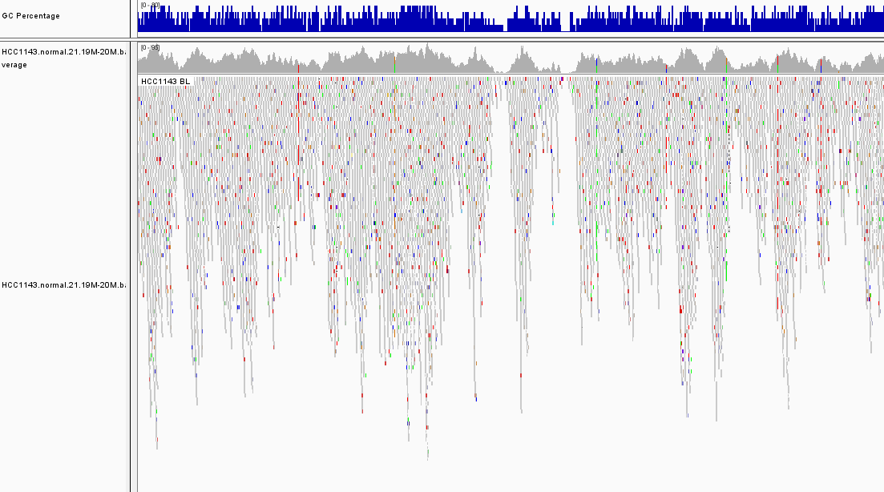
IGV: Coverage by GC percent
Benjamini & Speed (2012) proposed that PCR step generates this GC bias
Severity differs from experiment to experiment
Notes:
We see a concordance of GC content with coverage.

Slide 17
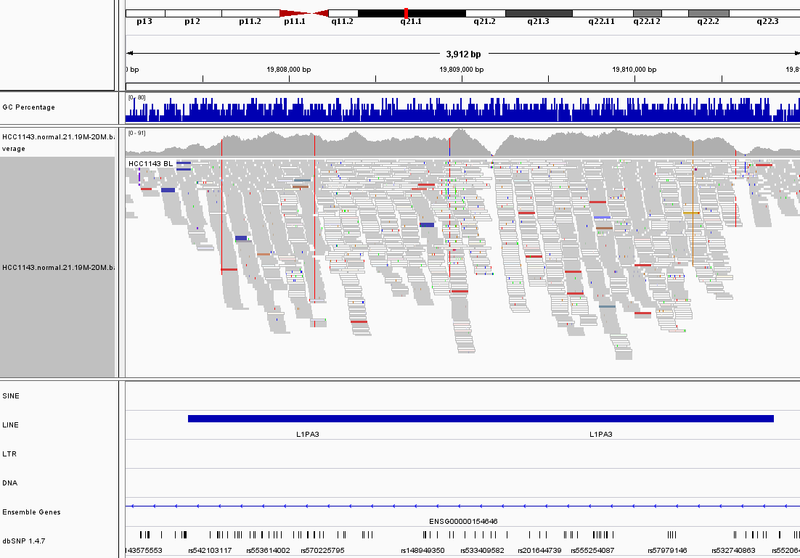
IGV: Low Mapping Quality
Repetitive elements (tandem repeats, LINEs, SINEs, etc.) can have multiple nearly identical copies in the genome
Reads will map to multiple versions in the genome
Referred to as “low mapping quality” (reads visualized as white, not grey)
Notes:
Those white color reads interspersed with the grey reads are low mapping quality because they map to multiple regions in the genome equally well. They cannot be uniquely mapped and are therefore assigned a low mapping quality (hover over individual reads to inspect the MAPQ scores)

Slide 18
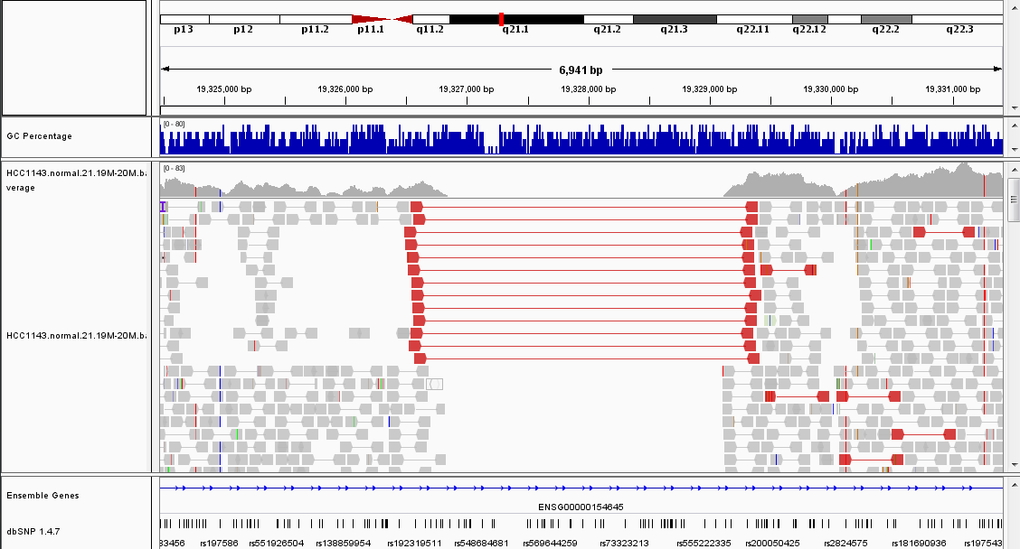
IGV: Homozygous Deletion
All mate pairs that map here span the deletion
Visually, the reference contains an “insert” of ~3kb
Look at the sizes of other fragments

Slide 19

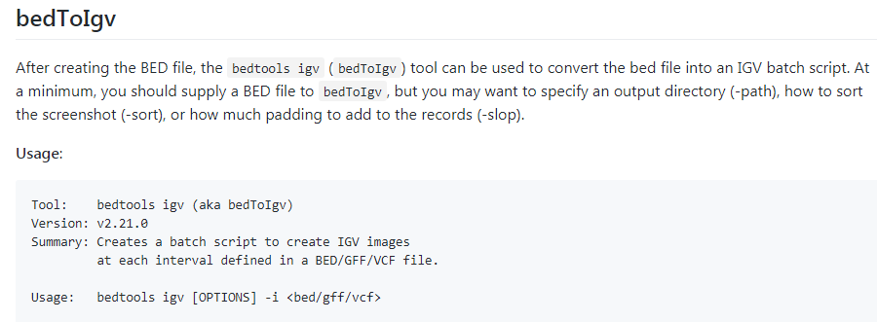
Automating Tasks
IGV has its own set of common commands that it recognizes
You can load a bunch of tracks for example using successive “load” commands in a script file
The commands can be harnessed to do cool things (like sweep through a bed file and create snapshots of all the regions):
Notes:
That’s our very own David Jenkins
As you get more used to looking at your alignment tracks, you’re going to start wanting to implement some of these automated tasks

Slide 20
UCSC genome browser
Notes:
The UCSC genome browser is a “site that contains the reference sequence and working draft assemblies for a large collection of genomes”
The genome browser itself is just one of many utilities of the genome.ucsc website
Other utilities of potential interest:
Table browser – annotations with many different options for formatting. Made to order. Endlessly useful

Slide 21
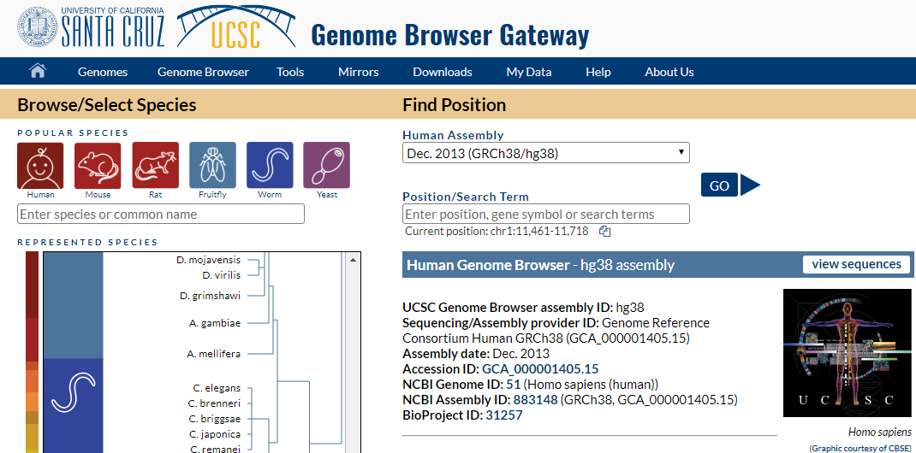
Selecting which species to browse
A wide variety of species/references are available
Notes:
This is first screen you hit on the genome.ucsc.edu website
Everything from Human to the Ebola virus
All human references from hg16 to hg19 (and hg38)

Slide 22
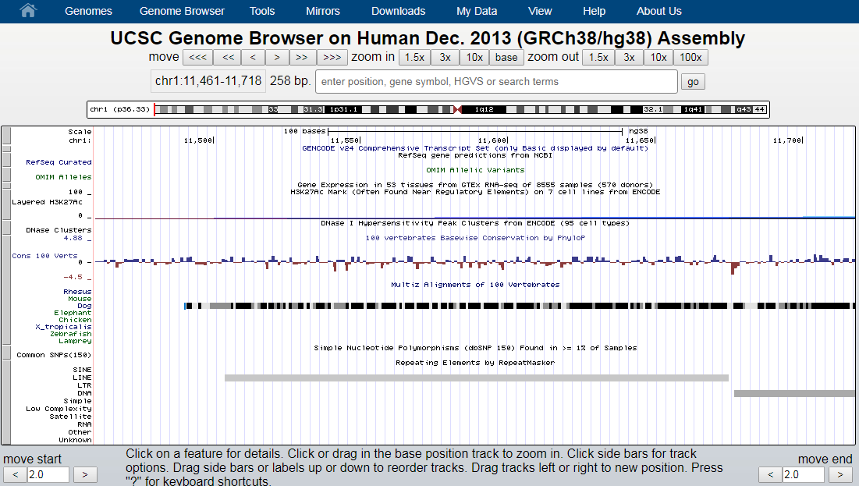
UCSC genome browser interface
Notes:
Shown here is the human reference genome (hg38) on some random window on chromosome 1.
You can see how similar it is to the IGV interface that you’re used to:
At the top, you have your navigation options, and zoom
You have the window you’re currently in, how many bases long it is, and a search bar where you can query the location of something you might be interested in (genes, different genome positions etc.)
There’s a schematic representation for where you are within the chromosome

Slide 23
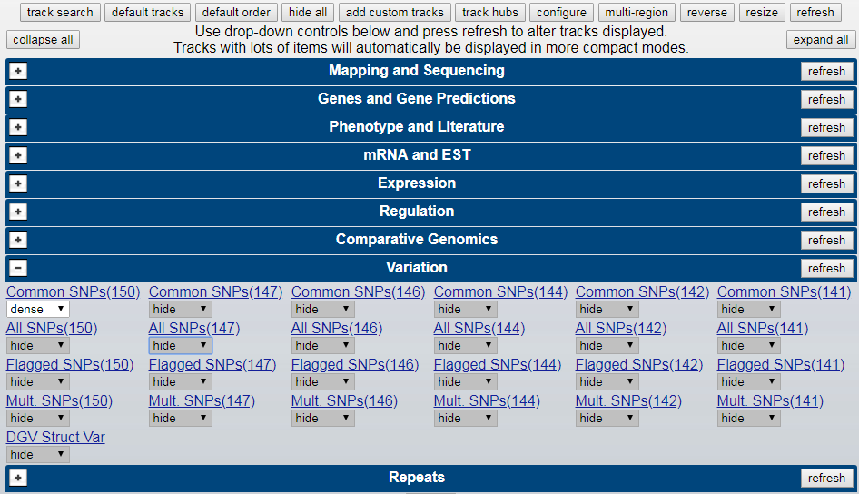
Where UCSC beats IGV
Notes:
This is a screenshot of when you scroll down on the genome browser page. There’s a vast collection of annotation tracks that are readily available and quick to load onto the reference you’re browsing.
If you remember from when you were loading in annotations from a server using IGV, there wasn’t nearly as vast a collection of annotations available.
Each of the above categories has many, many tracks that can be layered on to the reference you’re looking at. You can select or hide as many of them as you like

Slide 24
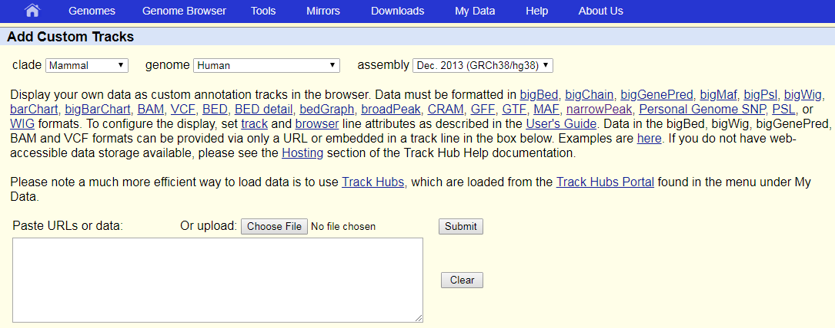
Options for viewing your own data
Online:
Individual tracks can be loaded using the “add custom tracks” option (not recommended)
Paste link to a track or track hub hosted elsewhere
Notes:
Other labs might host their data somewhere

Slide 25
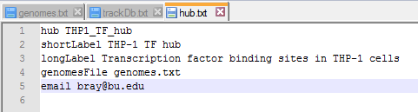

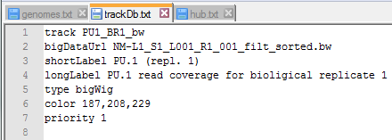
Options for viewing your own data
Local:
Version of the UCSC genome browser can be downloaded (VirtualBox + GBiB)
Supports viewing custom tracks, local track hub configurations
Left: Text files that configure a local track hub
Notes:
A bit of a pain to set up for the first time, but the upkeep is easy and you can script ways to generate these files pretty easily as part of your analysis pipelines
All the “usual suspect” formats are supported as well. You can actually use IGV and UCSC pretty interchangeably if you run them locally

Slide 26
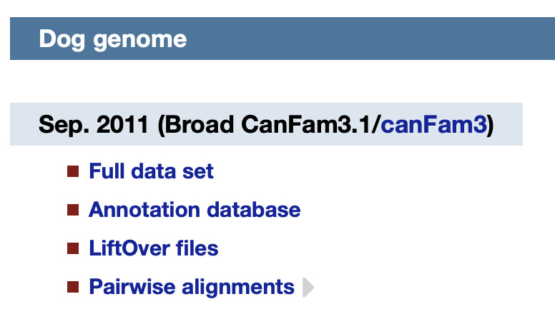
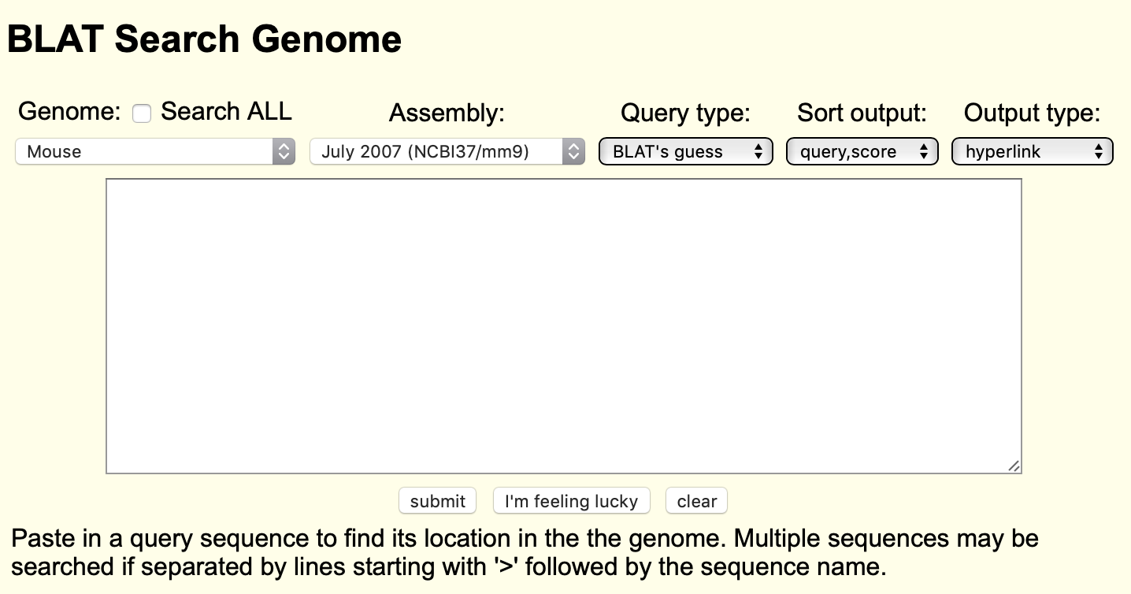
Other Fun Things from UCSC
Notes:
BLAT = BLAST-like alignment too. It is very quick but requires exact or nearly-exact matches

Slide 27
IGV vs. UCSC
IGV | UCSC
Java application | Run in web browser
Run on your local computer | Hosted on the web
Data stored locally | Data stored on the web
Handles all major file types | Handles all major file types
Must load most tracks manually | Vast number of preloaded track types

Slide 28
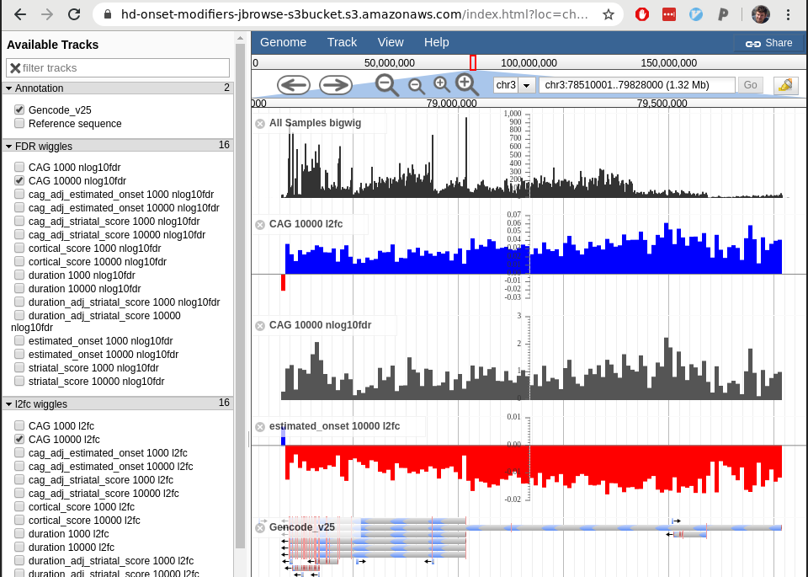
Honorable Mention: JBrowse
Javascript-based genome browser software
Open source
Highly extensible, customizeable
Must be hosted on a web server

Slide 29
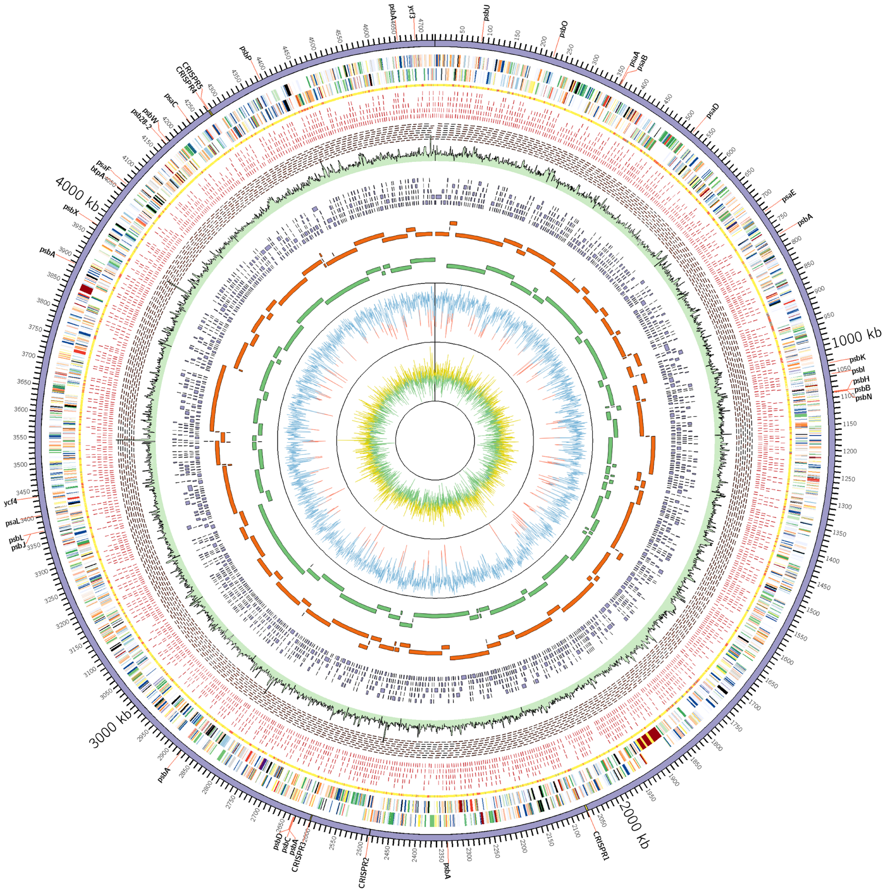
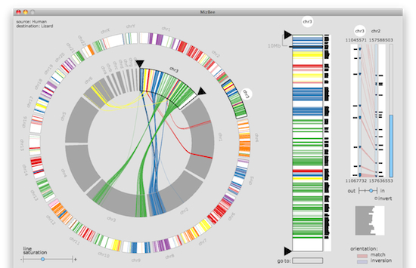
Other Genome Visualization Tools
Circos
http://circos.ca/software/
MizBee
(A Multiscale Synteny Browser)
http://www.cs.utah.edu/~miriah/mizbee/Overview.html

