Slide 1
Sequence Analysis - RNA-Seq 2

Slide 2
RNA-Seq
Identify sequence of RNA molecules
“Unbiased” - possible to sequence any molecule in sample
Molecules sequenced in proportion to relative abundance in sample
Most often used for gene abundance estimation

Slide 3
Common Types of RNA-Seq Analyses
Sequence based
  Transcriptome reconstruction
  Splicing analysis
  Gene fusion discovery
  Coding variants
Abundance based
  Differential expression
  Allele-specific expression (with genotyping)

Slide 4
Transcriptome reconstruction
Given RNA fragments, recover original transcript
Two approaches:
  De novo - no reference transcriptome available
  Reference or genome guided - reference available
Very challenging with short reads!

Slide 5
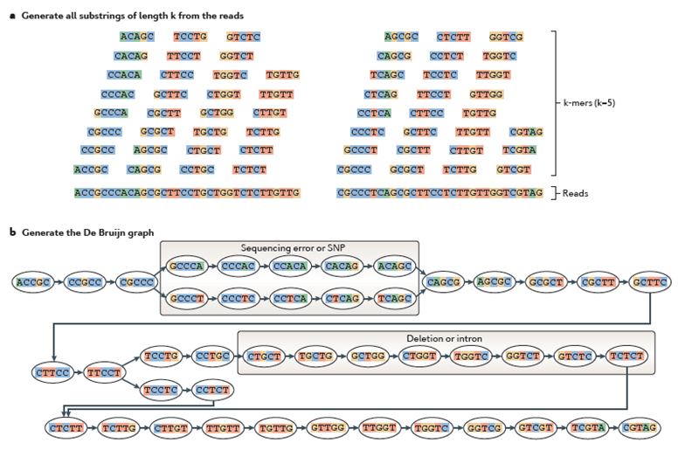
De novo transcriptome reconstruction

Slide 6
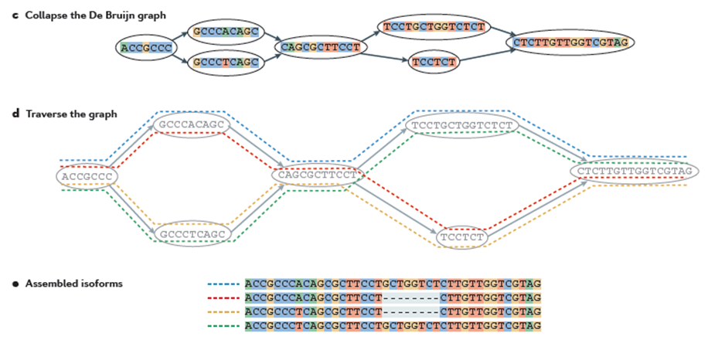
De novo transcriptome reconstruction

Slide 7
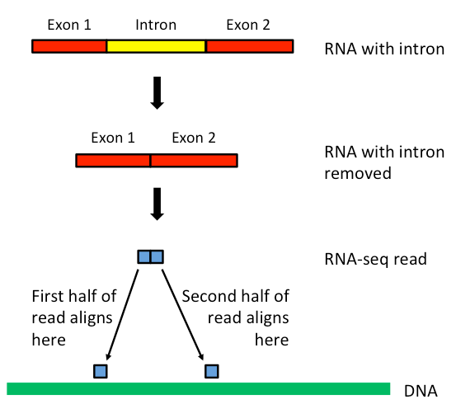

Concept: Spliced Alignment
Coding sequences interrupted by introns
mRNA molecules have introns excised
Some reads span splice junctions
Spliced alignment aligns junction or spliced reads
https://discoveringthegenome.org/discovering-genome/rna-sequencing-up-close-data/spliced-alignment

Slide 8
Concept: Spliced Alignment
Splicing-aware programs:
  STAR, TopHat
Splicing unaware programs:
  bwa, bowtie, most others
De novo - use only genome sequence
Transcriptome guided - use known splice junctions to guide alignment

Slide 9
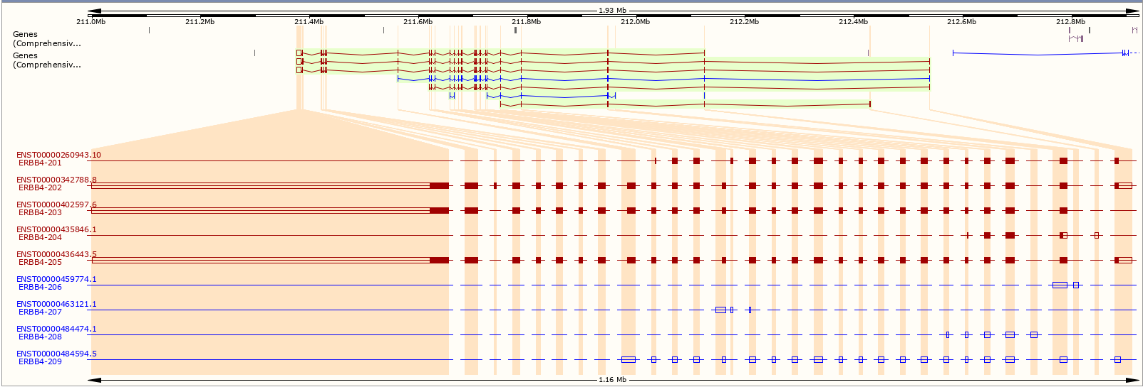
Concept: mRNA Isoforms
Isoform: pattern of exons/transcribed sequence

Slide 10
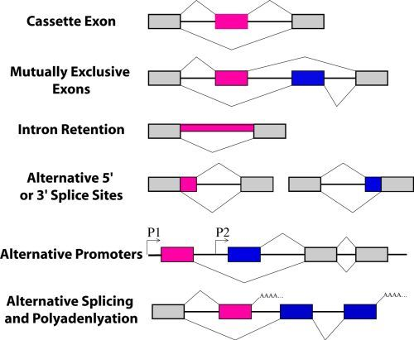
Alternative Splicing (AS) Analysis
Detect and/or quantify isoforms
Different AS types
Examine pattern of exons in spliced reads
Methods:
  Whippet
  MISO
  rMATS
  IRFinder, and many others
https://www.ncbi.nlm.nih.gov/books/NBK19730/figure/A1150/

Slide 11
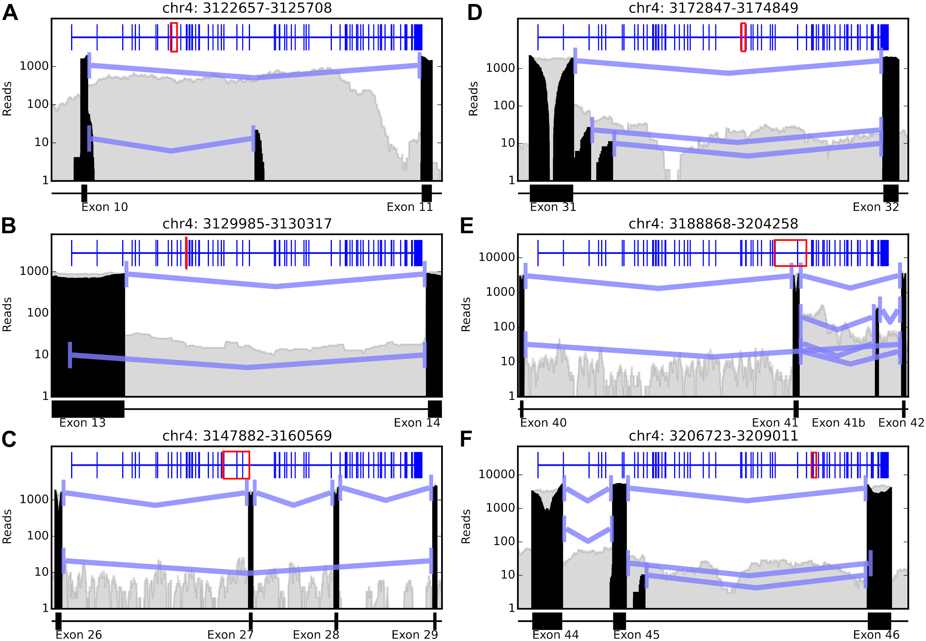
Alternative Splicing (AS) Analysis
Read support: # of reads containing splice junction
Grey areas → overall aligned read depth
Black areas → spliced reads
These have minimum 10 supporting reads per splicing event
https://journals.plos.org/plosone/article?id=10.1371/journal.pone.0141298

Slide 12
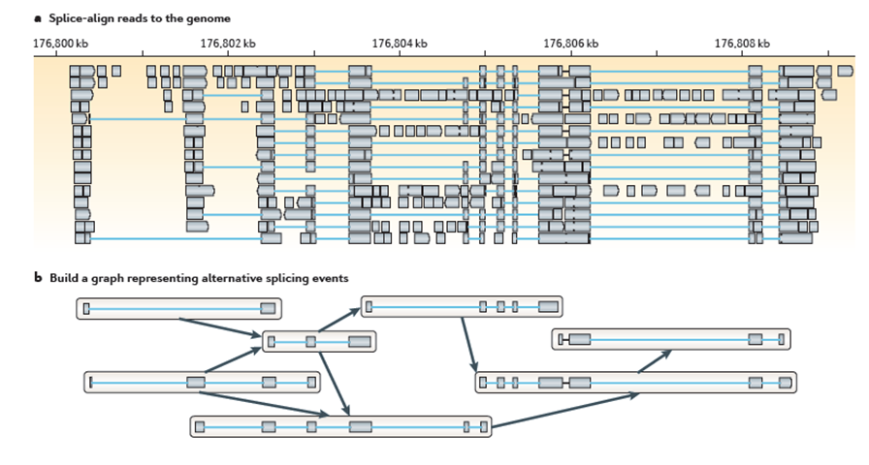
Reference guided reconstruction

Slide 13
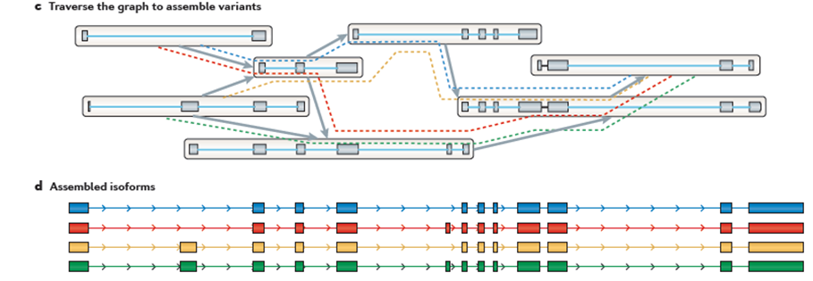
Reference guided reconstruction

Slide 14
Gene Expression (RNA Abundance)
Measure relative abundance of RNA species
# reads mapping to a gene is proportional to # of molecules transcribed
Example:
  Gene A = 5, Gene B = 10, Gene C = 10 reads
  Gene A is about half as abundant Gene B
  Gene A and Gene C have about the same abundance
Gene A
Gene B
Gene C

Slide 15
Bag of Fragments Analogy
Reads are samples drawn from the distribution of all RNA fragments
Drawn in proportion to frequency
High abundance transcripts drawn frequently
Low abundance transcripts might not be drawn at all (black read)
More reads sequenced → more chance to draw low abundance transcripts
Absence of evidence is not evidence of absence!
Metaphorical
bag
All RNA
Fragments
(billions and billions)

Slide 16
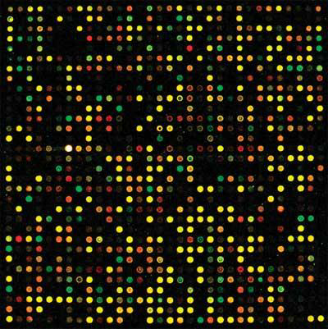
RNA-Seq vs Microarray
RNA-Seq compared to microarray:
“Unbiased” - de novo sequences
Larger dynamic range
Information rich
More complex data
Much larger data
More expensive

Slide 17
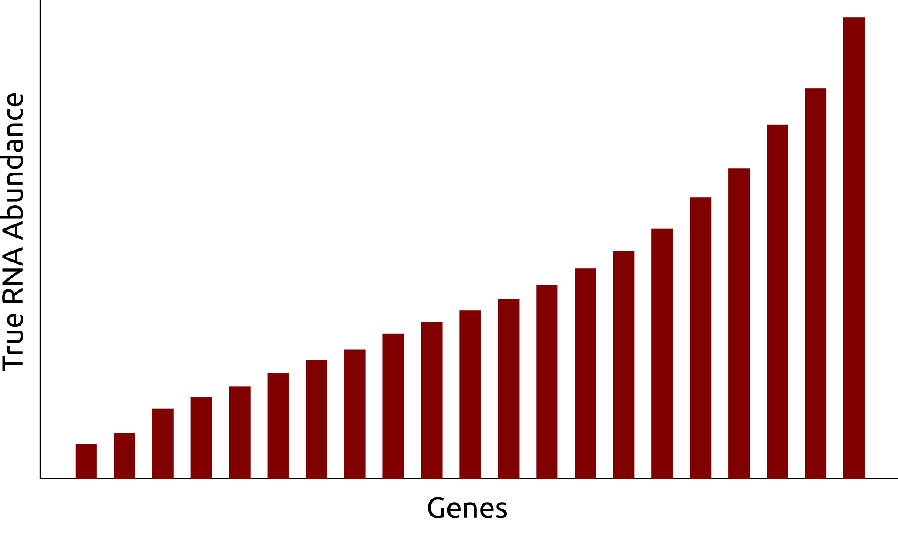
Dynamic Range - Detection Limits
Low depth RNA-Seq
High depth RNA-Seq
Microarray

Slide 18
Gene Expression Analysis Strategies
Align+count
  Explicit alignment against genome
  Count reads aligned to known loci (e.g. genes)
Quantify
  “All-in-one” approach
  Quasi-alignment (i.e. “good enough” alignment) against transcriptome only
  Statistical model estimates abundance

Slide 19
Abundance Estimation: Align and Count
Align against reference genome
Compare alignments with annotation
Count # of reads within desired features (e.g. exons, coding sequence)
Sum to transcript or gene level
Read counts are estimates of abundance

Slide 20
Concept: Multimapping Reads
Paralogs, repetitive sequence may transcribe identical RNA
Multimapping read: read that maps equally well to multiple loci
Can cause abundance estimation bias
Mitigate by:
  Filtering out multimappers
  Limit reads to aligning to a maximum # of loci (e.g. 1, 10)
  Multimap resolution methods (e.g. mmr, ORMAN)

Slide 21
Abundance Estimation (Quantification)
Quasi- (or pseudo-)alignment: map reads to sequences without explicit alignment
Must build reference transcriptome
Statistical model performs abundance inference
Handles multimapping reads implicitly
Similar accuracy, faster than align+count

Slide 22
Expression Analysis Strategies Summary
Align+count:
  Spliced alignment methods: STAR, TopHat
  Counting methods: htseq, featurecounts, VERSE
  Advantages: flexible, accurate, whole genome
  Disadvantages: slow, many parameters to choose
Quantify
  Methods: salmon, kallisto
  Advantage: very fast, accurate, handles multimaps
  Disadvantage: transcriptome only

Slide 23
Differential Expression (DE)
Start with expression matrix of genes x sample counts/estimates
Which genes have counts associated with variable of interest, e.g. case vs control?
Each gene will have
  significance (e.g. p-value)
  Effect size (e.g. log2 fold change)

Slide 24
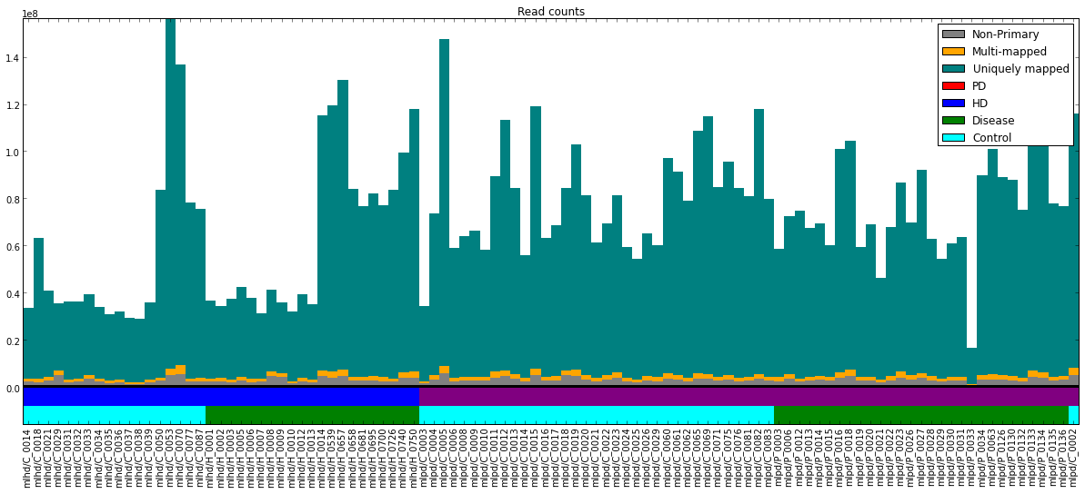
Concept: Count Normalization
# of reads differ between libraries
Counts proportional to library size
Must be normalized for samples to be comparable
Un-normalized counts called raw counts

Slide 25
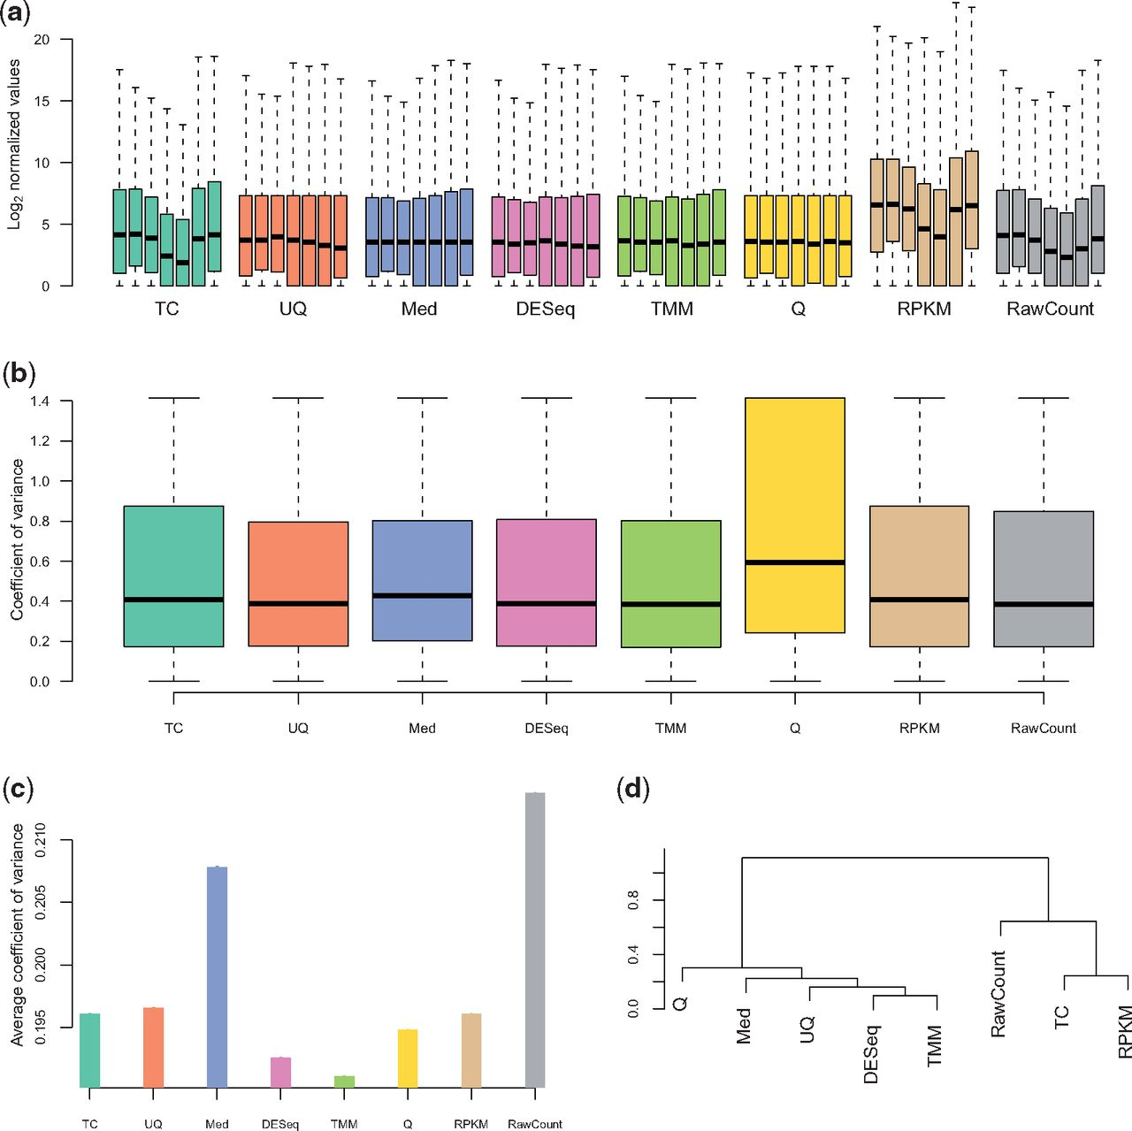
Count Normalization Strategies
DESeq2 - median of geometric mean count ratio
FPKM/RPKM - fragments (reads) per kilobase per million reads
  Divide each gene count by length of gene*10^6
Others proposed, these two most common
Dillies, M.-A. et al. A comprehensive evaluation of normalization methods for Illumina high-throughput RNA sequencing data analysis. Brief Bioinform 14, 671–683 (2013). http://bib.oxfordjournals.org/content/14/6/671.full

Slide 26
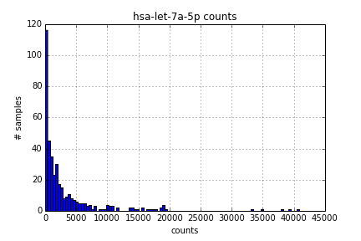
Modeling Count Data
Count data are not normally distributed:
  Non-negative integers
  Mean-Variance dependence
  Long upper tail
Modeled as Negative Binomial Distributed
Negative Binomial Regression Utilized for DE

Slide 27
Differential Expression Methods
Current state of the art:
  DESeq2 (Negative Binomial Regression)
  edgeR (Negative Binomial Regression)
  Count transformation + limma (linear regression)
Deprecated:
  Cufflinks (Negative Binomial Regression)
These methods perform normalization

