Slide 1
Proteomics
BF528

Slide 2
Life Is Made Of Proteins
40%-50% of dry mass of cells are proteins
The “work horses” of the cell
Participate in essentially all biological functions
Amino acid precursors likely first biomolecules
Cause of many human diseases

Slide 3
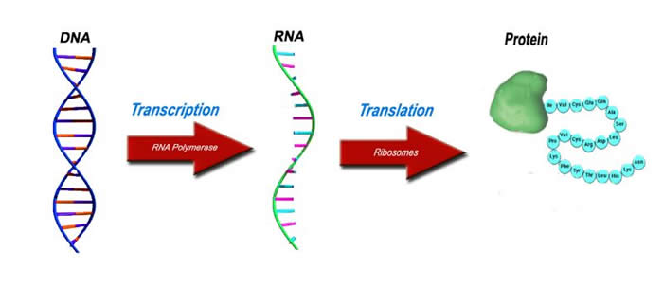
Central Dogma

Slide 4
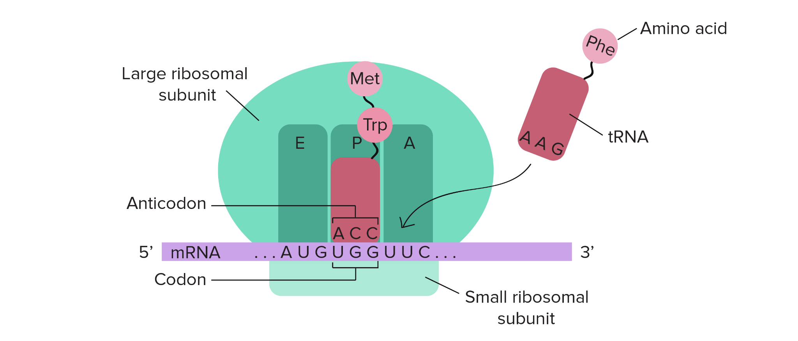
Translating RNA to Amino Acids

Slide 5
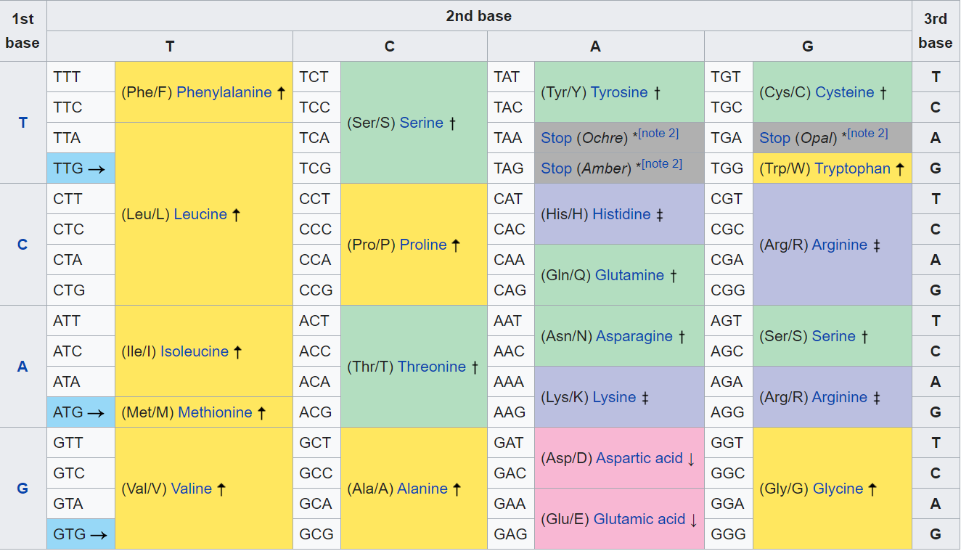
RNA Sequence Implies Protein Sequence

Slide 6
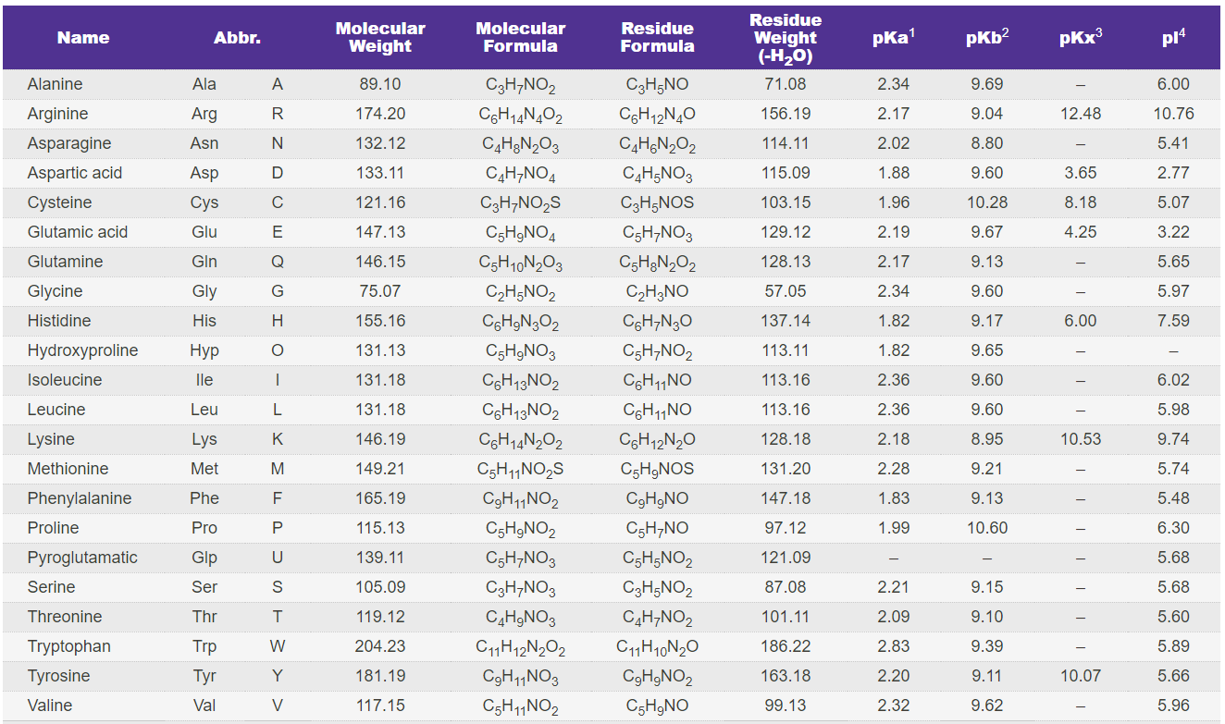
Amino Acids and their Properties

Slide 7
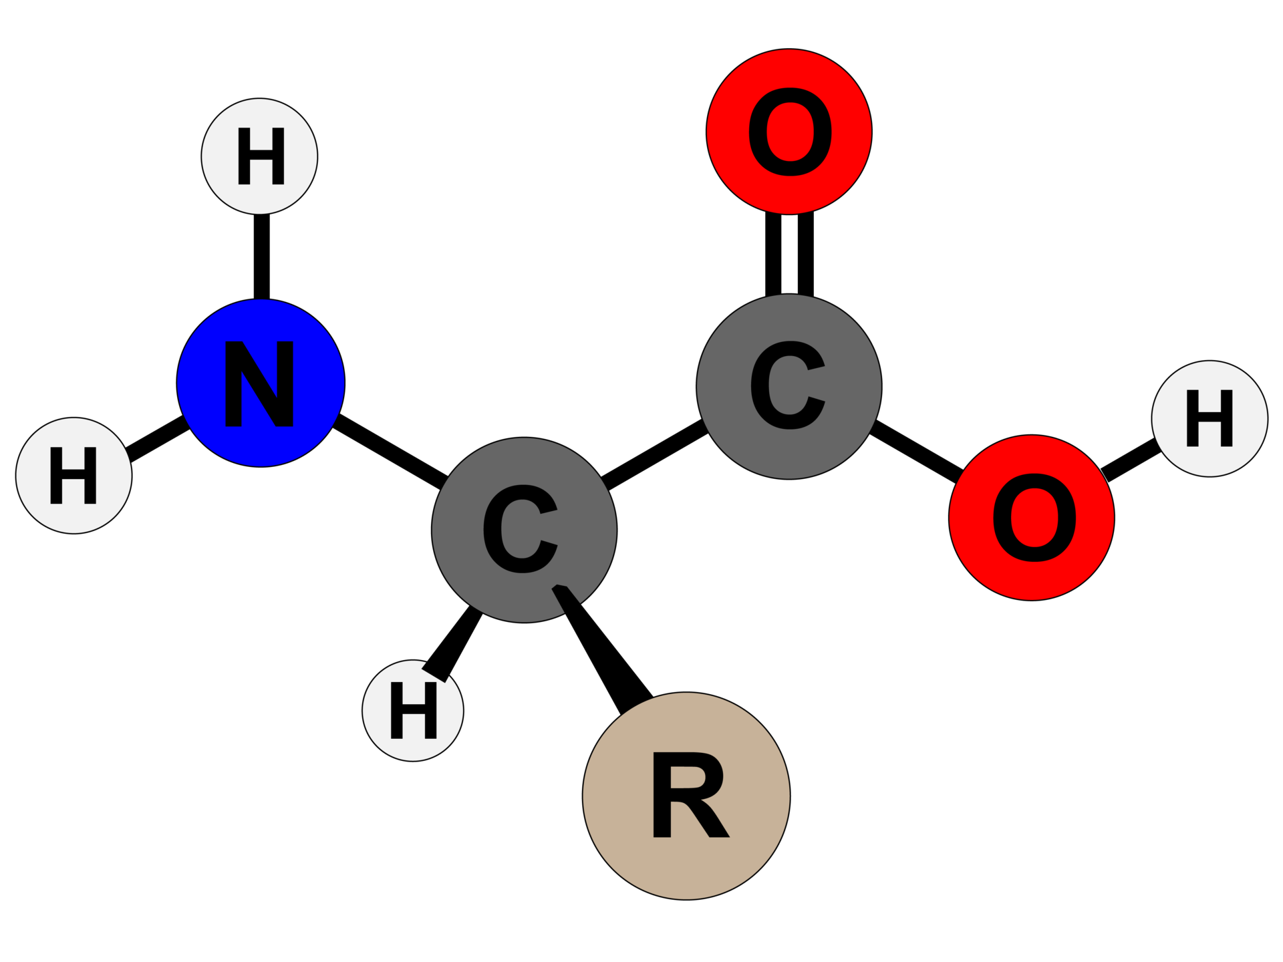
Protein Primer
Linear sequences of amino acids
Directional:
  N-terminus, C-terminus
Polypeptide backbone
Post translational modifications

Slide 8
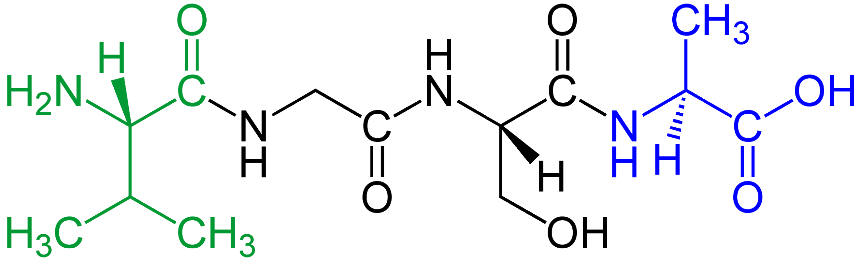
Peptides
Valine
Glycine
Serine
Alanine

Slide 9
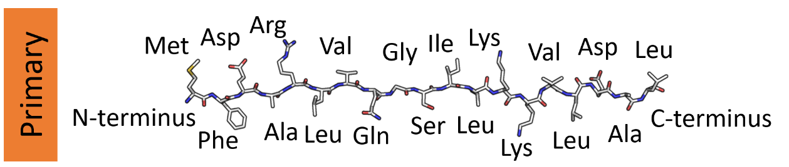
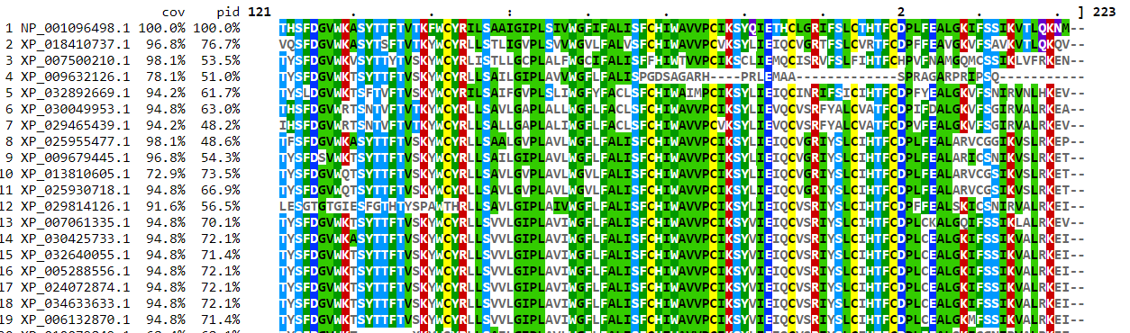
Proteins Have Sequence

Slide 10
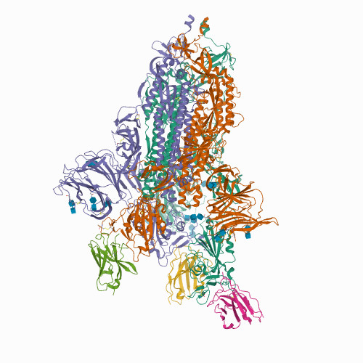
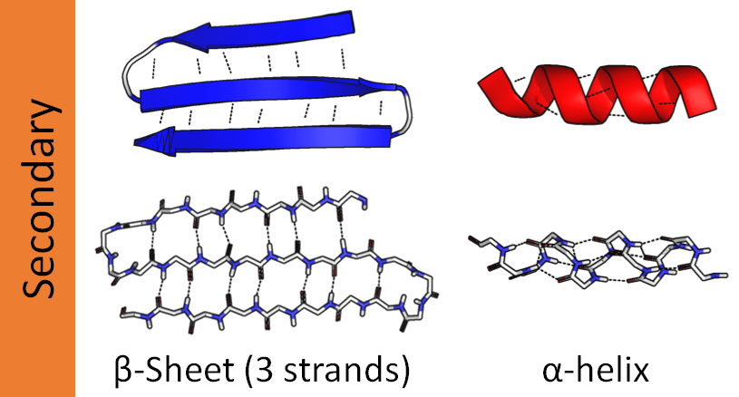
Proteins Have Structure
Cryo-EM structure of the SARS-CoV-2 spike protein bound to neutralizing nanobodies (Ty1)
https://www.rcsb.org/structure/6zxn

Slide 11
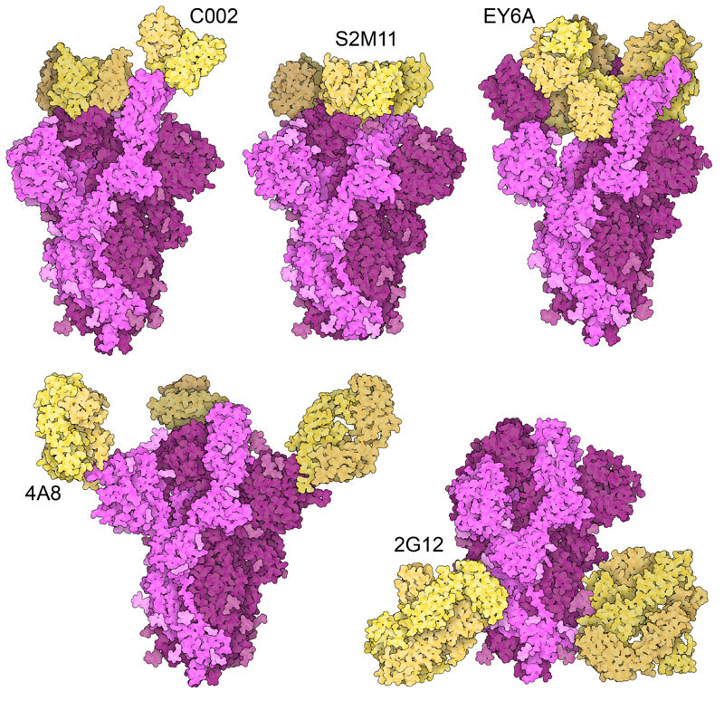
Proteins Have Shape
Structures of antibody Fab fragments (yellow) bound to SARS-CoV-2 spike protein (magenta). All structures include the variable domains of the antibodies, and some of the structures also include constant domains. http://pdb101.rcsb.org/motm/256

Slide 12
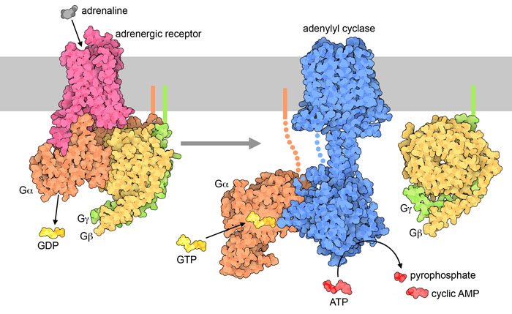
Proteins Have Function
Signaling with G-proteins. Hormones like adrenaline bind to a GPCR receptor (left), which binds to a heterotrimeric G-protein and releases GDP. Then the G-protein separates into two pieces, and the G-alpha subunit binds to GTP and activates adenylyl cyclase (right).

Slide 13
Measuring Proteins Indirectly
Infer protein sequence from DNA sequence
  Gene model prediction
  Homology
Infer protein sequence from RNA sequence
Infer protein abundance from expression
Immunohistochemistry
Others...

Slide 14
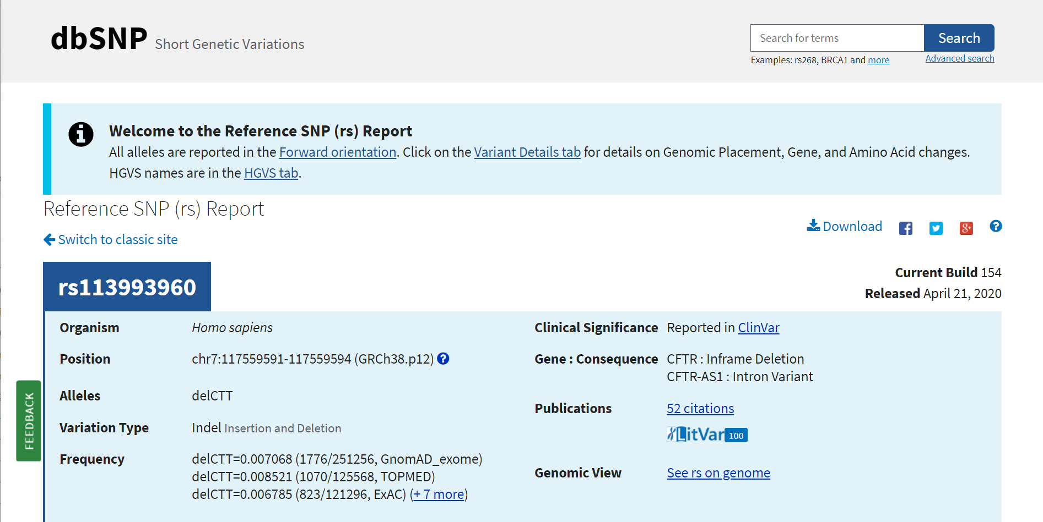
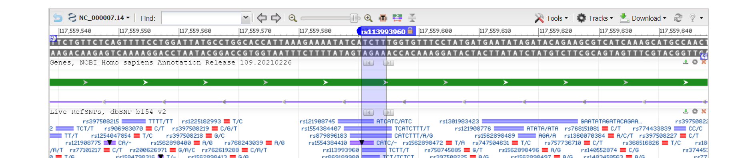
SNPs and Variants
Cystic fibrosis transmembrane conductance regulator (CTFR)
Loss of phenylalanine (F) residue at amino acid position 508

Slide 15
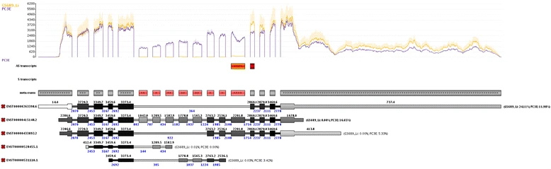
RNA Isoforms
Alternative splicing alters amino acid sequence

Slide 16
Proteomics
“Proteomics is the large-scale study of proteins. Proteins are vital parts of living organisms, with many functions. The proteome is the entire set of proteins that is produced or modified by an organism or system.” - Wikipedia

Slide 17
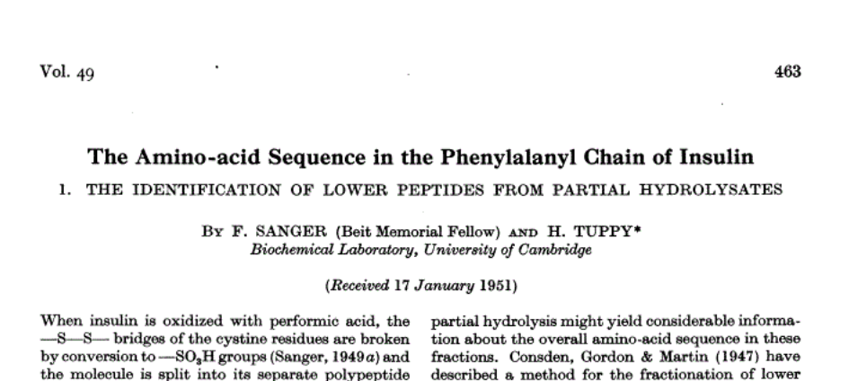
Proteomics History
First biological sequences ever determined were amino acids!

Slide 18
Measuring Proteins Directly
Although proteins are sequences, no current technology can directly sequence amino acids
Modular nature of amino acids enables decomposition, measurement, and “puzzling together” of complete proteins

Slide 19
Mass Spectrometry (MS)
Measures mass and charge of molecules
Measures any ions
  not just proteins/peptides!
Only measures ions
Can measure both identity and abundance of ions

Slide 20
Conceptual MS Architecture
1. Ionization
3. Detection
Sample
-
+
+
+
+
+
+
+
+
+
-
2. Acceleration (Mass Analyzer)
Intensity
Ion Mass
+
+
+
Time of Flight (m/z)

Slide 21
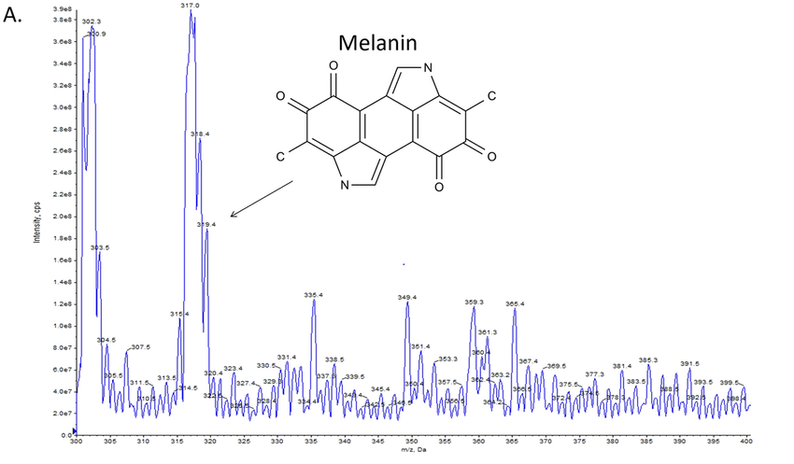
Mass/Charge Spectra
317
Molecule can be identified by comparing m/z with known/expected molecules
Area under each curve is proportional to abundance of corresponding molecule
Intensity
m/z

Slide 22
Mass Spec Proteomics Workflow
Sample collection/processing
Fractionation (Liquid Chromatography)
Digestion
Ionization
Mass Analyzer
Ion Detection
Spectra Analysis

Slide 23
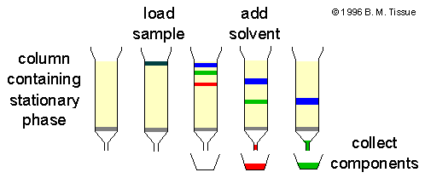
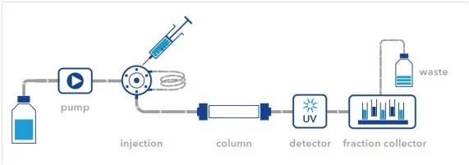
Chromatography
Column Chromatography
Method for separating constituent molecules from a mixture
Separated using physical properties of molecules,
e.g. polarity
Sample dissolved in mobile phase, passed through stationary phase
Molecules separated by amount of interference passing through column
Liquid Chromatography

Slide 24
Liquid Chromatography Mass Spec (LCMS)
Sample
MS
LC Column
1. Ionization
2. Acceleration (Mass Analyzer)
Intensity
Analytes
3. Detection
Time of Flight (m/z)

Slide 25
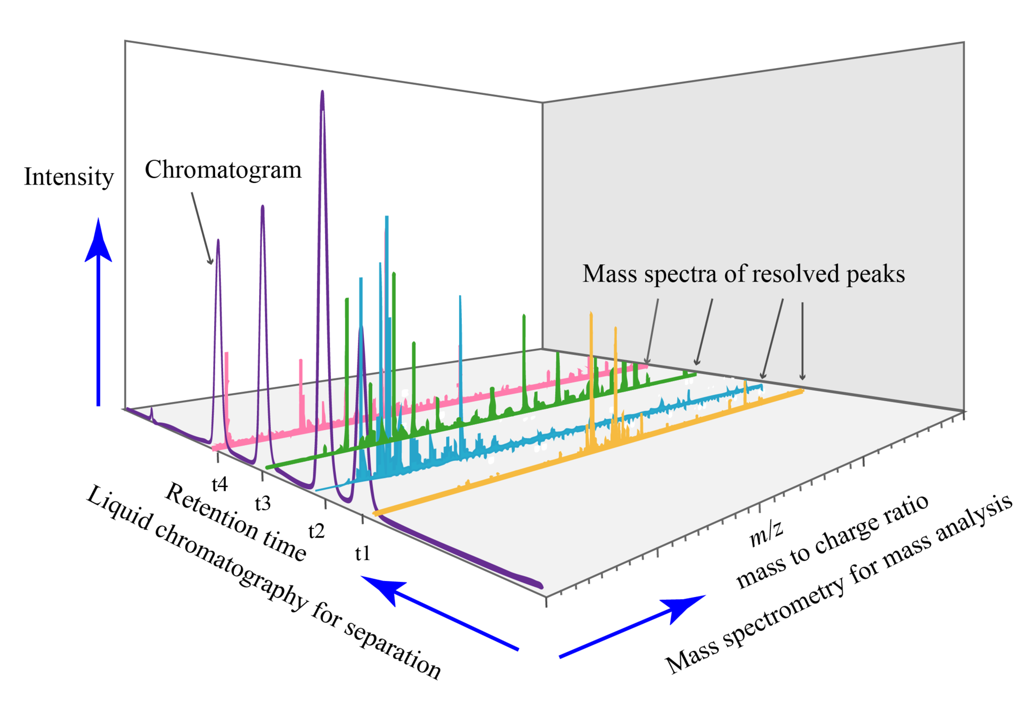
Each LC Fraction Has Its Own Spectra

Slide 26
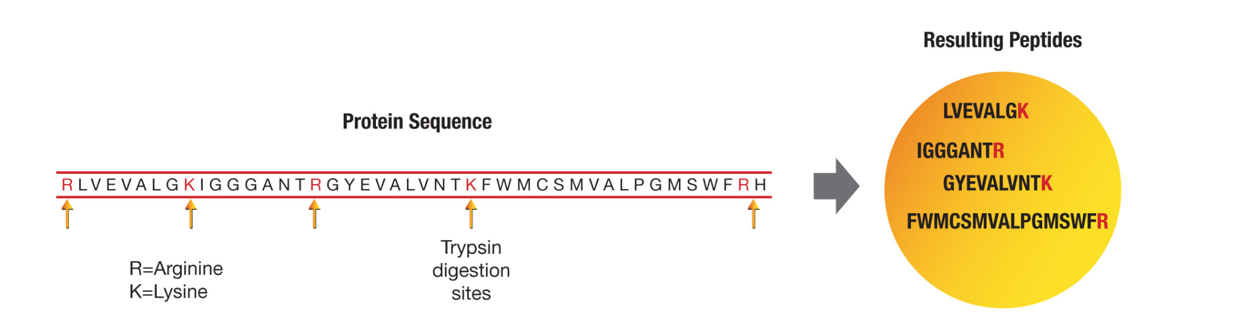
Protein Digestion
Proteins are macromolecules → big!
Measuring entire mass of a protein may not be enough to identify it
Digest into predictable peptides with protease, e.g. trypsin

Slide 27
LC/MS for Proteomics
Sample
LC Column
MS1
Fragment
Peptides
Digestion
Peptide Fragments
Intensity
MS2
Time of Flight (m/z)

Slide 28
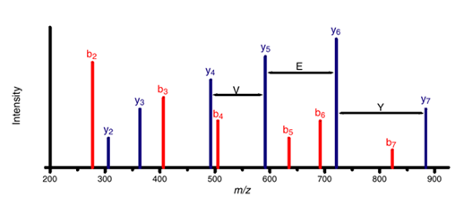
Peptide Identification
Peptide fragmented into constituent components
Each component has a m/z
Sequence of peaks (aka ladder) uniquely identifies originating peptide
Spectral pattern searched in a database of known spectra to identify peptide

Slide 29
Spectra Databases
Many peptide spectral databases available
UniProtKB
Human Proteome Map
PeptideAtlas
Post-Translational Modification databases

Slide 30
Protein Identification
Identify compatible peptides using spectral databases
Peptide 1
Peptide 2
Peptide 3
Identify compatible proteins based on identified peptides + digestion method using genomics+protein databases
Possible proteins

Slide 31
Quantification
Above analysis produces a mapping of peaks → peptides → proteins
Height/AUC of peaks proportional to peptide intensity
Peptide intensity can be mapped to a protein abundance matrix
Analyze/interpret much like e.g. RNA-Seq

Slide 32
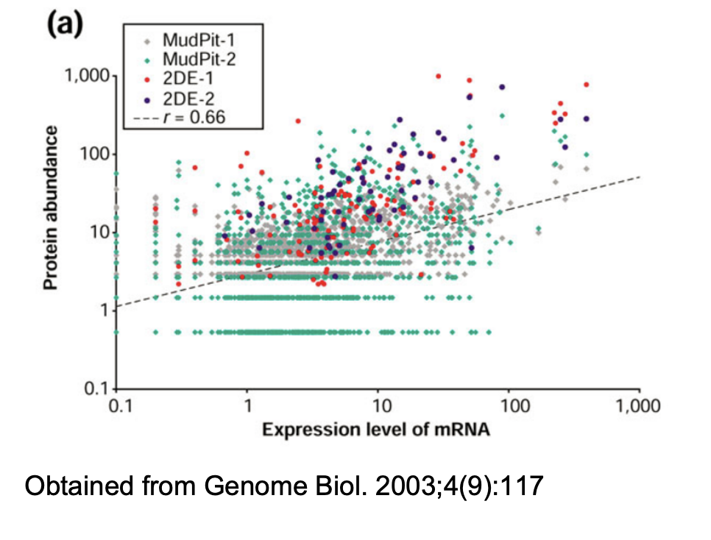
Caveats & Considerations
RNA vs protein abundance are not well correlated

Slide 33
Caveats & Considerations
Proteins can also be post-translationally modified → even more complex!
Spectral databases are incomplete
Some protein families are very complex
  Glycoproteins
Not all important macromolecules are proteins
  Lipids, DNA, metabolites, etc

