Slide 1
BF528 - Submitting
Jobs on SCC

Slide 2
Writing and Executing Scripts
Script: a file that contains a sequence of one or more commands
Shell Script : sh script_name.sh
Rscript : Rscript script_name.R
Python : python script_name.py

Slide 3
Environment configuration and executing jobs
Modules – Used to load applications not automatically loaded by the system, including alternative versions of applications.
Check the available modules
[kkarri@scc4 newdir]$ module avail R
Load a module in current environment
[kkarri@scc4 newdir]$ module load R/3.4.0
Unload a module
[kkarri@scc4 newdir]$ module unload R/3.4.0
To check the version of a tool or software
  [kkarri@scc4 newdir]$ which R

Slide 4
Running Jobs
Job: unit of computation, e.g. execute a single program
Two types of jobs:
Interactive job – running interactive shell: run GUI applications, code debugging, benchmarking of serial and parallel code performance;
Batch job – job command specified in a script and run on a cluster node with no user interaction
Most of your jobs will be batch jobs submitted as qsub scripts

Slide 5
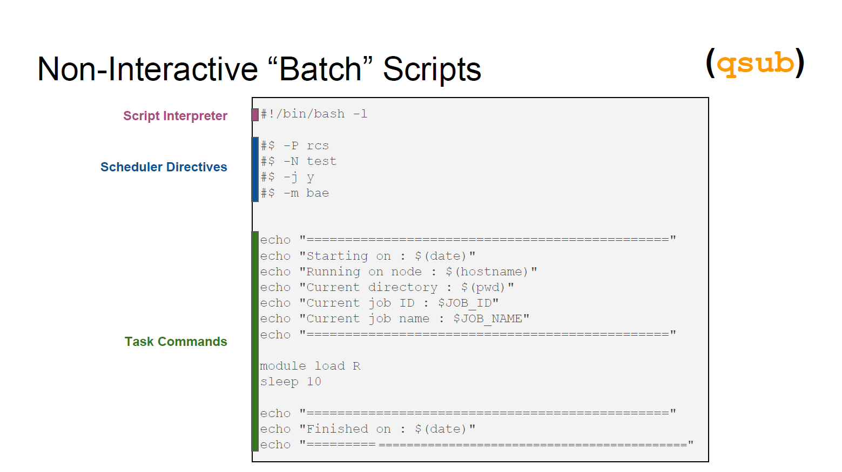
Anatomy of a qsub script

Slide 6
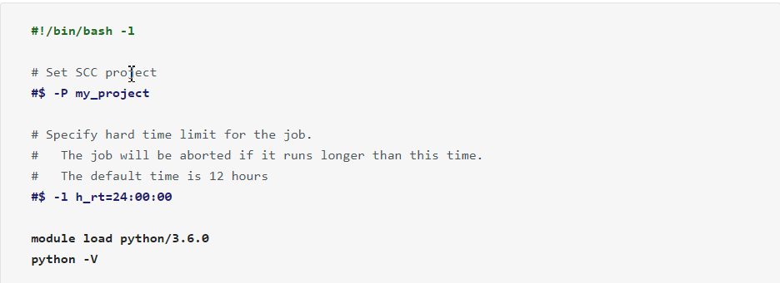
Simple qsub script example
More information available on: http://www.bu.edu/tech/support/research/computing-resources/tech-summary/

Slide 7
Batch Jobs – qsub and qstat
Use the Open Grid Scheduler (OGS) command qsub to submit the compiled program to the batch system:
[kkarri@scc4 stranded]$ qsub -P bf528 stranded_transcriptome.qsub
NB: ‘-P <project name>’ is a required argument!
Check the status of your job with qstat
[kkarri@scc4 stranded]$ qstat -u kkarri
job-ID prior name user state submit/start at queue slots ja-task-ID
---------------------------------------------------------------------------------------------------------------
3987947 0.11135 QLOGIN kkarri r 01/20/2018 11:23:05 linga@scc-ka8.scc.bu.edu 32
3990472 0.11118 new_cuffme kkarri r 01/21/2018 13:09:13 mem512@scc-wj3.scc.bu.edu 28

Slide 8
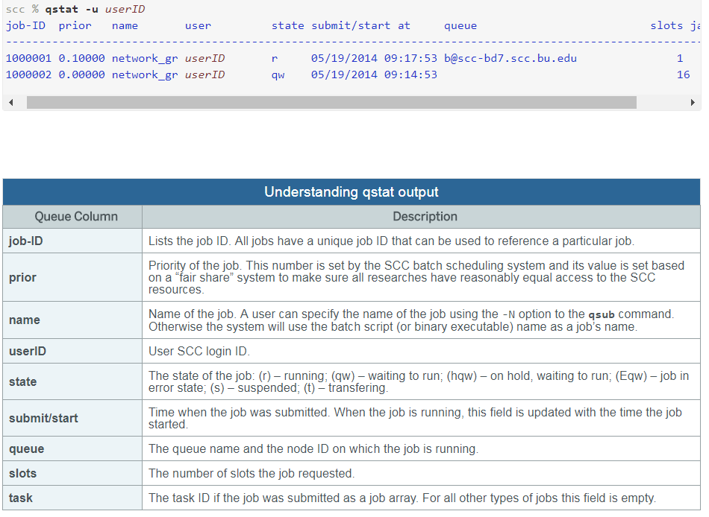
Understanding qstat output

Slide 9
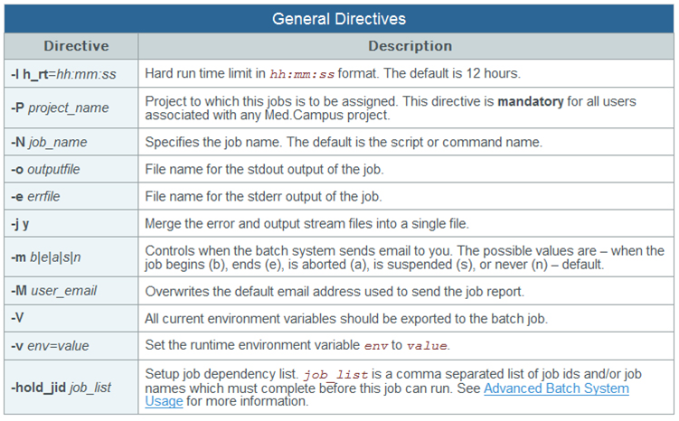

Slide 10
Delete single or multiple jobs
qdel command and Job id can request to delete a job
[kkarri@scc4 newdir]$ qdel 3992851
kkarri has deleted job 3992851
Delete all of your running and queued jobs
[kkarri@scc4 newdir]$ qdel -u kkarri
kkarri has deleted job 3992852
kkarri has deleted job 3992853...

Slide 11
SCC OnDemand Demonstration: qsub

Slide 12
For Next Time
Review the workshop on cluster computing and shell scripting:
Workshop 6. Shell Scripts and Cluster Computing
Group assignments announced next class

