Slide 1
Computational Pipeline Strategies

Slide 2
Characteristics of Bioinformatics Analyses
Many different files involved
Files are often large
Each file analyzed in sequence of steps
Each step can be time consuming/ computationally intensive
Use many different tools, each with analysis-specific parameters

Slide 3

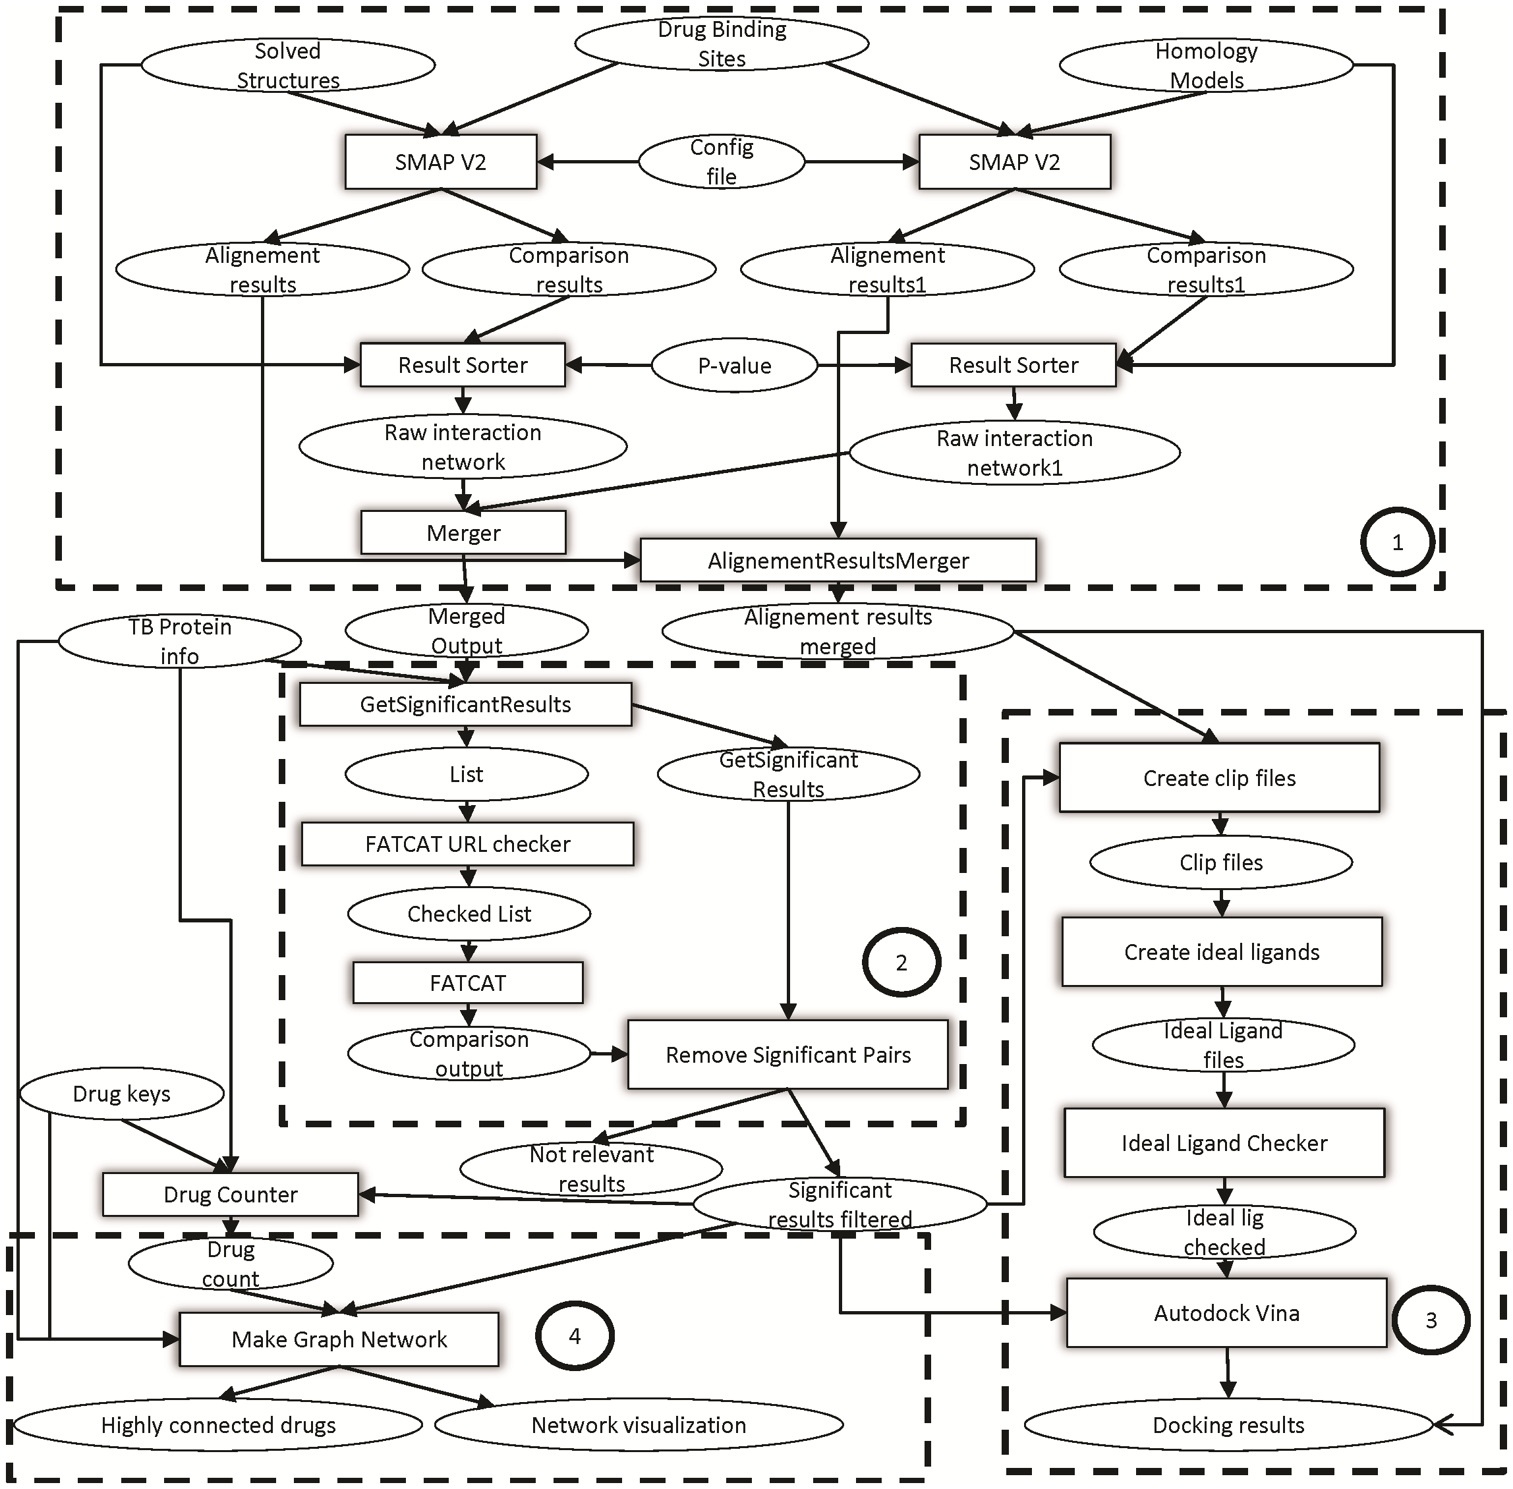
To reproduce the result of a typical computational biology paper requires ~300 hours!

Slide 4
Computational Pipelines
Pipeline or workflow: A serialized set of data processing steps where output from one step is input into the following step
Final
Output
Input
Step 1
Output 1
Step 2
Output 2
Step 3

Slide 5
Example Analysis
Goal: Profile transcriptional landscape of mammalian cardiac regeneration
Steps:
  Perform quality control on FASTQ files
  Adapter- and quality- trim reads
  Align reads to reference genome
  Quantify gene expression
  Identify differentially expressed genes
  Interpret findings

Slide 6
Example Pipeline in Bioinformatics
Trimmomatic
Tophat
Raw Reads
Trimmed
Reads
Count Matrix
Cuff
links
Aligned
Reads
FastQC
Cuff
diff
FastQC
Output
DE
Genes
Summary
Analysis
Final
Output

Slide 7
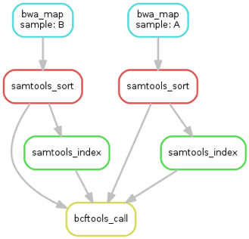
Analysis as a DAG
Analysis is a Directed Acyclic Graph (DAG)
  Deterministic sequence of steps
  Output of step → Input of next
  Computation “flows” down graph, no cycles
Pipelines are an implementation of a DAG

Slide 8
Naive Model
Run all commands on all files manually
User must track:
  All parameters and commands for all steps
  Which steps completed for each file
  Whether a step failed, is file complete?
Onerous for even simple workflows
Impossibly impractical for large numbers of samples!

Slide 9
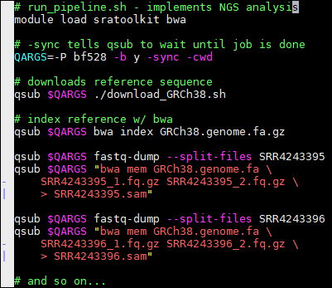
Slightly-Less-Naive Model
Solution:
  Bash scripts
  Parallelize w/ qsub
Single-machine or
cluster command-line
workflows
No easy restart from
Failure
Sometimes expedient for small workflows

Slide 10
Properties of the ideal pipeline system
General purpose: familiar language, can apply to any task
Modular: any language, well-tested components
Scalable: parallelize for free, independent of components
Integrated: metadata, viz, versioning, reporting
Versioned: reproduce from snapshots in time
Idempotent: resume from failure, guarantee outputs

Slide 11
Common Pipeline/Workflow Tools
make | Tool for building software on UNIX-based systems
snakemake | Python-based workflow language & software
Nextflow | Groovy-based, implements dataflow programming model
Airflow | Airbnb/Apache pipeline creator, python-based
SciPipe | GO-based pipeline language

Slide 12
snakemake

Slide 13
Snakemake
Python-based workflow language/software
Based on GNU make
File-based production rules:
  Rule is: input file(s) → transform → output file(s)
Excellent documentation
Implicit parallelism and cluster integration
Includes reproducibility tools
  Shared rule wrappers
  Conda and singularity integration

Slide 14
Snakemake Example: Variant Calling
Starting Data
  Short read sequences in fastq format
  Publicly available genome fasta file
Required Steps:
  Map reads to genome
  Sort and index mapped reads
  Call Variants
Target Output:
  VCF file of found variants

Slide 15
Snakemake Example - bwa index
3. ...on the file data/genome.fa, (assume we have already created it)
rule index:
input: "data/genome.fa"
output: "data/genome_index"
shell:
"bwa index -p genome_index {input}"
1. If we want to create the file
data/genome_index...
2. ...we need to run this command...

Slide 16
Snakemake Example - Mapping
rule bwa_map:
input:
index="data/genome_index",
fq="data/samples/A.fastq"
output:
"mapped_reads/A.bam"
shell:
"bwa mem {input.index} {input.fq} | \
samtools view -Sb - > {output}"
From previous rule, snakemake knows how to make
data/genome_index using data/genome.fa

Slide 17
Snakemake Example - Generalize
rule bwa_map:
input:
index="data/genome_index",
fq="data/samples/{sample}.fastq"
output:
"mapped_reads/{sample}.bam"
shell:
"bwa mem {input.index} {input.fq} | \
samtools view -Sb - > {output}"

Slide 18
Snakemake Example - Sort Alignments
rule samtools_sort:
input:
"mapped_reads/{sample}.bam"
output:
bam="sorted_reads/{sample}.bam",
bai="sorted_reads/{sample}.bam.bai"
shell: """
samtools sort -T \
sorted_reads/{wildcards.sample} \
-O bam {input.bam} > {output}
samtools index {output}
"""
From previous rule, snakemake knows how to make
mapped_reads/{sample}.bam using data/{sample}.fastq

Slide 19
Snakemake Example - Call Variants
SAMPLES = [“A”, “B”]
rule bcftools_call:
input:
fa=”data/genome.fa”,
bam=expand(“sorted_reads/{sample}.bam”,
sample=SAMPLES),
bai=expand(“sorted_reads/{sample}.bam.bai”,
sample=SAMPLES)
output:
"calls/all.vcf"
shell:
"samtools mpileup -g -f {input.fa} {input.bam} |
bcftools call -mv - > {output}"

Slide 20
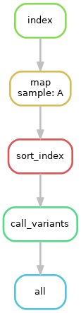
Snakemake Example : One Sample

Slide 21
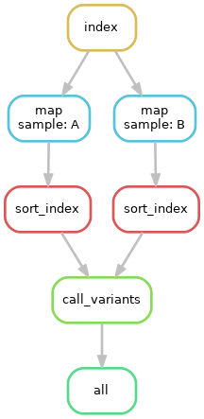
Snakemake Example : Two Samples

Slide 22
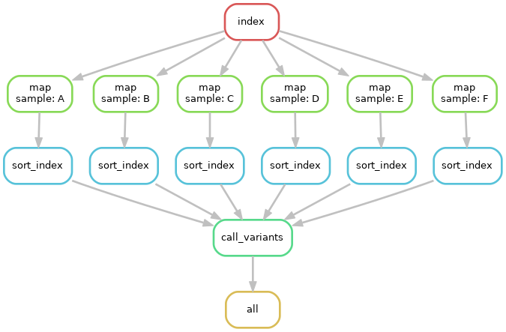
Snakemake Example : Many Samples

Slide 23
Snakemake Alternative: Nextflow
Implements dataflow programming model
Process: Input → transform → output
Processes are connected via “pipes”
Different strategies:
  snakemake: “pull” data by specifying outputs
  Nextflow: “push” data through pipes from input
Each tool has its trade-offs

Slide 24
Nextflow Example
params.in = “$baseDir/data/sample.fa”
/*
* split a fasta file in multiple files
*/
process splitSequences {
input:
path 'input.fa' from params.in
output:
path 'seq_*' into records
"""
awk '/^>/{f="seq_"++d} {print > f}' < input.fa
"""
}
/*
* Simple reverse the sequences
*/
process reverse {
input:
path x from records
output:
stdout into result
"""
cat $x | rev
"""
}

Slide 25
Summary
Workflow management software is indispensable:
  Simplifies analyzing many files in the same way
  Seamlessly runs code locally or on a cluster
  Documents your analysis - reproducible!
  Learn how to use it!
Many different workflow/pipeline tools
  No one is best, each has strengths/weaknesses
  Pick which one you like

