Slide 1
ChIP-seq analysis

Slide 2
Acknowledgements
Much of the content of this lecture is from:
Furey (2012) – ChIP-seq and beyond
Park (2009) – ChIP-seq – advantages + challenges
Landt et al. (2012) – ChIP-seq guidelines + practices
Notes:
Oldies but goodies

Slide 3
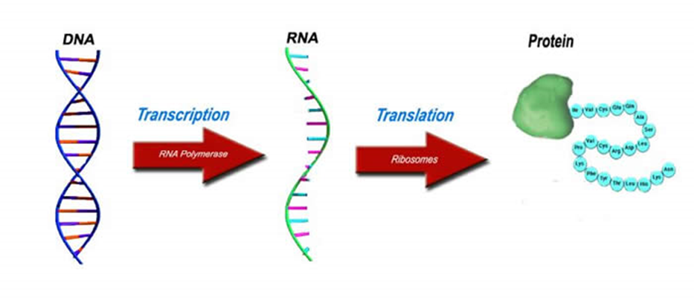
Central Dogma of Biology
Some proteins can bind DNA to influence how genes are expressed

Slide 4
ChIP-seq
Chromatin immunoprecipitation followed by high-throughput sequencing
Assays the genome-wide locations of a single protein (bound to DNA) or a single histone modification

Slide 5
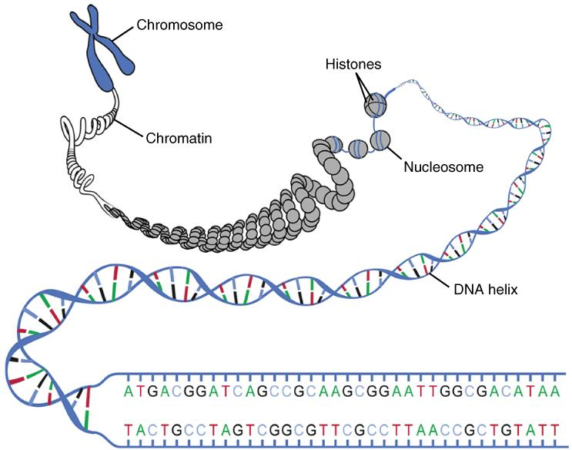
What is chromatin?
Complex of macromolecules (DNA, protein, RNA)
Packages DNA into compact shape
Prevents DNA damage
Controls gene expression, DNA replication
Notes:
Here is the complete scale from chromosome to individual nucleotides

Slide 6
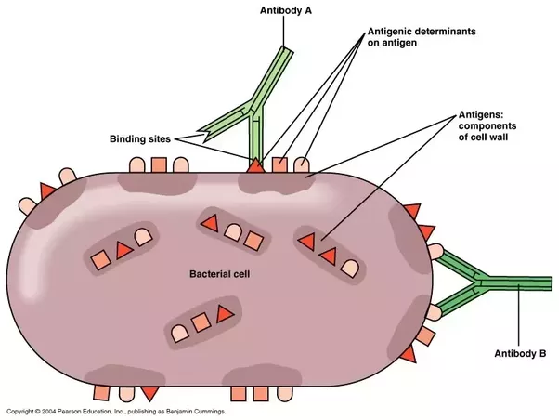
What is immunoprecipitation?
Antibodies are used to immunoprecipitate proteins
Antibodies bind in a (mostly) specific way to their antigen
Used by the immune system to neutralize pathogens
ChIP-seq uses antibodies raised against proteins
Notes:
Here is the complete scale from chromosome to individual nucleotides

Slide 7
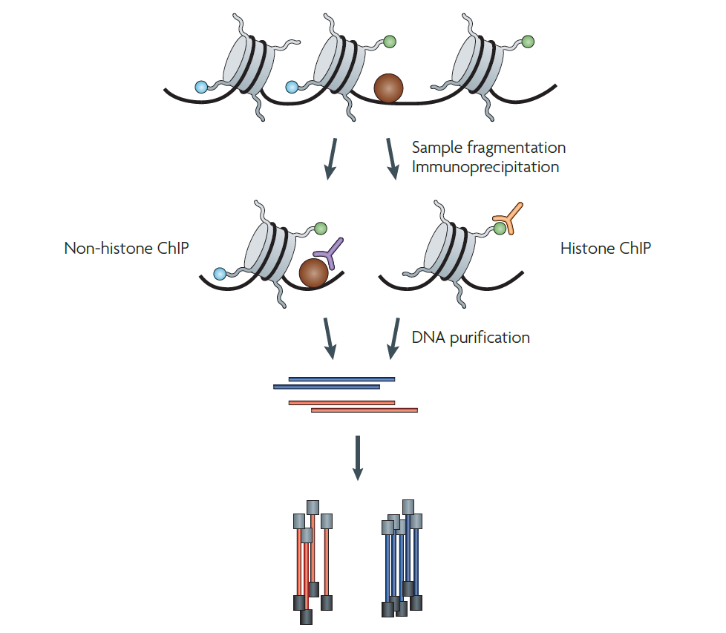
ChIP-seq protocol (very brief)
crosslink
GOAL:
Determine genomic DNA associated with a given protein or histone modification
(reverse crosslink)
Library prep +
sequencing
Notes:
Using antibodies raised against a protein or histone modification of interest, you can isolate

Slide 8
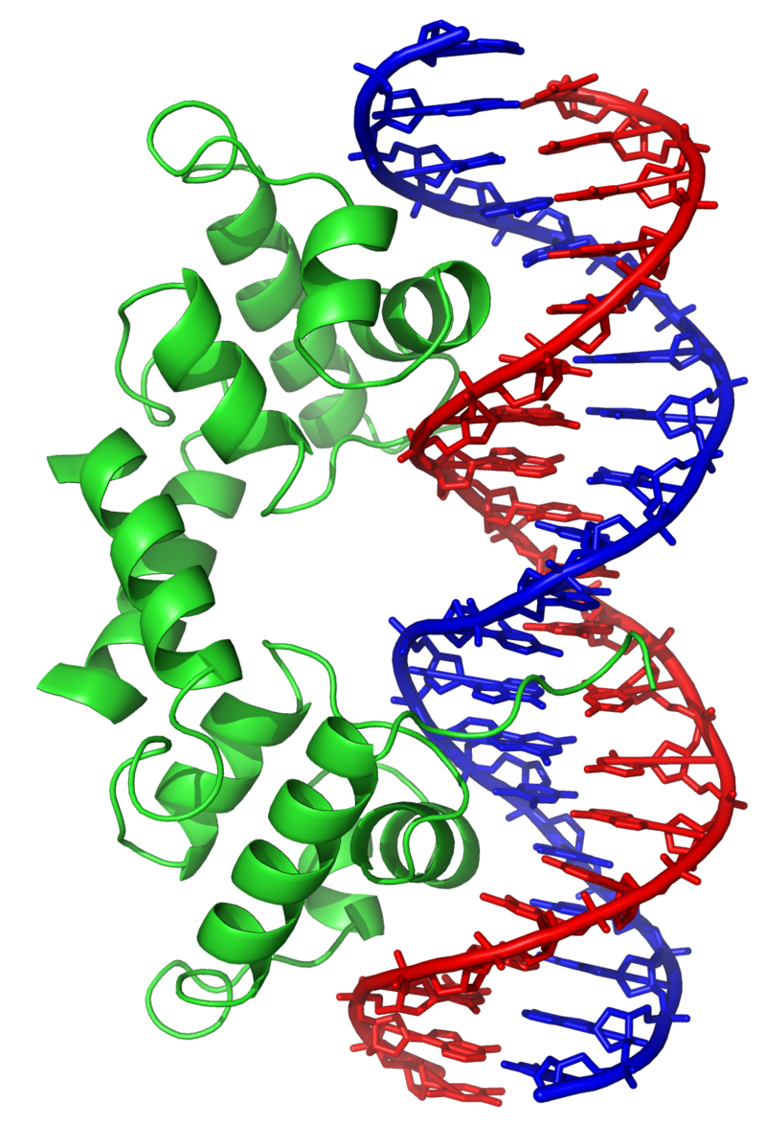
Why study protein binding to DNA?
Transcription factors (TFs) affect how genes are regulated
DNA binding proteins (such as CTCF and cohesin) regulate the 3D structure of DNA
Notes:
CTCF and cohesion facilitate formation of chromatin loops which brings
ChIP-seq can be used therefore to study both the structure of DNA and how the information encoded in DNA is regulated

Slide 9
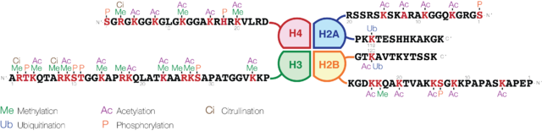
Why study histone modifications?
Combinations of chemical modifications to the histone tails correlate with regulatory activities
Referred to as the “histone code”
Notes:
Shown here are 4 of the components of a histone octamer. The full octamer has 2 sets of these. The full octamer is what DNA coils around to create a nucleosome. The nucleosomes are packed together to form chromatin

Slide 10
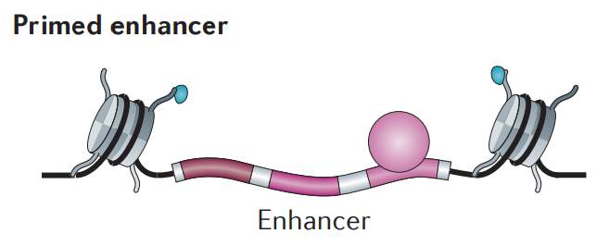
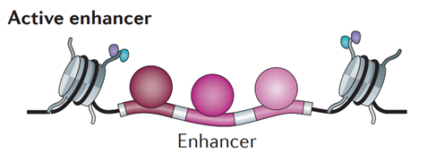



Integration of protein and histone ChIP-seq
ChIP-seq assays only 1 thing at a time
Integration of several proteins and histone modifications provides more insight
Notes:
More on this in integrative genomics

Slide 11
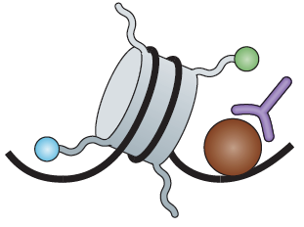
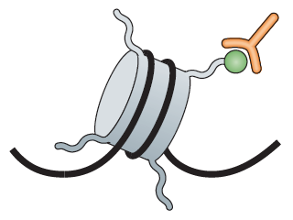
Research Questions
Protein
Histone mods
DNA motif discovery – Which DNA sequences does my protein like to bind to OR which binding sequences correlate with a histone modification?
Conserved/differential protein binding OR histone modification across conditions (time points, cell types, species, treatments)
Genes (and gene sets) under regulation by a given protein or histone modification

Slide 12
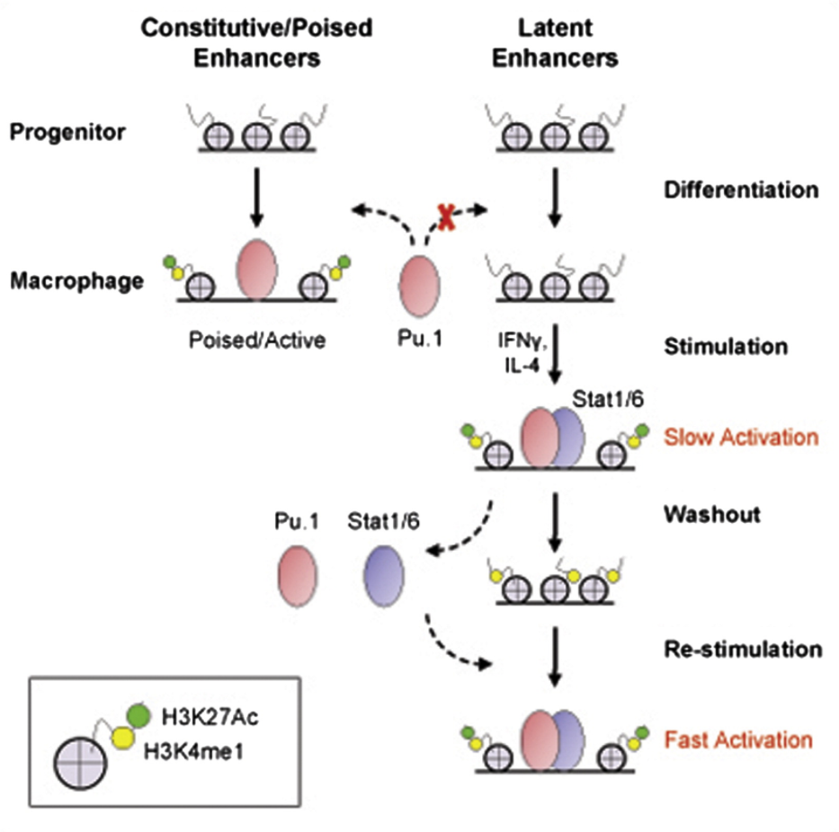
ChIP-seq study example
Ostuni et al. (2013)
Enhancer repertoire expanded during immune response
Enhancers did not return to original state post-stimulus (epigenetic memory)
Response upon restimulation was stronger and faster
Notes:
There will not be a project on ChIP-seq so really you will only encounter it again if you work at a company/lab that does this kind of stuff
Here’s a couple examples of studies that used mostly ChIP-seq results
115 TOTAL CHIP-SEQ EXPERIMENTS FROM THIS STUDY ALONE UPLOADED TO GEO

Slide 13
ChIP-seq Analysis Methods

Slide 14
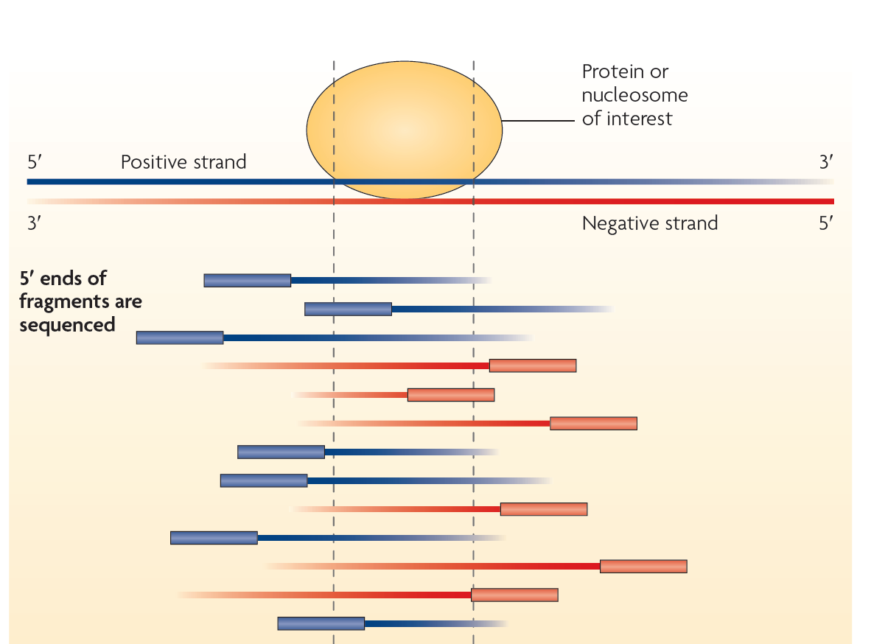
Preliminary Analysis Goal
Define where your protein is binding or where histone modifications are occurring
Inferred on a reference genome based on short reads
Notes:
Fragment size is determined by beads and is typically a distribution. Minimum you can select for is about 200bp (I think?) through beads. You end up with a distribution that is typically ~250-300bp

Slide 15
RNA-Seq vs ChIP-Seq: A key difference
RNA-seq can use same gene annotation for each experiment
Proteins can bind anywhere in the genome
ChIP-seq features are experiment-specific
Define features (called peaks) as part of the analysis pipeline
RNA-seq
Gene 1
Gene 2
Sample 1
5
2
Sample 2
9
3
Sample 3
0
6
ChIP-Seq
Sample 1
Sample 2
Sample 3

Slide 16
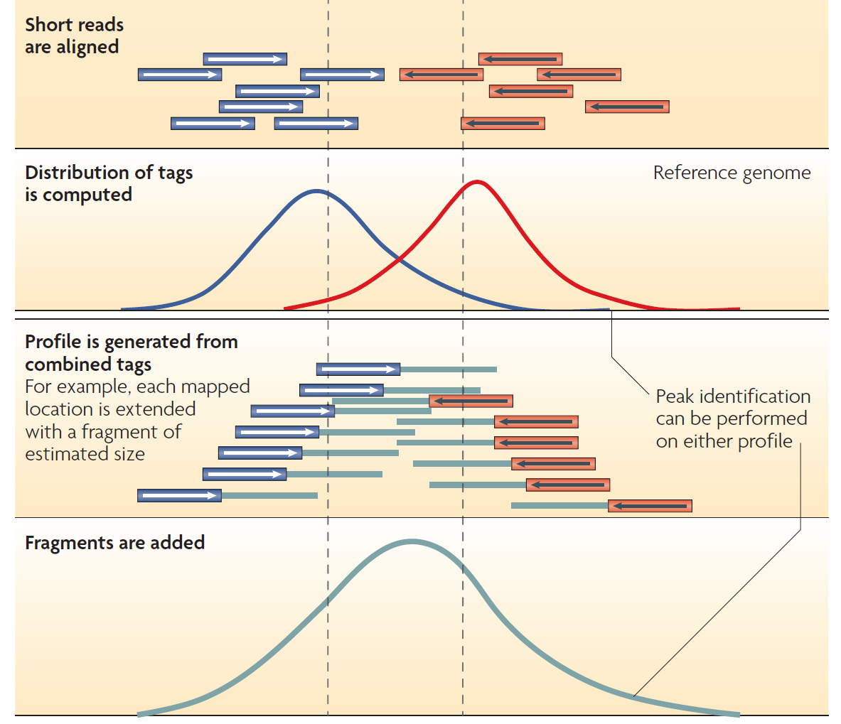
Defining ChIP-seq peaks
Peaks are areas where read mapping is enriched compared to a control experiment
Software exists to automate peak finding
Popular programs include MACS2, GEM, HOMER, SPP
Notes:
Anyone want to hazard a guess as to why the distributions aren’t the same for the + and – strand? Peaks usually end up being a bit bigger than your fragment size (about ~350bp for a point source TF) but this of course will depend on the software you use. If using HOMER for example, the program enforces the same peak length for each peak centering around the summit. MACS allows for more dynamic peak lengths

Slide 17
Controls for ChIP-seq
Input DNA : A portion of DNA sample removed before immunoprecipitation
Mock IP : DNA obtained from a fake IP performed without antibodies
IgG : DNA from a non-specific IP using antibody against protein not involved in DNA binding
Usually 1 is performed and most common is input which accounts for technical biases

Slide 18
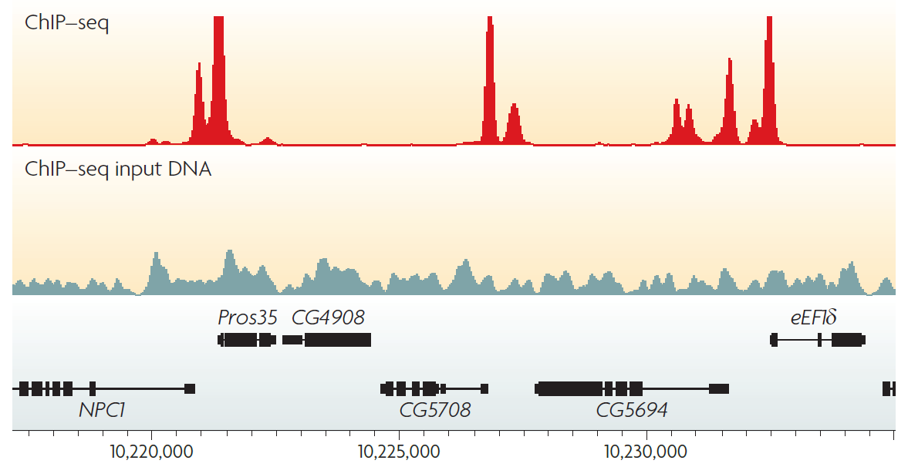
ChIP-seq vs. input DNA
Input allows for correcting bias in variable solubility, shearing, and amplification during experiments

Slide 19
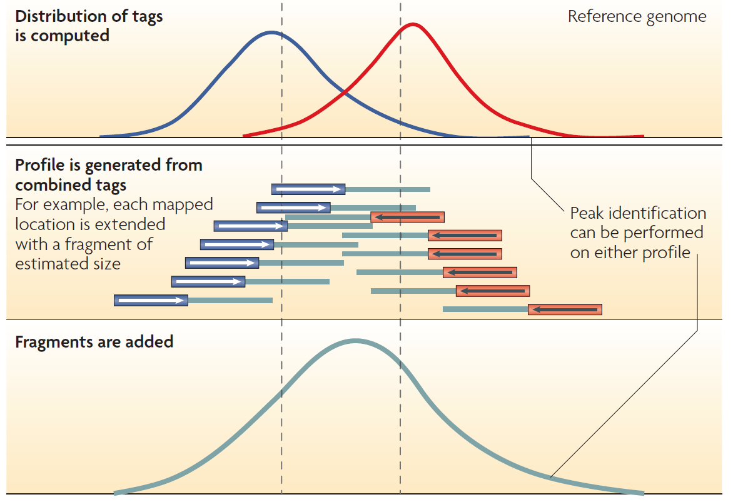
How does a peak caller work?
Walks along the genome to identify enriched regions
Estimates fragment size to extend reads into profile

Slide 20


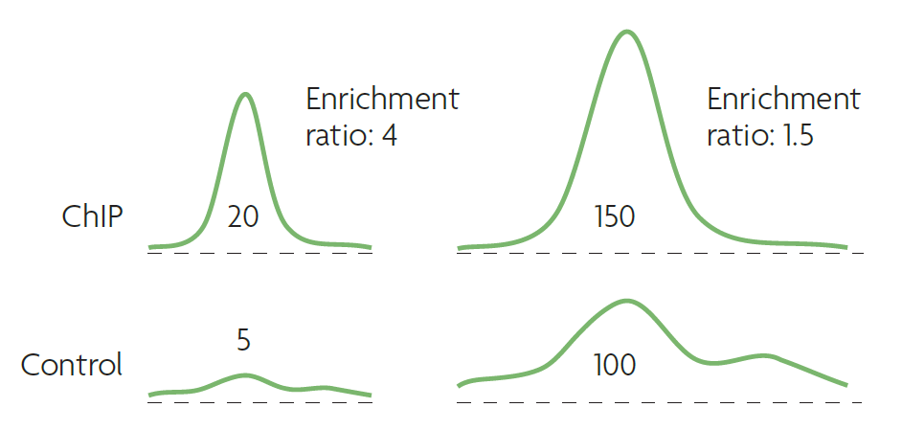
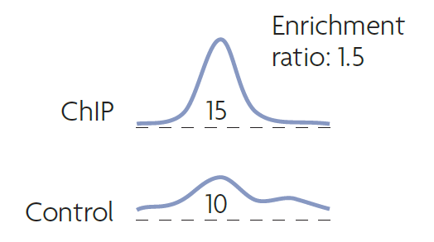
Scoring peaks (general example)
Poisson model for tag distribution accounts for ratio as well as absolute tag number
Notes:
This is just a rough example and is not meant to say that small effect sizes between ChIP and control conditions are never significant. This will depend on the individual experiments. Imagine in the case of the blue sample, the control can go higher locally which is kind of a good transition into why correcting for multiple hypothesis testing is important. This is also where analyzing replicates can be applied as well. If these low signal events appear across distinct cell populations for a given type/condition (termed biological replicate) at a similar enrichment ratio across your replicate populations, you might infer that this is actually a real binding event. IDR (irreproducible discovery rate) is a strategy that reports some of these low signal events if they can be replicated

Slide 21
Significance of a Peak
Statistical significance formally measured using false discovery rate (FDR)
FDR is expected proportion of incorrectly identified sites among those found to be significant
Can be measured by swapping input with ChIP sample and identifying false peaks
The q value of a peak is the minimum FDR at which the peak is deemed significant
Analogous to p value for a single hypothesis test

Slide 22
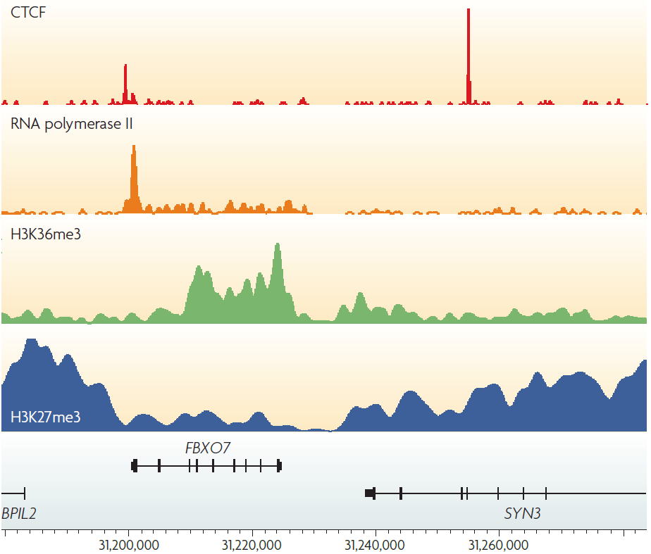
Peak calling for TF vs. histone mark
Histone ChIP-seq produces much broader regions of enrichment
Peak callers usually have a “histone” option or set of “broad” parameters if needed
Notes:
Models and strategies used to call peaks on histone marks are completely different from those for sequence-specific transcription factors
Breakdown of H3K27me3: H3 family of histones, K is the abbreviation for lysine (the amino acid), 27 is the position of the aa residue counting from the N-terminus, me is a methyl group, and 3 is the number of methyl groups added. It has to do with downregulation of nearby gene expression and is broadly associated with heterochromatin regions (heterochromatin is the densely packed type of chromatin).

Slide 23
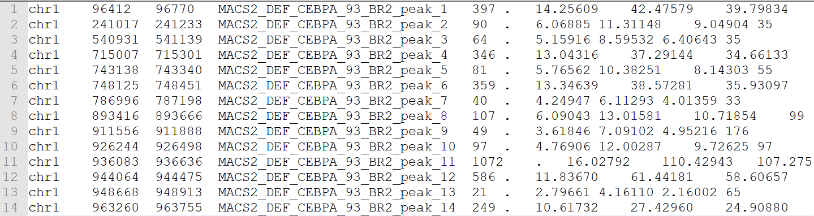
Output from peak calling
Took a while to get here…
List of genomic loci where either your protein is bound OR your histone is modified) – usually BED format
Peak numbers vary wildly by protein, organism, etc.
Notes:
Also by library size, antibody and pull down efficiency, etc.

Slide 24
Typical analysis workflow
MACS2
HOMER
GEM
Bowtie2
BWA
ChIP
Short reads
Mapped reads
Peaks
Input
Short reads
Mapped reads
FASTQ
FASTA
SAM
BAM
BED
Notes:
In theory, given a data set in any of the above formats, you can jump in where appropriate

Slide 25
Functional Characterization
Notes:
The output from the previous step gives you a list of genomic coordinates/ranges and some associated information for each.

Slide 26
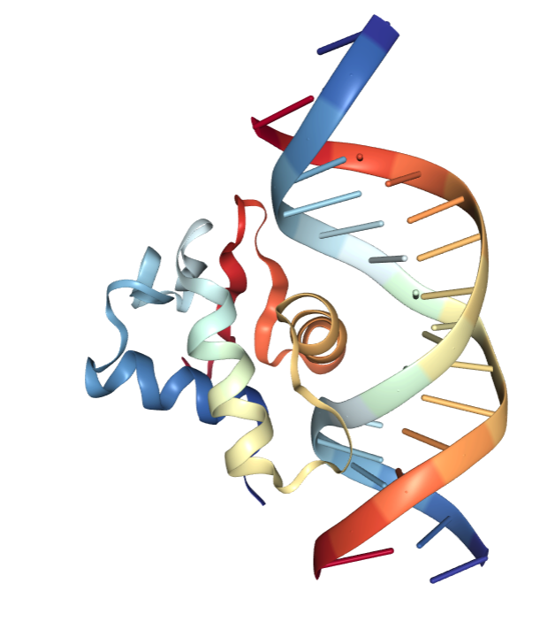
Where and how is my protein binding?
Peaks are areas where read mapping is enriched compared to a control experiment (~300bp)
Actual binding sites (for proteins) are 8-12bp
Binding site can be inferred using motifs and motif analysis
Notes:
Information content is a bit of a weird concept (especially if you don’t really care about DNA binding motif). The gist is that 2 bits is the maximum because you can figure out which base is there by asking a maximum of 2 questions: “Is it a pyrimidine?” if yes, you can ask “Is it T?”. Regardless of the answers, you figure out the base. The y-axis is actually the maximal information possible – actual information. So that big is essentially always there. We don’t need to ask any questions to figure out what’s there (0). 2-0 is 2 which is why those letters are so big. Think of the height of the stack as conservation at that position. For the smaller stacks, we are not quite sure what’s there but we know the proportions.

Slide 27
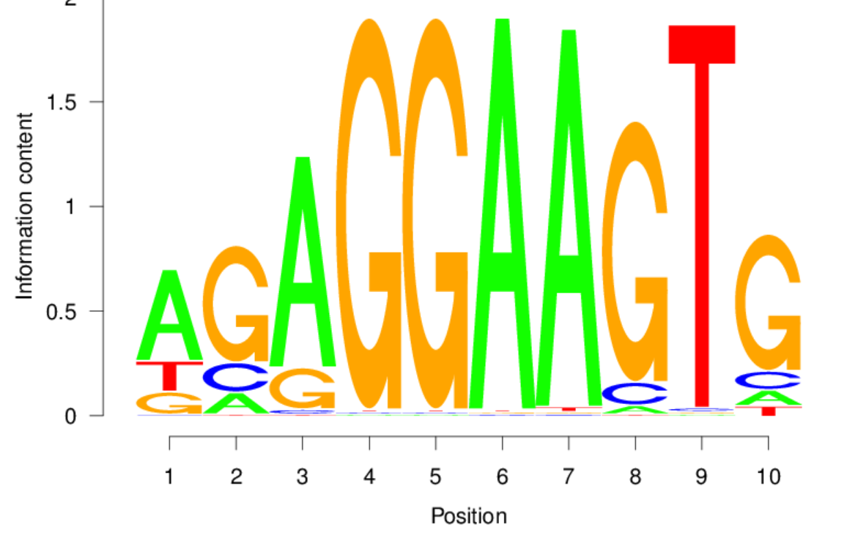
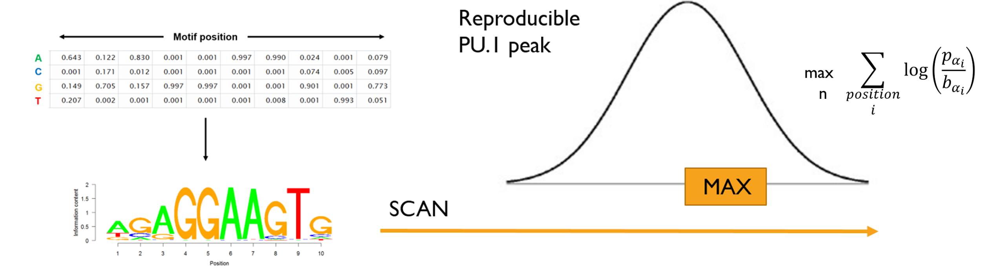
What is a DNA-binding motif?
Notes:
Information content is a bit of a weird concept (especially if you don’t really care about DNA binding motif). The gist is that 2 bits is the maximum because you can figure out which base is there by asking a maximum of 2 questions: “Is it a pyrimidine?” if yes, you can ask “Is it T?”. Regardless of the answers, you figure out the base. The y-axis is actually the maximal information possible – actual information. So that big is essentially always there. We don’t need to ask any questions to figure out what’s there (0). 2-0 is 2 which is why those letters are so big. Think of the height of the stack as conservation at that position. For the smaller stacks, we are not quite sure what’s there but we know the proportions.

Slide 28
Motif scanning (scoring)
“Scan” for binding sites using probability model
Ask at each position in peak “how likely is it that this is a binding site and not some random sequence?”
Motif occurrences typically are located near peak summits
Notes:
Note: there’s a directionality to scanning. Usually done 5’ to 3’ so you have to scan the reverse complement as well

Slide 29
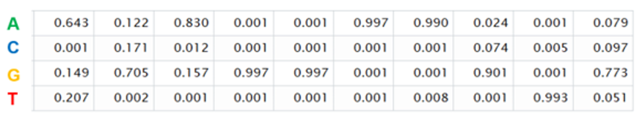
Motif scoring example
How likely is it that this is a binding site and not some random sequence?
T
G
G
G
G
A
A
G
T
G
Pr (binding site) = 0.207 x 0.705 x 0.830 …
Pr (random seq) = 0.250 x 0.250 x 0.250 …
Notes:
You arrive at a sequence that looks like this
Dividing top by bottom gives you a likelihood ratio
The log version of the formula in previous slide just allows you to add ratios instead of multiply them (easier for computers to do)
In practice you don’t really have to worry about all this. Programs will do this for you
Significance is kind of baked into the likelihood ratio threshold you’re using

Slide 30
What if I don’t know the binding site?
2 general approaches:
Motif enrichment analysis: Scan a library of known motifs against your peaks (and a background) to determine which motifs are most enriched
De novo motif finding: learns new motifs using expectation/maximization (MEME) or k-mer based approaches (HOMER)
If chipping a protein previously done, both motif analyses should yield similar results

Slide 31
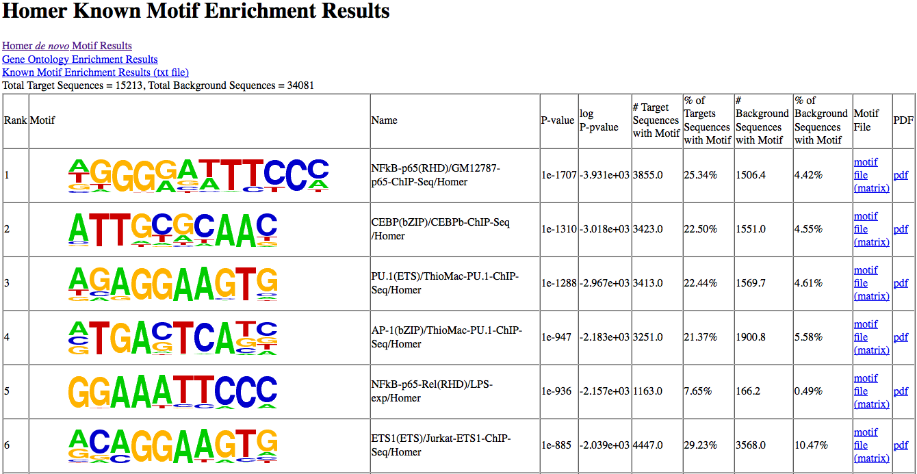
Example Homer report (enrichment)

Slide 32
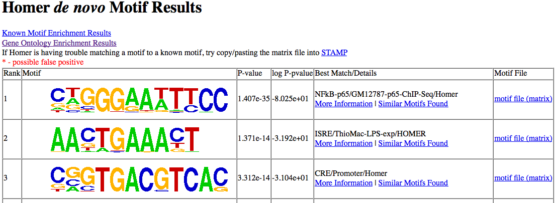
Example Homer report (de novo)

Slide 33
What is my protein doing?
Integration with RNA-seq data – You can do pathway/ontology EA using nearest gene (careful!)
Differential binding – Very similar to RNA-seq (even uses the same software – genomic loci instead of genes)
  DESeq2, DiffBind, etc.
Integration with other ChIP-seq experiments – Does my protein bind enhancers? Repressed regions? Co-bind with other proteins?
  Will talk more about these in integrative genomics
Notes:
Differential binding: can be across time-points, conditions, etc.

