Slide 1
Sequence Analysis - RNA-Seq 1

Slide 2
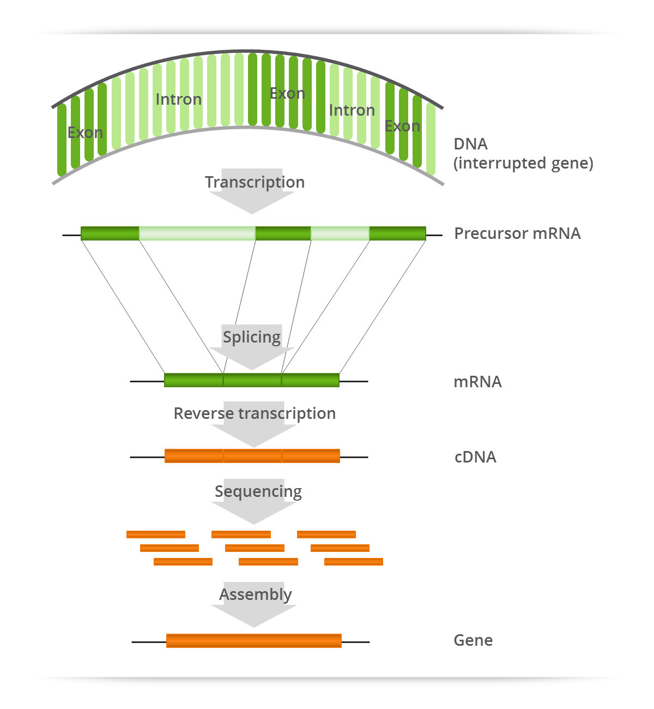
The Transcriptome
Complete set of RNA
transcripts in the cell
Many types of RNA, e.g.:
  mRNA
  lincRNA
  Anti-sense
  rRNA
  Small molecules:
    tRNA, snoRNA, miRNA, piRNA, etc

Slide 3
Transcriptome Studies
From abundance
Gene expression
Transcriptional regulatory networks
Biological pathway discovery
From sequence
Alternative splicing
Amino acid sequence
Fusion transcripts
RNA editing
Gene discovery
Coding variants

Slide 4
RNA-Seq
Identify sequence of RNA molecules
“Unbiased” - possible to sequence any molecule in sample
Molecules sequenced in proportion to relative abundance in sample
Most often used for gene abundance estimation

Slide 5
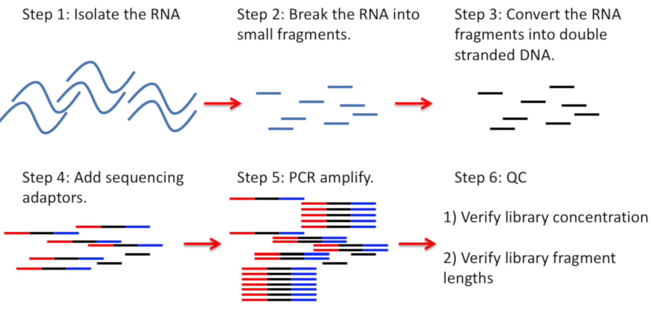
RNA-Seq Library Construction

Slide 6
Design Choices & Considerations
Single vs paired end
Read length
Ribosomal Depletion Strategy
Fragment length
RNA Integrity
Stranded vs Unstranded
Library size
Multiplexing

Slide 7
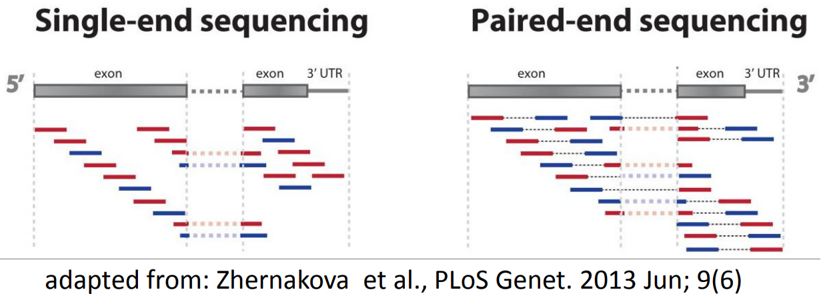
Design Choice: Single vs Paired End
Single end vs paired end
  2x more distinct molecules sequenced
  Harder to find reads spanning splice junctions
For RNA-Seq, use paired end

Slide 8
Design Choice: Read Length
Read length determines mappability
Longer reads:
  more unique sequence → more uniquely mappable
  more likely to span splice junction
Shorter paired reads better than longer single end (why?)
2 x 75bp enough for hg, 2 x 150bp overkill

Slide 9
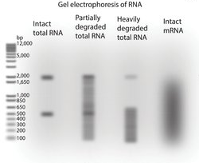
Design Choice: poly-A or Ribo-depletion
~95% of RNA in cell is ribosomal RNA
5S, 5.8S, 18S, 28S in humans
Two removal strategies:
  poly-A selection (positive)
    poly-A capture
    Only poly-A transcripts (mRNA)
  Ribo-depletion (negative)
    Probe-based rRNA capture
    Leaves all other RNA sequence

Slide 10
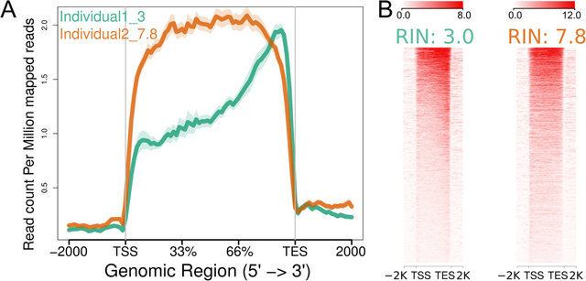
Removing rRNA: poly-A
poly-A (mRNA-Seq)
Enriched for mRNA (protein coding)
Little pre-mRNA/ lincRNA/etc
👍Splicing analysis
👎Sensitive to low RIN
👎3’ degradation bias
https://bmcgenomics.biomedcentral.com/articles/10.1186/1471-2164-15-284

Slide 11
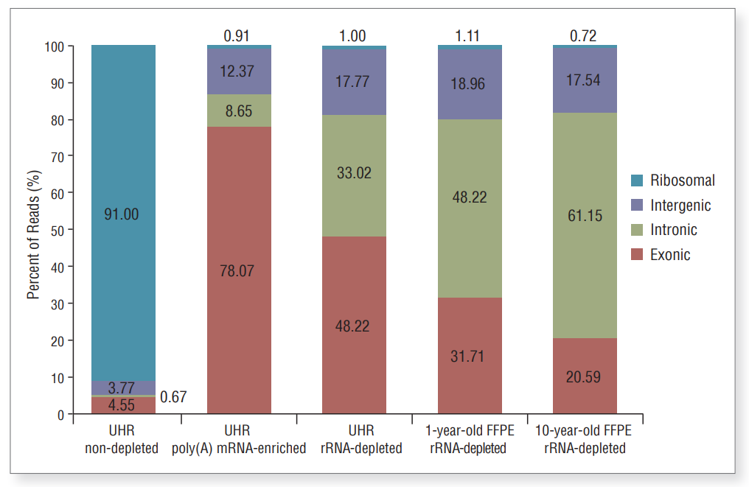
Removing rRNA: Ribo-depletion
Ribo-depletion (RNA-Seq)
Removes rRNA with probes
👍Diverse RNA sequences
Relatively less protein coding
Little to no 3’ bias
Fewer spliced/exonic reads
👍Effective for degraded RNA
👎Harder to interpret protein effects
https://www.neb.com/-/media/catalog/application-notes/selective-depletion-of-abundant-rnas-to-enable-transcriptome-e6310.pdf?rev=214e1d46d2834c12876fa0867ea5197d

Slide 12
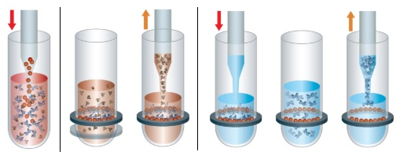
Large RNA Size Selection
Gel cut (old method):
  Size select with gel electrophoresis
  Fragment size distribution may indicate RNA quality
  Select ~300nt fragments by gel cut
SPRI Beads (current method)
https://www.researchgate.net/publication/280870031_Informatics_for_RNA_Sequencing_A_Web_Resource_for_Analysis_on_the_Cloud/figures?lo=1

Slide 13
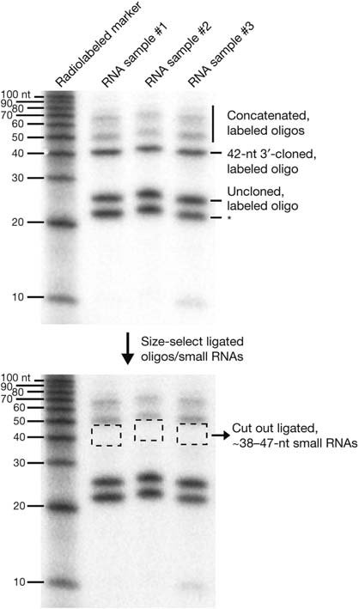
Small RNA Size Selection
https://www.researchgate.net/publication/231742684_Preparation_of_Small_RNA_Libraries_for_High-Throughput_Sequencing/figures

Slide 14
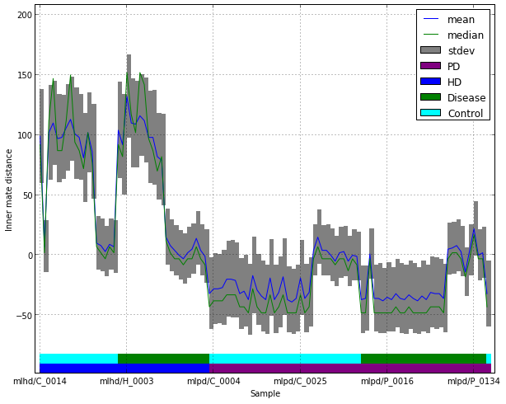
Batch effect: Fragment Length Distribution
Inner mate distance: unsequenced length between read pair
Inner Mate Distance
RNA Fragment (300nt)
Read 1 (100nt)
100nt
Read 2 (100nt)
RNA Fragment (150nt)
Read 1 (100nt)
Read 2 (100nt)
-50nt

Slide 15
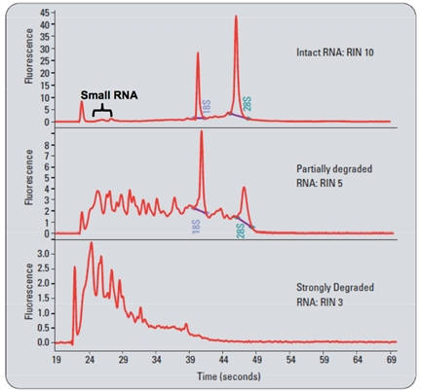
Design Consideration: RIN
RNA Integrity Number
Measurement of RNA quality
10 - best, 0 - worst
Transcripts
  degrade 5’ → 3’
  At different rates!
Rules of thumb
  >8 👍
  6-8 is ok if necessary
  3-6 is ok only if very necessary
  <3 👎
https://infravec2.eu/rna_seq/

Slide 16
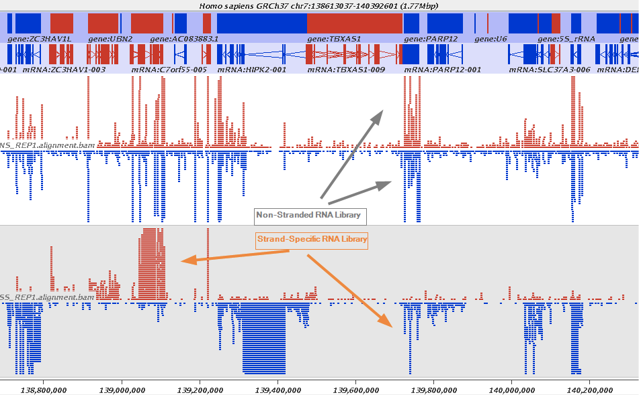
Design Choice: Stranded vs Unstranded
Stranded libraries maintain strand of molecule in reads
Unstranded do not
Important to resolve:
  Bi-directional transcription
  Anti-sense transcripts
  Overlapping genes
Modern RNA-Seq library prep kits are stranded

Slide 17
Design Choice: Library Size & Multiplexing
Library size: # of reads per sample
Depending on who you ask, a read is:
  A RNA fragment (same for single/paired end)
  One FASTQ record (not same for single/paired end)
Library size is target, # reads will vary
Rules of thumb for human transcriptome:
  poly-A: 30M for expression, 80M alternative splicing
  ribo: 50M for expression, 100M alternative splicing

Slide 18
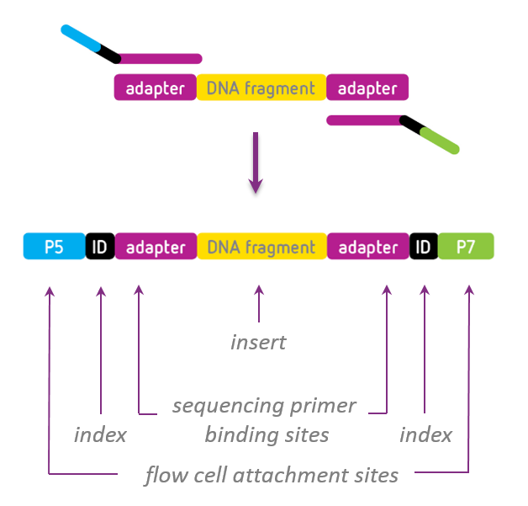
Design Choice: Multiplexing
Add unique barcode (index) to each sample library
Multiplexed samples pooled and sequenced together → avoid lane batch effects
Data will usually be demultiplexed for you

Slide 19
Design Choices & Recommendations
Fragment length: ~300nt (large RNA)
RNA Integrity: >8👍, >6 ok, >3 if need be
Ribosomal Depletion Strategy: depends
Single vs paired end: paired
Read length: 2 x 75bp
Stranded vs Unstranded: stranded
Library size: poly-A 30-80M, ribo 50-100M
Multiplexing

