Slide 1
BF528 - Whole Genome Sequencing and
Genomic Variation

Slide 2
Whole Genome/Exome Sequencing

Slide 3
Whole Genome Sequencing
Whole Genome Sequencing (WGS)
Generate enough reads to attain:
  >95% coverage of source genome
  >30x average depth
Two strategies:
  De novo: assemble reads into a new sequence
  Re-sequence: refine an existing reference sequence

Slide 4
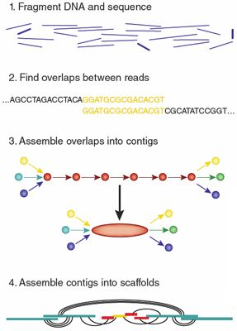
De novo assembly
Genome Assembly - Create new reference ‘from scratch’
Examine reads for overlapping sequence
Contig - longer assembled sequence from short reads
Scaffold - assembled contigs
Chromosome - assembled scaffolds
Assembly from short reads is hard
Michael Schatz, Cold Spring Harbor

Slide 5
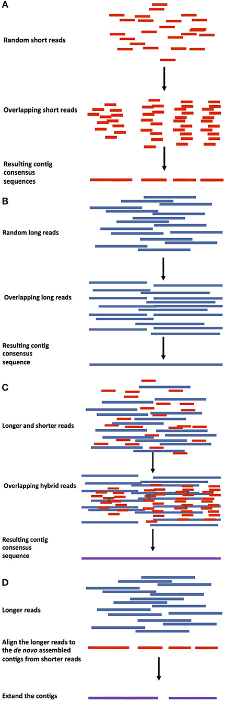
De novo assembly: greedy algorithm
Kyriakidou, Maria, Helen H. Tai, Noelle L. Anglin, David Ellis, and Martina V. Strömvik. 2018. “Current Strategies of Polyploid Plant Genome Sequence Assembly.” Frontiers in Plant Science 9 (November): 1660.

Slide 6
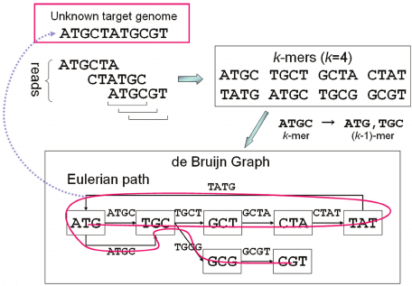
De novo assembly: graph-based
Greedy assembly creates linear sequences
Vulnerable to finding local optima
Graph representation considers all sequence content simultaneously
Graph data structure can encode variability (e.g. insertions, SNPs)
Computationally much more expensive

Slide 7
Reference guided genome assembly
Refine existing reference with new sequence
Can discover:
  New structural variants
  Novel insertions/alternate haplotypes or scaffolds
  Polymorphisms
Faster, easier than de novo assembly
More sensitive to existing biases in reference

Slide 8
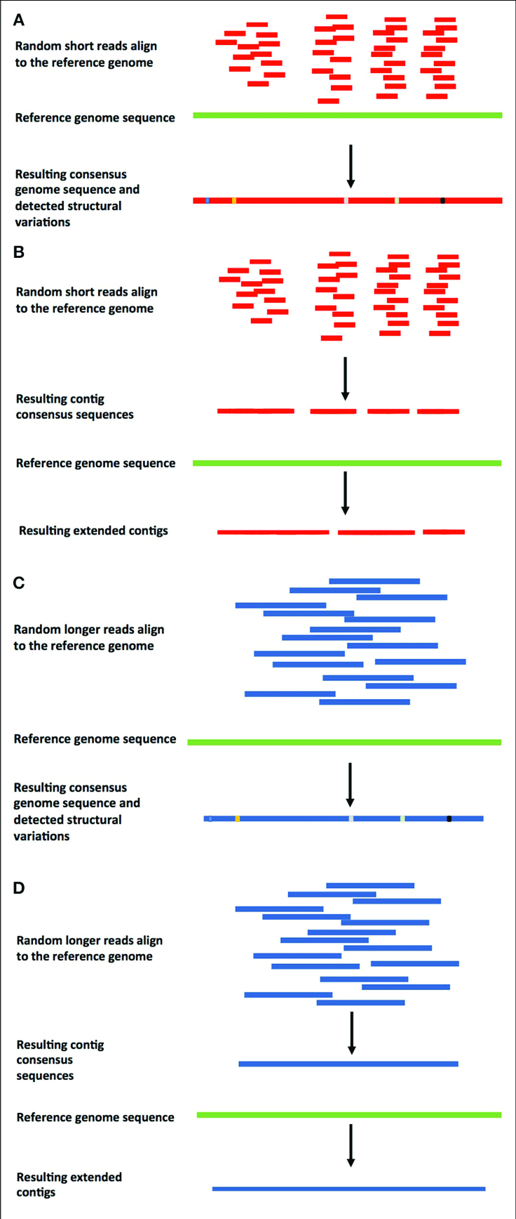
Reference guided genome assembly
Kyriakidou, Maria, Helen H. Tai, Noelle L. Anglin, David Ellis, and Martina V. Strömvik. 2018. “Current Strategies of Polyploid Plant Genome Sequence Assembly.” Frontiers in Plant Science 9 (November): 1660.

Slide 9
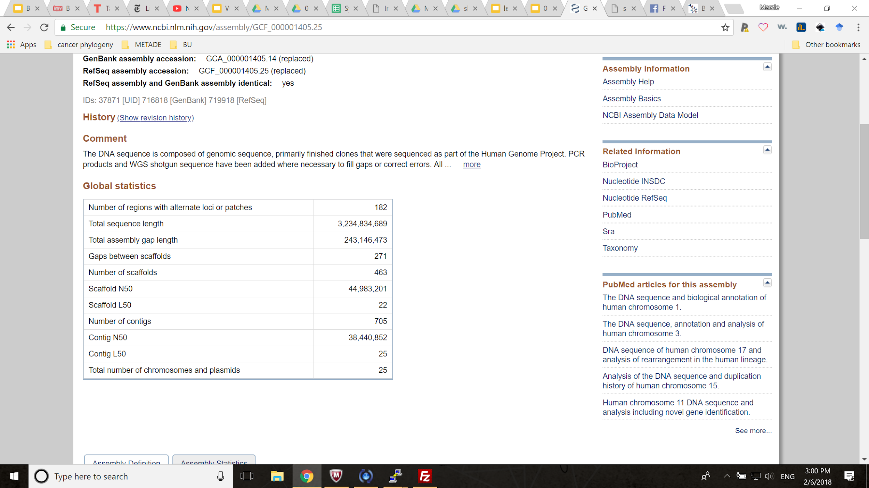
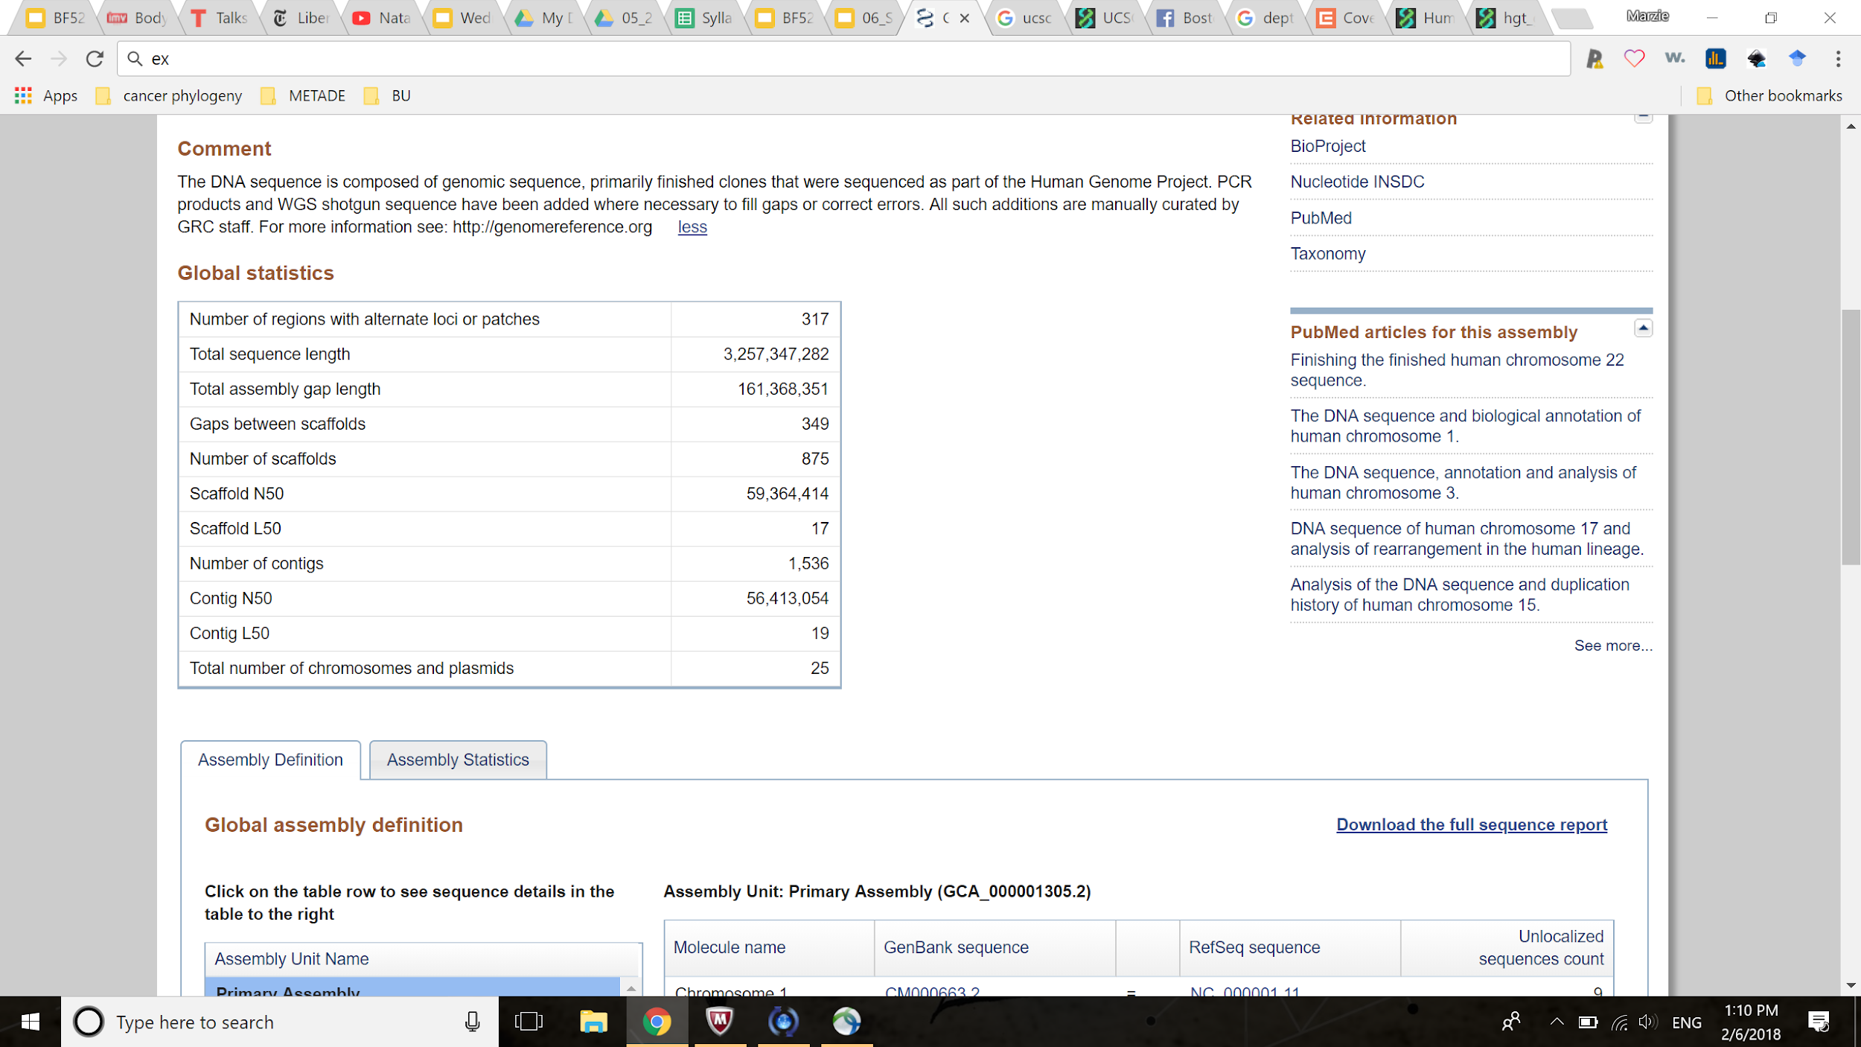
Human genome reference
Genome Reference Consortium human build 38 patch 12
Assembly GRCh37 patch 13 (hg19)
Assembly GRCh38 patch 12 (hg38)

Slide 10

Whole Exome Sequencing
Whole Exome Sequencing (WES)
Exons 1%-2% of human genome sequence
Pre-select reads that map to exons
Sequence to much greater depth than WGS
Identify coding variants

Slide 11
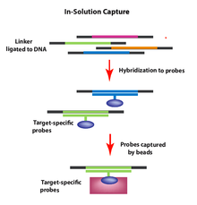
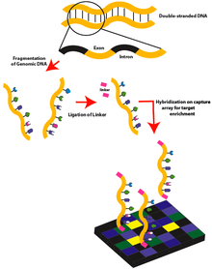
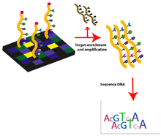
Exome Sequence Selection
Array-based capture
In-solution

Slide 12
Genomic Variation

Slide 13
Genomic Variants
Individual genomes from same species vary
WGS/WES compared with reference can identify differences
Variant: sequence that varies within species
Two general types:
  Small: <50 bp, single nucleotide polymorphisms (SNPs), indels
  Large: >50 bp, copy number variations, duplications, deletions, translocations, inversions

Slide 14
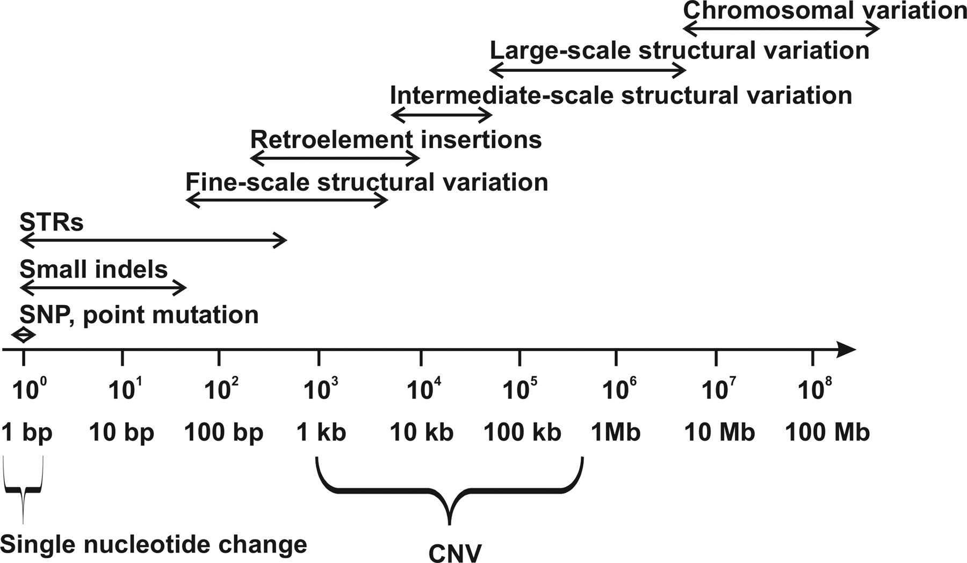
Genomic variants

Slide 15
Point mutations
reference: AA-TACGGACGGACTTTA
read1: AACTACGG-CGGACTTTA
read2: AACTACGG-CGGACTTTA
read3: AACTACGG-CGGCCTTTA
read4: AACTACGG-CGGACTTGA
read5: AACTACGG-CGGACTTGA
INsertion DELetion SNP

Slide 16
Single Nucleotide Polymorphisms (SNPs)
Most commonly studied type of variant
Types of single nucleotide alterations:
  Variant (SNV) - any single mutation
  Polymorphism (SNP) - SNV of appreciable frequency in population (e.g. >1%)
Typically base changes, e.g. A → C
SNPs (usually) indicate shared ancestry
May suggest disease mechanism

Slide 17
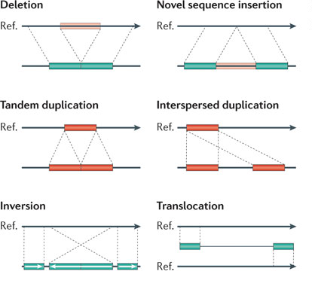
Structural variation
Deletions - sequence missing
Insertions:
  Novel - new sequence added
  Mobile-element - copied/moved from elsewhere in genome
Duplications:
  Tandem - consecutive
  Interspersed - non-consecutive
Inversion - segment is reversed
Translocation - segment moves

Slide 18
Genotyping
Genotype: an individual’s variant(s)
Phenotype: an individual’s physical form
De novo variant calling/detection: given genomic reads and a reference, find all the variants
Genotyping: examine individual for a priori variants at known locations
Can use arrays (i.e. SNP Chip) or WGS/WES

Slide 19
Human Genomic Variants
Humans have diploid genome
  i.e. 2 copies of each gene
660 million annotated human SNPs
113 million of those have been validated
Every human has on average:
  A variant every 1kb
  2-3 million SNPs
dbSNP - NCBI repository for SNP info

Slide 20
Human Genomic Terminology
Allele: sequence containing a variant
Homozygous variant: both same allele
  i.e. either same variant or same as reference
Heterozygous variant: different alleles
  i.e. one is variant, one is reference/different variant

Slide 21
Human Genomic Terminology
For coding (exonic) variants:
  Synonymous or sense: variant does not change amino acid sequence
  Non-synonymous or mis-sense: variant causes amino acid change
  Non-sense: causes early termination of protein by introducing stop codon
  Frameshift: insertion or deletion causes complete recoding of downstream proteins

Slide 22
Genomic Variant Terminology
Germline: Inherited from parents
  e.g. blue eyes, familial disease risk
Somatic: Acquired during life
  e.g. tumor vs normal tissue
Allele frequency: how common is a given variant in some population, e.g.:
  1% of human population
  30% within people with some disease

Slide 23
Genomic Variant Encoding
Reference allele - reference sequence
Alternate allele - variant sequence
We show alleles as:
  0/0 both reference allele
  0/1 one reference allele, one alternate
  1/1 both non-reference allele, homozygous
  1/2 both non-reference, heterozygous

Slide 24
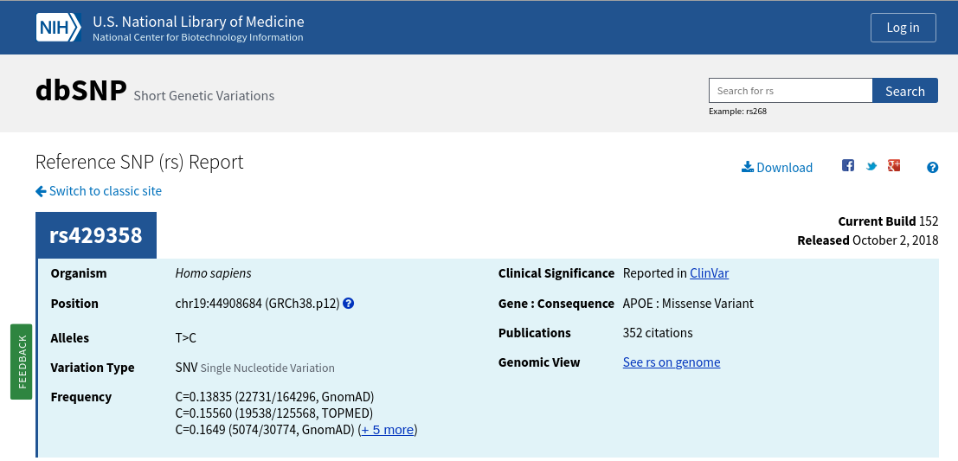
dbSNP - NCBI SNP Database

Slide 25
Variants Smaller Than A Read
Finding SNPs, indels almost a solved problem
SNPs called are 95% accurate
  i.e. with sufficient coverage
Structural variants cause false positives
  Duplications, somatic mutations may cause 3 or more alleles to be observed

Slide 26
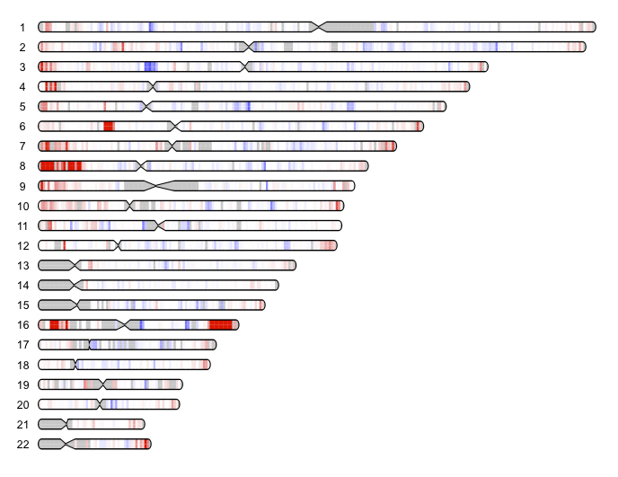
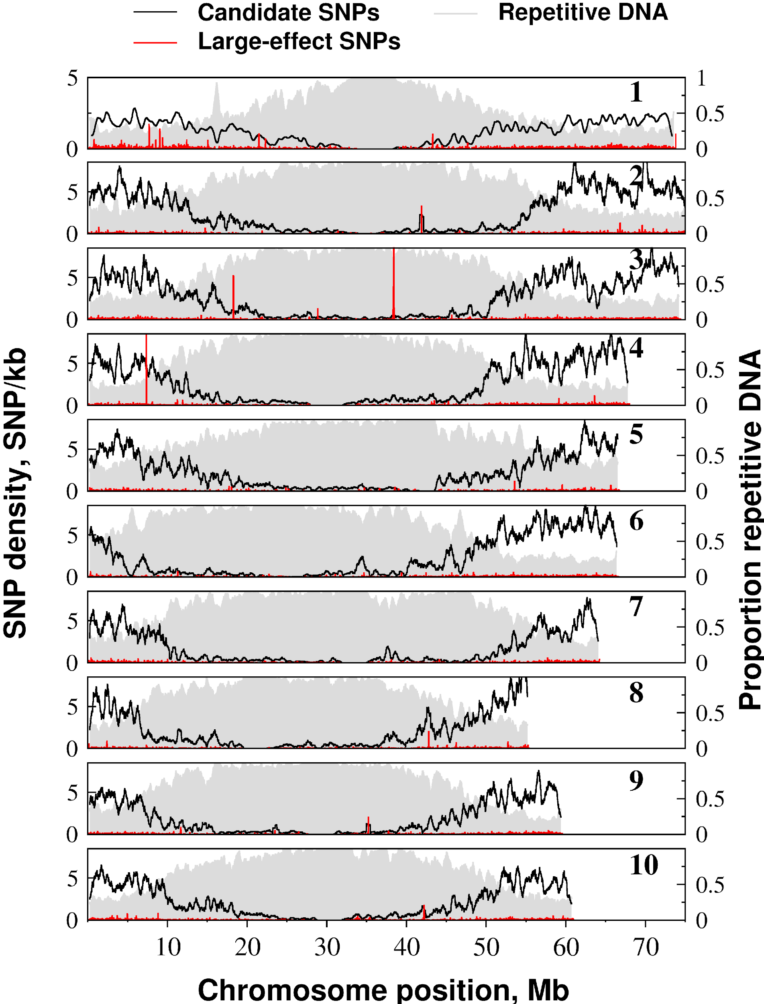
SNP and indel density is non-random

Slide 27
Variants Larger Than A Read
Structural Variation (SV)
Two types:
  Balanced - Do not change amount of DNA
  Copy Number Variants (CNV) - Change amount of DNA
Scales:
  Mini (hundreds of basepairs)
  Macro (visible by a microscope) variants
Much harder to find (especially balanced)
Non-random: SV ‘hotspots’

Slide 28
Haplotyping
DNA recombines in large blocks
SNPs in a block move around together
Looking at the common SNPs in a block, reveals the ancestry information
Linkage Disequilibrium (LD): adjacent SNPs co-occur more often than expected
  i.e. 2 SNPs are in LD with each other

Slide 29
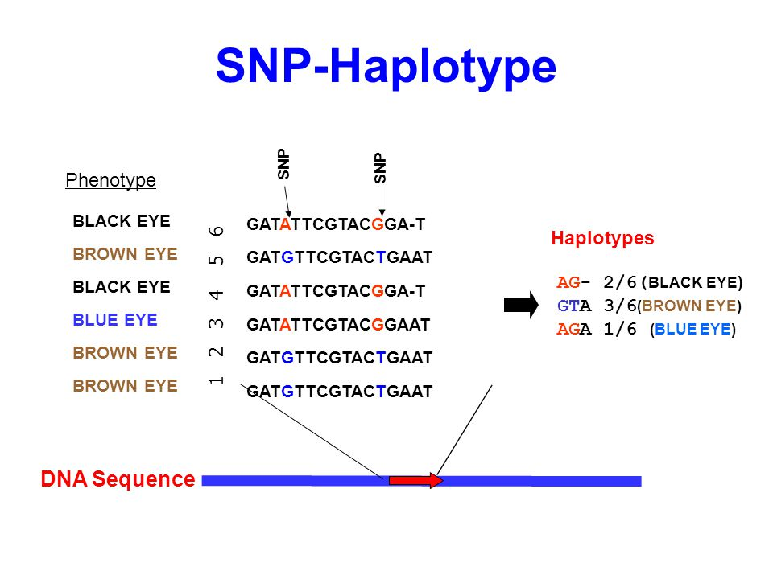
Haplotyping

Slide 30
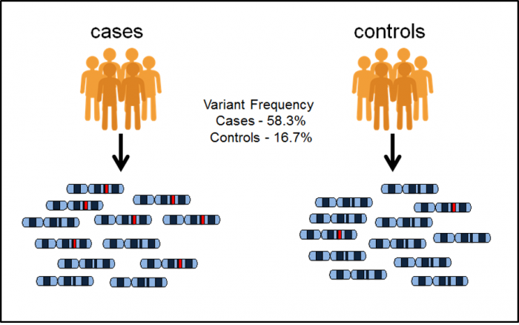
Genome Wide Association Studies (GWAS)
Which SNPs are associated with a variable of interest?
  e.g. disease, height
Does the frequency of any SNP differ between groups?
Associated SNPs have:
  Effect size - e.g. amount of increased risk
  p-value - precision of effect
Risk allele: allele associated with increased or decreased probability of having a disease

Slide 31
Calling SNPs - samtools
samtools mpileup -u -v -r chr22:29268316-29300343 -d 150 -f ../06/ref/chr22.fa NA12878_phased_chr22.bam > NA12878_chr22_samtools_EWSR1.vcf

Slide 32
Calling small variants - GATK
GATK - Genome Analysis Toolkit
gatk HaplotypeCaller \
-L chr22:29268316-29300343 \
-R ../06/ref/chr22.fa \
-I NA12878_phased_chr22.bam \
-O NA12878_chr22_gatk_EWSR1.vcf.gz \
-ERC GVCF # BP_RESOLUTION

