Slide 1
BF582 - git

Slide 2
Challenges of Writing Code
We write lots of code
Code evolves over time
Other people need to see/run our code
We work on teams and contribute to the same code base
Employers want to see your coding skill

Slide 3
git
“Git is a distributed version-control system for tracking changes in source code during software development.”

Slide 4
git
Distributed - no centralized location; every git repository contains entire change history
Version control - track changes over time, control who can make changes
Source code - instructions a computer can understand, and corresponding documentation (NB: NOT DATA!)

Slide 5
Core git concepts

Slide 6
The repository
Repository - directory containing a set of files git knows to track
Contains the current state of code, and a record of all previous states
mkdir my_git_repo
git init my_git_repo
ls my_git_repo/.git

Slide 7
What repositories track
TEXT FILES, AND ONLY TEXT FILES:
  Scripts/source code
  Documentation (e.g. README.md)
  Specific git files (e.g. .gitignore)
Do not track:
  Empty directories
  Large files (i.e. > 1Mb)
  Non-text files (images, binary files, etc)

Slide 8
The commit
Commit - atomic operation for tracking code changes
Both a noun (make a commit) and a verb (commit your changes)
Contains one or more code changes to one or more files
You choose what and when to commit

Slide 9
How to make a commit
Make changes to code (e.g. create new file)
Stage changes with git add
Commit those changes with git commit, adding a brief description of what changes were made

Slide 10
When to make a commit
Often - small, incremental changes are ideal
A logical change to the code:
  You add a new feature/script
  You changed one script which required changing another script
Sharing functionality:
  Your team mate needs to run one of your scripts
  You want to share/debug a piece of code

Slide 11
How to check which files have changed
git notices untracked files and uncommitted changes
Examine current state of repo: git status
Display exact differences: git diff

Slide 12
Collaborating with git

Slide 13
Github, Bitbucket, and GitLab
Free, publicly available git hosting services
All three provide essentially same functions:
  Code hosting
  Issue tracking
  Access control
Communities drive open source software development
  Many bioinformatics tools hosted on github

Slide 14
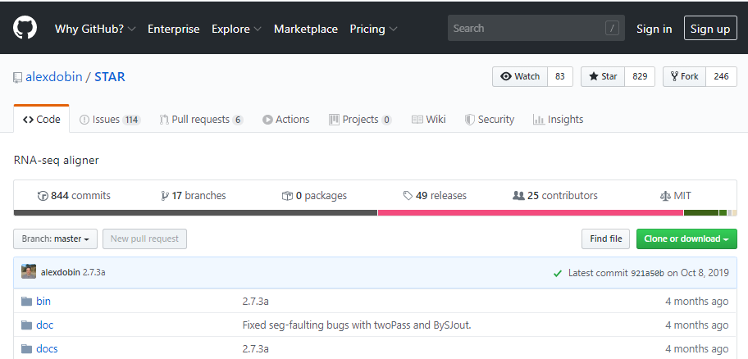
Cloning projects on github
Clone - make an exact copy of a repo; maintains link back to hosted repo

Slide 15
Creating your own projects on Github
Create a blank repo on Github
Clone your blank repo to your local computer/SCC/etc
Add files, make changes, local commits
Push your local changes to remote repo to sync up your changes

Slide 16
Integrating others’ changes
Your team pushes to the same github repo
To get others changes: git pull
git can figure out if changes to the same file can be merged
If changes cannot be merged, you have to fix it yourself
Merge conflicts can be difficult to sort out

Slide 17
git command cycle
git pull, if needed
git add to add new changes
git status to examine staged changes
git commit to commit those changes
git push to sync github with your changes
Repeat

Slide 18
git in your projects

Slide 19
Each project will have a github repo
The data curator will manage the repo
All code from the project should be committed to the repo
Add a README file describing what each script does in the repo root
We will look over your code as part of your assessment

Slide 20
Practices and conventions
You may organize your repo as you like
Do not commit data files!
Each member may clone repo, or you may let the data curator manage a single directory on SCC

Slide 21
git workshop

