Slide 1
Microbiome:
Metagenomics

Slide 2
Shotgun Metagenomics
(Randomly Sampled, Anonymous)
Untargeted
Genetic Material
“Beyond”
(Entire Community)

Slide 3
Why Shotgun Metagenomics?
Recover whole genome sequences of all microbial community members, not just selected organisms or single marker genes
  “All” == above a certain threshold (where the threshold depends on coverage/depth and the microbe’s abundance in the sample)
Can perform large-scale investigations of complex microbial communities
  Structure: Taxonomic composition (who’s there?)
  Function: Metabolic potential (what can they do?)

Slide 4
Microbiome
Metagenomic/
Whole Genome Shotgun
Sequencing
Bacteria
+
Archaea
+
Fungi
+
Viruses
16S rRNA Sequencing
18S rRNA Sequencing

Slide 5
Taxonomic Resolution
Domain
Kingdom
Phylum
Class
Order
Family
Genus
Species
Shotgun metagenomics yield species-level information
  Closely-related species have a high sequence similarity
    Similar issue to 16S sequencing

Slide 6
Metagenomic Sequencing
Who’s there?
Taxonomic
Classification
Shotgun Metagenomic
Sequencing
Sample
Population
Analysis
Functional
Analysis
What can they do?

Slide 7
Microbiome Analysis
16S rRNA sequencing helps us understand get a better understanding of community structure…
…but metagenomics gives us a better understanding of the metabolic potential of a community (“function”)…
…and next we need to focus on what the metabolic activity of a community (function)!

Slide 8
Shotgun Metagenomics Sequencing
Bioinformatics

Slide 9
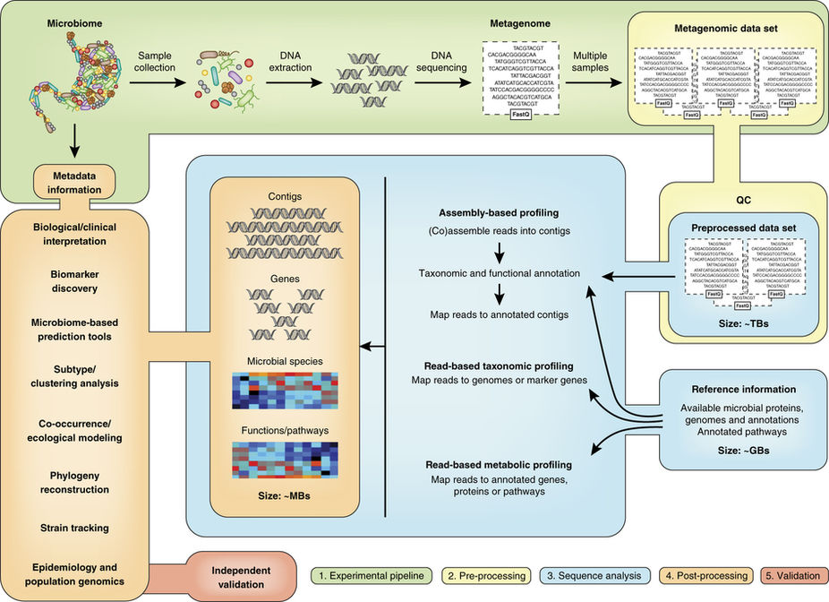
Metagenomics Workflow
Notes:
1. Collection, processing, and sequencing of the samples
2. Preprocessing of the sequencing reads
3. Sequence analysis to profile taxonomic, functional, and genomic features of the microbiome
4. Statistical and biological post-processing analysis
5. Validation

Slide 10
Sample Collection
Sample collection and preservation should be standardized → Avoid systematic biases
  Can be difficult if samples are collected by different research groups
  Time in frozen storage may vary in longitudinal studies
1. Collection, processing, and sequencing of the samples

Slide 11
DNA Extraction
Very small amounts of DNA are (usually) sufficient for sequencing
  Any contamination can overwhelm the “real” signal → need to be as sterile as possible
  Should include a “blank” as a sequencing control
Need to ensure that there is sufficient microbial biomass for sequencing
  There are many enrichment methods available (if needed) → often introduce their own biases
1. Collection, processing, and sequencing of the samples

Slide 12
Whole-Genome Amplification
Advantages
Limitations
Generates sufficient DNA for sequencing
  Even from tiny amounts of starting material
Can be applied directly to extracted environmental DNA
Can amplify DNA from the whole range of species present within a given sample
Can introduce significant biases
  Can skew resulting metagenomics profiles
Chimeric molecules can form
  Can confound assembly
Is unlikely to improve proportional abundance of DNA from a species of interest
1. Collection, processing, and sequencing of the samples

Slide 13
Preprocessing
Quality Assessment & Trimming
  Remove adapters, low-quality bases, PCR primers (if used)
  Demultiplex using barcodes, discard reads without a barcode
  Filter out “foreign” DNA (e.g. human)
Tools: FastQC, Trimmomatic, Picard
2. Preprocessing of the sequencing reads

Slide 14
Sequence Analysis
Assembly: Putting short sequences together to reconstruct a longer, source sequence
Mapping: Locating where one short sequence is found in a longer sequence
Binning: Identifying the “owner” of each anonymous DNA fragment → Classification of DNA sequences/reads/contigs
Lecture 3: Genetics and Genomics
Lecture 5: 2nd (Next) Generation Sequencing

Slide 15
Sequence Analysis
Next-Gen Sequencing yields a large volume of data (FastQ files) in the form of short reads
Can either assemble the reads into contigs
OR
Can map the reads to reference databases
3. Sequence analysis to profile taxonomic, functional, and genomic features of the microbiome

Slide 16



Assembly
We can put together a picture of the community profile like a puzzle (or a set of puzzles with the pieces all mixed together)
  We can use a reference genome or we can perform assembly de novo
Similar to whole-genome assembly
3. Sequence analysis to profile taxonomic, functional, and genomic features of the microbiome
Lecture 6: Sequence Analysis 1 – WGS/WES

Slide 17
Assembly
De Novo
Guided (Reference)
Does not require reference genomes
Uses graph theory algorithms to assemble sequencing reads into contigs
Computationally demanding
Requires reference genomes
Maps sequencing reads onto reference genomes to construct contigs joined in silico from individual reads
Limited by the quality and availability of reference genomes
3. Sequence analysis to profile taxonomic, functional, and genomic features of the microbiome

Slide 18
Assembly: Terminology
Contigs: Contiguous DNA sequences assembles from shorter, overlapping sequencing reads
  N50: Weighted median contig size (metric) → Higher N50 may mean more mis-assemblies (metric was designed for single-genome assembly)
    size to x Mbp, number to x Mbp
Scaffold: Merged contigs
MAG: Metagenomic Assembled Genome
3. Sequence analysis to profile taxonomic, functional, and genomic features of the microbiome
Lecture 6: Sequence Analysis 1 – WGS/WES

Slide 19
Binning
Can cluster based on similarity to a reference database or de novo (compared to each other)
  Can also cluster de novo and then use a database
Supervised: Use databases to label contigs into taxonomic classes
  Requires reference genomes…but many species are not sequenced
Unsupervised: Cluster contigs based on similarity
→ Both methods use a similarity metric
3. Sequence analysis to profile taxonomic, functional, and genomic features of the microbiome

Slide 20
Binning: MAGs
Once contigs are binned, you can assemble them again into scaffolds/MAGs
  Assess completeness by examining if single-copy core genes (e.g. tRNA synthetases, ribosomal proteins) are present
Note: Binning used to occur on raw reads
3. Sequence analysis to profile taxonomic, functional, and genomic features of the microbiome

Slide 21
Mapping
Taxonomic Profiling: Map reads to reference genomes
Metabolic Profiling: Map reads to annotated genes/proteins/pathways
→ Get “mixed bag”/“enzyme soup”
3. Sequence analysis to profile taxonomic, functional, and genomic features of the microbiome

Slide 22
Mapping after Binning
Taxonomic Profiling: Map reads contigs/scaffolds to reference genomes
Metabolic Profiling: Map reads contigs/scaffolds to annotated genes/proteins/pathways
→ Know which contig/scaffold/species contains which genes/proteins/pathways
3. Sequence analysis to profile taxonomic, functional, and genomic features of the microbiome

Slide 23
Sequence Analysis
Assembly
Scaffolding
Contigs
(fasta)
Scaffolds/MAGs
(fasta)
Reads
(fastq)
Mapping
Genes
(gff)
3. Sequence analysis to profile taxonomic, functional, and genomic features of the microbiome
Lecture 8: Biological Data Formats

Slide 24
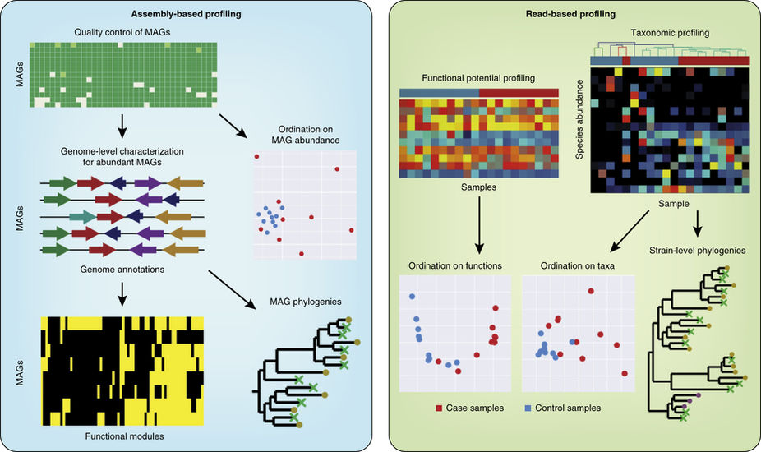
Sequence Analysis
Quince, Walker, Simpson, Loman, Segata (2017).
Shotgun metagenomics, from sampling to analysis. Nature Biotechnology
3. Sequence analysis to profile taxonomic, functional, and genomic features of the microbiome

Slide 25
Post-Processing Analysis
Scaffolds/MAGs
(fasta)
Contigs
(fasta)
Data Matrices
(sample vs features)
Species
Taxa
Genes
Pathways
Genes
(gff)
4. Statistical and biological post-processing analysis
Lecture 8: Biological Data Formats

Slide 26
Post-Processing Analysis
Heat maps
  Species/taxa
  Functions/pathways
Clustering
Correlations
Co-occurrence
Phylogeny
4. Statistical and biological post-processing analysis

Slide 27
Assemblers
Tools: Meta-IDBA, MetaVelvet, IDBA-UD, MetaSPAdes, MEGAHIT, Ray-Meta, SOAPdenovo
  Available memory is usually limiting
What’s best? Depends on biological factors (e.g. underlying community structure) and technical factors (e.g. sequence platform, coverage)
  Try a few and see what is “best”
Assembly result? Genomes! Contigs!

Slide 28
More Tools
Binners/Classifiers: MetaPhlAn, Kraken, Ray-Meta, MetaBAT, CONCOCT, Canopy
Bin Quality Assessment: CheckM
Gene/Functional Analysis: MetaProdigal
Gene/Functional Databases: PFAM, SEED, KEGG, CAZy
Statistical Analysis: HUMAnN2
Pipelines: MG-RAST, MEGAN, IMG/MER, mothur, QIIME
**Non-inclusive – there are MANY more tools out there.

Slide 29
Limitations and Opportunities
Metagenomics only looks at the gene sequences that encode proteins or functional RNAs → Tells you what the microbes a functionally capable of (genomic/metabolic potential)
  Need to examine RNA transcripts (metatranscriptomics) and/or translated proteins (metaproteomics) to see what microbes are actually doing

Slide 30
Limitations and Opportunities
Many genes are not annotated → we don’t know what protein they encode
  Our understanding of microbial communities is partial, based on what we can infer from existing knowledge (aka what is well-characterized and in databases)
  Lots of stuff to learn! But we still need to do the (expensive and low-throughput) gene-specific functional studies

Slide 31
Limitations and Opportunities
Available microbial genomes are biased towards model organisms, pathogens, and easily-cultivable bacteria
  All metagenomics computational tools rely on available genomes (databases), and are therefore affected by the biases in the reference sequence resources
Some reads may be unused even after assembly
  Still don’t know who these microbes are (or if they are just noise)
Are we sequencing the live microbes…or are we sequencing dead or damaged cells?

Slide 32
Backup

Slide 33
Reminder…
…metagenomics is an extension of many things you have already learned!
Genomics used to be computationally difficult, and now that’s metagenomics!
  Still developing tools/algorithms for data analysis (especially assembly and mapping!)

Slide 34
Why Sequencing?
Microbes are often difficult to culture
  (Ideally) Can study all microbes, not just those you can culture
Want to understand the structure and function of microbial communities
It has become (relatively) cheap

Slide 35
Things to Keep in Mind
Sequencing platform
  Error rate, biases, read length, noise
(Amplification process)
  Error rate, biases, choice of primer, DNA template concentration, PCR cycle number, introduction of chimeras
Coverage/Depth

Slide 36
DNA Extraction
Need to ensure that the DNA extraction methodology is stringent enough to extract DNA for all cell types in the sample → Avoid bias
  Should be effective for diverse microbial taxa → otherwise biased for easy-to-lyse microbes
  Vigorous extraction techniques can result in shortened DNA fragments → can contribute to DNA loss
Note: All extracted DNA is randomly sheared into desired fragment sizes
1. Collection, processing, and sequencing of the samples

Slide 37
Sequence Analysis
 | Assembly-Based | Read-Based (Mapping)
Comprehensiveness | Can construct multiple whole genomes, but only for organisms with enough coverage to be assembled and binned. | Can provide an aggregate picture of community function or structure, but is based only on the fraction of reads that map effectively to reference databases.
Community Complexity | In complex communities, only a fraction of the genomes can be resolved by assembly. | Can deal with communities of arbitrary complexity given sufficient sequencing depth and satisfactory reference database coverage
Novelty | Can resolve genomes of entirely novel organisms with no sequenced relatives. | Cannot resolve organisms for which genomes of close relatives are unknown.
Computational Burden | Requires computationally costly assembly, mapping, and binning. | Can be performed efficiently, enabling large meta-analyses.
Quince, Walker, Simpson, Loman, Segata (2017).
Shotgun metagenomics, from sampling to analysis. Nature Biotechnology
3. Sequence analysis to profile taxonomic, functional, and genomic features of the microbiome

Slide 38
Sequence Analysis
 | Assembly-Based | Read-Based (Mapping)
Genome-Resolved Metabolism | Can link metabolism to phylogeny through completely assembled genomes, even for novel diversity. | Can typically resolve only the aggregate metabolism of the community, and links with phylogeny are only possible in the context of known reference genomes.
Expert Manual Supervision | Manual curation required for accurate binning and scaffolding and for misassembly detection. | Usually does not require manual curation, but selection of reference genomes to use could involve human supervision.
Integration with Microbial Genomics | Assemblies can be fed into microbial genomic pipelines designed for analysis of genomes from pure cultured isolates. | Obtained profiles cannot be directly put into the context of genomes derived from pure cultured isolates.
Quince, Walker, Simpson, Loman, Segata (2017).
Shotgun metagenomics, from sampling to analysis. Nature Biotechnology
3. Sequence analysis to profile taxonomic, functional, and genomic features of the microbiome

Slide 39
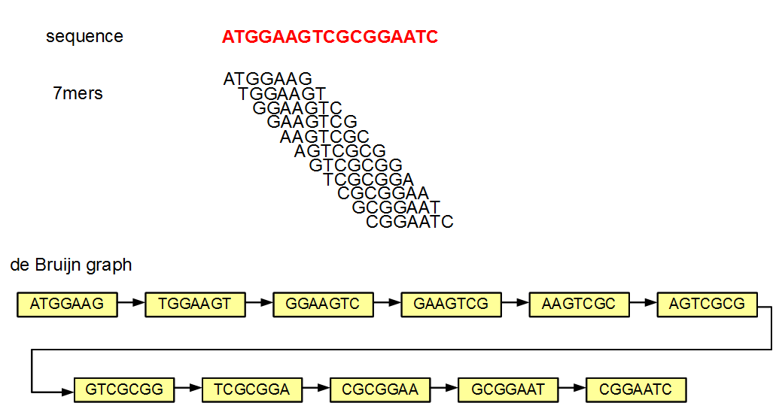
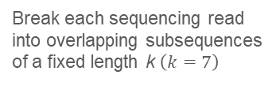
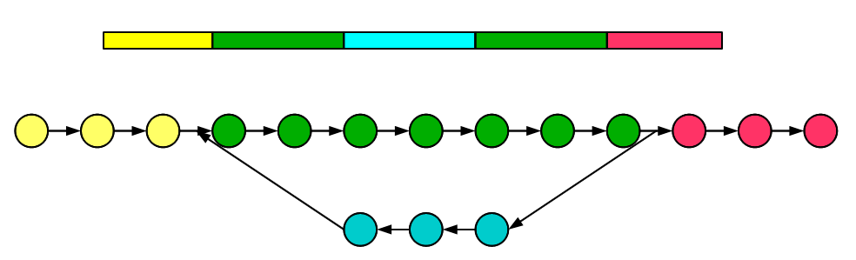
Assembly: de novo
Set of overlapping “k-mers” define the vertices and edges of the graph
Assembler finds the path through the graph that reconstructs the genome(s)
Repetitive regions make it difficult to resolve the original sequence
3. Sequence analysis to profile taxonomic, functional, and genomic features of the microbiome
3. Sequence analysis to profile taxonomic, functional, and genomic features of the microbiome

Slide 40
Assembly: Guided (Reference)
Align reads to a (database) of reference genomes
  Similarity scores
  Sometimes only a minority of reads can be aligned
Lecture 3: Genetics and Genomics
Lecture 6: Sequence Analysis 1 – WGS/WES
Lecture 13: Phylogenetics
3. Sequence analysis to profile taxonomic, functional, and genomic features of the microbiome
3. Sequence analysis to profile taxonomic, functional, and genomic features of the microbiome

Slide 41
Assembly: Unique Challenges
When assembling a single genome, we typically assume that sequence coverage is approximately uniform across the genome
  Find repeat copies
  Distinguish sequencing errors from the “real” sequence
  Identify allelic variation
…but the coverage of each community member depends on the abundance of its genome in the community
3. Sequence analysis to profile taxonomic, functional, and genomic features of the microbiome

Slide 42
Assembly: Unique Challenges
Communities are more biologically complex than individual microbes:
  Reads come from multiple species → Are near-identical/identical reads/configs from 1 or more species?
The presence of different strains of the same species can result in fragmented reconstructions.
Some DNA segments are repeated within the same organism, or shared between distinct organisms.
3. Sequence analysis to profile taxonomic, functional, and genomic features of the microbiome

Slide 43
Assembly: Unique Challenges
So if the coverage of each community member depends on its abundance…
…then low-abundance genomes may end up fragmented/incomplete
Coverage/Depth will determine how well you can characterize low-abundance community members
(Need “enough” overlapping reads)
Trade-off between:
  Recovering low-abundance genomes
  Obtaining long, accurate contigs for high-abundance genomes
3. Sequence analysis to profile taxonomic, functional, and genomic features of the microbiome

Slide 44
Binning
We don’t have prior knowledge about what species (or even how many) are in a sample…
…and we also don’t have prior knowledge about which contig derives from which genome…
…so we need to group contigs (bin)
3. Sequence analysis to profile taxonomic, functional, and genomic features of the microbiome

Slide 45
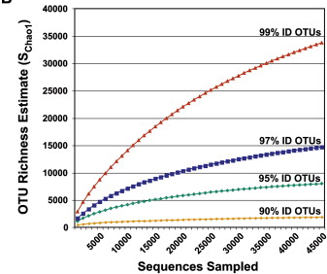
Binning
16S rRNA Sequencing:
Cutoffs: What percent sequence identify should you use?
→ Will depend on the error rate, etc.
3. Sequence analysis to profile taxonomic, functional, and genomic features of the microbiome

Slide 46
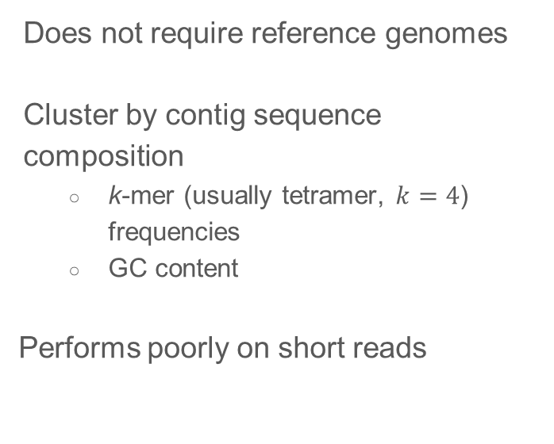
Binning
Composition-Based (Unsupervised)
Homology-Based (Supervised)
Requires reference genomes
Cluster by gene homology
  Similarity to known (marker) genes
Struggles to be discriminative when there are closely-related species
3. Sequence analysis to profile taxonomic, functional, and genomic features of the microbiome

Slide 47
Sequence Analysis: Challenges
The main limiting factor in profiling the metabolic potential is the lack of annotations
  Biased towards highly conserved pathways and housekeeping functions → may explain why function is consistent across different samples and environments event when taxonomy varies
3. Sequence analysis to profile taxonomic, functional, and genomic features of the microbiome

Slide 48
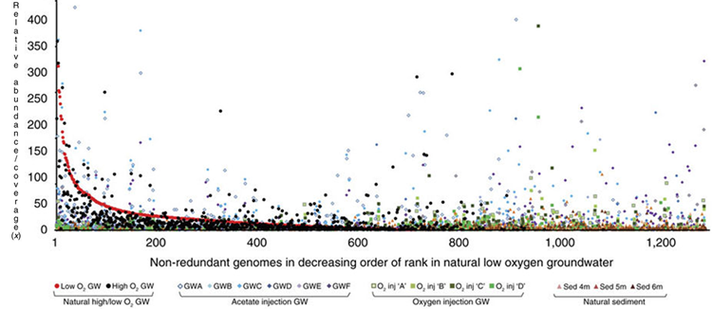
Post-Processing Analysis: Challenges
Taxonomic and functional profiles are proportional/compositional
Abundances are (log-normal) long-tailed distributions
4. Statistical and biological post-processing analysis

Slide 49
Things to Keep in Mind
You are taking a sample from a population
  There will be variation between samples from the same population
  Need to ensure that the study has enough statistical power to detect differences
Controls can be difficult to obtain
  Collect as much metadata as possible
    Clinical Samples: Gender, age, antibiotic/medication use, location, diet, etc.
    Environmental Samples: Location, season, pH, temperature, etc.
  Collect longitudinal data when possible

Slide 50
Things That Should Happen (But Don’t)
Technical replicates to assess variability
Blank controls to assess library preparation and sequencing biases/error/contamination
Corrections for confounding factors (e.g. batch effects)
…although uncommon now, will hopefully become common as costs decrease

Slide 51
Limitations and Opportunities
Quantitative features are normalized (relative abundance)
  Make sure you are using the appropriate statistical/analysis tools for normalized data!
  Can observe false correlations otherwise…
 | Sample 1 | Sample 2
Organism 1 | 10 | 20
Organism 2 | 2 | 2
Organism 3 | 3 | 3
 | Sample 1 | Sample 2
Organism 1 | 0.67 | 0.80
Organism 2 | 0.13 | 0.08
Organism 3 | 0.20 | 0.12

Slide 52
Microbiome Analysis
16S rRNA sequencing: structure
Metagenomics: metabolic potential
Metatranscriptomics/Metabolomics:
metabolic activity

