Slide 1
Single Cell Sequencing Analysis
Part 2

Slide 2
The Counts Matrix
Counts matrix contains either:
  Read counts or
  UMI counts if used
Each cell has:
  Total number of counts (col. sum, “library size”)
  Number of non-zero genes
Each gene has:
  # of non-zero cells
  Non-zero mean/variance
Matrix is sparse: many zeros
Zeros may be:
  Cell lacks gene
  A “drop-out”: gene present but was missed by qPCR
 | cell1 | cell2 | cell3 | cell4 | cell5 | cell6 | ... | cellM
gene1 | 93 | 25 | 0 | 0 | 3335 | 0 |  | 82
gene2 | 5 | 2 | 0 | 3 | 1252 | 0 |  | 12
gene3 | 0 | 0 | 0 | 0 | 0 | 0 |  | 0
gene4 | 98 | 21 | 1 | 1 | 5318 | 0 |  | 75
gene5 | 0 | 0 | 513 | 0 | 0 | 325 |  | 135
gene6 | 0 | 0 | 113 | 0 | 1 | 497 |  | 255
gene7 | 3 | 0 | 0 | 0 | 6 | 0 |  | 0
...
geneN | 68 | 52 | 0 | 2 | 4313 |  |  | 63

Slide 3
Typical Analysis Paths
Dimensionality Reduction
Projection
(tSNE, UMAP, etc)
Visualization
Counts matrix
Unsupervised Clustering
Differential Expression
Marker Gene Analysis
Differences in Proportion

Slide 4
Unsupervised Clustering
Wish to identify subpopulations of cells using similarity of transcript abundance
Clustering methods discover patterns in the data
A priori no knowledge of number of clusters
Many available methods and metrics:
PCA/Spectral analysis
Hierarchical or Ward agglomerative clustering
K-nearest neighbor clustering
Jaccard similarity
Louvain community detection
K-means
Graph based clustering
Many, many more...

Slide 5
Analysis: Differential Expression
Goal: identify gene expression differences between cell types (i.e. clusters)
Simple solution: DESeq2 of each cluster vs all the others
Significant genes drove the clustering
Examine for marker genes

Slide 6
Marker Gene Analysis
Goal: Label each cluster to known cell type
Biological domain experts know which genes are expressed by each cell type
Some clusters may be difficult to label (novel cell types?)
NB: cells of one cell type may cluster by state, e.g. cell cycle phase G1

Slide 7
Dimensionality Reduction
Counts matrix may have many dimensions
  1000s of genes x 1000s of cells
Reduces # dimensions while preserving variance
May be necessary for large datasets (>1M cells) to make downstream analysis algorithms tractable
Many methods available, including:
  PCA
  Multidimensional Scaling (MDS)
  Downsampling

Slide 8
Projection + Visualization
Goal: accurately visualize cell clusters in two dimensions
Projection: embed samples of high dimensional space into lower dimensional space, retaining structure of data
  e.g. map from (1000s genes x 1000s cells) to 2 (i.e. <x,y>)
Ideally preserve both local and global structure
NB: this is challenging to do efficiently+accurately!
Available methods:
  t-SNE: t-statistic Stochastic Neighbor Embedding
  UMAP: Uniform Manifold Approx. and Mapping
  PCA

Slide 9
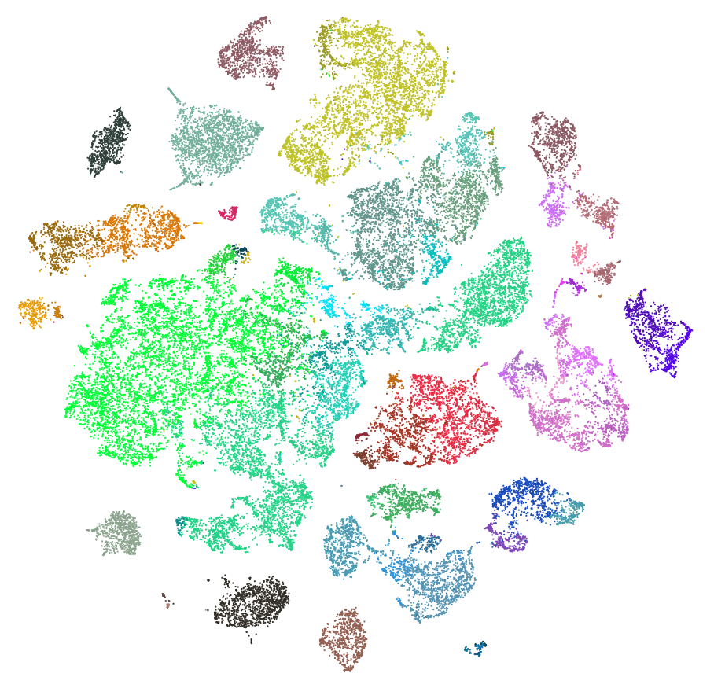
t-SNE, UMAP, et cetera
Conceptual idea:
Compute distance between all pairs of cells in high dimensional (i.e. all genes) space
Find a function that maps samples into 2D space s.t. cells that are close in original space are also close in embedded space
Can compute locally accurate mapping quickly:
Cells near each other are similar
BUT cells far away from each other are not necessarily proportionately far from each other!
Local structure is preserved, global structure is not!
t-SNE projections from human cortex single nuclear RNA-Seq https://portal.brain-map.org/atlases-and-data/rnaseq

Slide 10
Visualizing Projections
Wish to use clustering to interpret data
Projection methods produce an embedding
Strategy: map cell metadata onto embedding and visualize
Following slides:
  Single nuclear RNA-Seq from human cortex
  6 regions sampled
  Source: Brain-Map Cell Type Database https://portal.brain-map.org/atlases-and-data/rnaseq

Slide 11
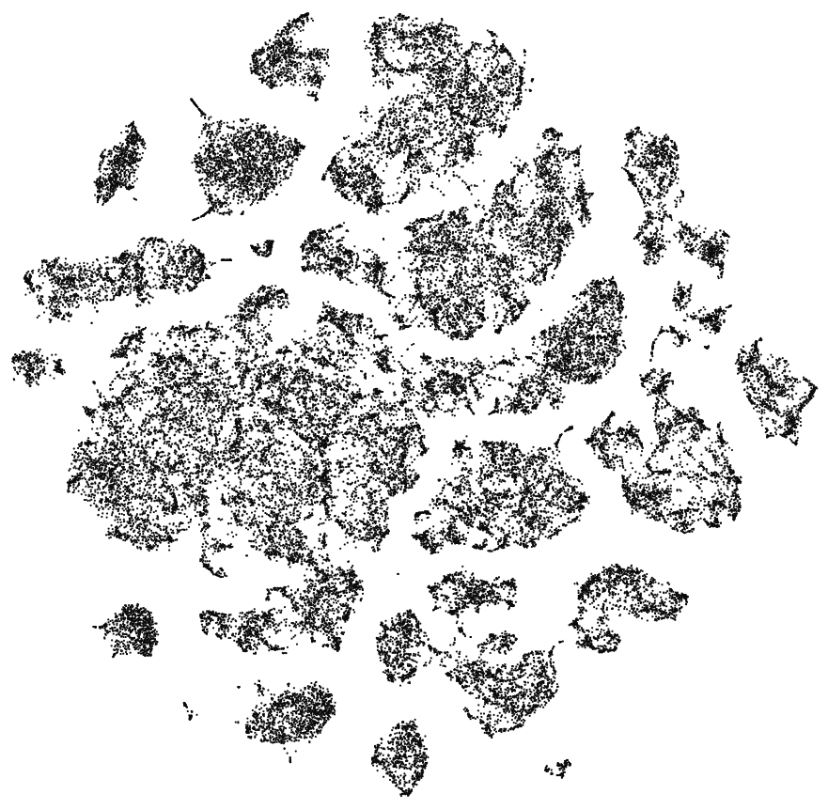
Visualizing Projections
No color
Colored by unsupervised clustering

Slide 12
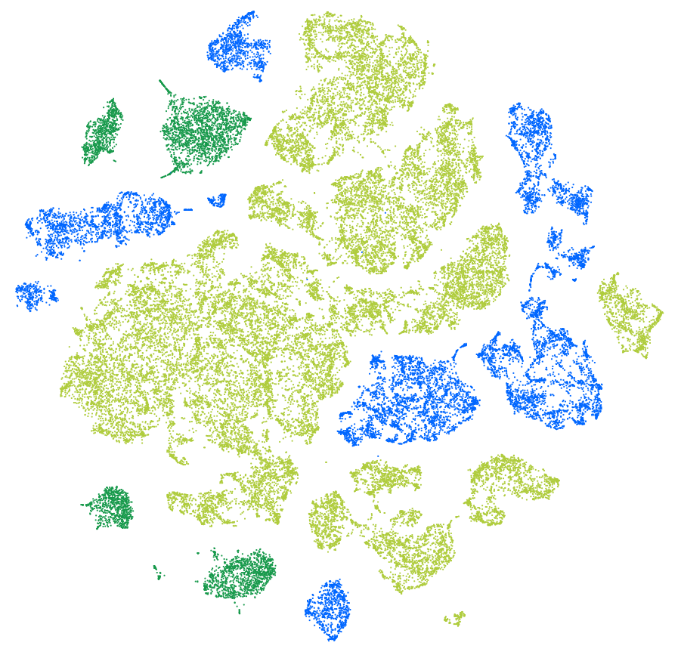
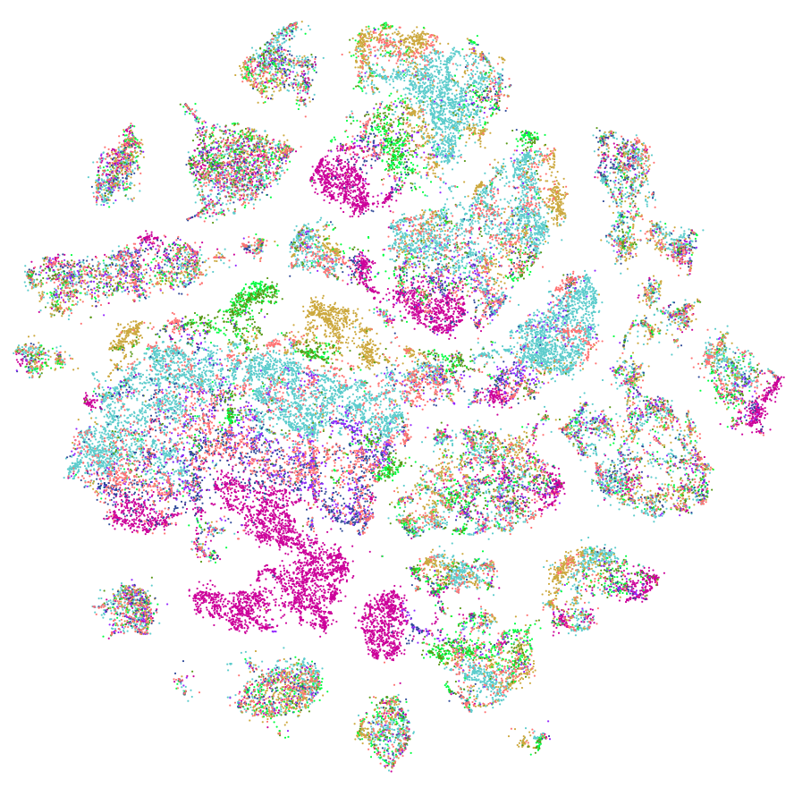
Visualizing Projections
Colored by cell class, labeled by known marker genes
Non-neuronal (glia)
Glutamatergic neurons
GABAergic neurons
Colored by brain region

Slide 13
The Many Subjects We Didn’t Cover
Supervised clustering of cells by known markers/cell states (e.g. cell cycle)
Comparing different samples
Pseudotime Analysis
  Inferring cellular development/change over time
Imputation
  Infer expression values for “dropout” genes
Many more...

Slide 14
Current Software
Bioconductor
  Seurat - One of the first analysis software packages
  SingleCellExperiment - official Bioconductor class
  scater - Single Cell Analysis Toolkit
scanpy - single cell analysis in python
Many others now
Millions of others soon...

