Slide 1
Docker Demo

Slide 2
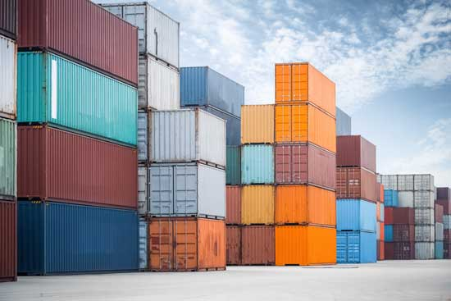
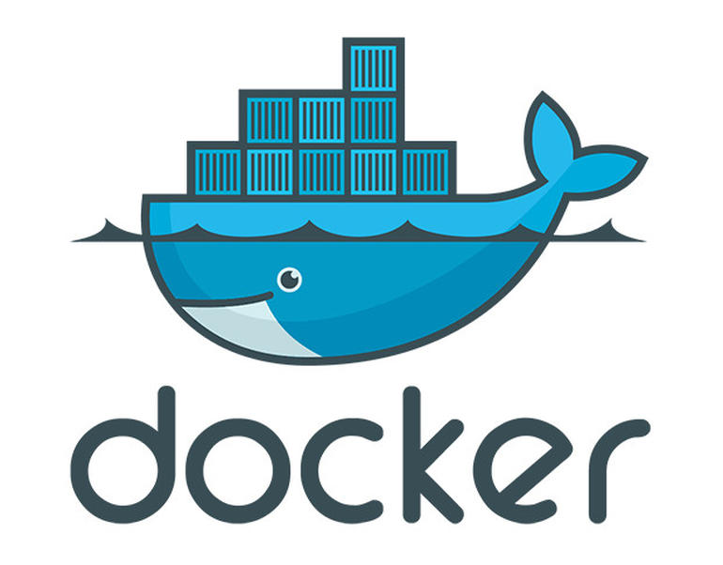

Containerization
Web server
A different web server
Parallelized
Research
Apps
Rstudio
Database

Slide 3
Containerization
Complete environment description
Essentially mini operatings systems
Contain all specific software needed for an analysis
Custom code can also be loaded into container
Current technologies: docker and singularity
Strengths: ideal strategy for encapsulating and sharing environments
Disadvantages: requires sysadmin knowhow, docker has prohibitive technical requirements for SCC

Slide 4
Docker basics
Docker software is an environment that runs containers
Containers execute in an isolated environment independent of host
Containers may be allowed access to specific host resources
  e.g. Local hard drive, networking, other containers

Slide 5
Docker images
An image: description of a set of software
Each image starts with a base image that provides a basic OS and environment
  E.g. Ubuntu, alpine linux, Windows, etc
More specific software is built upon the base image
Any docker image can be a base image

Slide 6
Dockerfiles
Images are specified in Dockerfiles
Dockerfiles are written in a language that has specific syntax
Many commands are available, but most often needed are:
  FROM, RUN, COPY, CMD
Docker uses the Dockerfile to build the container

Slide 7
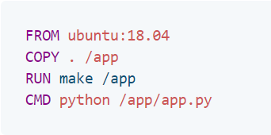
Example Dockerfile
Specify base image name and version
Base image
Copy files into the image from the local directory
Run a command while building the container
Execute this command when running the container

Slide 8
Docker Hub
Cloud application that hosts docker images
Many different images available
Images include a name and a version
Specialized images you might consider:
  r-base
  continuumio/miniconda
  python

Slide 9
Docker demo

