Slide 1
Metabolomics

Slide 2
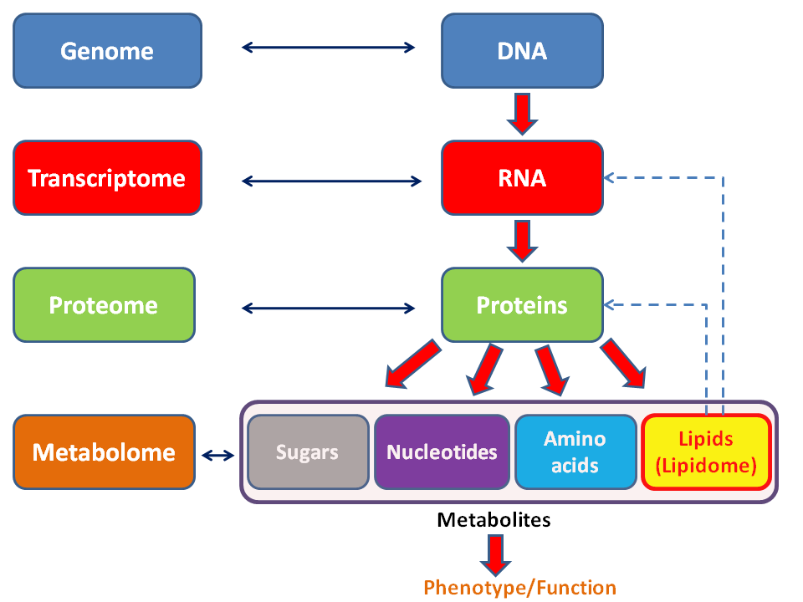
The Mechanism of Life
The Machinery
The Fuel/Exhaust
https://en.wikipedia.org/wiki/Metabolome

Slide 3

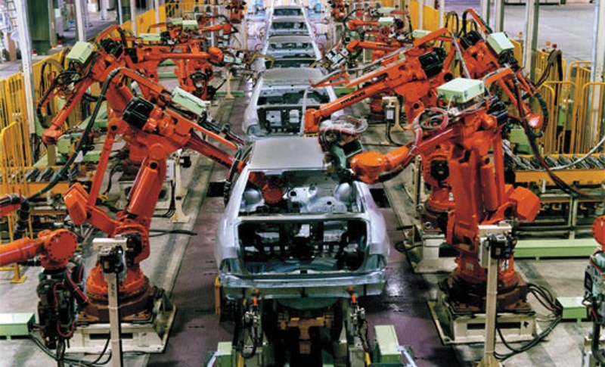

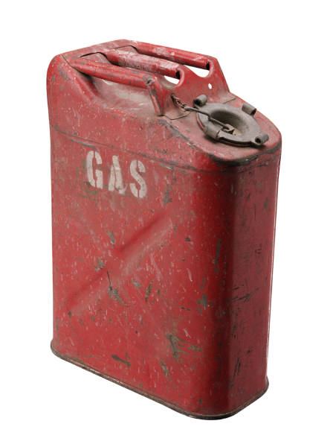
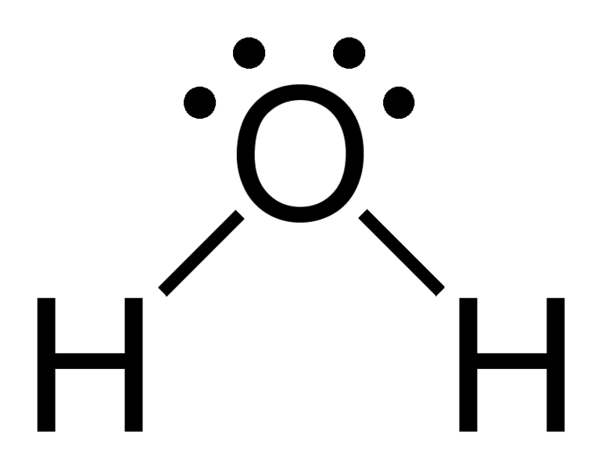

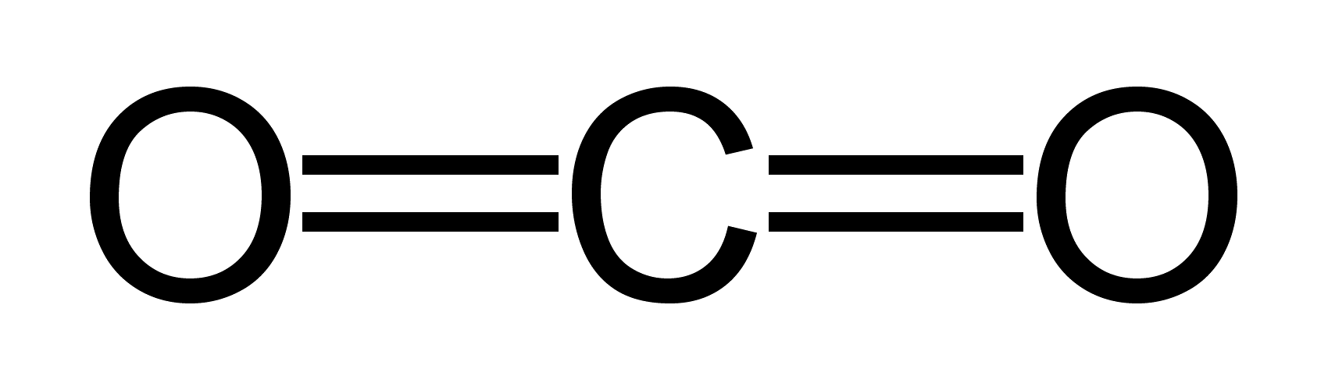
Central Dogma Plus
Genome
Transcriptome
Proteome
Metabolome

Slide 4
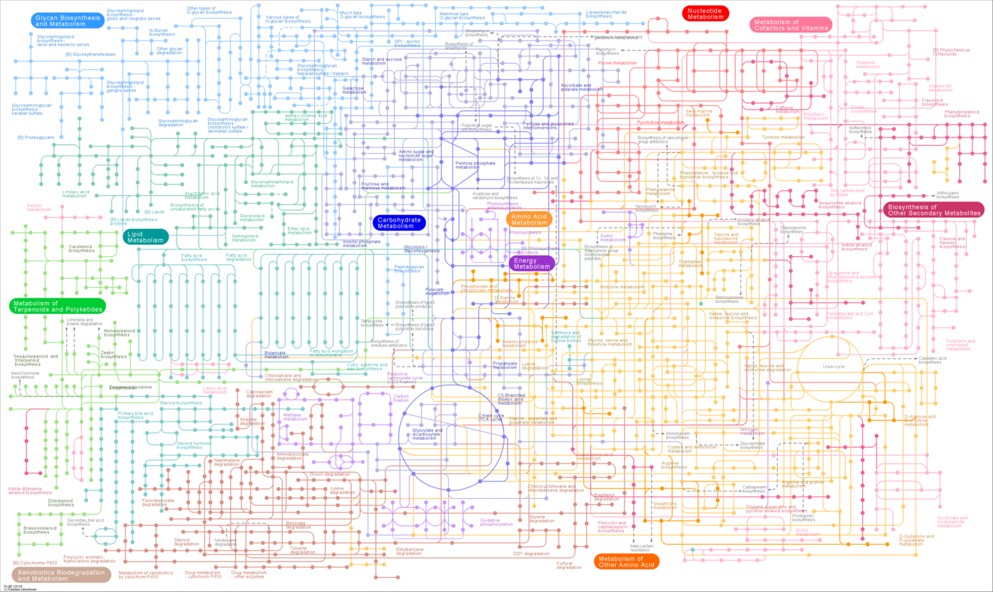
Terminology
Metabolism: Network of chemical reactions
  How a cell extracts energy from its environment
  How a cell synthesizes its “building blocks”

Slide 5
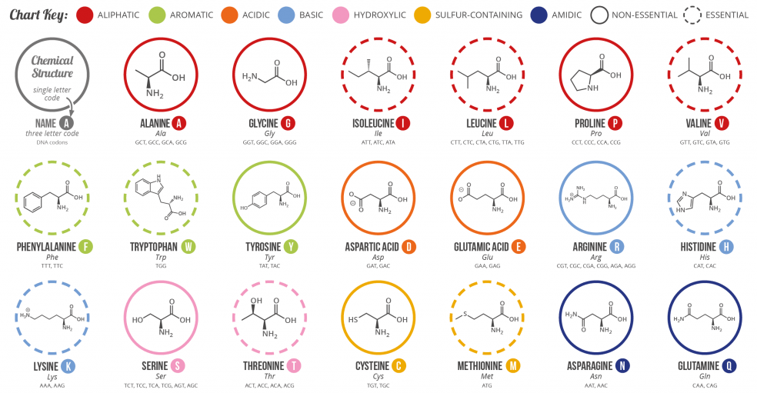
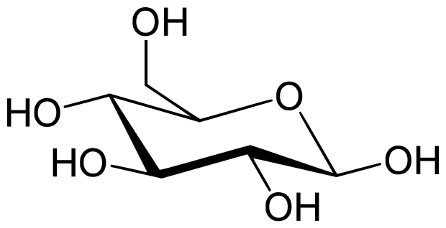
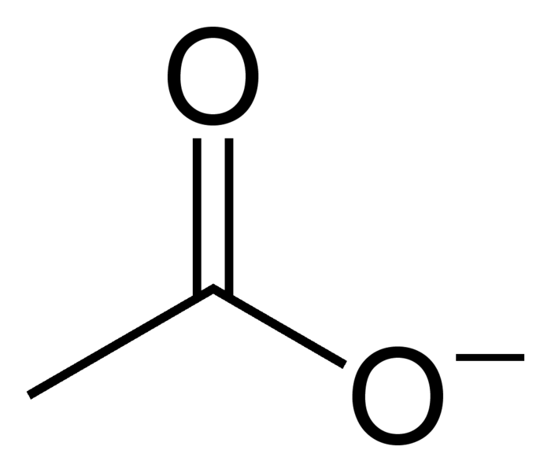
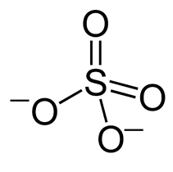
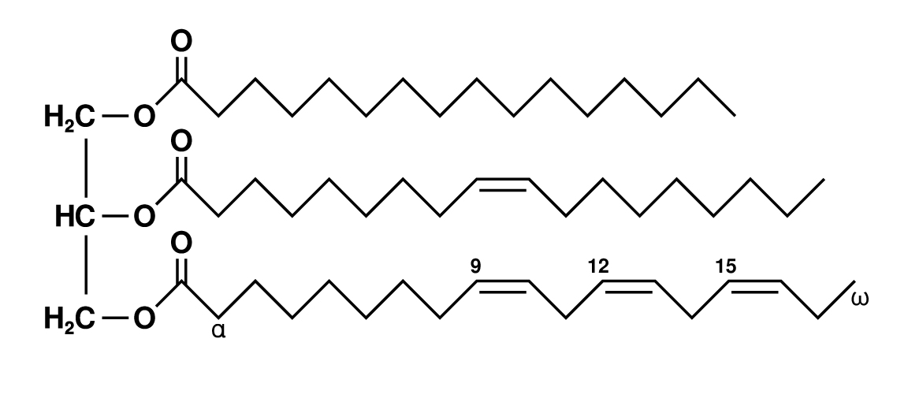
Terminology
Metabolite: Chemical compounds used in metabolism
  Amino acids, glucose, acetate, lactate, etc.
Metabolome: Metabolites produced/used by cells

Slide 6
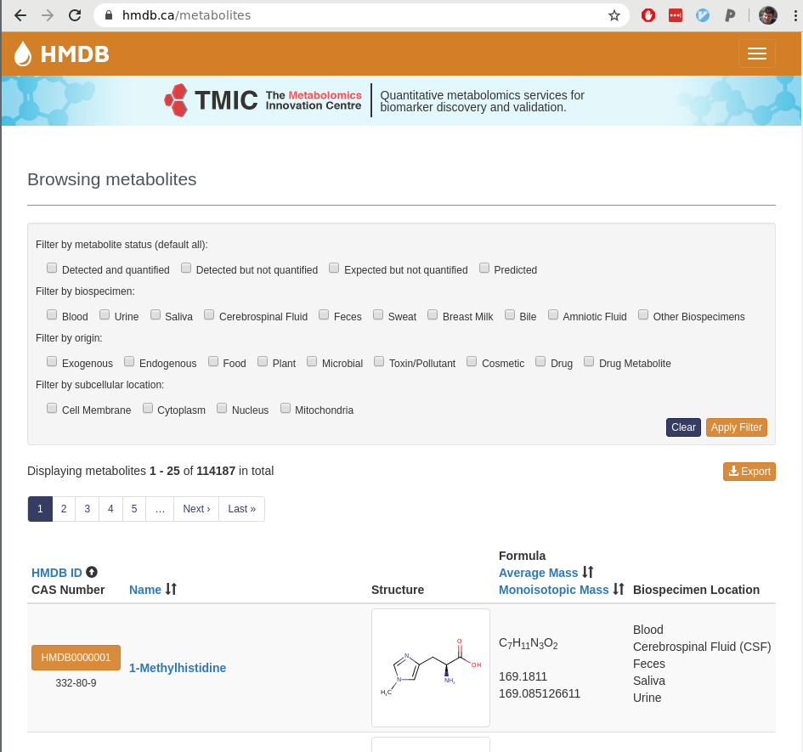
The Human Metabolome
Human Metabolome DB: hmdb.ca
100k+ metabolites
Various locations in human body/fluids
Various origins
Endogenous - created by cells
Exogenous - ingested (i.e. food)

Slide 7
Workflow
Collect samples: fluids, cells, media, etc
Separate molecules: chromatography
Detect using one of:
  Mass spectrometry
  NMR (Nuclear Magnetic Resonance)
  UV (Ultraviolet-Visible) or IR (Infrared) Spectroscopy
  Flame Ionization
Analyze: bioinformatics + statistics

Slide 8
Collect: Intra- vs. Extra-cellular
Can perform intra-cellular metabolomics, but it’s simpler to perform extra-cellular metabolomics (exometabolomics)
Extracellular sources - no cells:
Tissue: blood serum, cerebrospinal fluid (CSF), saliva, sweat etc
Microbial: Just look at the (spent) medium! What did the microbes secrete/take up?
Intracellular is very complicated to do properly
Must isolate cells from media
Complex experimental setup may be required: https://www.ncbi.nlm.nih.gov/pmc/articles/PMC4559092/

Slide 9
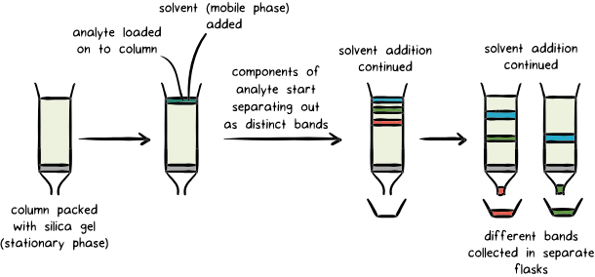
Separate: Chromatography
Can separate by size, charge
GC vs LC: Gas vs Liquid Chromatography

Slide 10
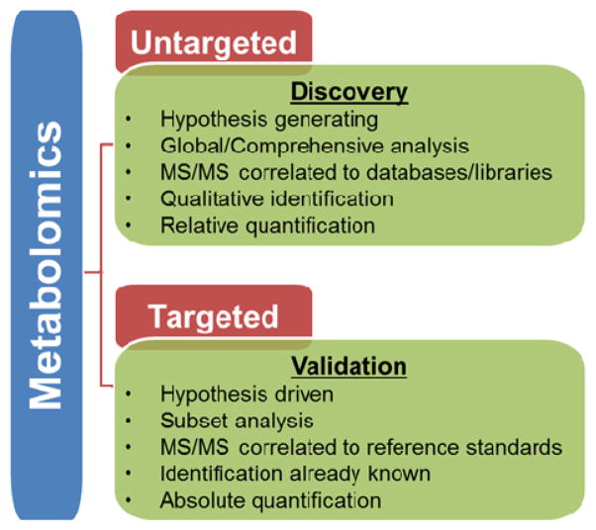
Design Choice: Targeted vs. Untargeted
Untargeted:
  What metabolites are there?
  Qualitative
  Measure “all” of the metabolites in the sample
Targeted:
  Measure a specific set of metabolites
  Quantitative
Schrimpe-Rutledge, Alexandra C., Simona G. Codreanu, Stacy D. Sherrod, and John A. McLean. 2016. “Untargeted Metabolomics Strategies-Challenges and Emerging Directions.” Journal of the American Society for Mass Spectrometry 27 (12): 1897–1905.

Slide 11
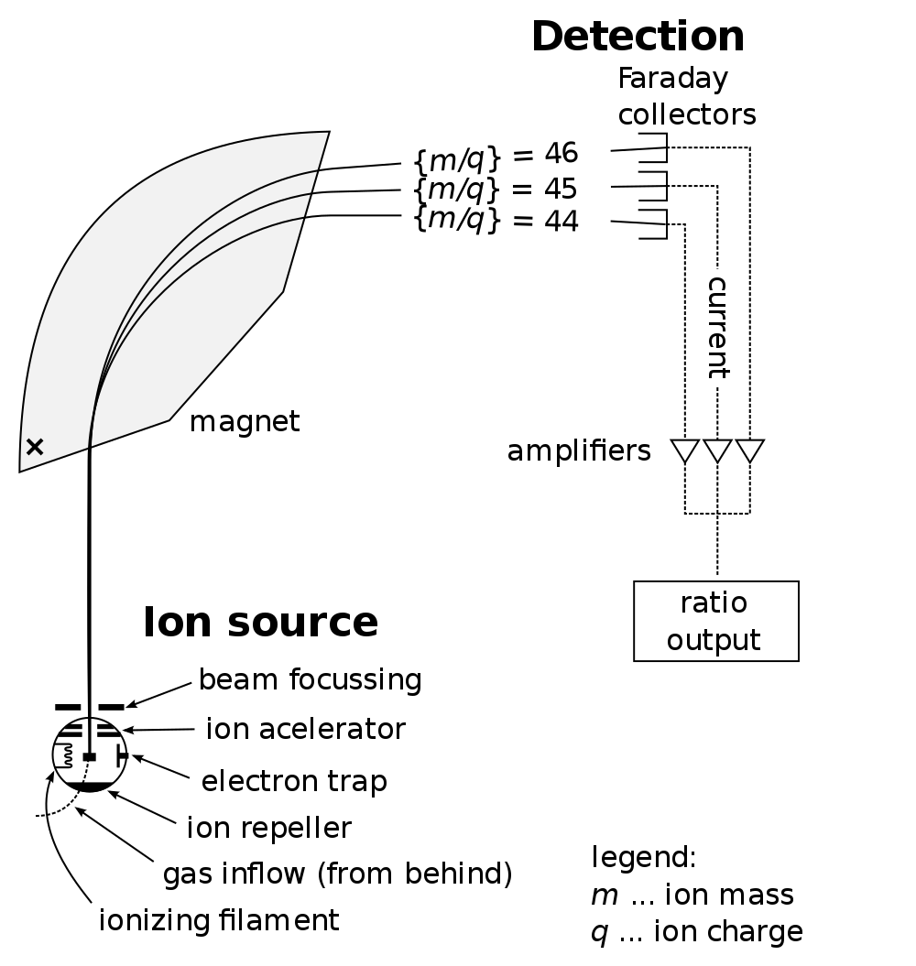
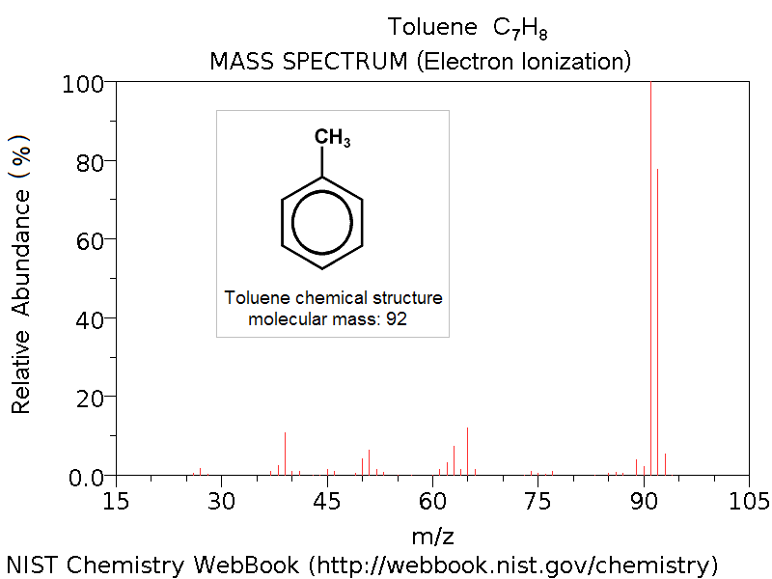
Detect: Mass Spectrometry
Identify mass/charge (m/z) of particles
Vaporizes compounds from chromatograph
Each molecule has a (hopefully unique) set of m/z spectra

Slide 12
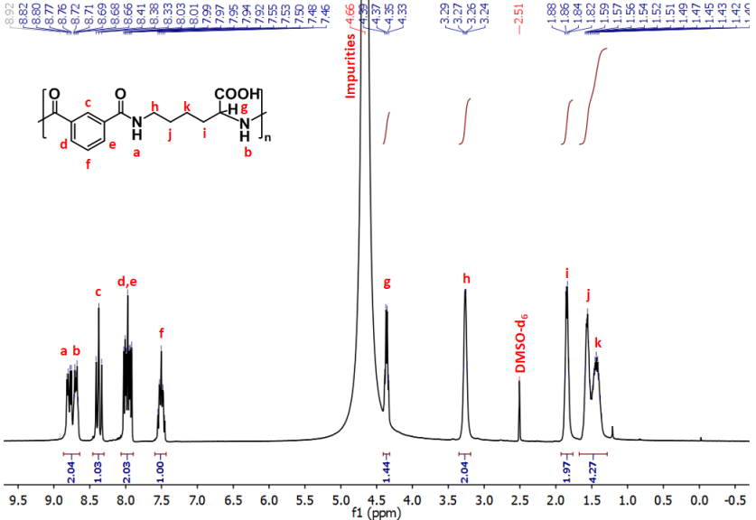
Detect: NMR Spectrometry
Measures magnetic resonance between atoms in a structure
Each atomic bond configuration has specific signature
Analyze spectra to identify content

Slide 13
Detection Methods
Need to carefully select your detection platform(s)
  Many complementary, analytical trade-offs
Experimental reagents, sample manipulation, etc. impact your results
Some media are less amenable to metabolomics
  High salt concentrations mess up chromatography columns
Isotopic tracers/labels

Slide 14
Analyze: Metabolomics Data
Quantities of metabolites for many samples
Forms a matrix
Pattern detection analysis
  Unsupervised: PCA, Hierarchical Clustering, etc
  Supervised: Regression/Partial Least Squares
Pathway enrichment
  Map metabolites → pathways, identify enrichment
  Input to Flux Balance Analysis

Slide 15
Analysis Considerations
No single accepted metabolomics analysis approach
Metabolite abundances thought to be “truncated log-normal” distributed
  Truncated because abundances can’t be negative
Check for log-normality yourself! (e.g. Wald test)
If log-normality holds, can use any statistical method that assumes normality
  e.g. Linear regression, PCA, etc...

Slide 16
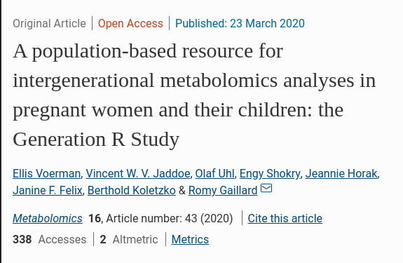
Example Study
Prospective study of 994 mother-child pairs
Either mother, infant, or 10y/o
Sampled blood serum or umbilical cord blood
Liquid chromatography followed by mass spec (LC-MS) to target:
  Amino acids
  Non-esterified fatty acids
  Phospholipids
  Carnitines
Measured ~200 metabolites in each sample

Slide 17
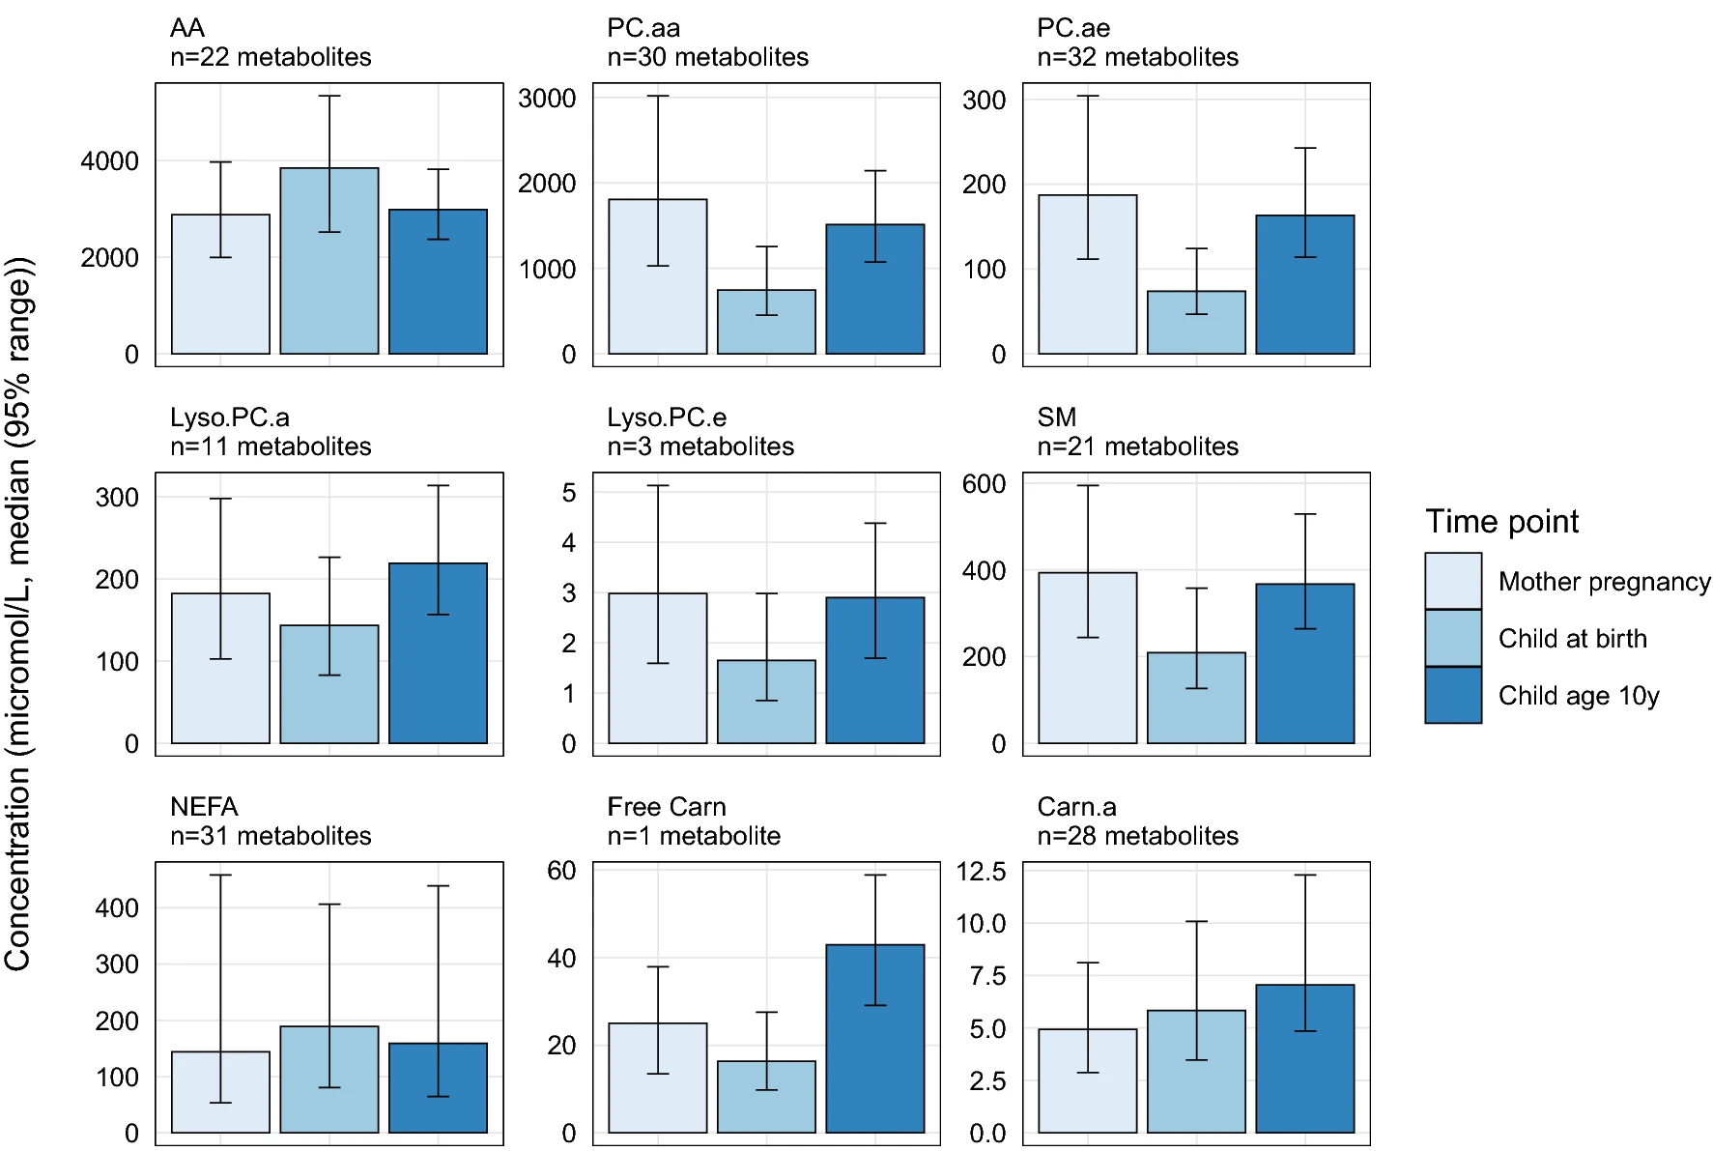
Example Study: Differential Concentration
Metabolites groups by structure:
AA - amino acid
NEFA - non-esterified fatty acids
PC - phospholipid
Carn - carnitines
Etc
Plotted absolute concentration divided by group
“Differential concentration” analysis

Slide 18
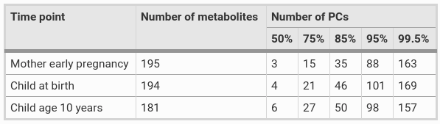
Example Study: PCA
Principal Component Analysis of all metabolite concentrations
More PCs required to explain variance in 10y/o compared with other sample types
% explained variance
# of components required

Slide 19
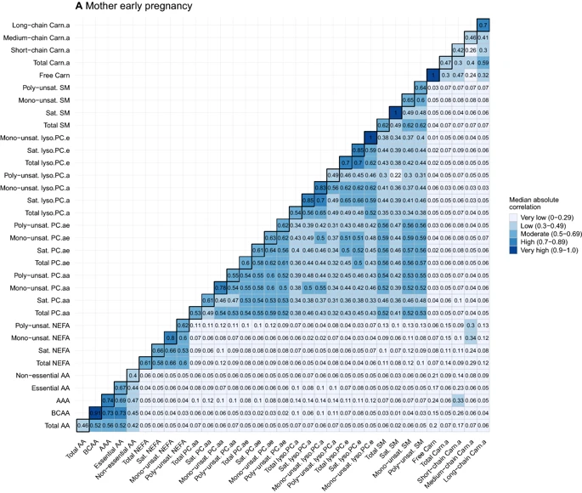
Example Study: Correlation w/in Individual
Metabolite concentration correlated by structure group
Plotted median absolute correlation (most are +) of all pairwise metabolites from each grouping
Correlation structure of mother in pregnancy similar to infant (not shown here, see study)

Slide 20
Common Challenges
Metabolomics analyzes a broad range of features
  Small, hydrophilic carbohydrates (e.g. glucose) – Large, hydrophobic lipids (e.g. triacylglycerides) – Complex, natural compounds (e.g. antibiotics)
    Different sizes, charge, composition
    Different biological roles and implications
Many metabolites are not in databases: our picture of cellular metabolism is incomplete
Identification of novel metabolites is difficult

Slide 21
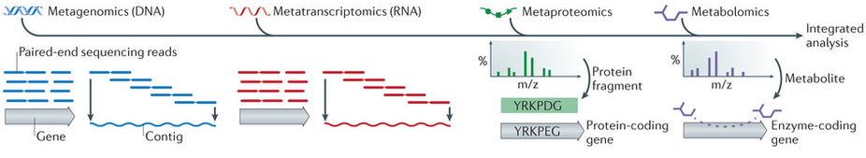
Approaches for Microbiome Analysis
“Metataxonomics”: What is the composition?
  Use marker genes (e.g. 16S rRNA)
Metagenomics: What is the composition and functional potential?
Metatranscriptomics: What genes are collectively expressed?
Metabolomics: What metabolic byproducts are used/produced?

Slide 22
Detection Methods
LC/MS
NMR
Separation required (sometimes multiple chromatographic methods)
Can resolve and quantify individual metabolites in complex mixtures
Biased against volatile metabolites
High sensitivity and dynamic range
Limited capacity for quantification
No separation required
Limited ability to resolve complex mixtures
Low(er) sensitivity
Absolute quantification of metabolites

Slide 23
Detection Methods
LC/MS
GC/MS
Separation required (sometimes multiple chromatographic methods)
Can resolve and quantify individual metabolites in complex mixtures
Biased against volatile metabolites
High sensitivity and dynamic range
Limited capacity for quantification
Separation required
Can quantify volatile and uncharged metabolites, isomeric compounds (e.g. sugars, lipids)
Absolute quantification of metabolites

Slide 24
Why Metabolomics?
Metagenomics enables the prediction metabolites (based on what enzymes are present)
Metabolomics enables the quantification/identification of metabolites through direct measurements
Provides a good measure of phenotype and biochemical activity

Slide 25
Metabolomics
?
“Beyond”
(Entire Community)

Slide 26
Meta-Metabolomics
Metabolites
“Beyond”
(Entire Community)

