Slide 1
Biological Databases

Slide 2
Biology Is A Data Science
Hundreds of thousand of species
Million of articles in scientific literature
Genetic Information
  Gene names
  Phenotype of mutants
  Location of genes/mutations on chromosomes
  Linkage (relationships between genes)

Slide 3
Data and Metadata
Data are “concrete” objects
  e.g. number, tweet, nucleotide sequence
Metadata describes properties of data
  e.g. object is a number, each tweet has an author
Database structure may contain metadata
  Type of object (integer, float, string, etc)
  Size of object (strings at most 4 characters long)
  Relationships between data (chromosomes have zero or more genes)

Slide 4
What is a Database?
A data collection that needs to be :
  Organized
  Searchable
  Up-to-date
Challenge:
  change “meaningless” data into useful, accessible information

Slide 5
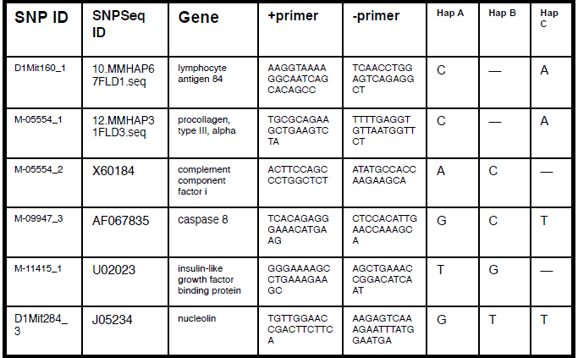
A spreadsheet can be a Database
Rectangular data
Structured
No metadata
Search tools:
  Excel
  grep
  python/R

Slide 6
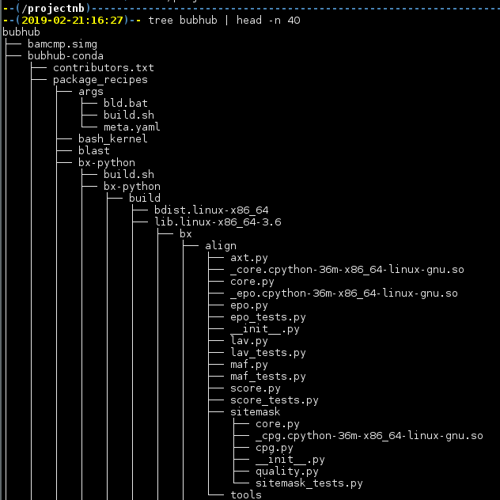
A filesystem can be a Database
Hierarchical data
Some metadata
  File, symlink, etc
Unstructured
Search tools:
  ls
  find
  locate

Slide 7
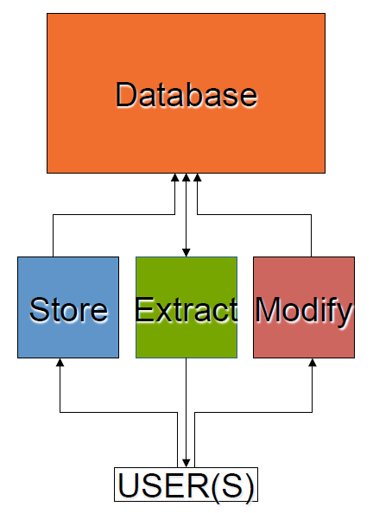
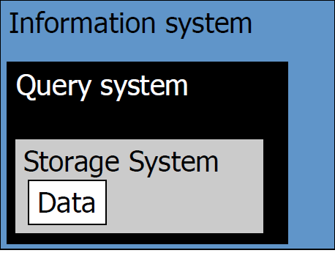
Organization and Types of Databases
Every database has tools that:
  Store
  Extract
  Modify
Flat file databases (flat DBMS)
  Simple, restrictive, table
Hierarchical databases
  Simple, restrictive, tables
Relational databases (RDBMS)
  Complex, versatile, tables
Object-oriented databases (ODBMS)
Data warehouses and distributed databases
Unstructured databases (object store DBs)

Slide 8
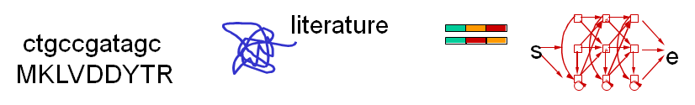
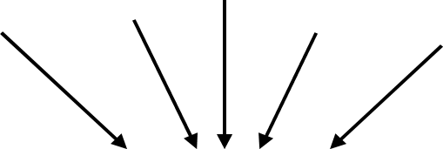


Where do the data come from ?

Slide 9
Types of Biological Data
Primary data types (observed properties):
  Molecular Sequence: nucleic or amino acids
  Quantity: DNA, RNA, Protein, cell count, metabolites
  Locality: membrane, nucleus, epithelium
  Structure: 3D conformation, proximity, size
Secondary data types (inferred properties):
  Molecular Function
  Dynamics
  Relation: multiplicity, distribution, binding
  Association: co-occurrence, correlation
  Predicted: computational models

Slide 10
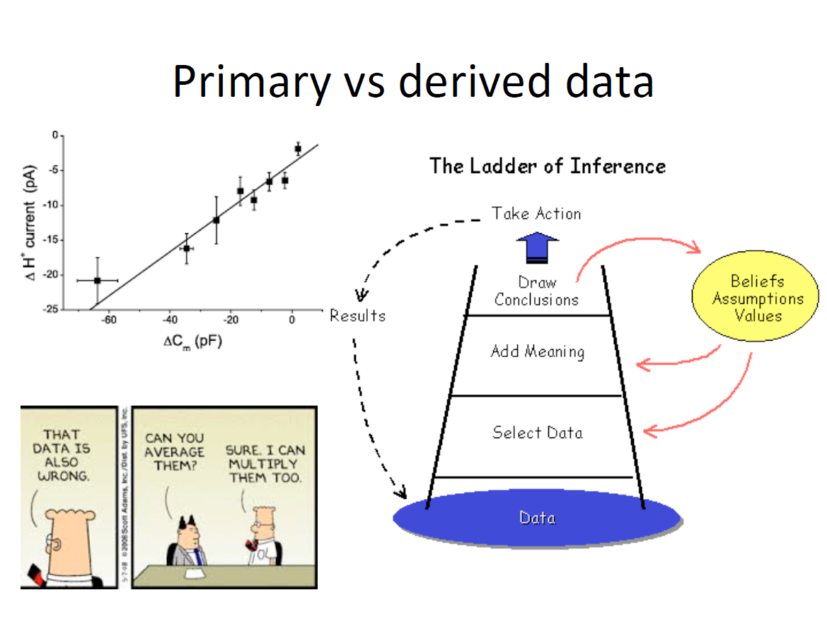
Types of Biological Databases
Primary Databases:
  Original submissions by experimentalists
  Content controlled by the submitter
  Examples: GenBank, Trace, SRA, SNP, GEO
Secondary databases:
  Results of analysis of primary databases
  Aggregate of many databases
  Content controlled by third party (NCBI)
  Examples: NCBI Protein, Refseq, RefSNP, GEO datasets, UniGene, Homologene, Structure, Conserved Domain

Slide 11
NCBI
National Center for Biotechnology Information
>50 different biological databases and tools
Most popular:
  PubMed - search for citations/papers
  BLAST - search for sequences
  Nucleotide - all nucleotide sequences (DNA, etc)
  Genome - published genomes
  SNP (dbSNP) - all human SNPs
  Protein - amino acid sequences

Slide 12
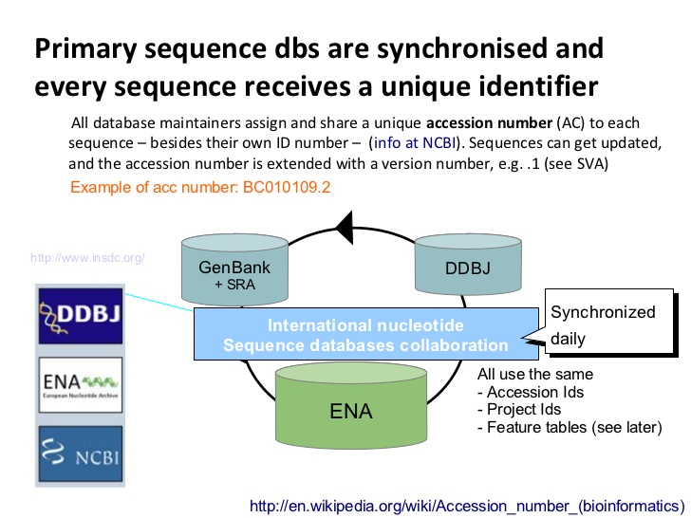
International Sequence Database Collaboration
International Sequence Database Collaboration: http://www.insdc.org/
National Centre for Biotechnology Information (NCBI) : https://www.ncbi.nlm.nih.gov/
European Nucleotide Archive (ENA) : https://www.ebi.ac.uk/ena
DNA Data Bank of Japan (DDBJ) : http://www.ddbj.nig.ac.jp/

Slide 13
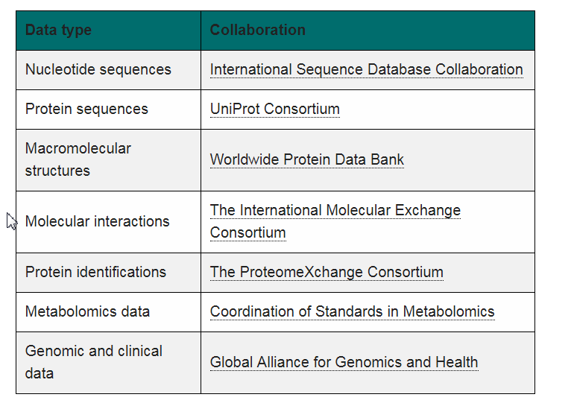
Data sharing collaboration
Ensure data consistency
Avoid duplication
Open data sharing

Slide 14
Biological Databases I:
Biomedical Literature

Slide 15


Biological Database I : Biomedical Literature Database
Citation/publication databases
Medline: https://www.nlm.nih.gov/bsd/pmresources.html
  NLM journal citation database.
  Includes citations 5,600 scholarly journals
PubMed https://www.ncbi.nlm.nih.gov/pubmed/
    Includes MEDLINE
    journals/manuscripts deposited in PMC
    NCBI Bookshelf

Slide 16
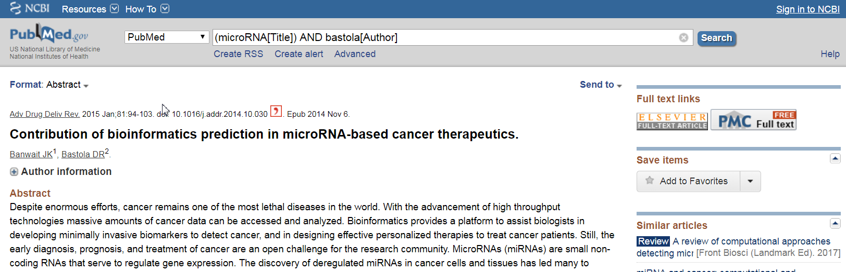
Searching PubMed with MeSH terms
MeSH (Medical Subject Headings) is the NLM controlled vocabulary used for indexing articles for PubMed.
  the U.S. National Library of Medicine's controlled vocabulary
  arranged in a hierarchical manner called the MeSH Tree Structures
  updated annually

Slide 17
Biological Databases II:
Genomics and Transcriptomics

Slide 18
Biological Database II - Genomics and Transcriptomics
GenBank: https://www.ncbi.nlm.nih.gov/genbank/
  Flat file
  DNA only sequence database
  Archival in nature: Historical, Redundant
  Sample GenBank record (accession number U49845)
    NCBI: https://www.ncbi.nlm.nih.gov/nuccore/U49845
    ENA: https://www.ebi.ac.uk/ena/data/view/U49845
    DDBJ: http://getentry.ddbj.nig.ac.jp/top-e.html

Slide 19
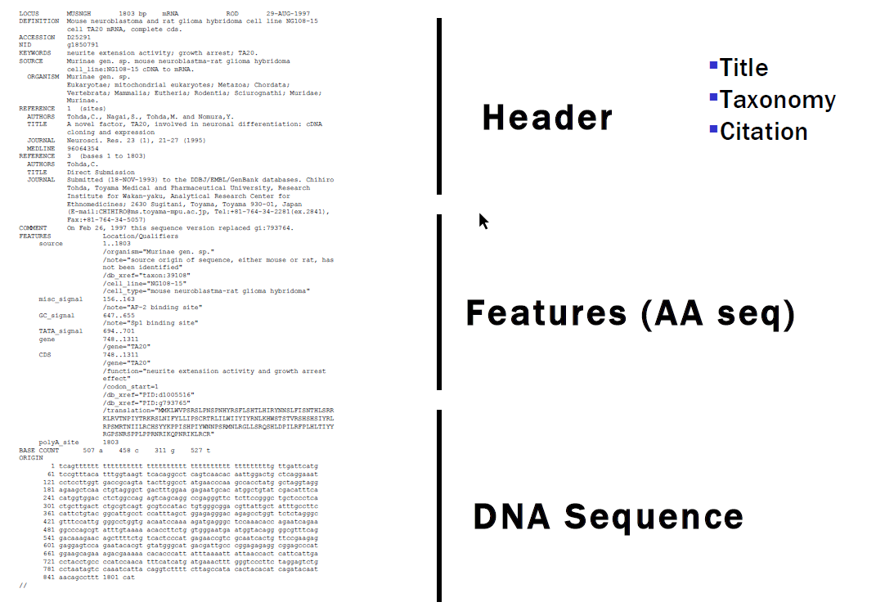
GenBank Flat File

Slide 20
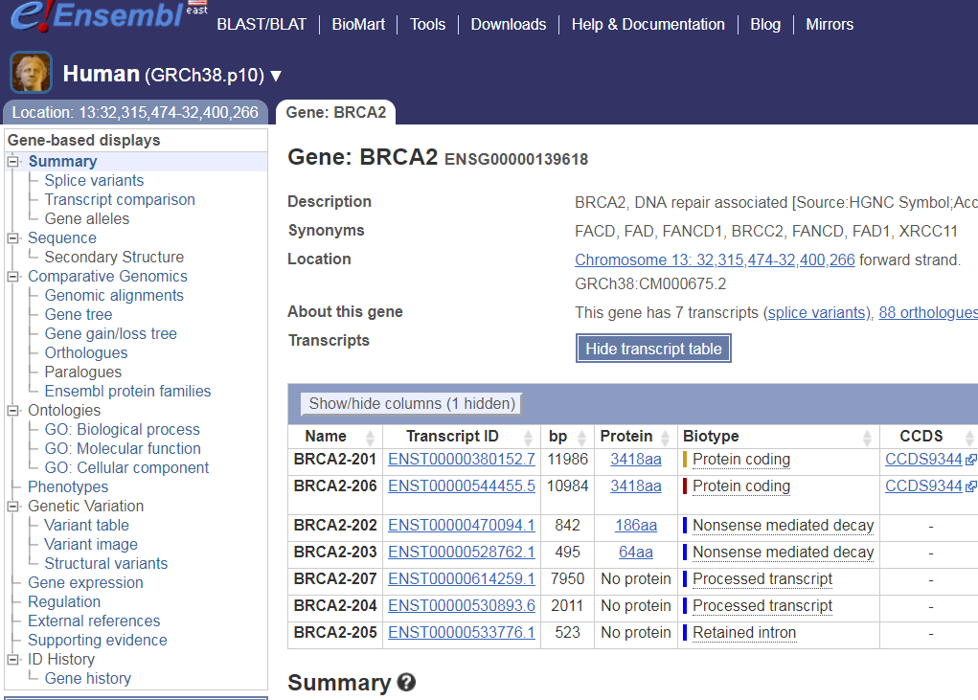
Ensembl
Comprehensive DNA/RNA sequence and annotation database
Automated annotation:
  Genes (known or predicted)
  Single nucleotide polymorphisms (SNPs)
  Repeats
  Homology
Analysis tools:
  BLAST
  BioMart
  Variant Effect Predictor

Slide 21
Nucleic Acid Structure Database
NDB Nucleic acid-containing structures http://ndbserver.rutgers.edu/
NTDB Thermodynamic data for nucleic acids http://ntdb.chem.cuhk.edu.hk/
RNABase RNA-containing structures from PDB and NDB http://www.rnabase.org/
SCOR Structural classification of RNA: RNA motifs by structure, function and tertiary interactions http://scor.lbl.gov/

Slide 22
Biological Databases III:
Proteomics

Slide 23
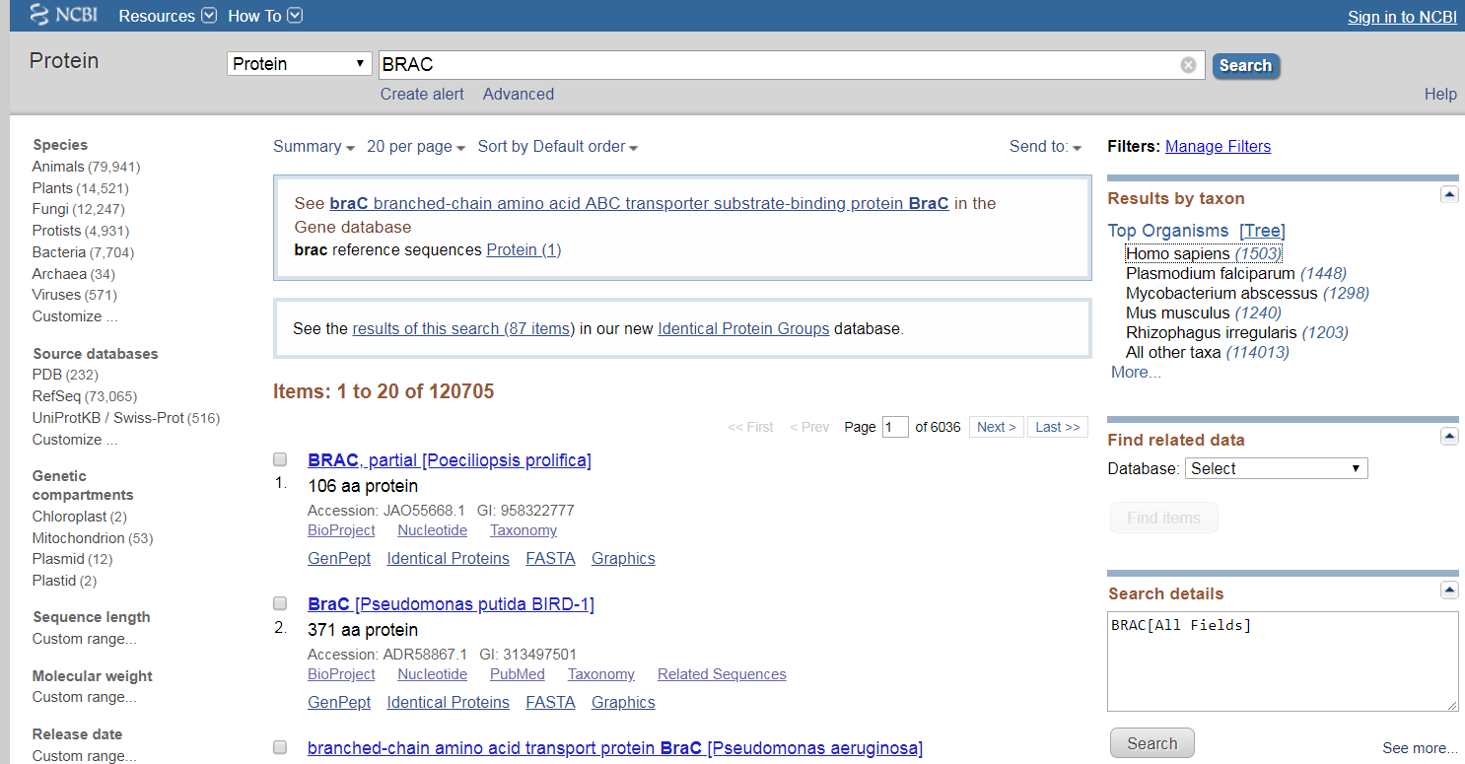
Biological Database III - Proteomics
Protein sequence database: https://www.ncbi.nlm.nih.gov/protein/

Slide 24
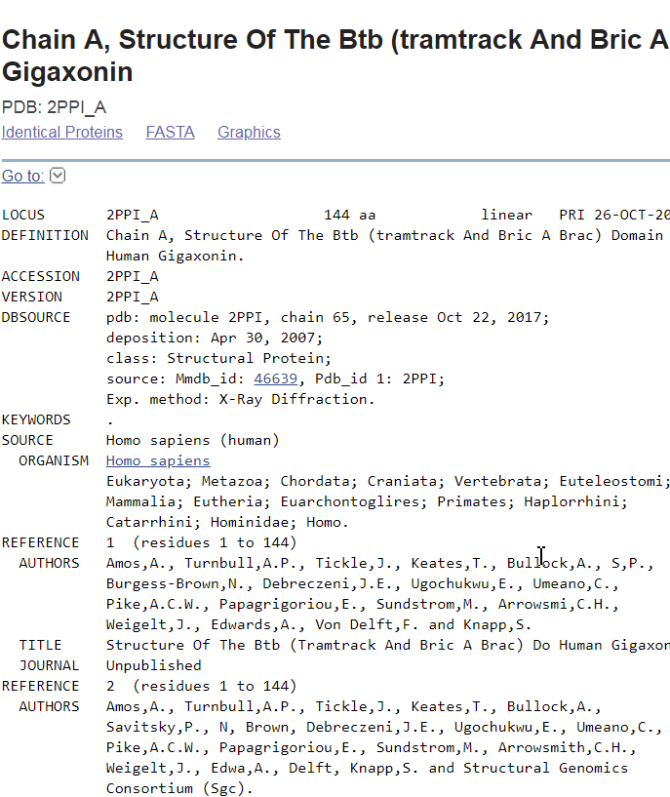
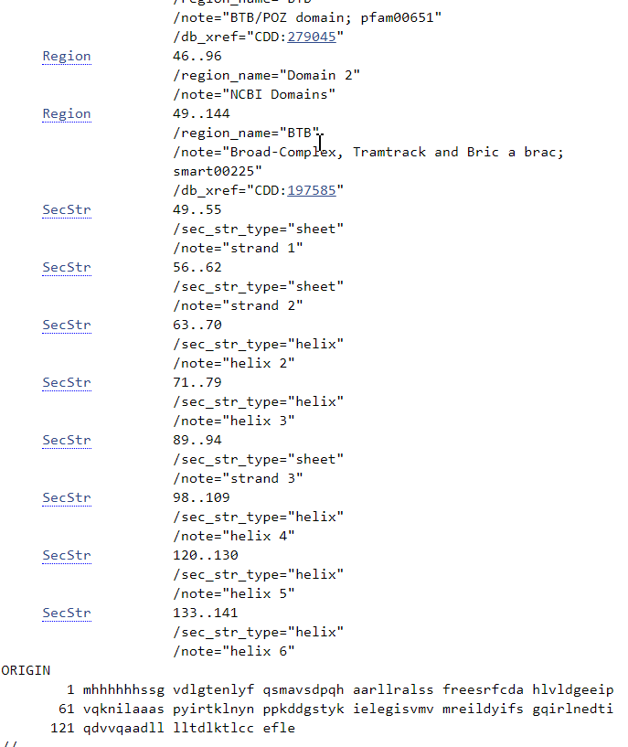
Genpept

Slide 25
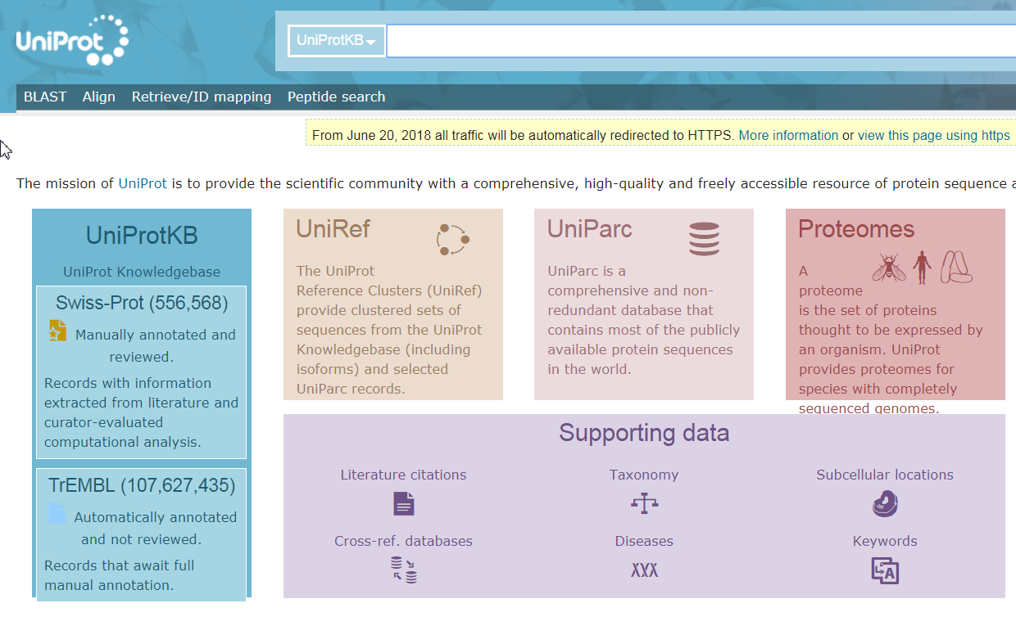
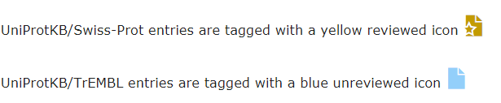
Uniprot
The Universal Protein Resource
Comprehensive resource for protein sequence and annotation data
Collaboration between:
  EMBL-EBI
  Swiss Institute of Bioinformatics
  Protein Information Resource
Entries in two categories:
  Swiss-Prot (experimentally verified)
  TrEMBL (computer-annotated)
http://www.uniprot.org/

Slide 26
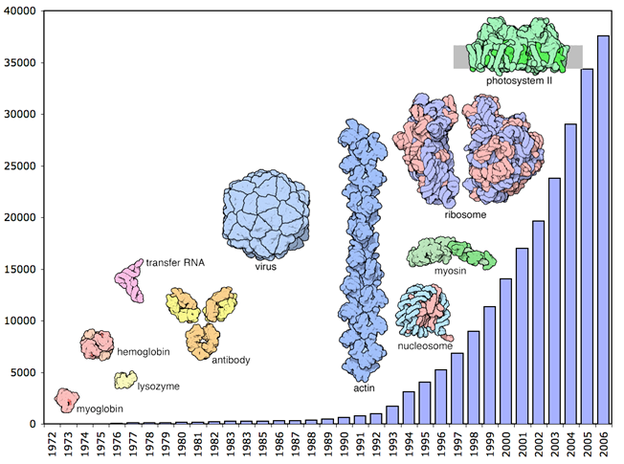
Protein Structure database - PDB
Protein Data Bank (PDB) http://www.rcsb.org/
Dedicated to 3D structure of proteins and peptides
~150,000 predicted and experimental (solved) structures

Slide 27
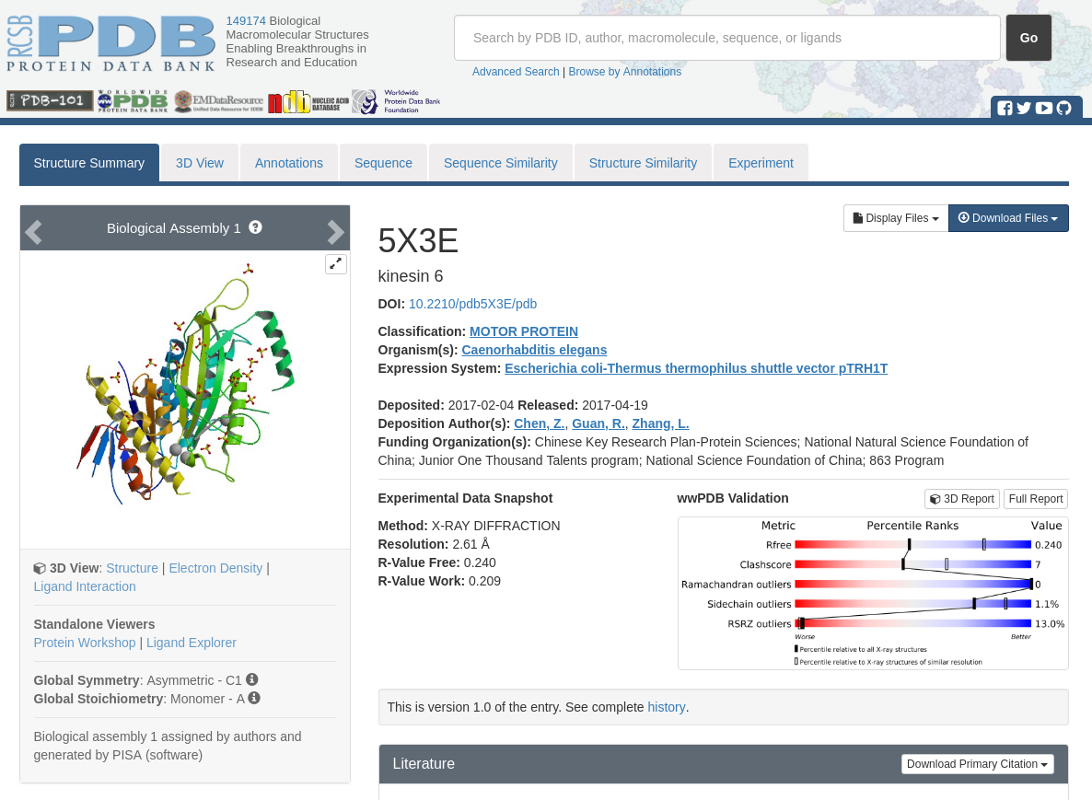
PDB: kinesin 6

Slide 28
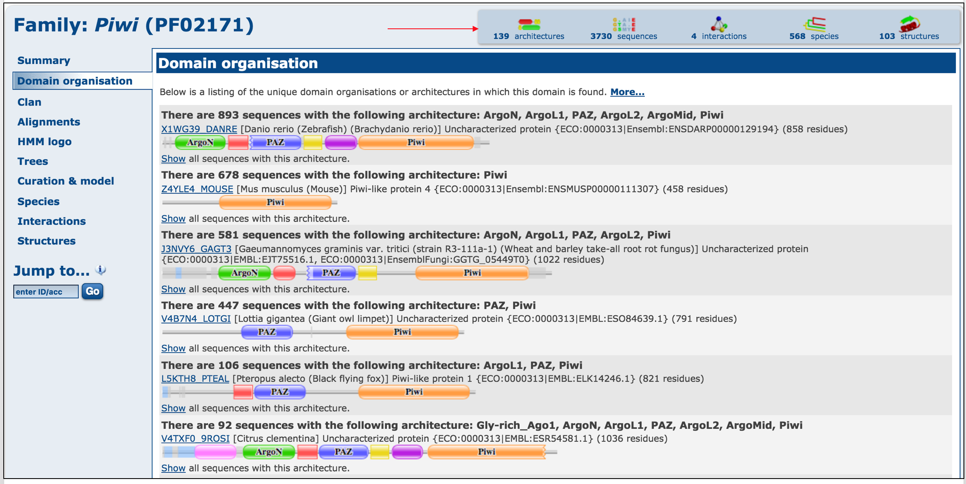
Protein Family Database
http://pfam.xfam.org/family/piwi
Pfam is a database of protein families that includes their annotations and multiple sequence alignments generated using hidden Markov models

Slide 29
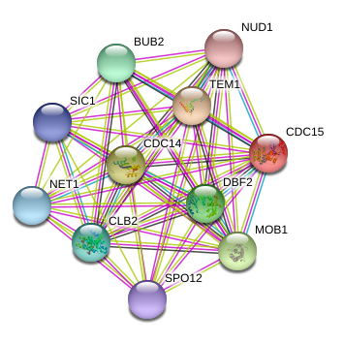
Protein-Protein Interaction Database
STRING: https://string-db.org/
Search Tool for the Retrieval of Interacting Genes/Proteins
Database of protein/protein interactions
Information from numerous sources:
  experimental data
  computational prediction methods
  public text collections
Expressed as interaction graphs:
  Nodes: Network nodes represent proteins
  Edges: Edges represent protein-protein associations

Slide 30
Data vs Annotation Database
RefSeq: curated nonredundant biological sequences https://www.ncbi.nlm.nih.gov/refseq/
  Source: Genbank (INSDC)
  Annotated: Community collaboration, automated computer, NCBI staff curation
Advantages of using RefSeq
  Non-redundancy
  Curated, validated
  Format consistency
  Distinct accession series
  Updates to reflect current sequence data and biology
Notes:
https://www.nature.com/scitable/topicpage/genomic-data-resources-challenges-and-promises-743721#

Slide 31
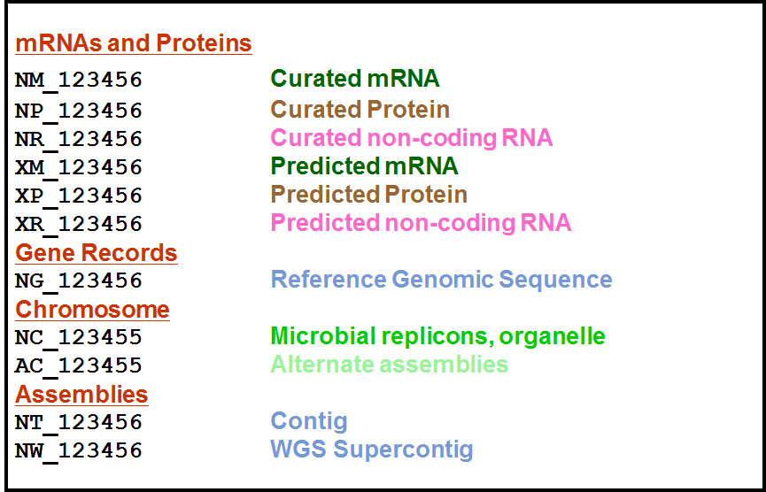
Selected Refseq Accession

Slide 32
High-Throughput Sequencing Databases
Gene Expression Omnibus (GEO)
NCBI Sequence Read Archive (SRA)
db of Genotype and Phenotype (dbGAP)
European Genome Phenome Archive
Notes:
GEO (e.g. GSE37757)
Submitters supply their gene expression data in four sections:
Platform: describes the list of features on the array (e.g.,cDNAs, oligonucleotides, etc.)
Sample: describes the biological material and the experimental conditions under which the sample was handled, and the abundance measurement of each feature derived from it.
Series: defines a set of related Samples that are considered to be part of an experiment.
Supplementary data: original microarray scan images or raw quantification data.
FTP download: All Platform, Sample and Series records, raw data, with annotation are available for bulk download via FTP at

Slide 33
Other Specialised Databases
UCSC Xena: https://xenabrowser.net/datapages/
Genotype-Tissue Expression Gtex: https://www.gtexportal.org/home/
mirBase:http://www.mirbase.org/
Pubchem: https://pubchem.ncbi.nlm.nih.gov/
DrugBank: https://www.drugbank.ca/
Many more...

Slide 34
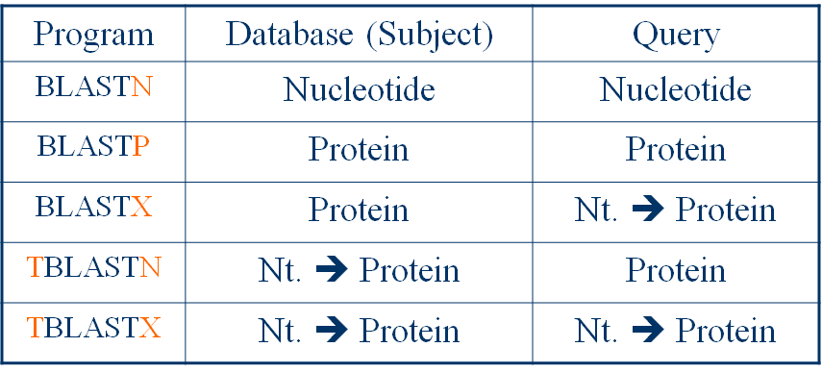
BLAST
BLAST stands for Basic Local Alignment Search Tool
  Good balance of sensitivity and speed
  Searches all publicly available sequences
  Flexible
Produce local alignments
Applies heuristic, no optimality guarantee

Slide 35
