Slide 1
Reproducible Bioinformatics Research

Slide 2
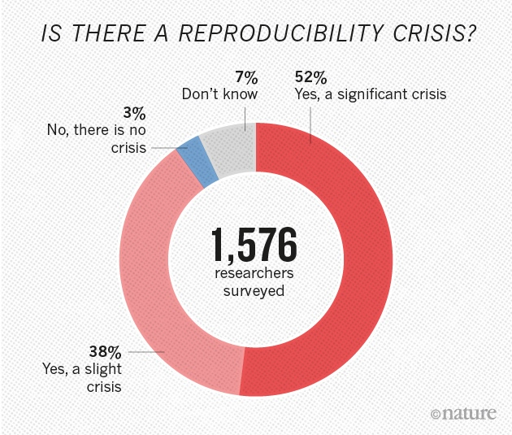
The Reproducibility “Crisis”
“More than 70% of researchers have tried and failed to reproduce another scientist's experiments, and more than half have failed to reproduce their own experiments.”
Baker, Monya. 2016. “1,500 Scientists Lift the Lid on Reproducibility.” Nature 533 (7604): 452–54.

Slide 3
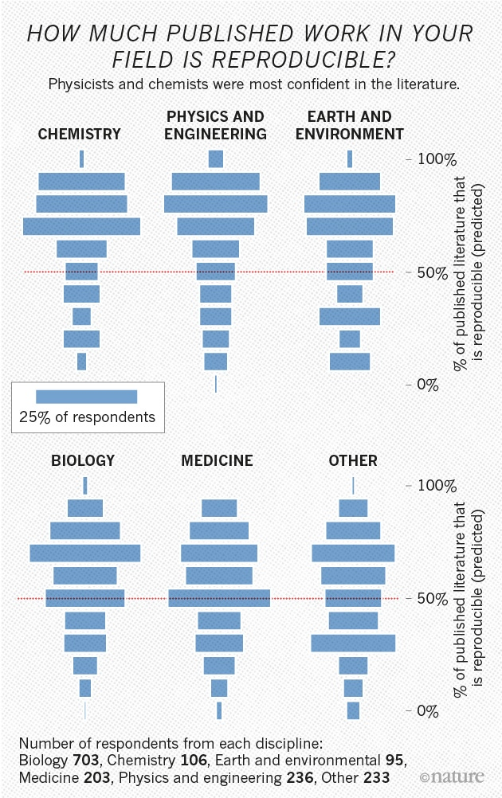
The Reproducibility “Crisis”

Slide 4
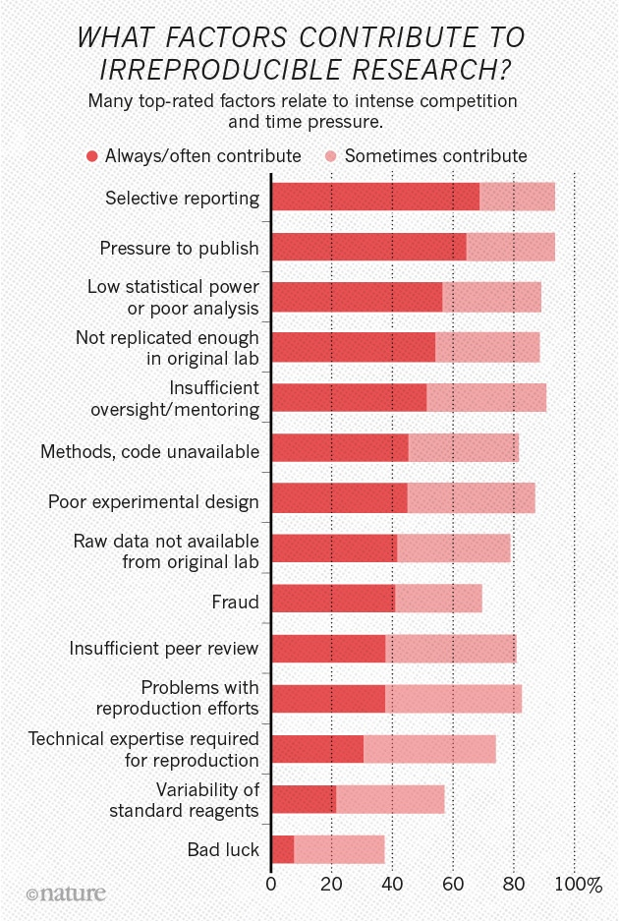
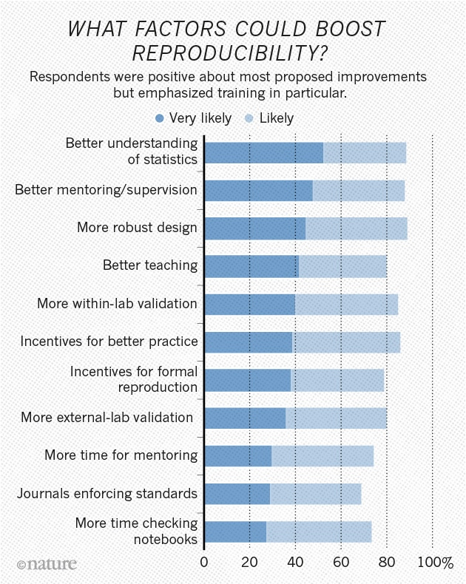
The Reproducibility “Crisis”

Slide 5
Reproducibility vs Replicability
Reproduce: create identical conditions to a previous result and come to the identical result
Replicate: repeat a previously described experiment with new material or data
Depending on who you ask, these definitions are reversed!
http://languagelog.ldc.upenn.edu/nll/?p=21956

Slide 6
What is Reproducibility?
Reproduce: create identical conditions to a previous result and come to the identical result
For Bioinformatics, this means:
  apply the same methodology (ideally same code) to
  the same data and obtain
  the same result
If code is not available, must first reimplement the method

Slide 7
What is Replicability?
Replicate: repeat a previously described experiment with new material or data
For Bioinformatics, this means:
  apply the same methodology to new data or
  a new methodology to the same data and arrive at
  the same biological conclusion
If code is not available, must first reimplement the method

Slide 8
Definitions for this lecture
Reproduce = show methodology was applied correctly
Replicate = test whether the scientific result is “true”
Reimplement = turn verbal description of method into a new reification of the method
Reapply = run existing code on existing or new data
In summary:
Reproducibility and replicability are about results
Reimplementation and reapplication are about methods

Slide 9
Reproducibility in Bioinformatics

Slide 10
Four Main Components of Analysis
Computational Environment
Data
Code
Presentation

Slide 11
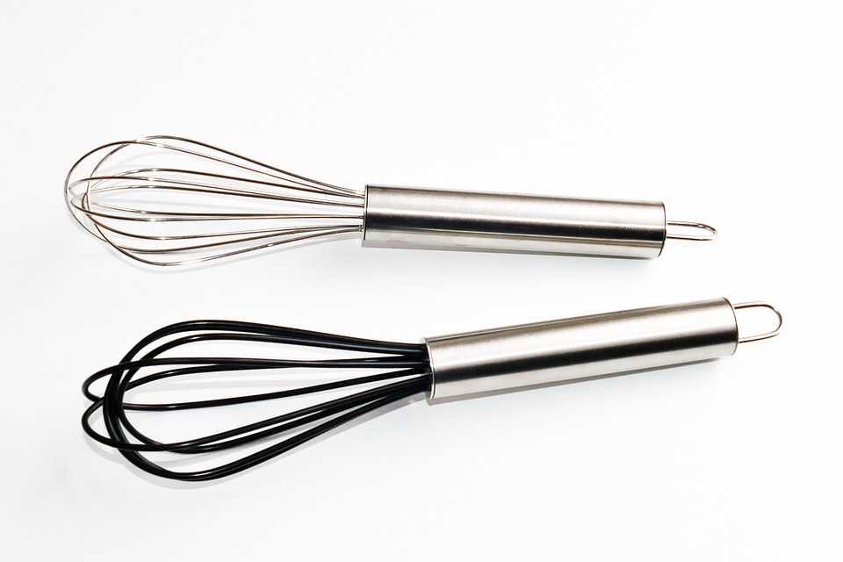
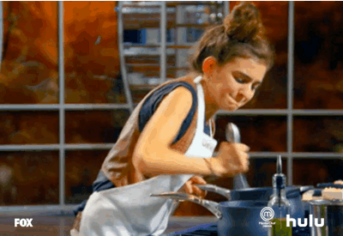

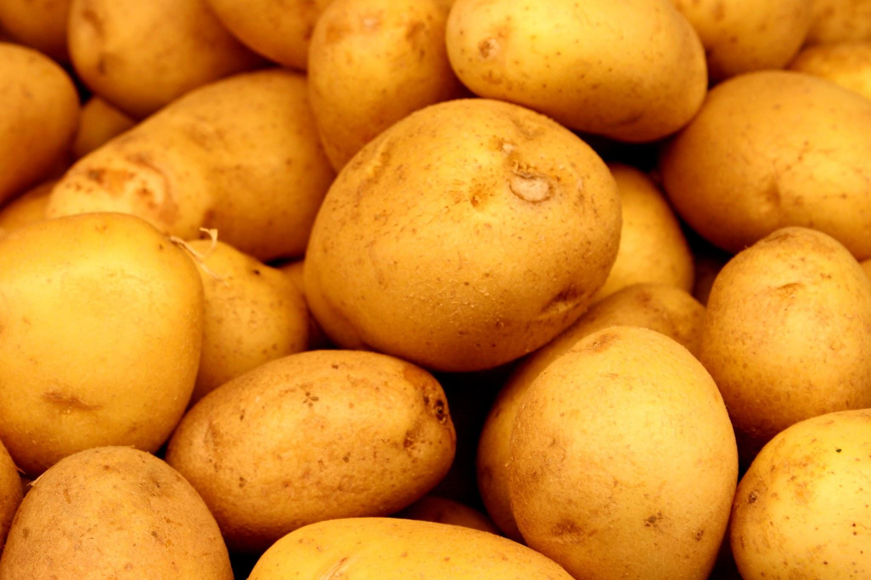

Kitchen Analogy
Code
+
Environment
Data
Presentation

Slide 12
Computational Environment

Slide 13
Software Environment
Software requires other software
e.g. DESeq2 → bioconductor → R → OS libs
Every piece of software has a version
Not all OSes have all software versions
Must describe software and versions and their dependencies and their versions to fully recreate an environment!

Slide 14
Hardware Environment
Analyses are run on specific hardware
e.g. intel, AMD, GPU, SCC
Some software is hardware-specific
Any known hardware specificities must be described to recreate an environment

Slide 15
Environment Management
Environment management = organization and configuration of a set of software
It is: a set of operations that make specific software executable
It may be: a portable description of the software environment

Slide 16
GNU modules
System for organizing software and its dependencies
Typically used by system administrators
A module manipulates your shell to include specific files and libraries
Not a means to portable reproducibility!
Strengths: software locally maintained, easy to use
Disadvantages: manually maintained, requires sysadmin support and/or knowledge

Slide 17

Anaconda and miniconda
anaconda: python distribution and
environment management suite
miniconda: just environment management suite
create environment that installs and describes a set of packages with versions
software organized into channels, e.g. bioconda
Strengths: easy to use, good environment description
Disadvantages: packages must already be in channels, when it fails it fails hard...

Slide 18
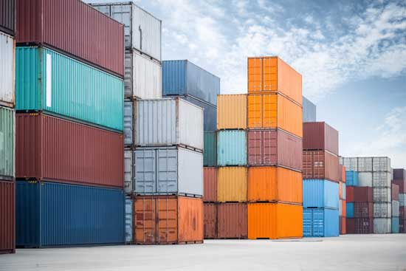


Containerization
Web server
A different web server
Parallelized
Research
Apps
Rstudio
Database

Slide 19
Containerization
Complete environment description
Essentially mini operatings systems
Contain all specific software needed for an analysis
Custom code can also be loaded into container
Current technologies: docker and singularity
Strengths: ideal strategy for encapsulating and sharing environments
Disadvantages: requires sysadmin knowhow, docker has prohibitive technical requirements for SCC

Slide 20
Data

Slide 21
Three types of data
Source data
  short read datasets, microarrays, etc
Support data
  Reference genomes, gene annotations, etc
Transformed data
  Alignments, gene counts, etc.

Slide 22
Source Data
Raw, unprocessed data is always preferred
  E.g. untrimmed reads directly from sequencer
Data should be deposited in a publicly available repository
  E.g. GEO, dbGaP, figshare, zenodo
Repository should have a plan for longevity
  No personal servers!

Slide 23
Support Data
Data used to condense, process, annotate, and interpret source data
Most support data are maintained in persistent repositories with consistent formats
If there is a persistent link, specify it!
If not, download and store data yourself

Slide 24
Transformed Data
Derived from source(+support) data
Usually what we use to interpret our results
Code is a recipe for creating transformed data from source data
  Should not be maintained as part of your workflow
EXCEPT the final transformed form of the data used to make interpretations

Slide 25
Code

Slide 26

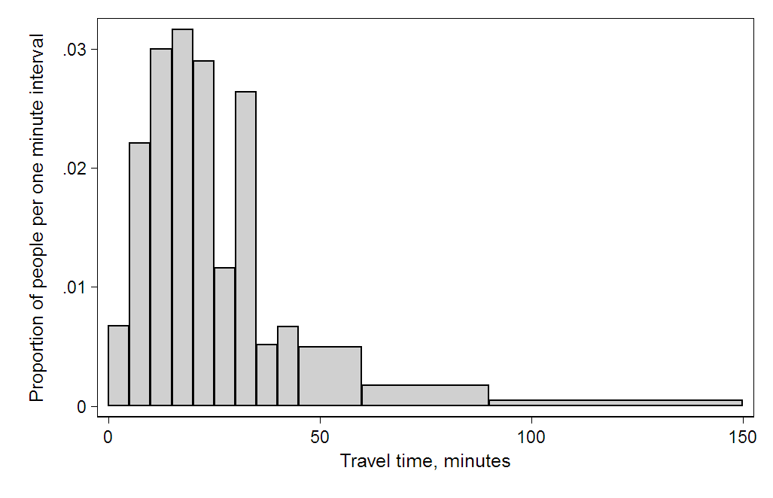

Code is a recipe
Describes how data is transformed from one form to another
Combination of analysis code and glue code
FASTQ
BAM
Counts
Interpretable plots
Countsmatrix
DE genes

Slide 27
Good Coding Practices
Code changes drastically during development
It is tempting to make copies of scripts to preserve old versions
  v1, v2, v2.1, v2.1_good, v2.1_final, v3…
Version Control Systems, e.g. git, are far superior

Slide 28


Web VCS platforms
Web platforms (github.com, bitbucket.org) enable:
  Seamless backup of code
  Simplified sharing and collaboration
  Public dissemination of analysis code upon publication
Employers look for your public software repos!

Slide 29
Code Documentation
Code should be well documented in comments and README files, also:
Code should be well documented in comments and README files, then:
Code should be well documented in comments and README files, also then:
Future you will thank current you for it

Slide 30
Presentation

Slide 31
Tables and Figures
Main vehicles of scientific communication
Guide readers through manuscripts
Visualizing data is very powerful, important,
...and very challenging
ALL the data underlying a figure must be available in textual form as well

Slide 32
Tables and Tabular Data
Avoid copy and paste whenever possible!
Tabular data should (almost) always be included as supplementary materials
Standardize formats (CSV, not excel!)
Human- and machine-readable:
  consistent , controlled textual values
  column headers, no comment rows
  no irregular formatting, etc

Slide 33
Figures
Create figures programmatically from transformed data whenever possible
Invest in learning plotting libraries (matplotlib, seaborn, ggplot, etc)
Output to Scalable Vector Format (SVG) rather than bitmap formats

