Slide 1
Single Cell Sequencing

Slide 2
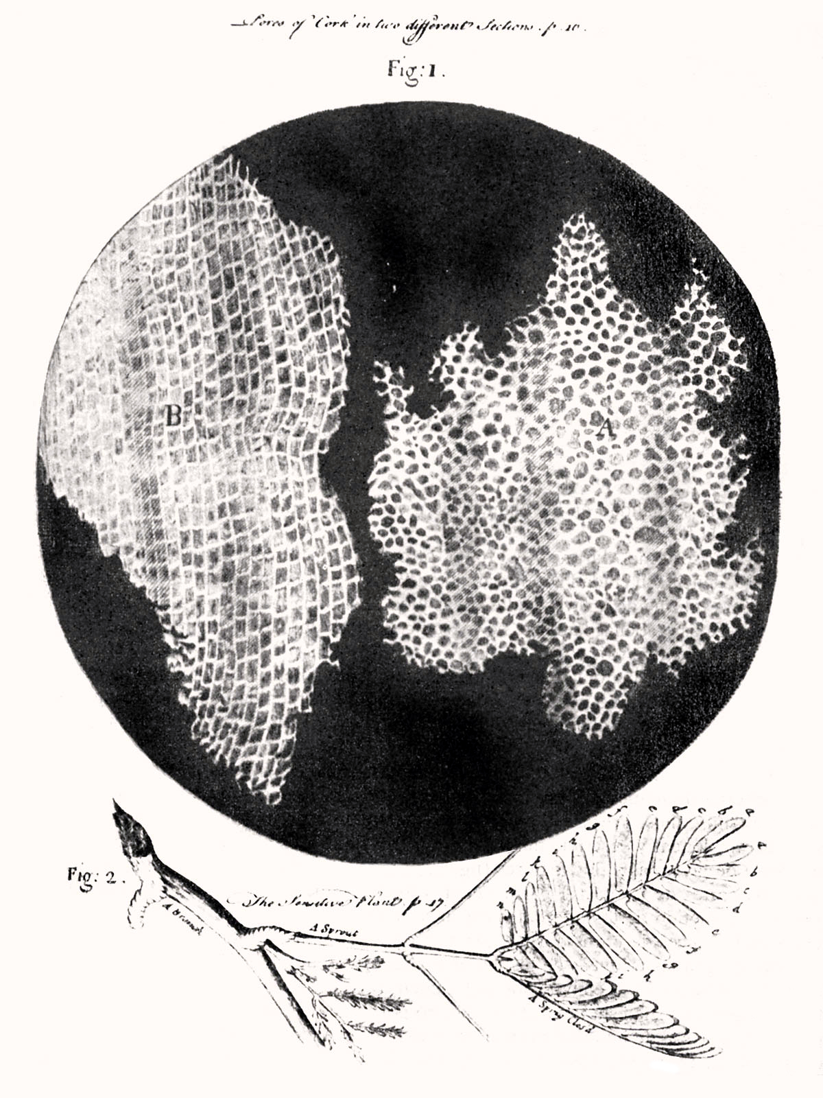
Cells are Important
Fundamental unit of life
Autonomous and unique
Interactive
Dynamic - change over time
Evolution occurs on the cellular level
Robert Hooke’s drawing of cork cells, 1665

Slide 3
Cells are Diverse
Type | Prokaryotes | Eukaryotes
Typical size | ~ 1-5 μm | ~ 10-100 μm
DNA form | Circular | Linear
DNA location | Cytoplasm | Nucleus
DNA amount | ~ .3-16 fg | ~3-300,000 fg
RNA amount | ~ 5-26,000 fg | ~ 1,000-350,000 fg
Landenmark HKE, Forgan DH, Cockell CS (2015). An Estimate of the Total DNA in the Biosphere. PLoS Biol 13(6): e1002168. https://doi.org/10.1371/journal.pbio.1002168

Slide 4
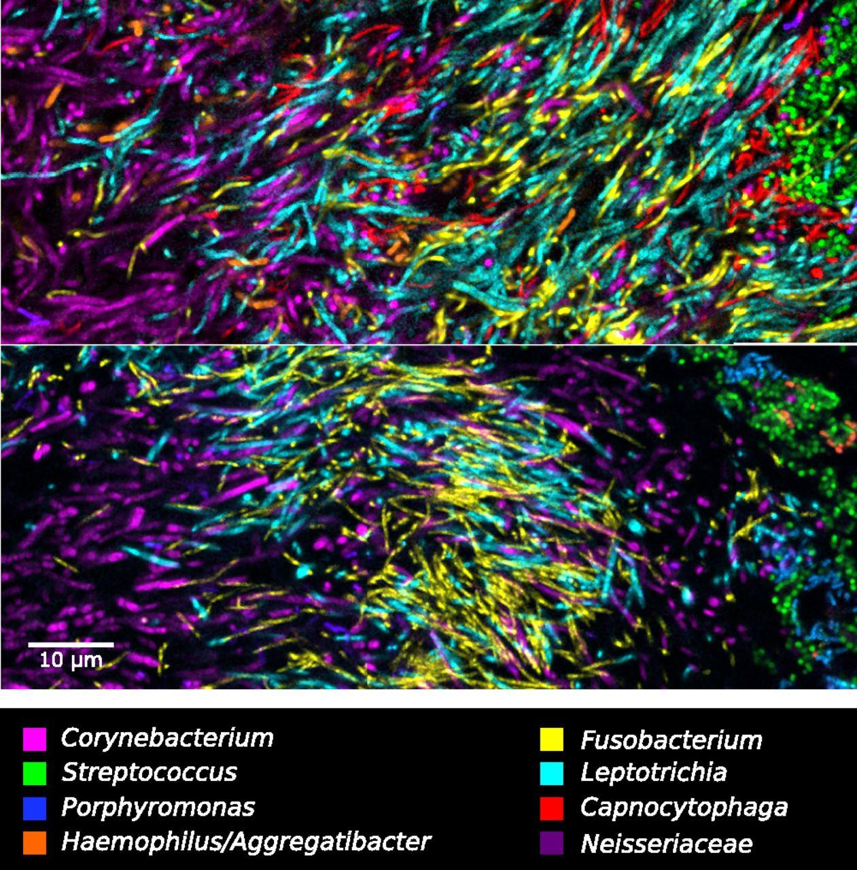
Cells are Diverse: Microbial Ecology
Nearly every environment on Earth supports microbial life
Coresident microbes usually work together in a balance
Imbalances (or invaders) can disrupt the function of overall ecology
Which specific microbes out of millions cause a particular effect?
Mark Welch, et al. 2016. “Biogeography of a Human Oral Microbiome at the Micron Scale.” Proceedings of the National Academy of Sciences of the United States of America 113 (6): E791–800.

Slide 5
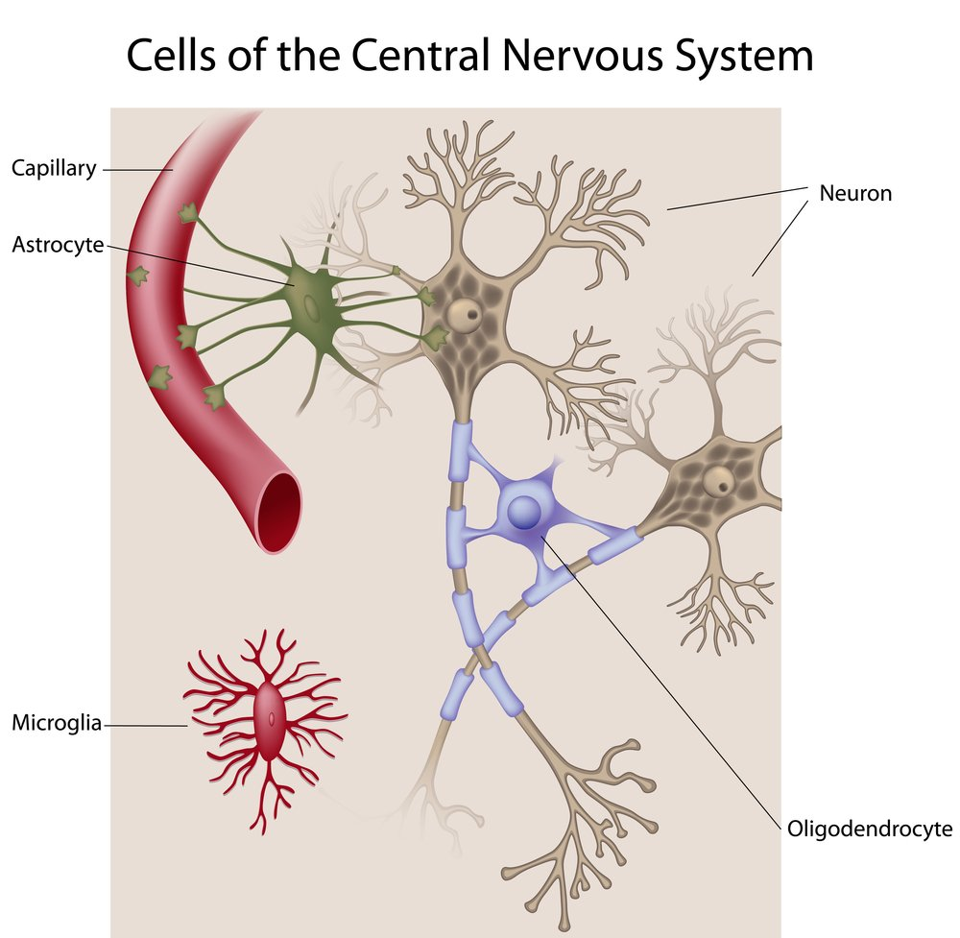
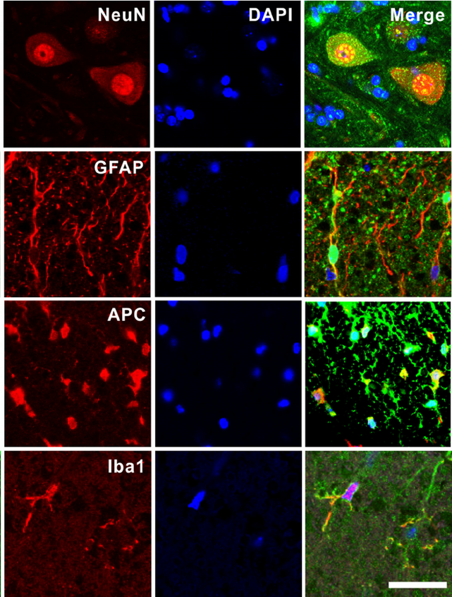
Cells are Diverse: Human Brain
Glia
The vast majority of cells (10x-50x) in your brain are glia, not neurons

Slide 6
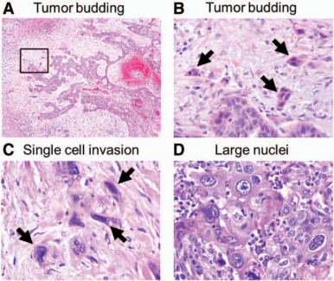
Cells are Diverse: Tumors
Tumors are seeded by single mutated cells
Founder cells divide and further mutate
Large tumors undergo angiogenesis
Selectively kill the cancerous cells: cure the cancer
But which cells to target?
Kadota, Kyuichi, et al. 2014. “Comprehensive Pathological Analyses in Lung Squamous Cell Carcinoma: Single Cell Invasion, Nuclear Diameter, and Tumor Budding Are Independent Prognostic Factors for Worse Outcomes.” Journal of Thoracic Oncology: Official Publication of the International Association for the Study of Lung Cancer 9 (8): 1126–39.

Slide 7
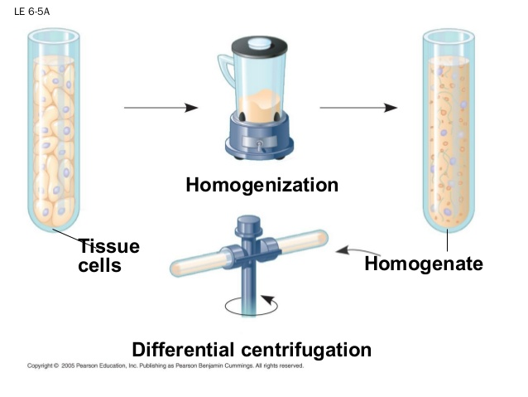
The Forest: Tissue Homogenate

Slide 8
The Trees: Cells
What cell types are in a sample?
What are their proportions?
How does their transcription differ?
Which/how do specific cells respond to stimulus?
How do cells develop over time?
What is the level of mosaicism in tissues?

Slide 9
Single Cell Sequencing Workflow
Dissociation of tissue, isolation of cells
FAC sorting (optional)
Nucleic acid extraction and processing
Sequencing library prep + sequencing
Analysis

Slide 10
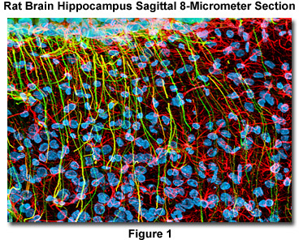
Dissociation of Tissue
Cells in complex tissue are highly intermingled
Must separate cells from each other without destroying them or breaking membranes
Complex cellular morphology
(e.g. neurons) makes dissociation challenging
Can isolate nuclei instead:
  Contain DNA/some RNA
  Much more input material needed

Slide 11
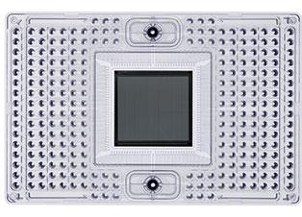
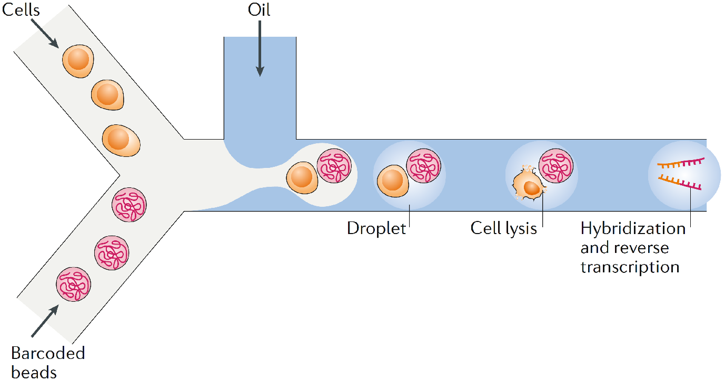
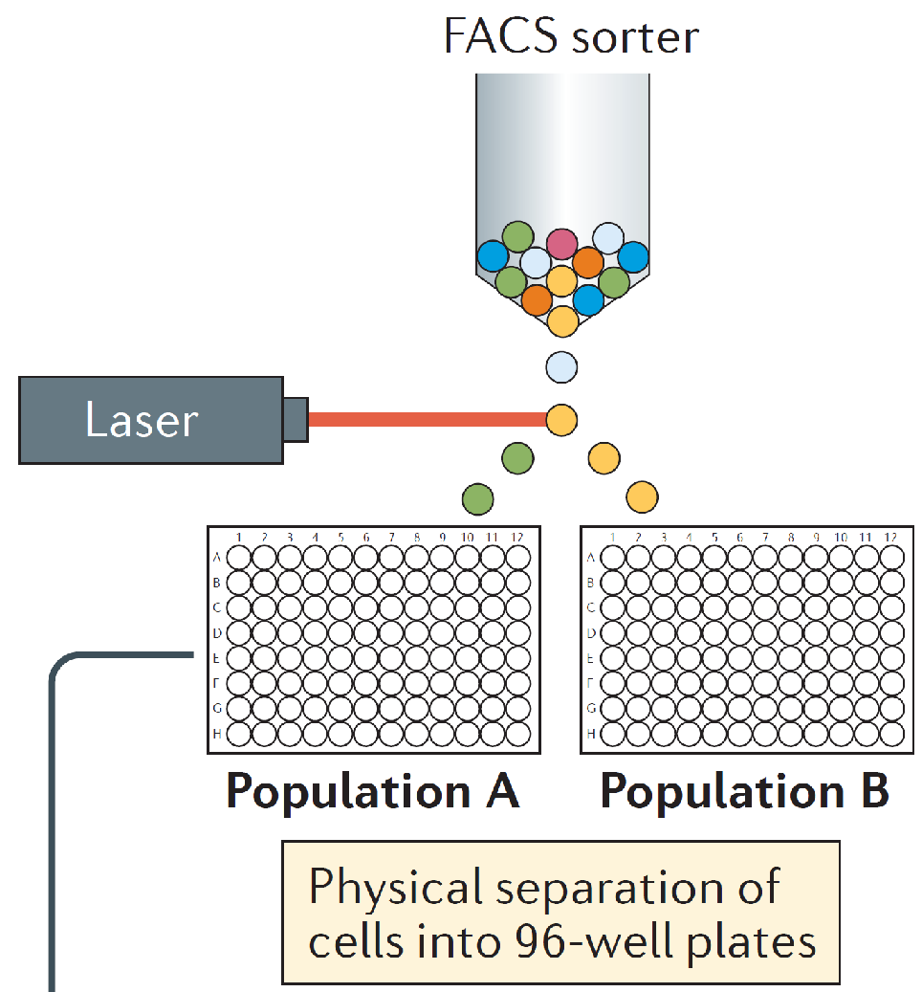
Cell Isolation Techniques
Fluorescence Activated Cell Sorting (FACS)
Droplet Based
Microfluidics
Fluidigm C1
Integrated Fluidic Circuit (IFC)
Some technologies use all three!
Potter, S. S. 2018.
Papalexi, E. Satija, R. 2018.

Slide 12
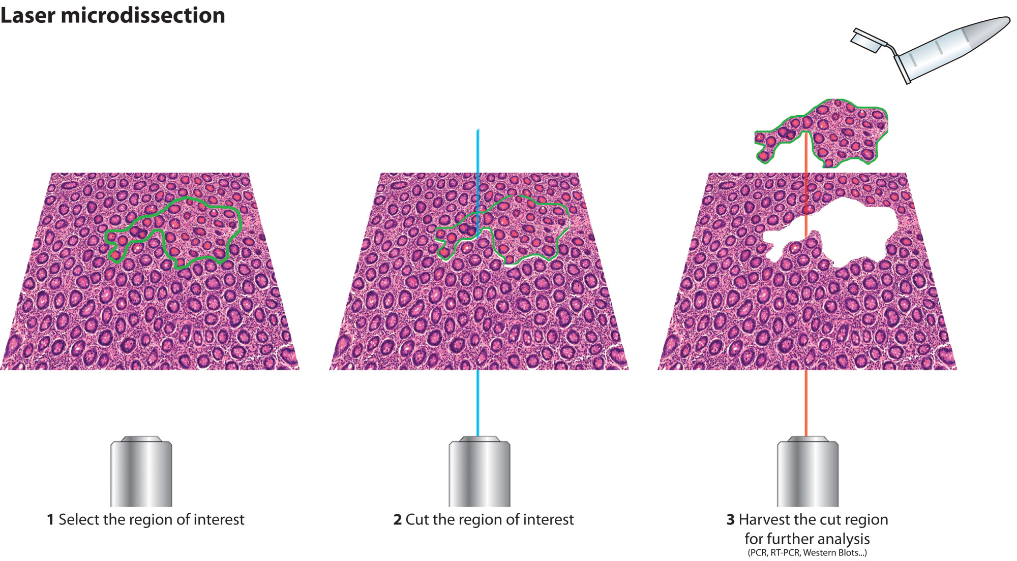
Laser Capture Microdissection
Technique for isolating groups of cells in situ
Low throughput, requires expensive equipment
Laser causes damage to tissue and degrades RNA
Not generally suitable for single cell sequencing

Slide 13
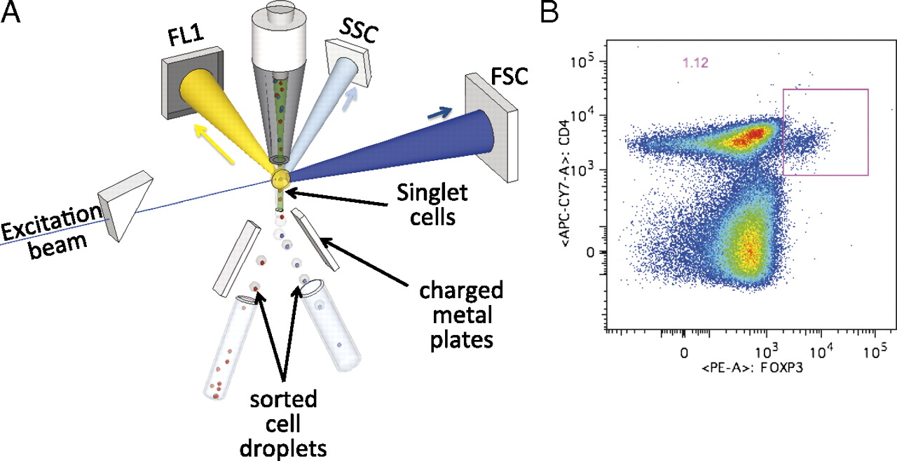
Fluorescence-Activated Cell Sorting (FACS)
Cells with known surface markers are tagged with fluorescent antibodies
Tagged cells excited by lasers during flow cytometry
Excited and non-excited cells separated and collected
Cell type specific populations can be sequenced and studied
Jaye, David L., Robert A. Bray, Howard M. Gebel, Wayne A. C. Harris, and Edmund K. Waller. 2012. “Translational Applications of Flow Cytometry in Clinical Practice.” Journal of Immunology 188 (10): 4715–19.

Slide 14
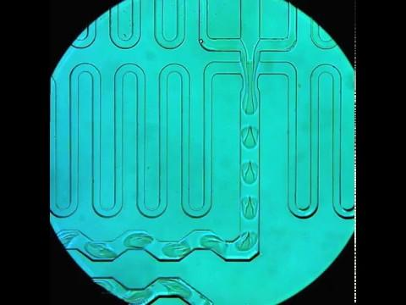
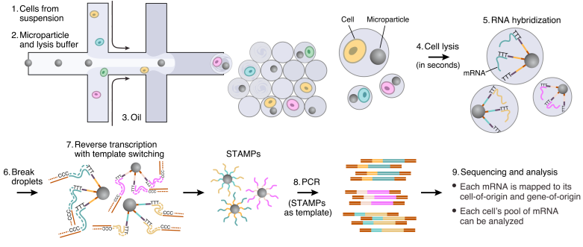
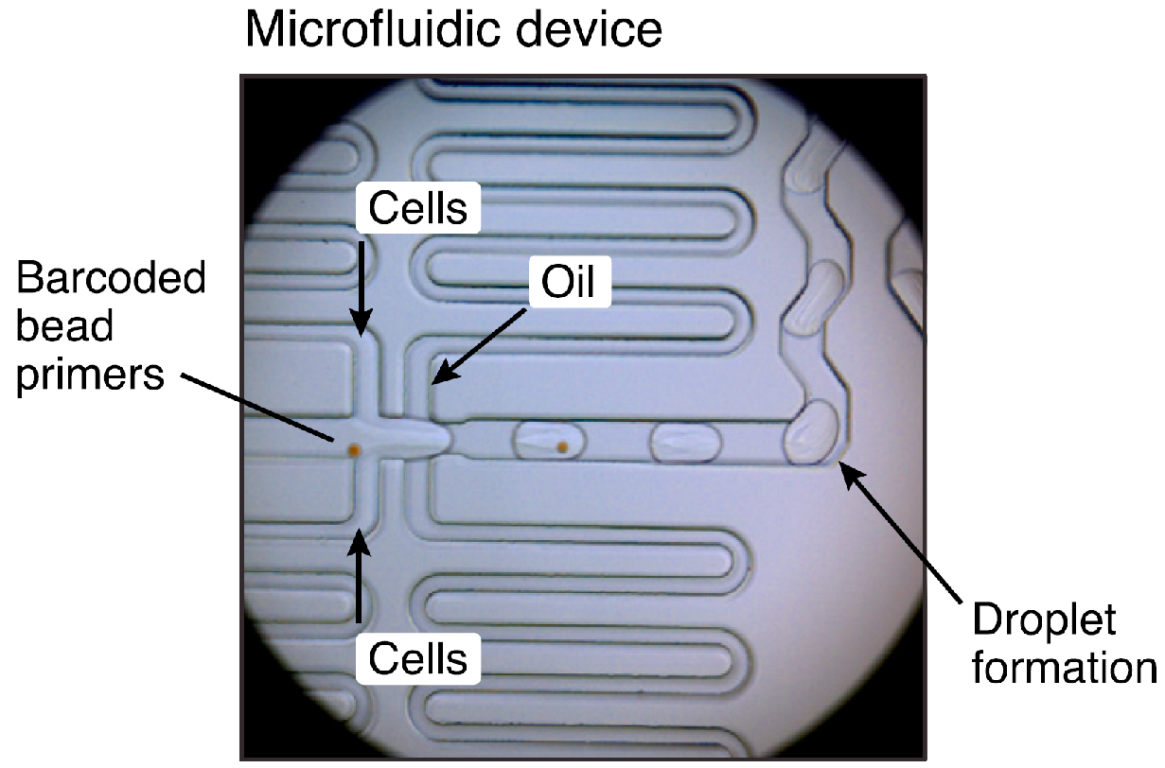
Drop-seq
Microfluidics used to pair cells and barcodes/reagents into separate oil droplets
Concentrations carefully controlled to get 1:1 cell/barcode matches in each oil droplet with high statistical confidence

Slide 15
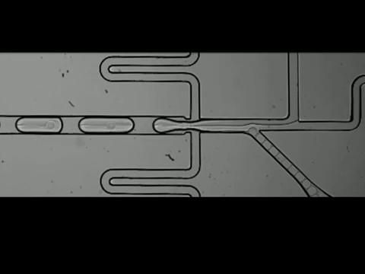
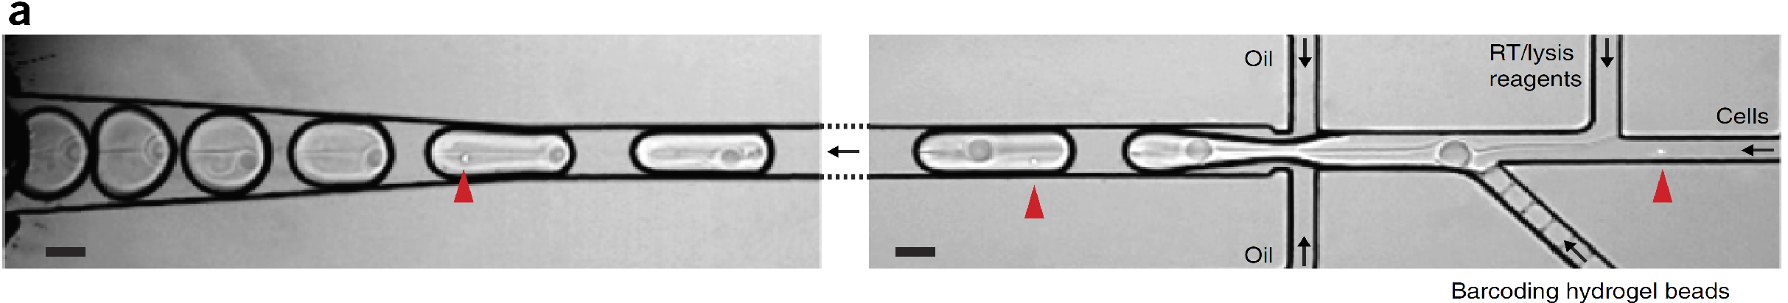
inDrops
Alternative technology to Drop-Seq
Essentially the same strategy, but uses hydrogel beads instead of microparticles

Slide 16
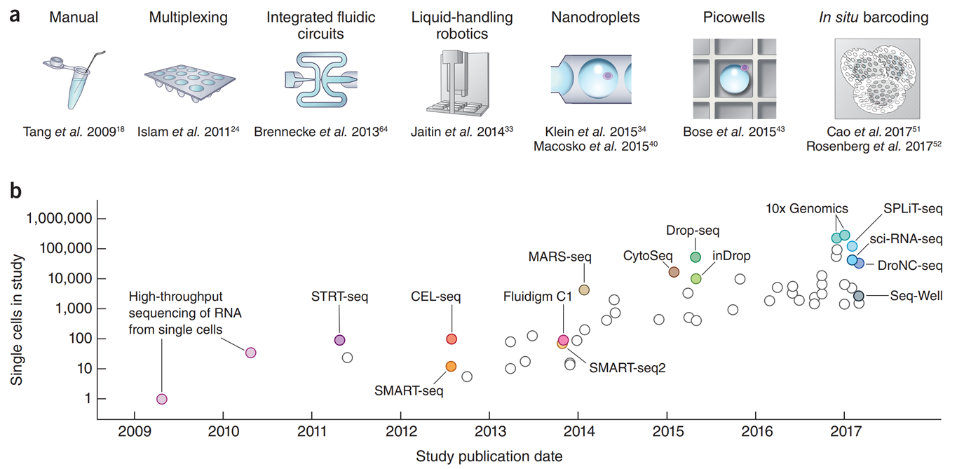
A decade of single cell RNA-seq
Svensson et al. 2018. DOI:10.1038/nprot.2017.149
Slide by Lior Pachter and Matt Thomson

Slide 17
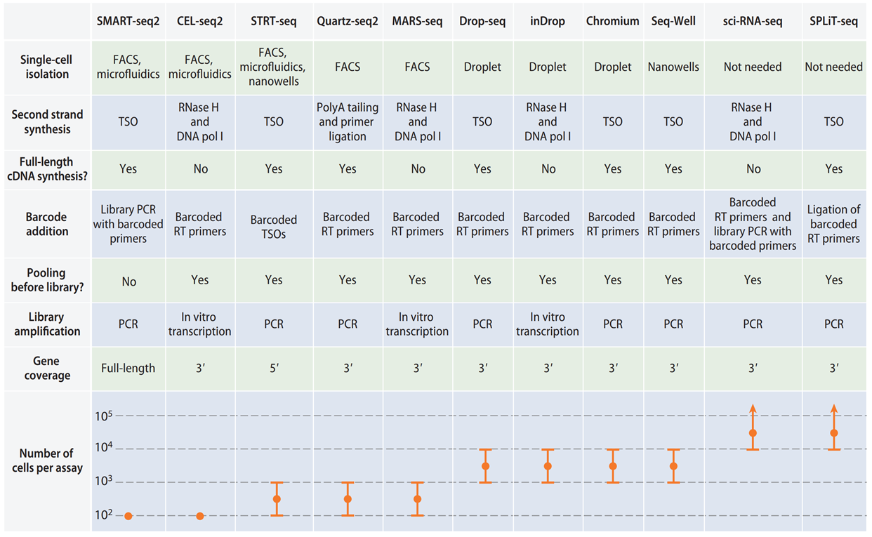
A decade of single cell RNA-seq
Chen et al. 2018. DOI:10.1146/annurev-biodatasci-080917-013452

Slide 18
Nucleic Acid Extraction + Processing
femto- to picograms of input material
Each cell is:
  Assigned a unique DNA barcode
  Optionally treated with UMIs
  Amplified by one of:
    Reverse transcriptase (RNA)
    Multiple displacement amplification (DNA)
    In vitro transcription (RNA)

Slide 19
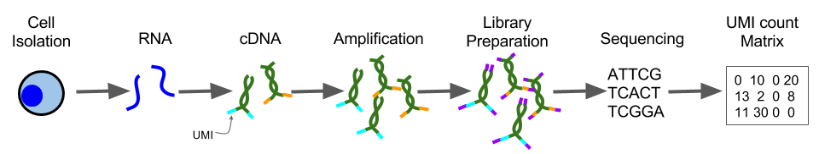
Unique Molecular Identifiers (UMIs)
Low input material may cause amplification bias
UMIs are sequences that correspond to one fragment
Sequenced reads with the same UMI are from the same fragment
Unique sequences collapsed/deduplicated for counting

Slide 20
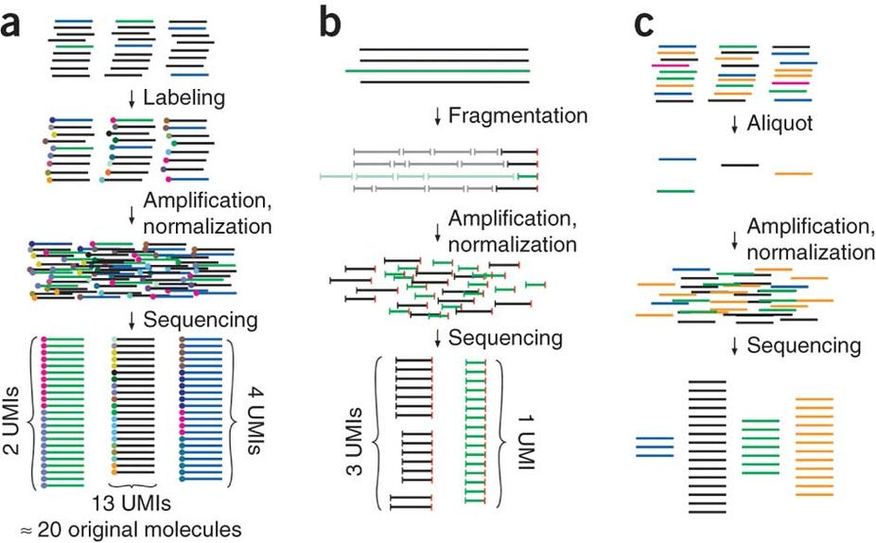
Unique Molecular Identifiers (UMIs)
Strategies for counting individual molecules
Kivioja et al. 2011. “Counting Absolute Numbers of Molecules Using Unique Molecular Identifiers.” Nature Methods 9 (1): 72–74.

Slide 21
Sequencing Library Prep and Sequencing
Previous protocols typically include sequencing primers
Sequencing depth = (# of cells) x (required depth):
  RNA - 50k paired end reads / cell for cell type classification
  RNA - .25M-1M paired reads / cell for transcriptome coverage
  DNA - 30-100x per cell
e.g. 1000 cell scRNA-Seq = 250M-1B reads per sample!
Sequences in one PE fastq file are entirely barcodes
Read length > 50bp for annotated genome
Single cell sequencing is still very expensive
Rizzetto, et al. 2017. “Impact of Sequencing Depth and Read Length on Single Cell RNA Sequencing Data of T Cells.” Scientific Reports 7 (1): 12781.

Slide 22
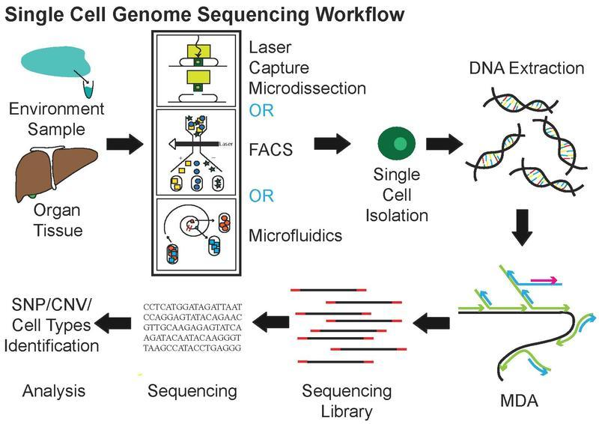
scDNA-Seq Workflow

Slide 23
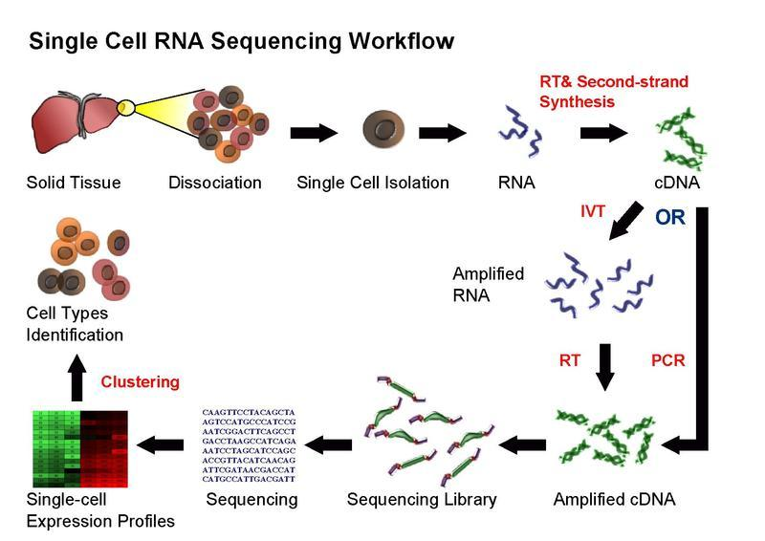
scRNA-Seq Workflow

Slide 24
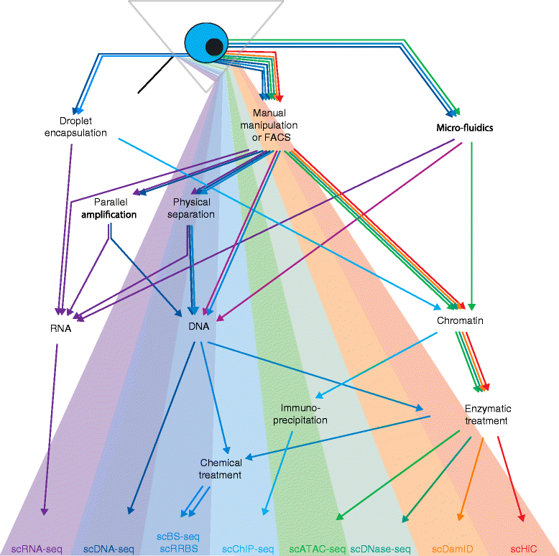
Different Types of Single Cell Sequencing
Clark, Stephen J., Heather J. Lee, Sébastien A. Smallwood, Gavin Kelsey, and Wolf Reik. 2016. “Single-Cell Epigenomics: Powerful New Methods for Understanding Gene Regulation and Cell Identity.” Genome Biology 17 (April): 72.

Slide 25
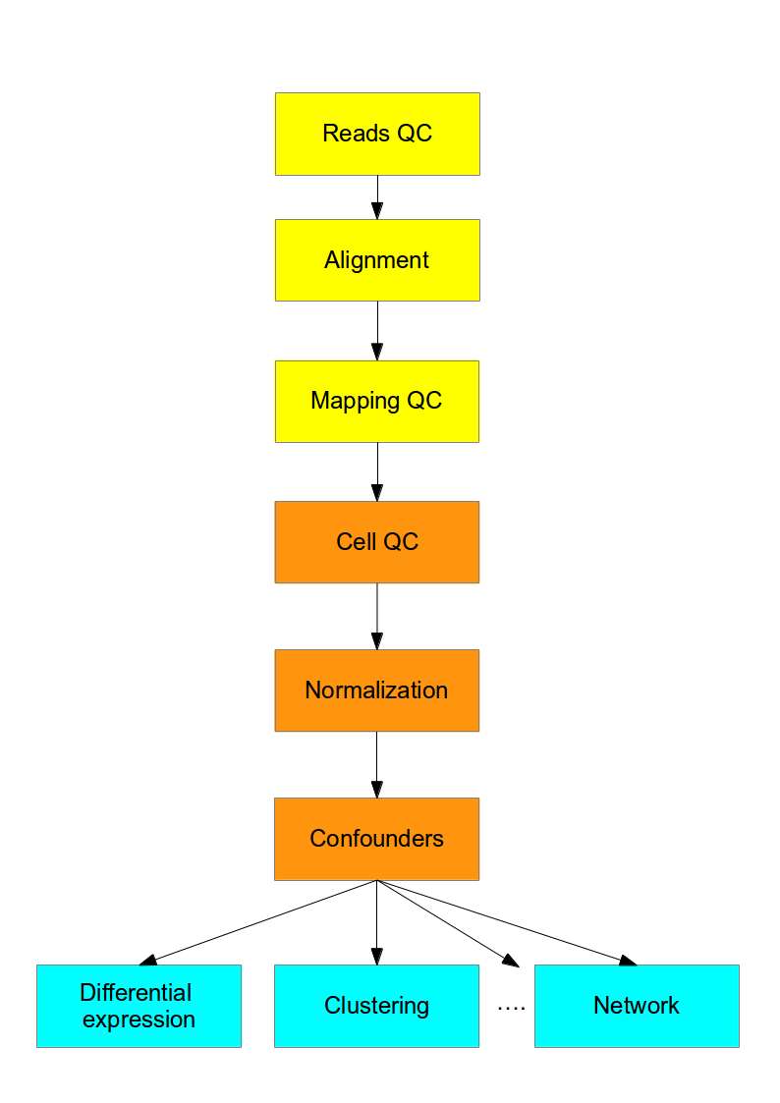
Analysis Overview
Sequence QC
  Demultiplex
  UMI Collapsing
Alignment
Quantification
Normalization
DE, Clustering, etc
https://hemberg-lab.github.io/scRNA.seq.course/introduction-to-single-cell-rna-seq.html

Slide 26
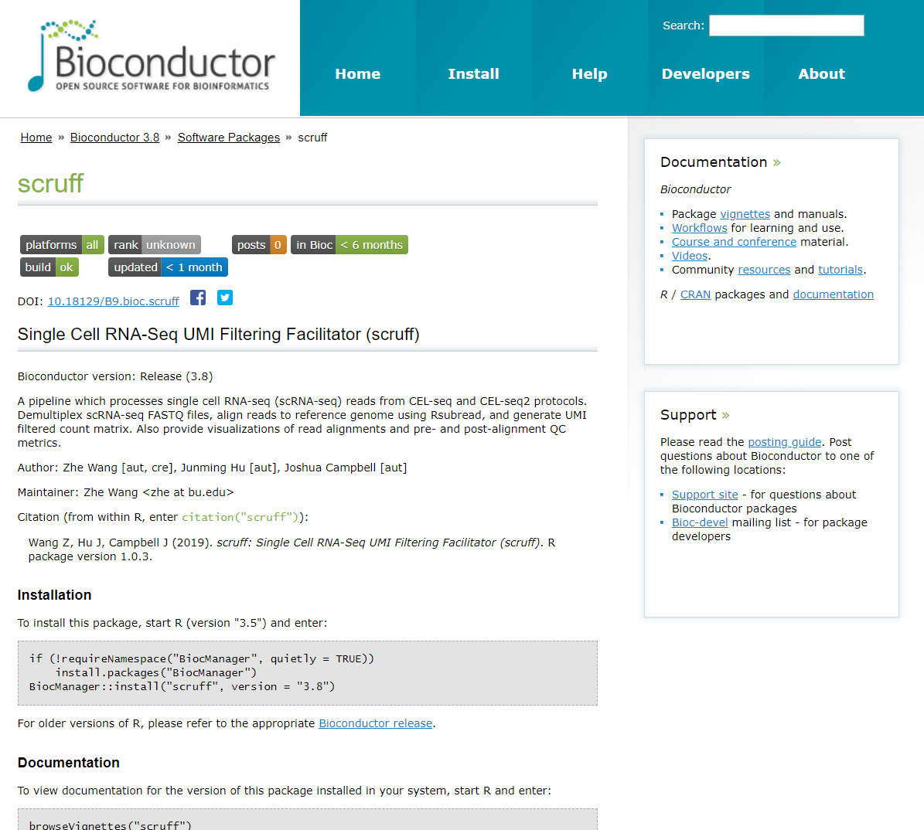
scruff R/Bioconductor package

Slide 27
Sequence QC
One sample is 100s or 1000s of cells
  i.e. ~1,000 fastq files per sample
  May or may not be already demultiplexed by core
UMI-Tools - open source UMI software
Normal fastq processing and QC:
  Adapter and quality trimming
  fastqc, multiqc

Slide 28
Alignment
Standard tools and QC
Alignment: STAR, bwa, bowtie, etc
QC: RSeQC, multiqc, etc

Slide 29
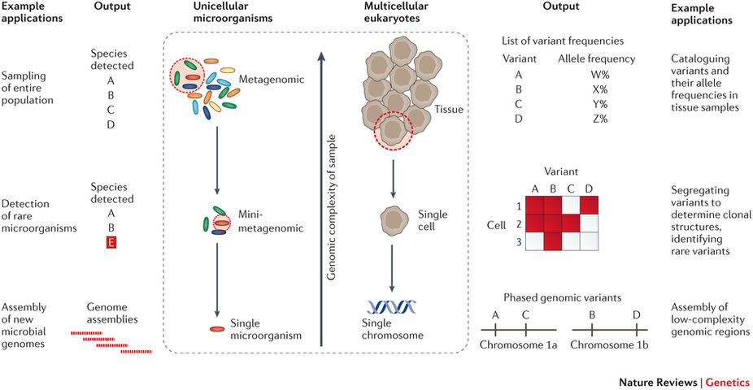
scDNA-Seq Analysis
Gawad, Charles, Winston Koh, and Stephen R. Quake. 2016. “Single-Cell Genome Sequencing: Current State of the Science.” Nature Reviews. Genetics 17 (3): 175–88.

Slide 30
scDNA-Seq Analysis
Genome assembly
  Bacteria genomes
  Mosaic/chimeric genomes (e.g. tumors)
Cell lineage-specific
  SNPs
  Structural variants
  Ploidy

Slide 31
Quantification
STAR+htseq-count, kallisto, salmon, etc
Each sample has a different # of cells
Each cell has the same number of measurements (e.g. genes)
  = (# of samples) x (# of cells) x (# of genes)
  Sparse: most will be zero!

Slide 32
The Counts Matrix
Matrix is cells x genes
Needs to be filtered:
gene3 - all zeros
gene5 - mostly zeros
cell3 - failed/rare cell
cell5 - failed/overamplified cell
 | cell1 | cell2 | cell3 | cell4 | cell5 | ... | cellM
gene1 | 93 | 25 | 0 | 52 | 3335 |  | 82
gene2 | 5 | 2 | 0 | 3 | 1252 |  | 12
gene3 | 0 | 0 | 0 | 0 | 0 |  | 0
gene4 | 98 | 21 | 1 | 1 | 5318 |  | 75
gene5 | 0 | 0 | 0 | 0 | 50 |  | 0
...
geneN | 22 | 52 | 0 | 31 | 4313 |  | 63

Slide 33
Count Matrix Normalization
Each cell is like an independent dataset
Normalization to compare between cells
No consensus yet, many methods (CPM, FPKM, upper quartile, downsampling etc…)
Just within sample normalization, between sample is even harder
Confounding factors are...confounding

Slide 34
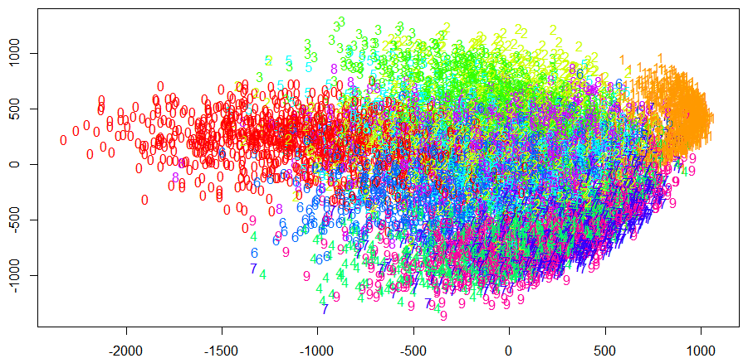
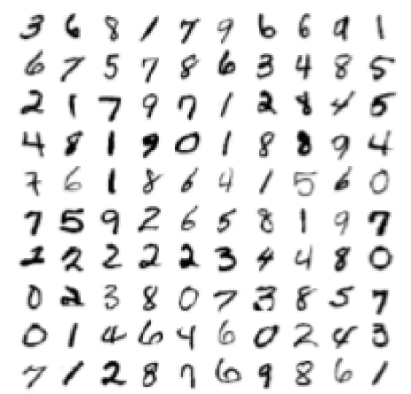
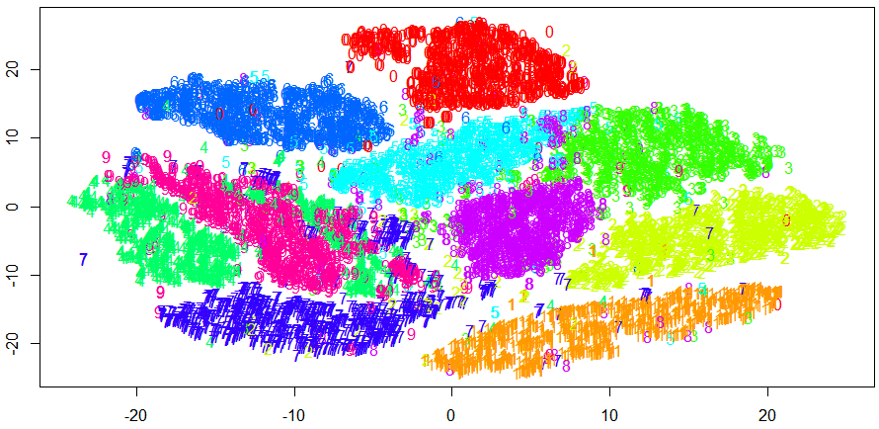
Analysis: Dimensionality Reduction
PCA
Digit Recognizer (Kaggle)
10,000 hand written digits, 784 pixels per digit. Pixel-value is an integer between 0 and 255, inclusive.
tSNE

Slide 35
Analysis: de novo Clustering
Wish to identify clusters of cells using similarity of transcript abundance
Unsupervized clustering methods
A priori no knowledge of number of clusters
Current methods:
  PCA/Spectral analysis
  Hierarchical or k-means clustering
  Graph based

Slide 36
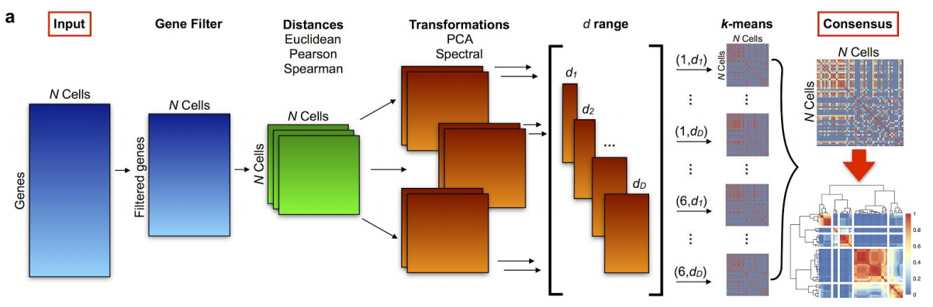
Analysis: de novo Clustering (SC3)
Kiselev, Vladimir Yu, Kristina Kirschner, Michael T. Schaub, Tallulah Andrews, Andrew Yiu, Tamir Chandra, Kedar N. Natarajan, et al. 2017. “SC3: Consensus Clustering of Single-Cell RNA-Seq Data.” Nature Methods 14 (5): 483–86.

Slide 37
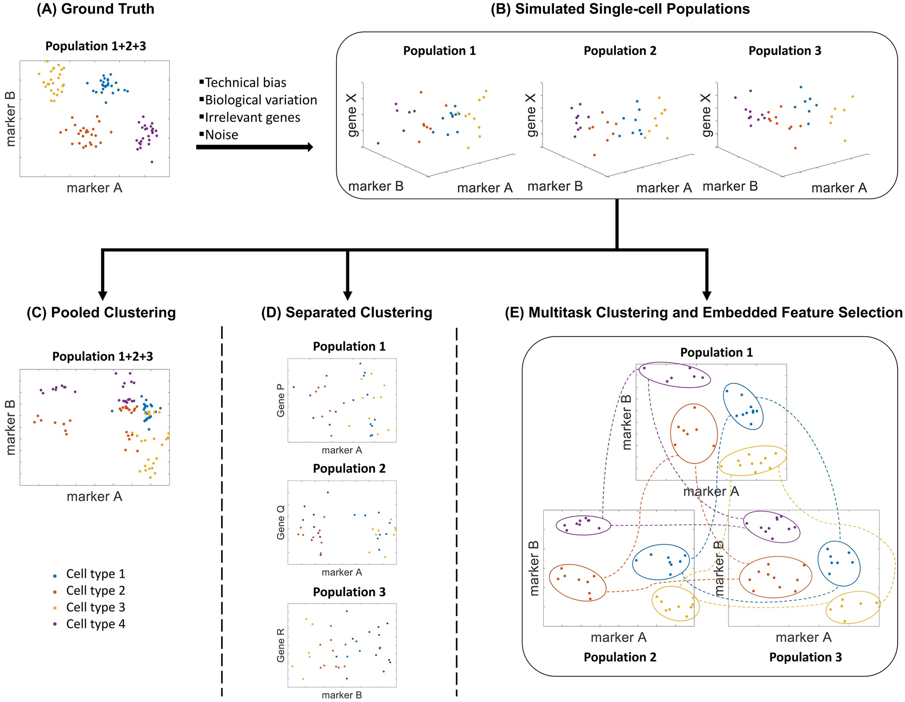
Analysis: Cross-cell-population clustering
How to compare cell clusters across samples?
Each sample may have differences in:
  Number of clusters
  Cell type composition
  Cell type behavior
Extremely open problem
This method (scVDMC) was published on Monday 4/9/2018
Zhang et al. 2018. “A Multitask Clustering Approach for Single-Cell RNA-Seq Analysis in Recessive Dystrophic Epidermolysis Bullosa.” PLoS Computational Biology 14 (4): e1006053.

Slide 38
Analysis: Differential Expression
Goal: identify gene expression differences between cell types
Current methods are similar to those used in bulk RNA-Seq
Dropouts: genes with zero abundance due to technical limitations (sequencing depth)
Extremely open problem

Slide 39
Other Analyses
Feature Selection
  Eliminating “noisy” genes
Pseudotime Analysis
  Inferring cellular development/change over time
Imputation
  Infer expression values for “dropout” genes

Slide 40
Current Software
Seurat - http://satijalab.org/seurat/install.html
SingleCellExperiment - bioconductor
scater - bioconductor
Many others now
Millions of others soon...

