Slide 1
BF528 - Sequence Analysis Fundamentals

Slide 2
Short Read Sequencing Review
Original molecules are DNA fragments
Fragments ~300-400 bases long
Millions to billions of short (<150nt) reads
All reads in dataset are the same length
Each read base has a quality score
Reads may be single or paired end
Probably in fastq formatted files

Slide 3
Typical Analysis Workflow
Assess sequence quality
Trim adapters and low-quality sequence
Assess trimmed sequence quality
Align or quantify reads against a reference
Assess alignment quality
Analyze alignments

Slide 4
Quality check with FastQC
FastQC: A quality control tool for high throughput sequence data
Command line and graphical interfaces
Produces HTML report
Several metrics calculated on single set of sequences (e.g. fastq file)
Useful to identify bad or outlier samples

Slide 5
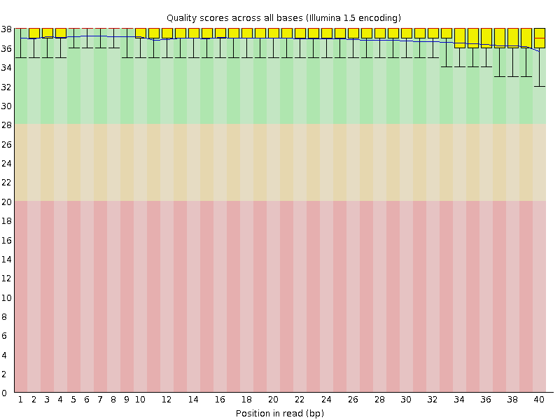
FastQC: Read Quality
Untrimmed reads all have same length
Each position in each read has a Phred score
Quantify the distribution of Phred scores in each position
Beginning of most reads is of high quality
Quality can degrade towards the end of read

Slide 6
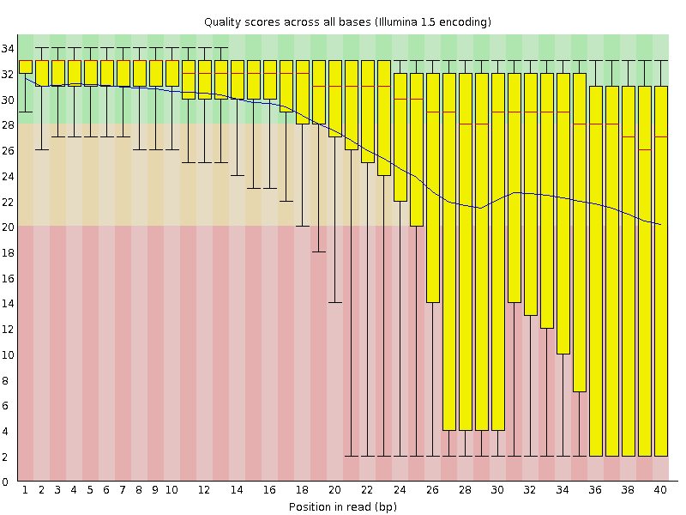
FastQC: Poor Read Quality Example
Median score
Mean score
Inner quartile range of quality score distribution is very large
Many reads have very poor quality at end

Slide 7
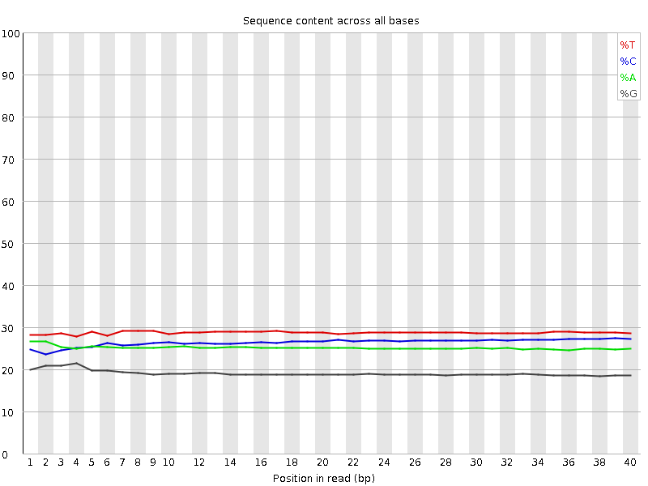
FastQC: Nucleotide distribution
Ligation biases cause first 8-10 bases to have non-uniform distribution
Each read position may be an A, C, G, or T (or N)
Each position has a distribution across reads
Distribution should match originating molecule distribution

Slide 8
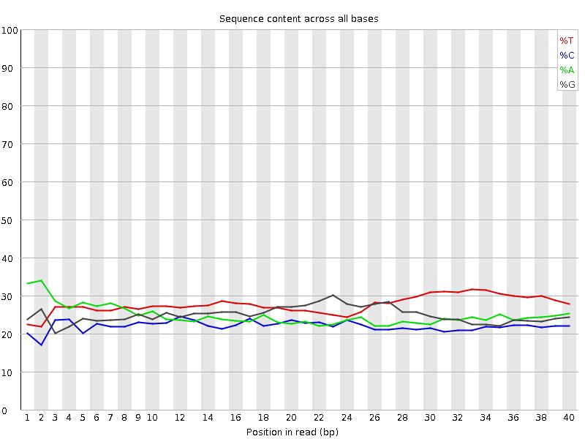
FastQC: Non-uniform nucleotide dist.
Higher than expected %T on end of reads for unknown reason
Nucleotide distribution non-uniform across read positions

Slide 9
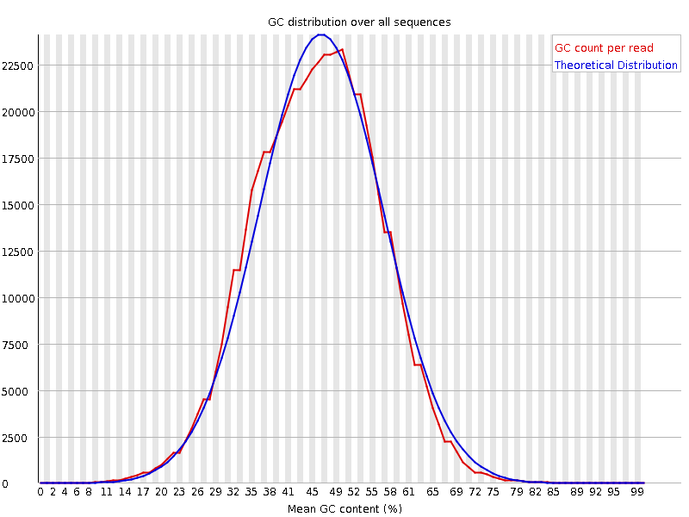
FastQC: GC Content Distribution
Mean GC content is not always 50%
GC content is the fraction of C and G nucleotides
Each read has a GC content (% GC)
Most reads should have %GC equal to original molecules
Should follow normal distribution

Slide 10
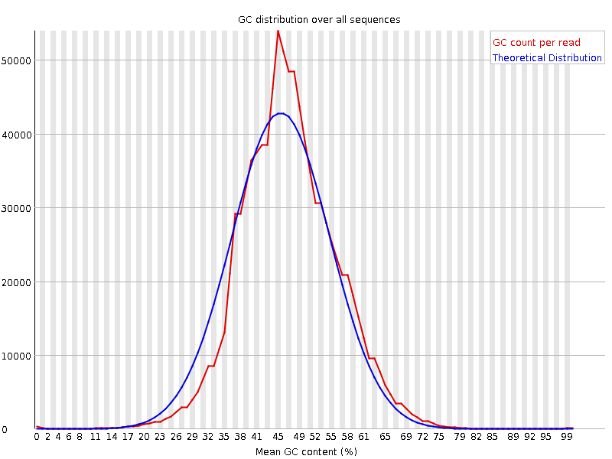
FastQC: GC Content Mismatch
Mean GC content may be different from expected target molecules
Empirical distribution deviates from expected normal distribution

Slide 11
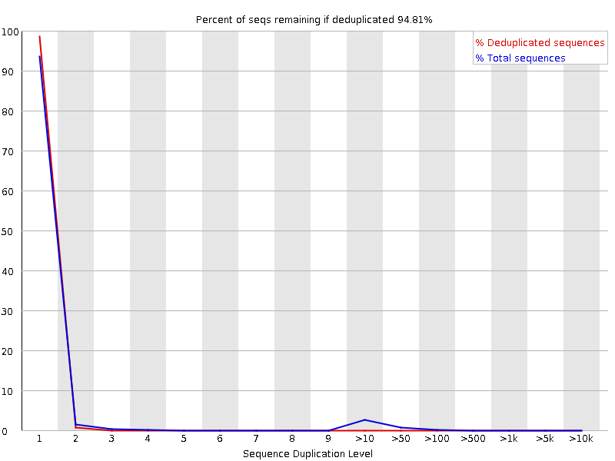
FastQC: Read Duplication Levels
94.81% of sequences are unique
PCR amplification may bias certain molecules
Reads from these events have identical sequence
For genome sequencing, observing two identical DNA fragments is unlikely (why?)
Read sequences that have exactly N copies in dataset

Slide 12
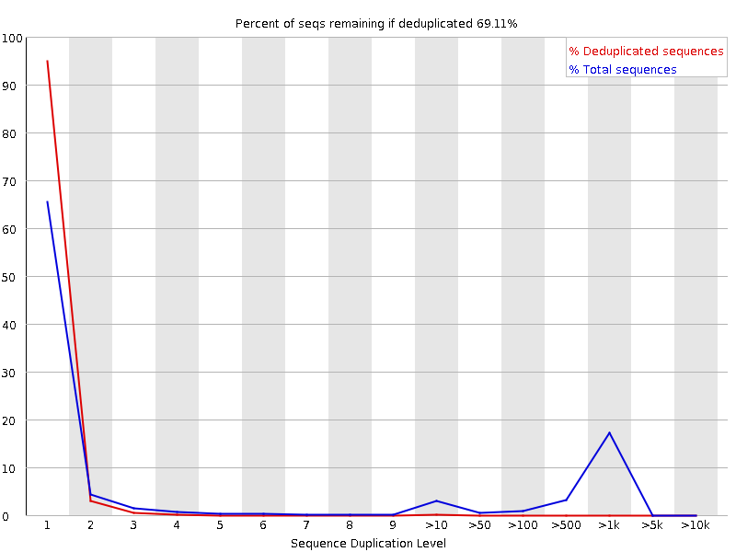
FastQC: Read Duplication Problem
69.11% of read sequences are unique, indicating possible contamination or PCR amp bias
~30% of reads have one or more duplicates

Slide 13
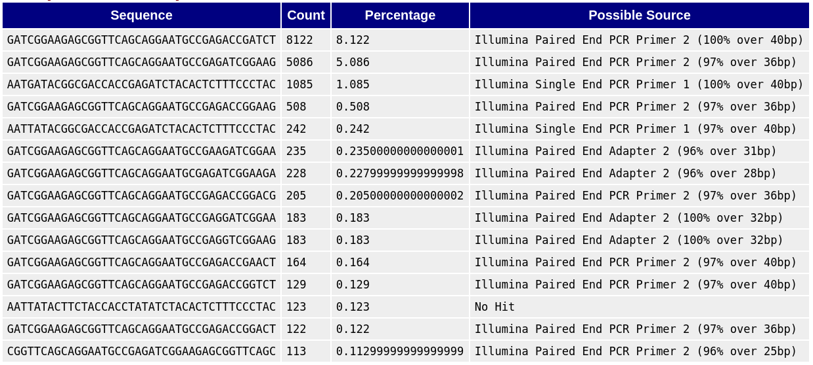
FastQC: Over-represented Sequences
Over-represented sequences may come from:
  Contamination
  Sequencing adapter
  Low library complexity
  PCR amp bias
  Inefficient rRNA depletion
Some low-complexity libraries, e.g. miRNASeq, will naturally have over-represented sequences
Library prep adapter is sometimes sequenced
Sequence unrecognized by FastQC
(it’s a barcoded Single End PCR Primer 1)

Slide 14
Running FastQC on SCC
Run as batch job!
$ module load fastqc
$ fastqc --help
$ fastqc SRR1919605_1.fastq.gz

Slide 15
Trimming
Reads may have adapters and low quality 3’
Want to trim reads to remove these effects
Adapters/quality can be trimmed separately
Many programs available, most common:
  trimmomatic
  cutadapt
Trimmed reads are not same length

Slide 16
Trimming Example: Adapter
Untrimmed
@SRR1997412.1 1 length=125
NTTGTAGCTGAGGAAACTGAGGCTCAGGAGGACAAGTGGCCTGCCAAAAATGATACGGCGACCACCGAGATCTACACTCTTTCCCTAC
+SRR1997412.1 1 length=125
#<<BBFFFFFFFFFFFFFFFFFFFFFFFFFFFFFFFFFFFFFFFFFFFFFFFFFFFFFFFFFFFFFFFFFFFFFFFFFFFFFFFFFFF
Trimmed
@SRR1997412.1 1 length=125
NTTGTAGCTGAGGAAACTGAGGCTCAGGAGGACAAGTGGCCTGCCAAA
+SRR1997412.1 1 length=125
#<<BBFFFFFFFFFFFFFFFFFFFFFFFFFFFFFFFFFFFFFFFFFFF

Slide 17
Trimming Example: Quality
Phred ASCII encoding:
Character: !"#$%&'()*+,-./0123456789:;<=>?@ABCDEFGHI
| | | |
Score: 0 28 31 40
Untrimmed
@SRR1997412.1 1 length=125
NTTGTAGCTGAGGAAACTGAGGCTCAGGAGGACAAGTGGCCTGCCAAAAATGATACGGCGACCANCGAGATCTANANTCTTTNNNTNN
+SRR1997412.1 1 length=125
#<<BBFFFFFFFFFFFFFFFFFFFFFFFFFFFFFFFFFFFFFFFFFFFEC@@B<;9529.910,#(,-50.&%0#2#*(‘&%###$##
Trimmed
@SRR1997412.1 1 length=125
NTTGTAGCTGAGGAAACTGAGGCTCAGGAGGACAAGTGGCCTGCCAAAAATG
+SRR1997412.1 1 length=125
#<<BBFFFFFFFFFFFFFFFFFFFFFFFFFFFFFFFFFFFFFFFFFFFEC@@

Slide 18
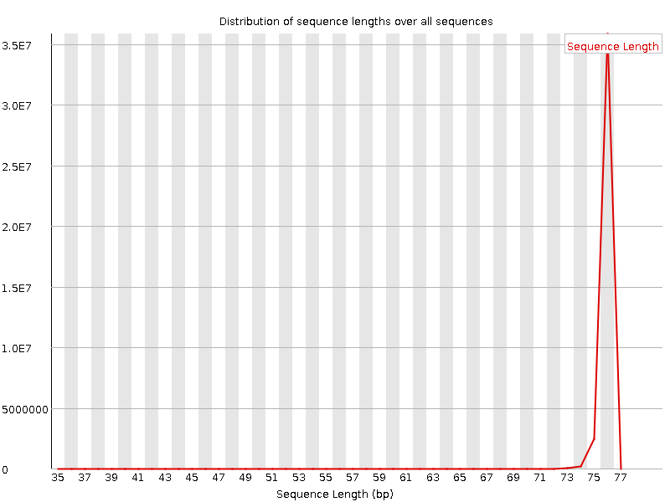
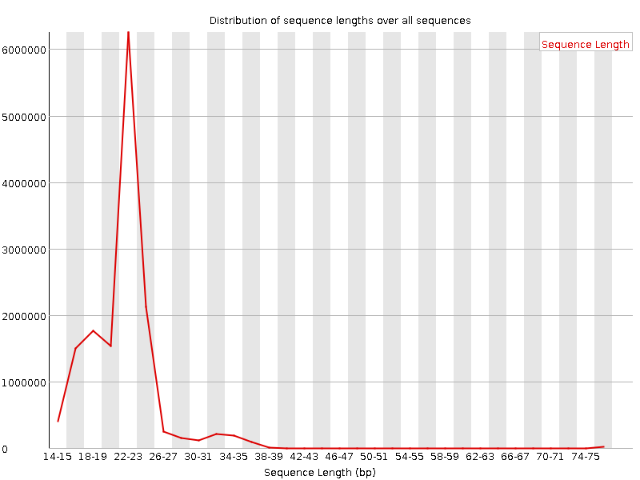
FastQC: Length Distribution
Untrimmed
Trimmed

Slide 19
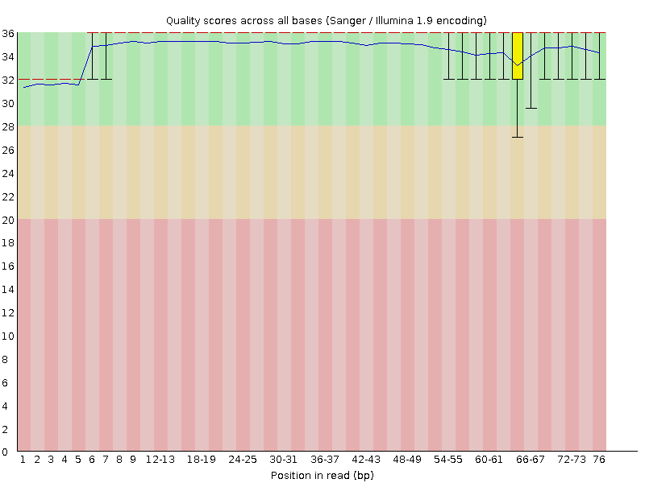
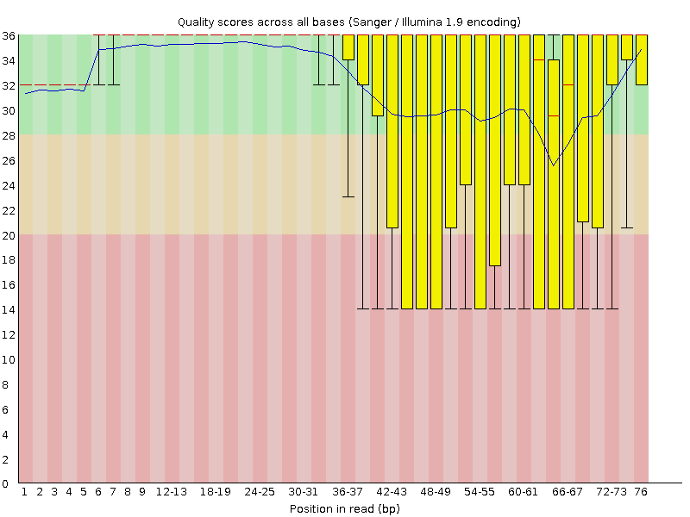
FastQC: Sequence Quality
Untrimmed
Trimmed
Why do we now see poor 3’ quality?

Slide 20
Alignment of short reads
Trimmed reads used for all downstream analysis
Alignment matches reads to some reference
Usually one of two approaches:
  Align - high resolution, explicit alignment, slow
  Quasi-align - ‘good enough’ resolution, heuristic alignment, fast

Slide 21
Alignment tools
Many tools to align reads
General aligners
  bwa
  bowtie and bowtie2
  SNAP → forces reads to align close to each other
Purpose specific (e.g. RNA-Seq)
  STAR
  tophat

Slide 22
Alignment reference
The reference is a haploid representation of the consensus of multiple individuals.
Human genome:
  GRCh37 (aka hg19)
  GRCh38 (hg38)
Mouse:
  GRCm38 (mm10)
  NCBI37 (mm9)
It is in fasta format (.fa or .fasta)

Slide 23
Alignment Example: bwa
Each aligner requires the reference to be prepared (indexed) in a certain way
Once reference is indexed, align reads
$ module load bwa
$ bwa index chr22.fa
$ bwa mem chr22.fa SRR1919605_1.fq.gz > SRR1919605.sam

Slide 24
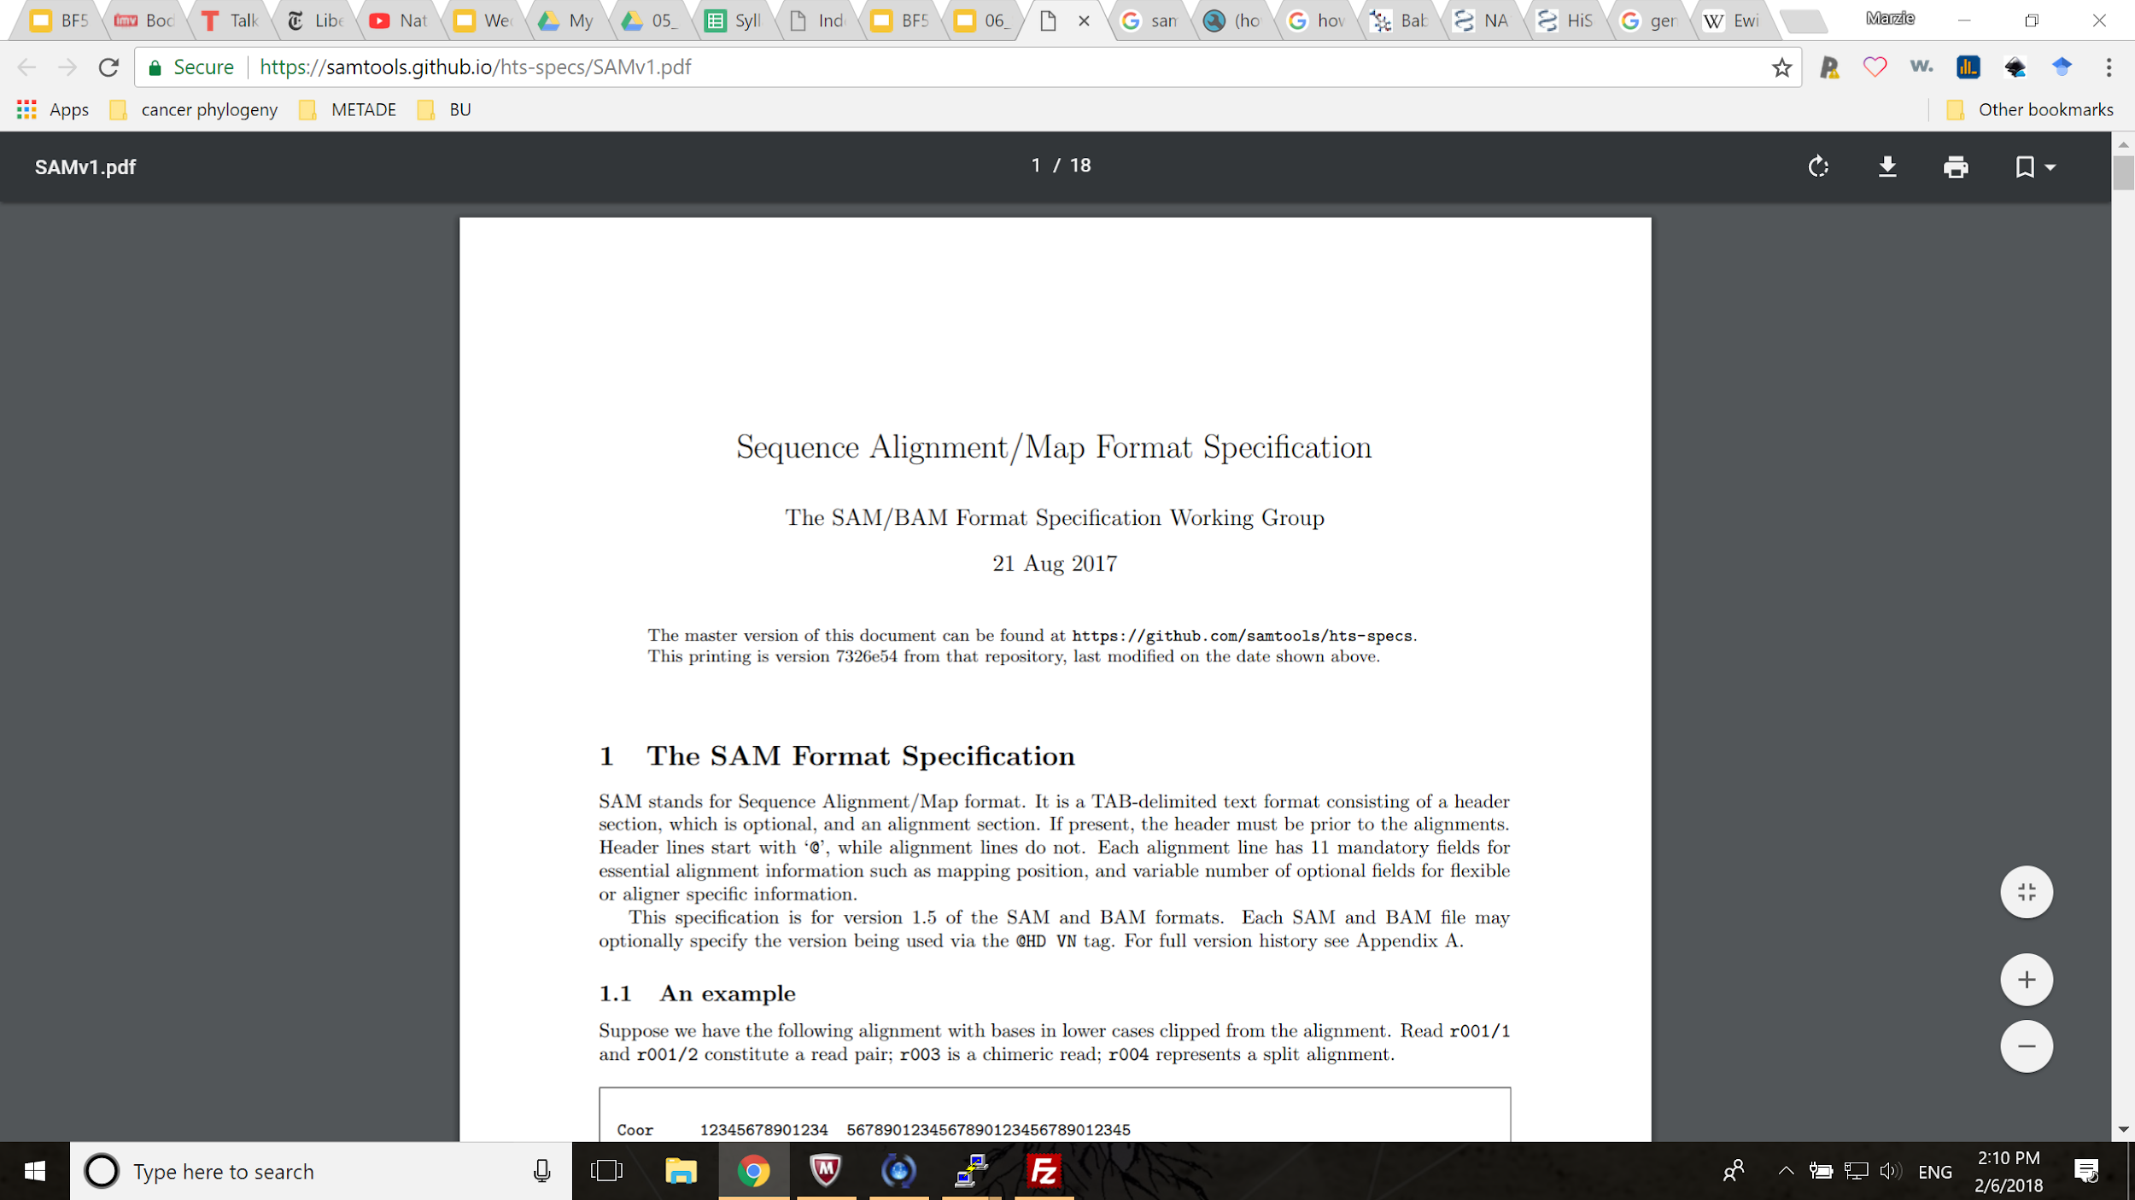
SAM format
https://samtools.github.io/hts-specs/SAMv1.pdf

Slide 25
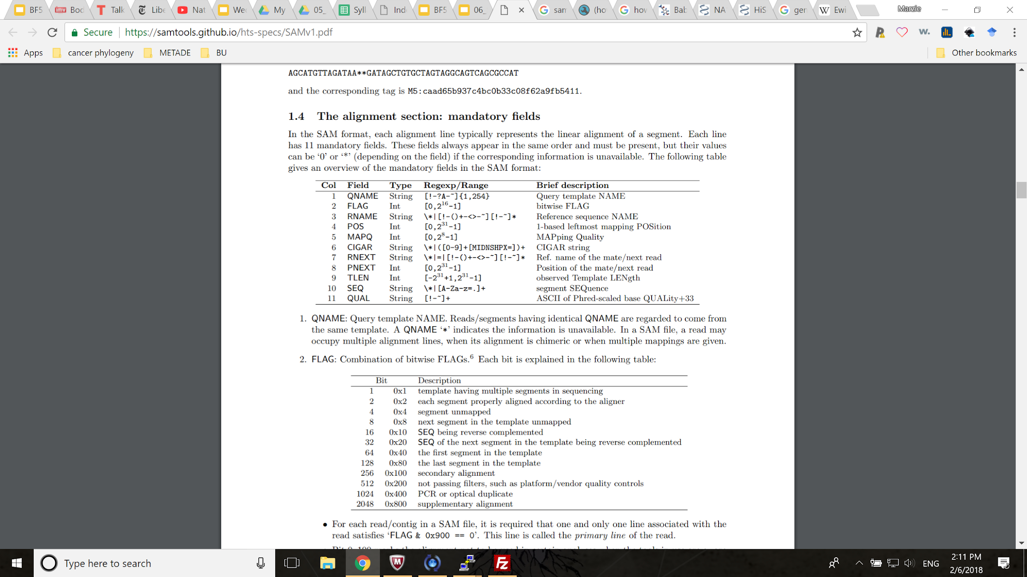
SAM format
@ header line
Each line has at least 11 fields
1 line per each read

Slide 26
SAM Format: Header
header lines start with @
@HD VN:1.5 GO:none SO:coordinate
@SQ SN:1 LN:248956422
@SQ SN:10 LN:133797422
@SQ SN:11 LN:135086622
@SQ SN:12 LN:133275309
@SQ SN:13 LN:114364328
@SQ SN:14 LN:107043718
…
@RG ID:50 LB:SRR1514950 SM:CHM1
...
@PG ID:MarkDuplicates VN:2.8.0-SNAPSHOT CL:picard.sam.markduplicates.MarkDuplicates
@PG ID:bwa PN:bwa VN:0.7.12-r1039 CL:bwa.real mem -t 16 GRCh38.fa SRR1919605_1.tar.gz
version
The reference names (i.e. chromosomes) and their lengths
read groups
Programs you ran

Slide 27
SAM Format: Aligned Read
Each line has at least 11 fields
1 line per each alignment
SRR1514952.11241320 147 1 10000 27 41S60M = 10034 -26 GAACCCTAGCCCTACCCCAACCCCGAACCCTACCCCGAACCATAACCCTAACCCTAACCCTAACCCTATCCCTAACCCTAGCCCTA #############################################################################A2A+;H;F XA:Z:X,+156030660,76M25S,5;Y,+57217180,76M25S,5;22,+50808410,60M41S,2;6,-147845,18S23M1D38M1D22M,7; MC:Z:75M1I25M MD:Z:27A11A20 NM:i:2 MQ:i:27 AS:i:50 XS:i:51 RG:Z:52 PG:Z:MarkDuplicates-24B543D9

Slide 28
samtools
BAM is a compressed sam.
CRAM is a better compressed SAM.
You can read all with samtools
module load samtools
samtools view SRR1919605.sam
# unmapped reads
samtools view -f 4 SRR1919605.sam
# pair unmapped
samtools view -f 8 SRR1919605.sam
# only mapped ones
samtools view -F 4 SRR1919605.sam
# quality at least 30
samtools view -q 30 SRR1919605.sam

Slide 29
Important Alignment Properties
Mapping quality - how good alignment is
Alignment rate - % of reads that align
Multimapped reads - align to multiple loci
Mate distance - distance between paired read alignments (paired end only)
Coverage, depth

Slide 30
Quasi-alignment tools
Heuristic approach to alignment
  i.e. fast, but not as sensitive as full alignment
Typically against a reference of relatively short sequences (e.g. transcriptome)
Include GC content, multimap adjustment
Used for quantification estimation
  i.e.what is the estimated expression of a gene?

Slide 31
Identifying Outlier Samples
Flag sample if:
  Deviate from expected (e.g. GC content)
  Deviate from most other samples
  Contain suspect sequences (e.g. contamination)
  Aligns poorly
MultiQC - tool for combining output from many tools run on many samples

