Slide 1
Integrative Genomics

Slide 2
Introduction
A single –omics experiment may only provide a limited view without further context
  Example: ChIP-seq. What’s so special about where a protein binds?
  Example: A single RNA-seq experiment. What can you learn using relative transcript abundance alone?

Slide 3
Introduction
Only looking at one component of a cell (transcripts, protein binding, etc.) can also lead to false conclusions
Ideally, results from different types of experiments should be integrated to support your conclusions

Slide 4
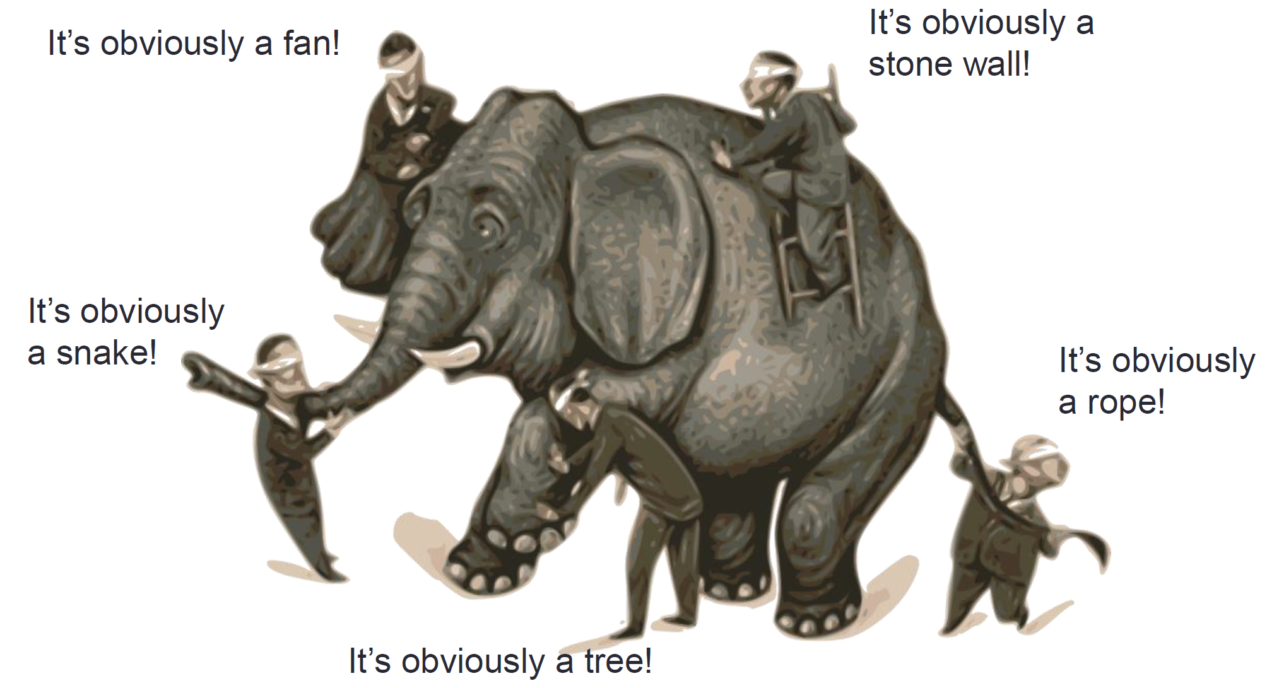
Metaphor 1: Blind men and an elephant
Notes:
A parable that originated on the Indian subcontinent about a group of blind men who have never come across an elephant before who are trying to conceptualize what an elephant is by touching it.
The point being that we as humans tend to project our partial experience as the whole truth, ignoring other information

Slide 5
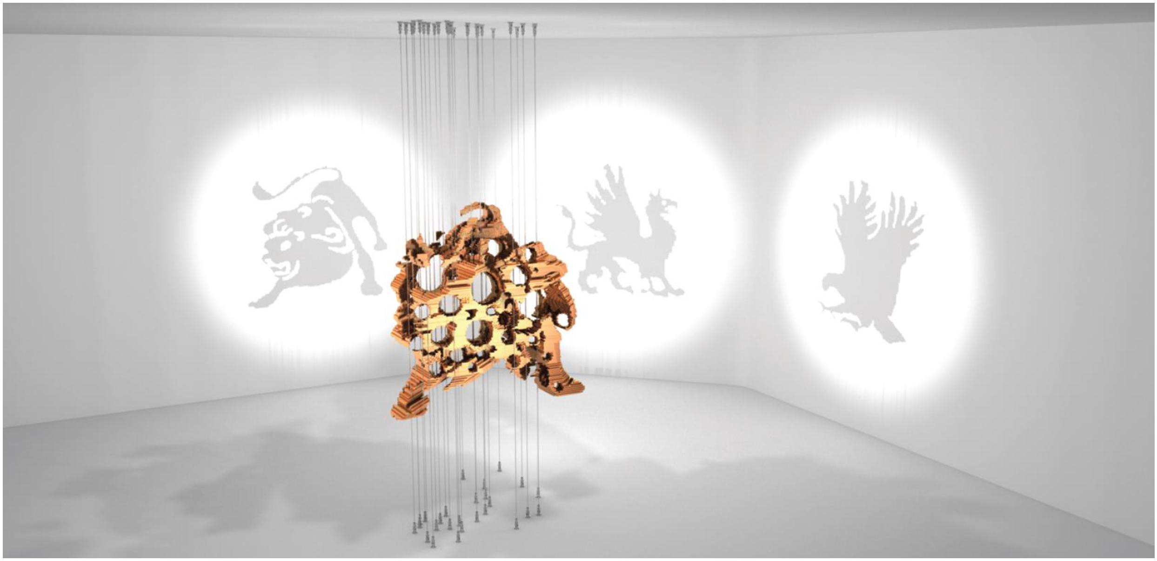
Metaphor 2: Shadow Art
http://graphics.stanford.edu/~niloy/research/shadowArt/shadowArt_sigA_09.html

Slide 6
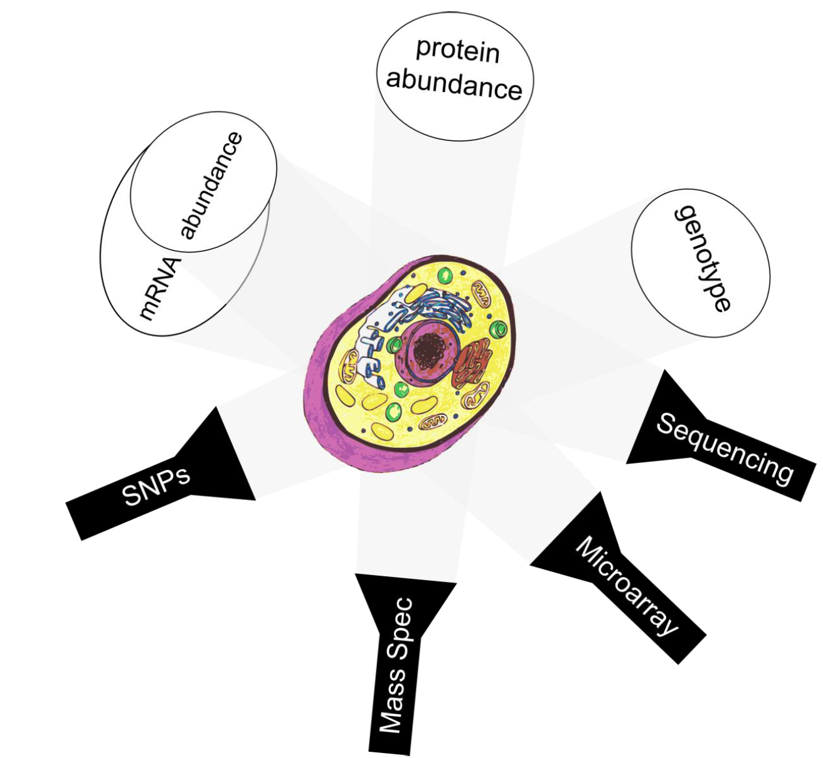
Each experiment provides a different view
Notes:
The cell isn’t so different

Slide 7
Why Does Some Biological Event Occur?
All Possible Explanations
Explanations Suggested by Dataset Y
Explanations Suggested by Dataset X
Most Likely Explanations
Explanations Suggested by Dataset Z

Slide 8
Integrative Genomics
One of the most valuable bioinformatics skills is to be able to combine several genome-scale experiments together
This practice is generally called integrative genomics
How do we combine genome-scale experiments together?
Notes:
Similar in practice to one of the schools of thought in Systems Biology which is why we put the lectures close together:
If you’re layering ChIP-seq, RNA-seq, ATAC-seq, etc. together, you’re trying to put together the different components of a system to learn about it

Slide 9
Reference Genomes
Consistent coordinate system across experiments allows different data to be integrated together
Features
Genomic
loci
Notes:
Also allows you to integrate your findings with other people’s findings
What are these genomic loci? Could be anything you’re interested in (genes, SNPs, whatever)

Slide 10
Today – Integrative Genomics
BED format redux
Set Theory & Genome arithmetic
  Useful tools (BEDtools, bedops, GAT)
  Basic operations
  Enumeration vs. association
Practical examples

Slide 11
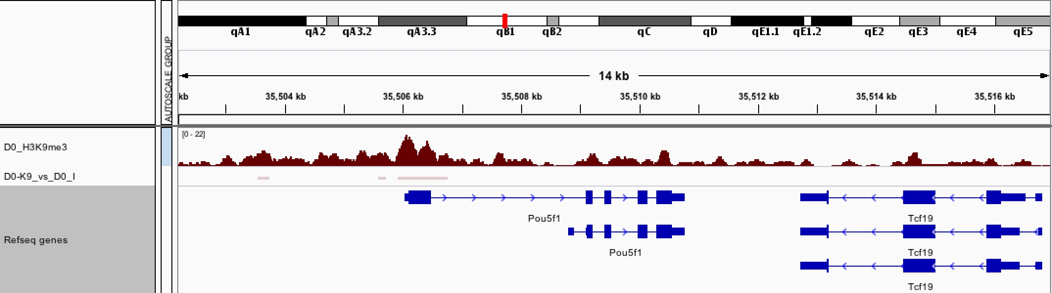
Review: ChIP-Seq Peaks

Slide 12
Review: ChIP-seq analysis workflow
Bowtie2
BWA
STAR
MACS2
HOMER
GEM
ChIP
Short reads
Mapped reads
Peaks
Input
Short reads
Mapped reads
FASTQ
FASTA
SAM
BAM
BED
Notes:
In theory, given a data set in any of the above formats, you can jump in where appropriate
BED is pretty much a summary of information associated with a genomic locus

Slide 13
The BED format
A loose tab-delimited text format that defines locations and information related to a genomic feature of interest
Columns can be variable but always start with these 3 (or 4):
  Chromosome, start, end, (and name)

Slide 14
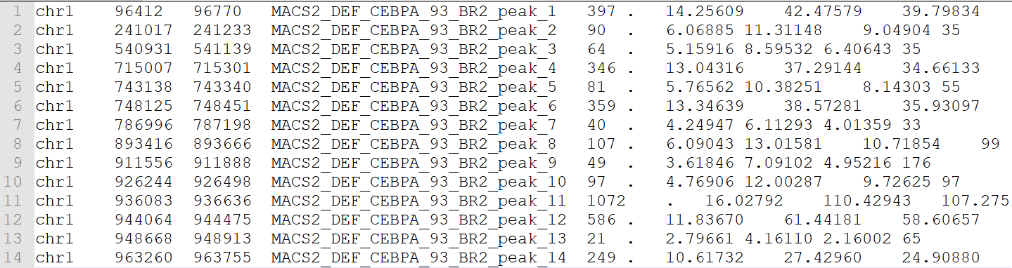
BED format example
Chromosome, start, end
Name of the feature
Associated statistics
ENCODE formats: tagAlign, narrowPeak, broadPeak

Slide 15
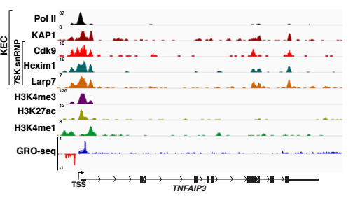
Integrating Multiple Genomic Datasets

Slide 16
Integrative Genomics on BED files
How do we learn information about 2 or more BED files?
There exists a core set of operations that can be applied to multiple BED files – genome arithmetic
These generally correspond to set theory operations but at the genome-scale

Slide 17
Set Theory
Branch of math/logic that studies sets which can be collections of any objects
Traditional arithmetic (+, -, x, /) is binary operations on numbers
Set theory encompasses binary operations performed on sets
Core operations can be visualized with Venn diagrams

Slide 18
Set Operations
Intersection:
A ∩ B
Union:
A ∪ B
Complement:
A \ B
A
B
One way!
Notes:
A and B can be any collection of objects
A = the set of bands that I like
B = the set of bands that Adam likes
Some of these are 2-way. Example: the intersection of A and B is also the intersection of B and A. Same with union
When computing union using larger sets with 1000s or millions of items, make sure to not double-count the intersection (more on this later). Another way to represent the union is A + B – (A ∩ B)
Complement can also be called set difference. THIS OPERATION IS ONE WAY. The complement of A is not the complement of B for example

Slide 19
Genome Arithmetic
Most basic operations in genome arithmetic are set theory operations
In this case, the sets we’re interested in are genomic features/loci from different BED files
A surprising amount of integrative genomics can be accomplished using these basic set theory operations

Slide 20
Genome Arithmetic
Transcription Factor “A”
Binding sites
Transcription Factor “B”
Binding sites
Intersection:
A ∩ B
Union:
A ∪ B
Complement:
A \ B
One way!
Notes:
This is the exact same slide as before but now our arbitrary A corresponds to the genome-wide binding sites of transcription factor A (found in some ChIP-seq experiment) and B corresponds to the genome-wide binding sites of transcription factor B
Intersection of A and B – binding sites shared by both A and B
Union of A and B – binding sites that were found in either experiment (or both)
Complement of A in B – binding sites for transcription factor B

Slide 21
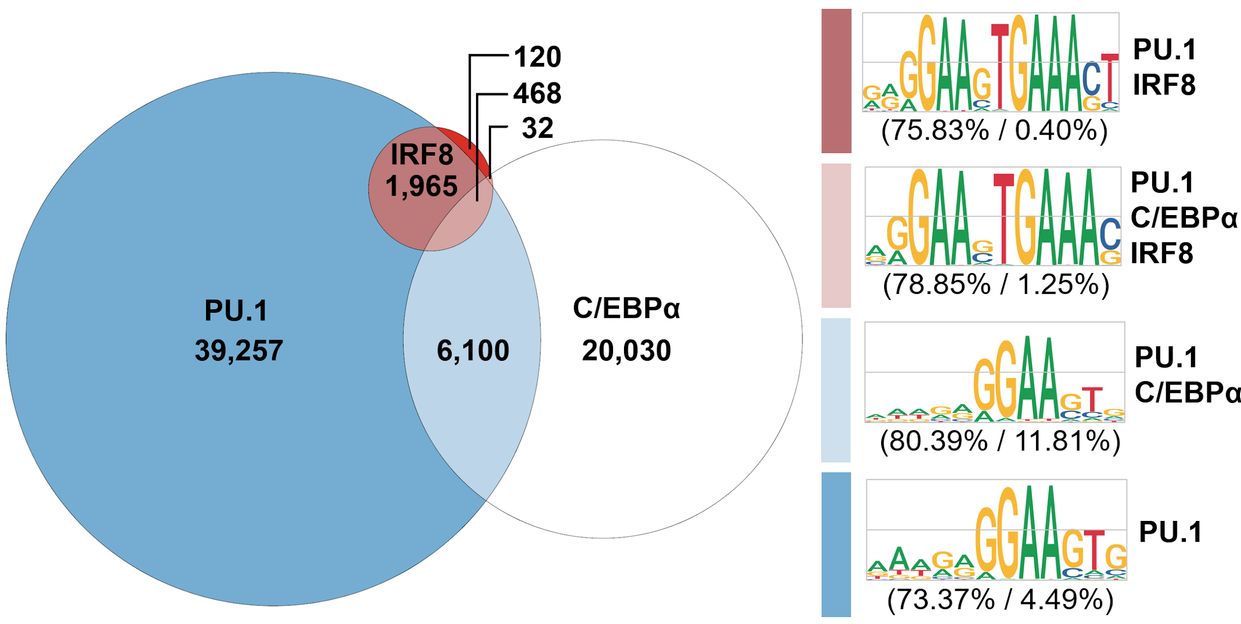
Integrative Genomics Example
Notes:
These are all lineage-determining TFs in monocytes meaning they all contribute to the identity of the cells through gene regulation. A monocyte can’t really exist without them
Apologies for the shameless self-promotion
The PU.1 sites that intersect with IRF8 show a completely different binding site specificity compared to PU.1 itself. So you can start to ask, is IRF8 changing the specificity of PU.1 at genomic loci that they can both bind to? Is there an interaction between these TFs?
These analyses (aside from the motif analyses which were performed downstream) started off with just simple set operations on BED files

Slide 22
BEDtools
The self-proclaimed “swiss army knife” of genomic arithmetic
A set of command-line operations that can be performed on BED files – sets of genomic features (chrom, start, end)
Includes the basic operations (intersections, unions, set differences) as well as more advanced functionalities

Slide 23
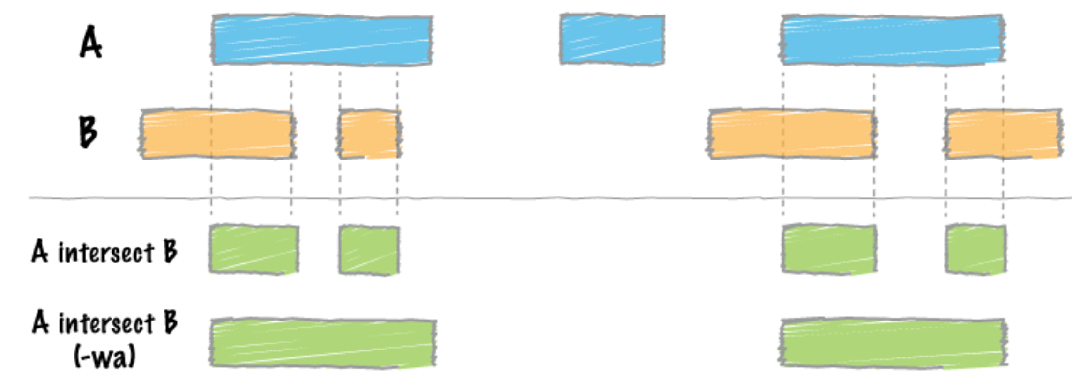
Genome arithmetic in BEDtools
The intersection of 2 sets of genomic features (ChIP-seq peaks for example):
Notes:
The first intersection (in green) requires both A and B to overlap. The second (with the –wa flag) is an option that reports every feature in A that also appears in B

Slide 24
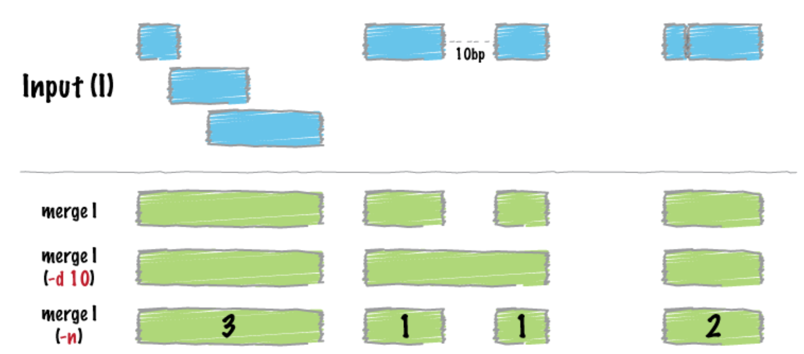
Genome arithmetic in BEDtools
The union set of genomic features (merge)
Notes:
The command here is “bedtools merge”

Slide 25
Example: Differential Binding Motifs
Notes:
Let’s de-construct the previous example I put up. How would I obtain the numbers necessary to plot the diagram and how would I isolate the genomic loci of particular groups to do the downstream motif analysis?

Slide 26
Genomic loci co-enriched with TFs
First need a unioned set of loci as a comparator
  cat PU1.bed CEBPA.bed IRF8.bed > loci.bed
  sort –k1,1 –k2,2n loci.bed > loci_sorted.bed
  bedtools merge –i loci_sorted.bed > loci_merged.bed
Check which loci are co-enriched for binding of multiple TFs
  bedtools closest –a loci_merged.bed –b PU1.bed …
  bedtools closest –a loci_merged.bed –b CEBPA.bed …
  bedtools closest –a loci_merged.bed –b IRF8.bed …
Examine proximity pattern for overlap of PU.1, C/EBPa, and IRF8 sites
Notes:
Actually done using the “closest -wao” flag (with respect to file A, report the distance)

Slide 27
Genomic loci co-enriched with TFs
Overlapping features are given a closest distance of “0”
Non-overlapping features have a signed distance
loci_merged.bed
PU.1
C/EBPa
IRF8
chr1 | 594823 | 595234
chr1 | 724309 | 724623
chr1 | 928347 | 928702
chr1 | 992918 | 993253
0
0
10293
0
0
9283
0
0
-58437
0
20394
0
…
Signed distance from given feature
Notes:
Those aren’t real coordinates. Don’t actually go looking for the binding sites

Slide 28
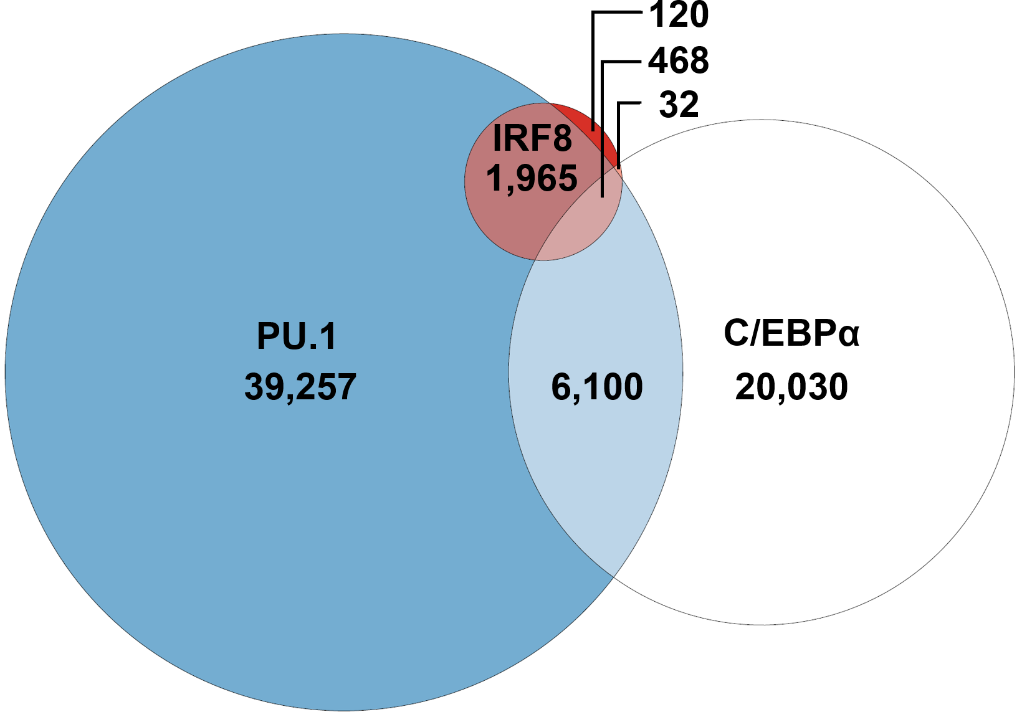
Deconstructing the previous example
PU.1
C/EBPa
IRF8
0
0
10293
0
0
9283
0
0
-58437
0
20394
0
Count number of occurrences of each

Slide 29
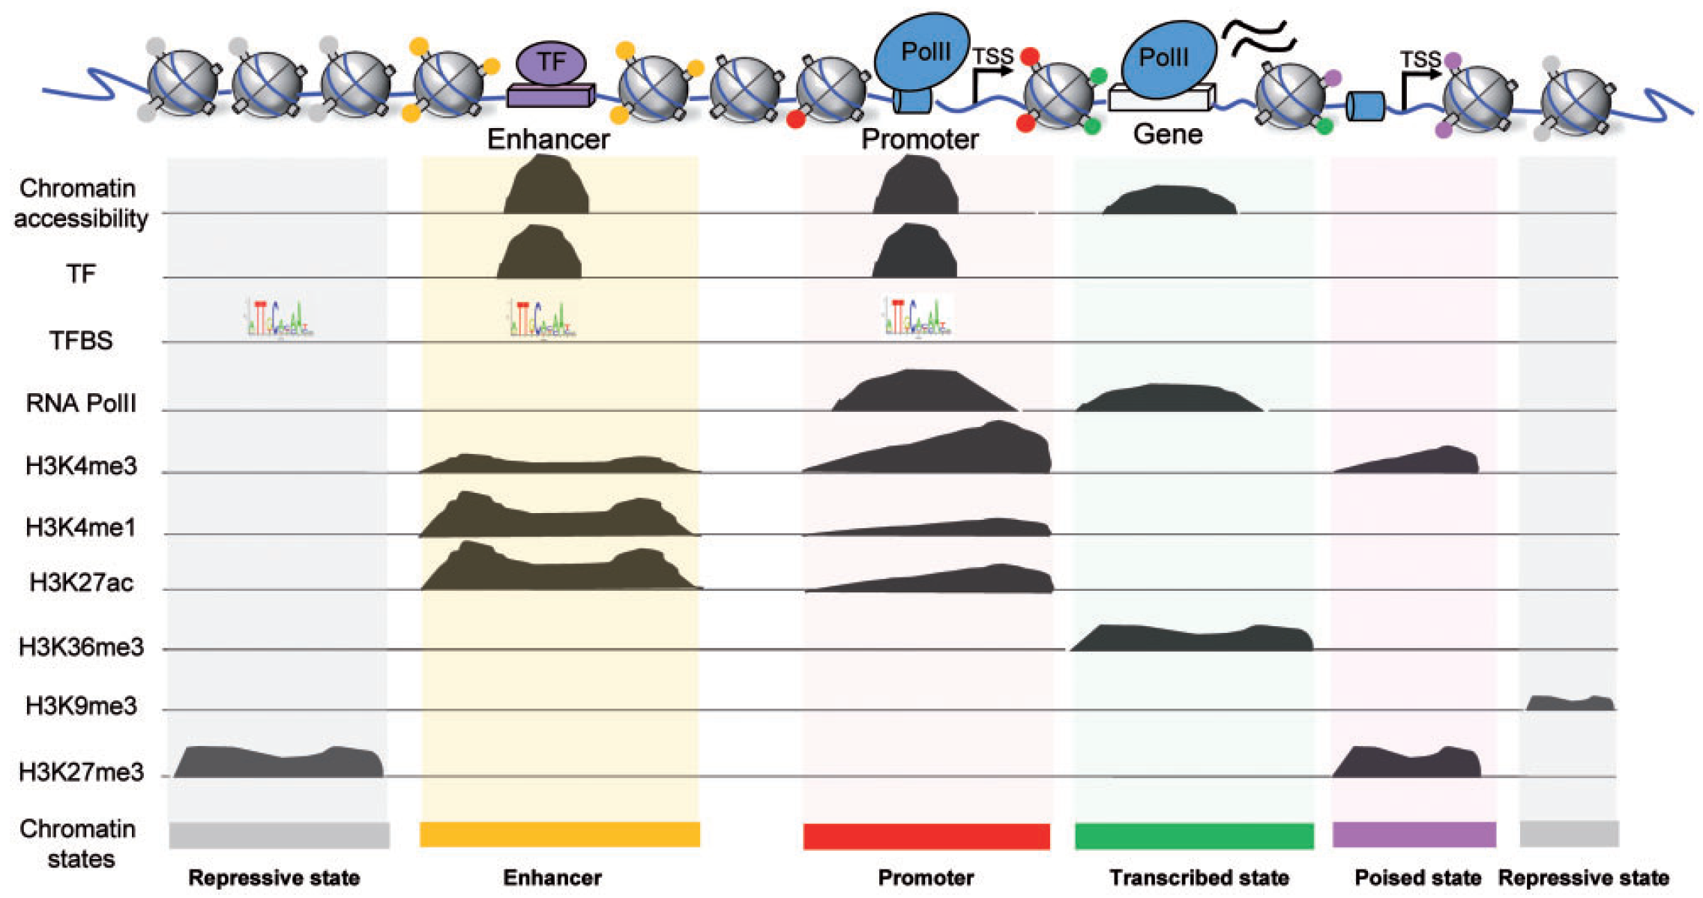
A larger example – Chromatin States
Notes:
From Jiang et al. (2018)
Each one of those data types represents a BED file that can be used in a similar manner to previously
You can use combinations of overlapping features to segment/annotate a genome

Slide 30
Genome Associations
Sometimes it’s not enough to find and count which features overlap others
Often times you would like to know if the amount of overlap is surprising
For example, do 2 types of features overlap more/less than should be expected?

Slide 31
Practical Example – SRF binding
Given a complete set of genomic SRF binding sites, where does SRF bind?
2 ways to approach this problem:
  Annotate the binding site locations (intergenic, intronic, UTR3, UTR5, CDS, etc.) and enumerate them
  Does SRF preferentially bind certain locations more or less than we would expect?
Notes:
The problem you choose to look into will depend on your project and goals. For example, if you just want to compare SRF to other TFs, it might be enough to just look into enumerating the binding at different locations and comparing it with other factors.
SRF is one of those ubiquitous factors involved in stimulating both cell proliferation and differentiation

Slide 32
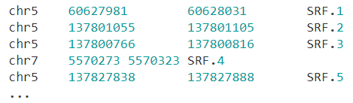
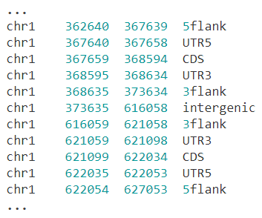
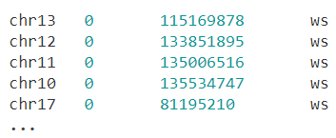
GAT – the Genome Association Tester
GAT is a flexible, easy-to-use command line program to test genome associations
Takes 3 files as input: segments of interest, annotation segments, and genome workspace
Notes:
Genome associations being “do these overlap more/less than expected?” type of questions
For this toy example, the segments of interest are SRF ChIP-seq peaks, annotation segments are genomic annotations (that can be obtained from Ensembl among other places), and our workspace is the whole genome

Slide 33
GAT – association testing steps
GAT performs the following:
  Measures observed nucleotide overlap between your segments of interest and the annotation track
  Randomizes the location of your segments of interest (user-specified number of times) while again measuring overlap to empirically obtained the expected overlap
  Reports observed overlap, expected overlap, confidence intervals, p-values, adj. p-values for each annotation
Notes:
P-value in this case corresponds to what proportion of samples was a higher enrichment or lower depletion found than the one that was observed

Slide 34
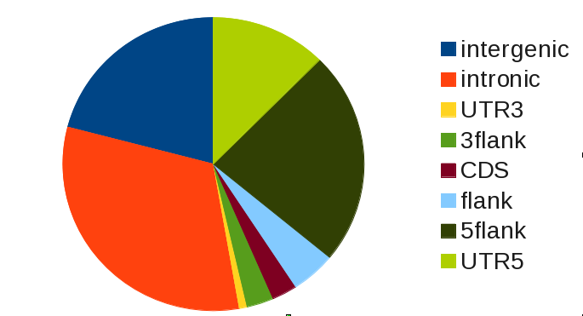
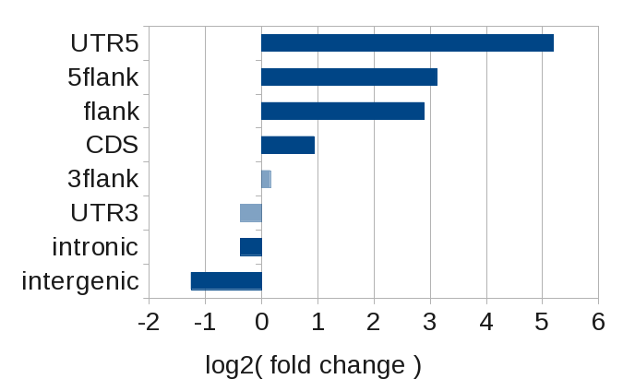
Enumeration vs. Association
Where does SRF bind in the genome?
Enumeration (via BEDtools/bedops)
Association (via GAT)
Notes:
They provide very different answers to a similar question.
Measuring overlap of an SRF binding site with the annotation track using something like BEDtools might lead us to think that SRF likes to bind intronic and intergenic regions for example
Looking into the association between SRF sites and genomic annotations, we see that UTR5 is actually the most preferred. Intergenic binding actually occurs significantly less than we expect. So even though a large number of SRF binding sites are intergenic, once we account for the fact that most of the genome is actually intergenic (the space between genes), we see that it binds there less than we would think
In this case, association is arguably more biologically meaningful. SRF is known as this promoter-binding ubiquitous factor. Most of the overrepresented annotation categories are proximal to the transcription start site (TSS)
We can even apply this to the previous problem. IRF8 binding for example almost always occurred proximal to PU.1. The binding of IRF8 would be extremely associated with PU.1 sites (if we were to use PU.1 sites as our annotation track). You might choose to express the previous figure as a log2 (fold change) type association as well.

Slide 35
Integrative Genomics Summary
BED files are the standard format for most “downstream” genomics analyses
Set theory (genome arithmetic) is the basis for operations used in integrative genomics
Chaining BEDtools operations can take you a long way
Enumeration and association can provide different answers (learn when to use each!)
Notes:
P-value in this case corresponds to what proportion of samples was a higher enrichment or lower depletion found than the one that was observed

Slide 36
Recommended Tutorial
http://quinlanlab.org/tutorials/bedtools/bedtools.html
  Official bedtools tutorial
  Walks you through many of the basic operations (intersect, merge, complement, genomecov)
  Shows you how to do higher order operations (chaining multiple commands, performing PCA using bedtools and R)

Slide 37
Acknowledgements
Much of the content in this lecture is from:
  Quinlan Lab & bedtools (http://bedtools.readthedocs.io/en/latest/)
  Heger et al. (2013) – GAT: A simulation framework for testing the association of genomic intervals
  Jiang & Mortazavi (2018) – Integrating ChIP-seq with other functional genomics data

Slide 38
Be sure to practice!
Notes:
You’ll be thinking in terms of bedtools operations in no time

Slide 39
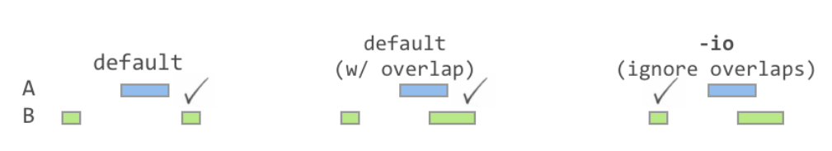
Genome arithmetic in BEDtools
Similar to intersect: “closest”
Returns closest feature regardless of whether the feature intersects or not
In practice, I use this much more than intersect
Notes:
The first intersection (in green) requires both A and B to overlap. The second (with the –wa flag) is an option that reports every feature in A that also appears in B

Slide 40
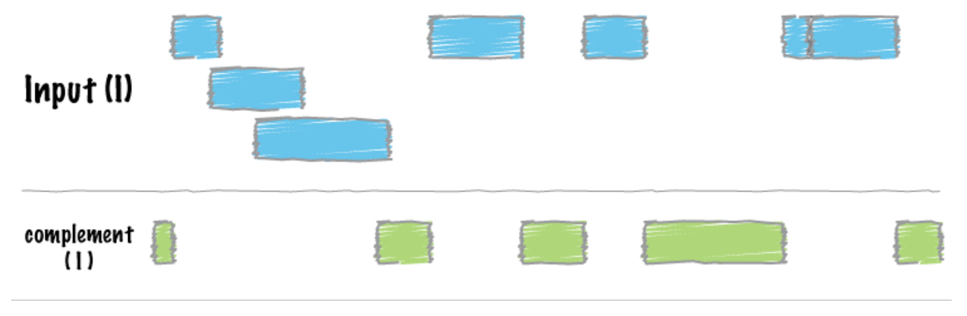
Genome arithmetic in BEDtools
The complement set of features
Corresponds to every interval in your reference track that isn’t covered

Slide 41
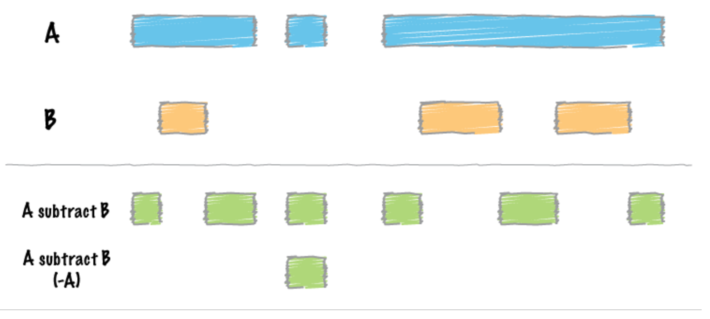
Genome arithmetic in BEDtools
Subtracting features from a BED file
Contrasts with “complement” from previous slide

Slide 42
Other BEDtools functions
In addition to the basic set operations (intersection, union, set difference):
  Shuffle – samples a genome file and outputs genomic features of the same size as your input with different locations
  Random – generates pseudo-random intervals of a user-specified size
  Resizing or moving features - Slop, shift

