Slide 1
BF528 - Introduction to Genetics and Genomics

Slide 2
NHGRI Lecture Series
These materials were developed in part from this excellent lecture series at the NIH:
http://www.genome.gov/12514288

Slide 3
Origin of “Genomics”: 1987
“For the newly developing discipline of [genome] mapping/sequencing (including the analysis of the information), we have adopted the term GENOMICS… The new discipline is born from a marriage of molecular and cell biology with classical genetics and is fostered by computational science.”
- McKusick and Ruddle, A new discipline, a new name, a new journal, Genomics, Vol. 1, No. 1. (September 1987), pp. 1-2

Slide 4
What is genomics?
“Genomics is a discipline in genetics that applies recombinant DNA, DNA sequencing methods, and bioinformatics to sequence, assemble, and analyze the function and structure of genomes (the complete set of DNA within a single cell of an organism).”
- Wikipedia

Slide 5
What is genomics?
“Research of single genes does not fall into the definition of genomics unless the aim of this genetic, pathway, and functional information analysis is to elucidate its effect on, place in, and response to the entire genome's networks.”
- Wikipedia

Slide 6
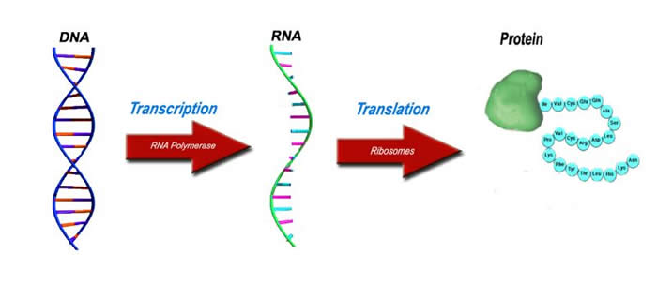
Central Dogma of Biology
http://www.lhsc.on.ca/Patients_Families_Visitors/Genetics/Inherited_Metabolic/Mitochondria/DiseasesattheMolecularLevel.htm

Slide 7
What can genomics tell us?
DNA Sequence
Gene Sequence
Regulatory Sequence
DNA Variation
Protein Sequence
Gene Expression
Human disease
Protein/Gene Function

Slide 8
How do we study genomics?
Isolate nucleic acid molecules from biological samples
Determine nucleotide sequence using biochemical techniques
Digitize nucleotide sequence
Examine digital sequences to identify patterns with algorithms and statistics
Relate patterns to biological observations by:
Comparing patterns detected across many samples
Manipulating a system to see how patterns change

Slide 9
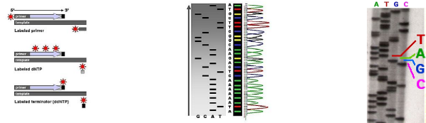
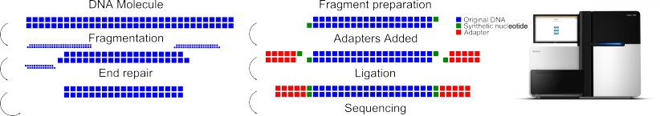
Sequencing Techniques
Sanger sequencing – fluorescent-labeled DNA fragments
Sequencing by synthesis, pyrosequencing
Adapted from http://web.uri.edu/gsc/next-generation-sequencing/

Slide 10
Sequence Analysis
Assembly – putting short sequences together to reconstruct a longer, source sequence
Mapping – locating where one short sequence is found in a longer sequence
Pattern recognition – looking for specific patterns within sequences that have special meaning
In each of these cases, sequences are aligned to one another

Slide 11
Sequence Alignment
Provides a measure of relatedness
Alignment quantified by similarity (% identity)
Useful for any sequential data type:
  DNA/RNA
  Amino acids
  Protein secondary structure
High sequence similarity might imply:
  Common evolutionary history
  Similar biological function

Slide 12
What Alignments Can Tell Us
Homology - Orthologs, Paralogs
Genomic identity/origin of a sequence/individual
Genome/gene structure
  Genic structure (exons, introns, etc)
  RNA 2D structure
  Chromosome rearrangements/3D structure

Slide 13
DNA Sequence Alignment Example
Sequence 1
ATACACAGTAGGAGATACCAGTAAGGGAGGGGG
Sequence 2
ATACCATAAGCGAG
Match
Mismatch
Alignment 1
ATACACAGTAGGAGATACCAGTAAGGGAGGGGG
--------------ATACCA-TAAGCGAG----
Gap
Alignment 2
ATACACAGTAGGAGATACCAGTAAGGGAGGGGG
ATAC-CA--------------TAAGCGAG----
Alignment 3
ATACACAGTAGGAGATACCAGTAAGGGAGGGGG
ATAC-CA-TA--AG---C--G--AG--------

Slide 14
Scoring/Substitution Matrices
Given alignment, how “good” is it?
Higher score = better alignment
Implicitly represent evolutionary patterns
 | A | C | G | T | -
A | 2 | -3 | -1 | -3 | -3
C | -3 | 2 | -3 | -1 | -3
G | -1 | -3 | 2 | -3 | -3
T | -3 | -1 | -3 | 2 | -3
- | -3 | -3 | -3 | -3 | NA
ATACCAGTAAGGGAG
ATACCA-TAAGAGAG
Score = 22
ATACCAGTAAGG-GAG
ATACCA-TAAG-AGAG
Score = 19
ATACCA-GTAAGGGAG
A-TACCATAAGAGAG-
Score = -20

Slide 15
Sequence Alignment Algorithms
Global alignments - beginning and end of both sequences must align
Local alignments - one sequence may align anywhere within the other
Multiplicity:
  Pairwise alignments (2 sequences)
  Multiple sequence alignment (3+ sequences)

Slide 16
Global Alignment
Both sequences are aligned from end to end
AAANTAIYYDPNPDMP A--NTAI-YDPN--M-
Interior sequences are aligned as well as possible
AERAKDNLCRLEHTTLRKVTAAANTAIYYDPNPDMPVVAEDQEWVNVYYEM
A-----N------T-----------AI-YD--P------------N----M
However, sequences of vastly different length can produce meaningless alignments

Slide 17
Local Alignment
Alignment may begin and end at any position
AAANTAIYYDPNPDMP -AANTAI-YDPN--M-
AERAKDNLCRLEHTTLRKVTAAANTAIYYDPNPDMPVVAEDQEWVNVYYEM
---------------------AANTAI-YDPN--M----------------
Local alignment may produce better alignments when sequence lengths differ greatly

Slide 18
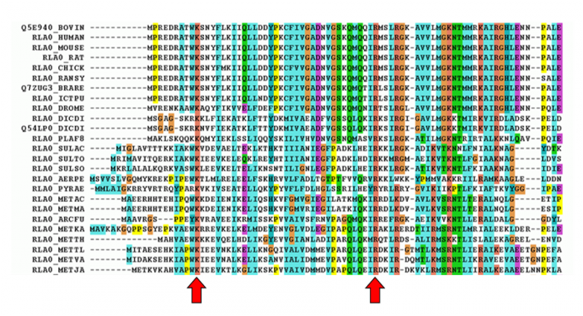
Multiple Sequence Alignment
Like pairwise alignment, but with N sequences
Sequence consensus among many species suggests evolutionary pressure

Slide 19
Alignment Examples

Slide 20
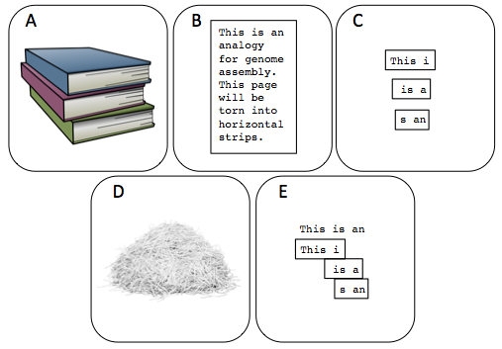
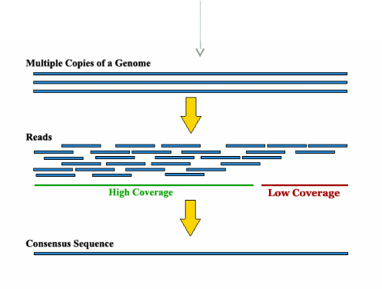
Example: Genome Assembly
We need multiple copies of each book (genome) to arrive at a consensus text (DNA sequence) of the original
If your genome was a book that had its sentences chopped into fragments, assembly is analogous to reconstructing all the sentences.
Great explanation of DNA sequence assembly: http://gcat.davidson.edu/phast/

Slide 21
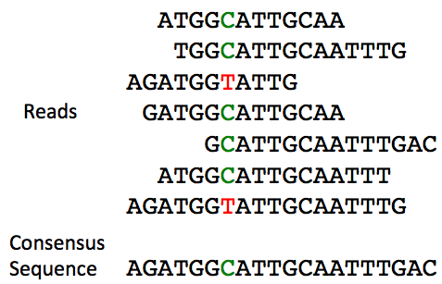
Example: Genome Assembly
An error?
A polymorphism?
A different allele?
Incorrect alignment?
Greedy approach: take most frequent nucleotide at each aligned position
Great explanation of DNA sequence assembly: http://gcat.davidson.edu/phast/

Slide 22
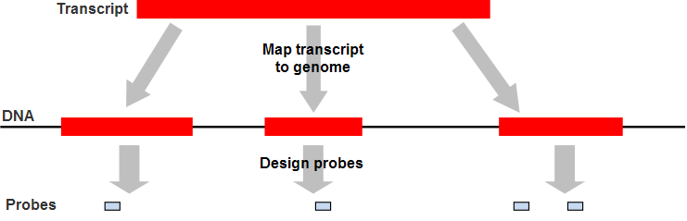
Example: Exon Microarray Probes
Microarray probes are short single-stranded DNA sequences from a reference genome
Exon Microarrays have probes only from exons
Exon probes must map to the correct exon, BUT
Probes must NOT map anywhere else, they must be unique in the genome

Slide 23
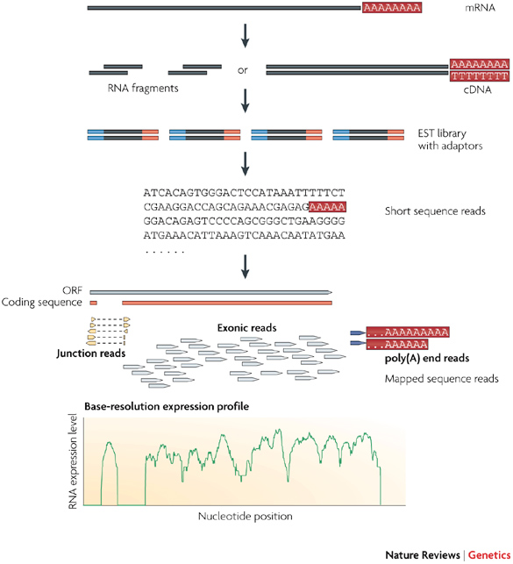
Example: mRNA-Seq Analysis
Start with a pool of mRNA molecules
Millions of DNA sequences 30-150 nucleotides long
Find all locations where sequences map in genome
Count the number of sequences that map to individual regions (e.g. genes)

Slide 24
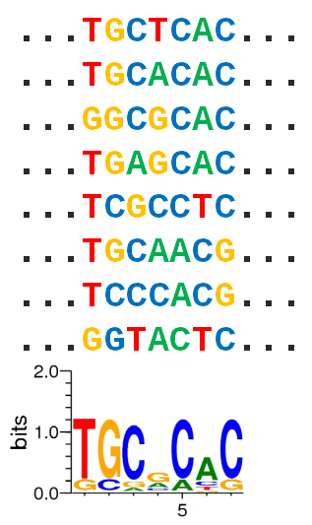
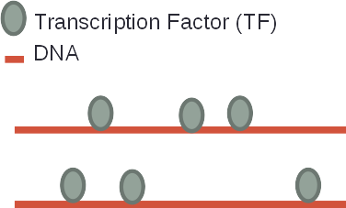
Example: DNA Binding Site Discovery
Identify genomic regions where a particular TF is bound across the entire genome
By extracting and aligning the DNA sequence corresponding to these binding events, we can identify which DNA sequences this TF tends to bind

Slide 25
Human Genomics and Gene Expression

Slide 26
The Human Genome Project
Planning begins 1984, launched 1990, “completed” 2001, “finished” 2004
Championed by Dr. Charles DeLisi
Overview of the Human Genome Project: http://www.genome.gov/12011238

Slide 27
Human Genome Composition
Key findings:
  ~20k genes
  More segmental duplications than expected
  Fewer than 7% of protein families vertebrate specific
  ~3% of sequence codes for protein coding genes
  >85% of the genome is transcribed
  Repetitive elements may comprise >66% of genome

Slide 28
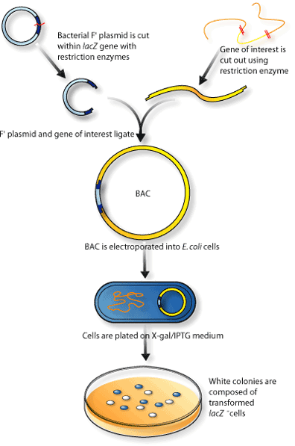
How The Genome Was Determined
International Human Genome Sequencing Consortium
Fragment DNA with restriction enzymes
Ligate fragments into bacterial artificial
chromosomes (BACs)
Amplify BACs with tagged DNA fragments
Fragment isolated BAC vectors
Sequence via Sanger-style sequencing to 4x coverage
Finished draft genome in ~10 years

Slide 29
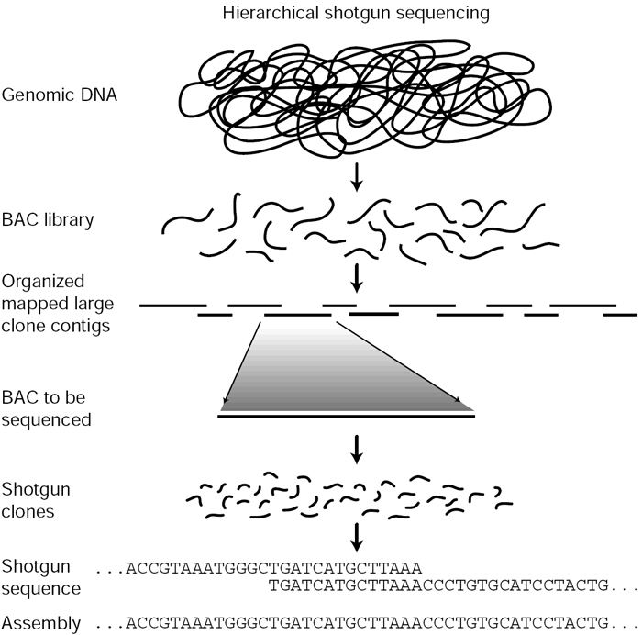
How The Genome Was Determined
Celera Technologies: shotgun sequencing
Used public BACs contigs from the
Human Genome Project and theirown
Much shorter DNA reads, assembled
later in silico using the HGP BAC clones
as a scaffold
Finished draft genome in ~3 years

Slide 30
The Genome Is All About Genes
Genic sequences
What do our genes do?
How are genes controlled?
What genes are different between humans?
How are genes associated with disease?
Gene Expression

Slide 31
Gene Expression
“Gene expression is the process by which information from a gene is used in the synthesis of a functional gene product.”
- Wikipedia

Slide 32
But What Is A Gene?
A specific DNA sequence
A fundamental unit of inheritance
A molecule created by transcription of an RNA product (then translated into a protein) which has a function
A “gene” is an abstract concept

Slide 33
But What Is A Gene?
DNA?
RNA?
Protein?
Informational molecule?
Functional molecule?
Yes, all of them

Slide 34
What Is Gene Expression?
Active mRNA transcription?
mRNA abundance?
mRNA translation?
RNA function?
Protein abundance?
Protein function?
Yes, all of them

Slide 35
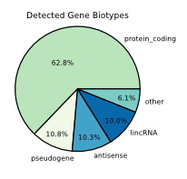
The Gene Expression Landscape
mRNA - protein coding genes
Functional non-coding RNA (ncRNA) biotypes:
  microRNA (miRNA)/small interfering RNA (siRNA)
  Long (intergenic) non-coding RNA (lncRNA/lincRNA)
  Ribosomal RNA (rRNA)
  Transfer RNA (tRNA)
  Many more (30+)
Antisense: transcript initiated from TSS
in opposite direction of primary gene
Pseudogenes

Slide 36
How We Measure Gene Expression
mRNA transcription/translation
  Fluorescent tagging + microscopy
  ribosomal capture
mRNA abundance
  Northern blots
  Quantitative polymerase chain reaction (qPCR)
  Microarrays
  High-throughput sequencing

Slide 37
How We Measure Gene Expression
Protein abundance
  Western blots
  Fluorescent tagging + microscopy
  Mass spectrometry
  Protein arrays
mRNA/Protein localization
  Fluorescent tagging + microscopy

Slide 38
mRNA Measurement Considerations
Most mRNA quantification techniques measure steady state abundance
mRNA measurements are snapshots
  Measure large populations of cells to quantify “average” abundance
Poor concordance between mRNA and corresponding protein abundance

