Slide 1
BF528 - R+RStudio Primer

Slide 2
R
R is a statistical computing language
Free and open source
Designed for statistics, data analysis, and visualization
Can be run on command line
More commonly run with rstudio

Slide 3
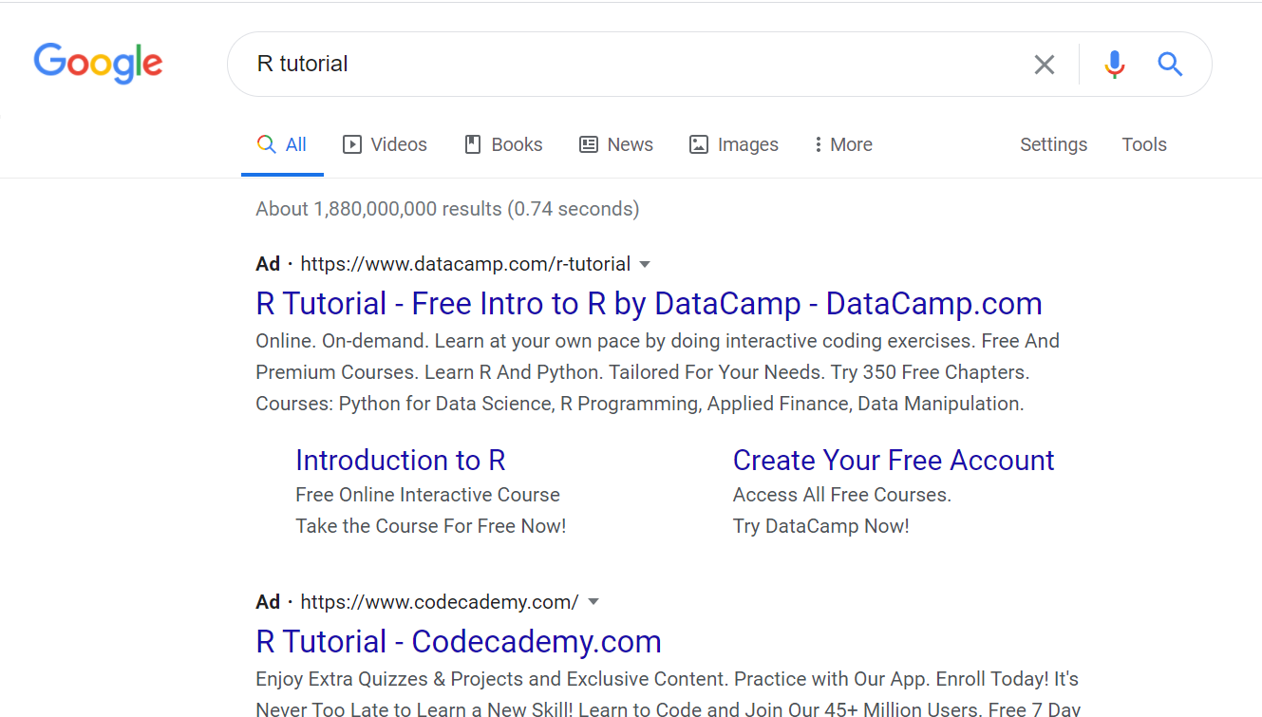
There Are Literally Billions of R Tutorials
(just joking, kind of)

Slide 4
SCC OnDemand: RStudio

Slide 5
R for Data Science
Excellent guide for learning R
tidyverse: set of packages that makes R less awful
https://r4ds.had.co.nz/

Slide 6
R Markdown and R Notebooks

Slide 7
Bioconductor

Slide 8
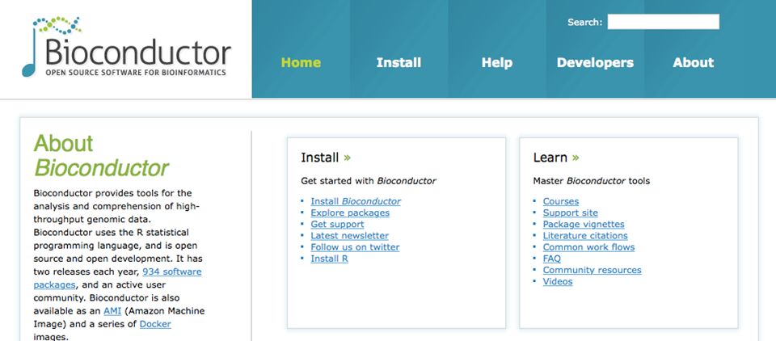
Bioconductor

Slide 9
R on the Command Line

Slide 10
A passing command line arguments
#!/usr/bin/env Rscript
args <- commandArgs(trailingOnly=TRUE)

