Slide 1
Single Cell Sequencing Analysis
Part 1

Slide 2
Single Cell Sequencing Data Review
Sequencing depth = (# of cells) x (required depth):
  RNA - 50k paired end reads / cell for cell type classification
  RNA - .25M-1M paired reads / cell for transcriptome coverage
  DNA - 30-100x per cell
e.g. 1000 cell scRNA-Seq = 250M-1B reads per sample!
  Bulk mRNA-Seq: 30M-80M per sample
Sequences in one PE fastq file are entirely barcodes
Read length > 50bp for annotated genome
Rizzetto, et al. 2017. “Impact of Sequencing Depth and Read Length on Single Cell RNA Sequencing Data of T Cells.” Scientific Reports 7 (1): 12781.

Slide 3
The Trees: Cells
What cell types are in a sample?
What are their relative proportions?
How do their transcriptomes differ?
Which/how do cells respond to stimulus?
How do cells change over time?
What is the level of mosaicism in tissues?

Slide 4
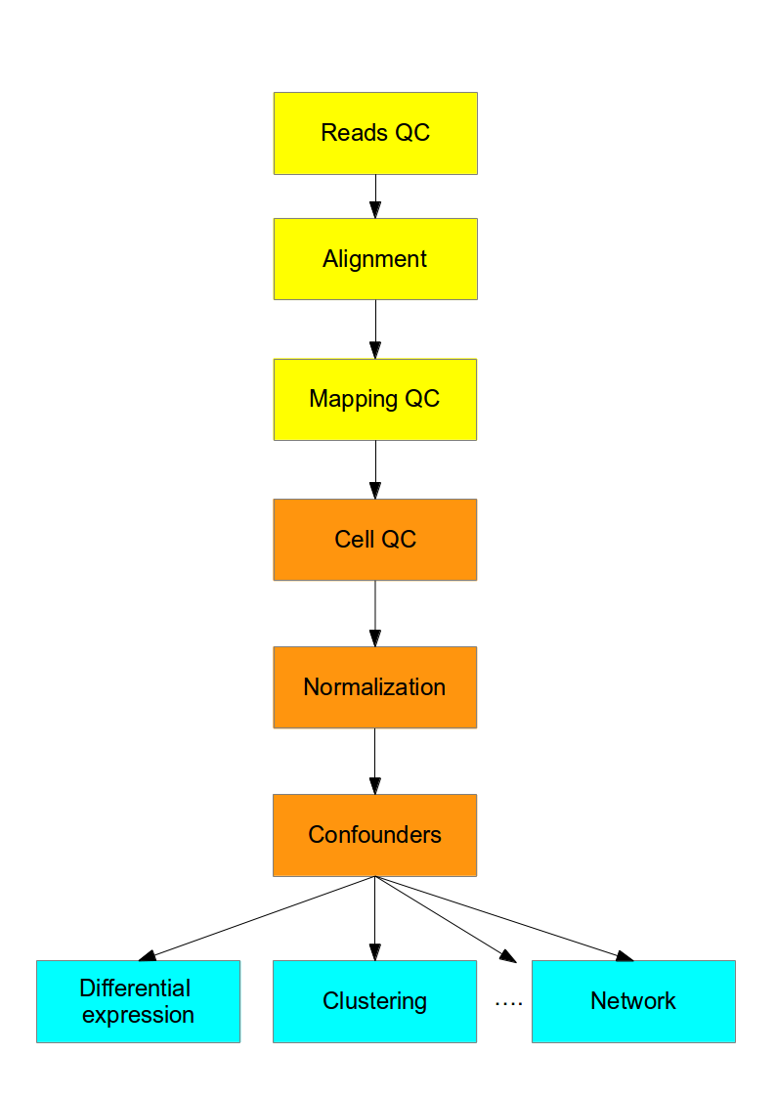
Analysis Overview: scRNA-Seq
Sequence QC
  Demultiplex
  UMI Collapsing
Alignment+QC
Quantification
Normalization
DE, Clustering, etc
https://hemberg-lab.github.io/scRNA.seq.course/introduction-to-single-cell-rna-seq.html

Slide 5
Sequence QC
One sample is 100s-10,000s of cells
  i.e. ~1,000 fastq files per sample
  May or may not be already demultiplexed by core
Paired end:
  Read 1: molecule sequence
  Read 2: barcode - used for demultiplexing and UMI collapsing
Normal fastq processing and QC:
  Adapter and quality trimming of both reads
  (barcode read can still have adapter)
  fastqc, multiqc

Slide 6
Unique Molecular Identifiers
Enable detection of qPCR amp. artefacts
Not required, but often used
Reads deduplicated or collapsed by cell barcode+UMI sequence prior to analysis
Barcodes/UMIs designed to tolerate sequencing errors
  i.e. >2 edit distance between any two sequences

Slide 7
Unique Molecular Identifiers
(conceptual)
Pool of UMI Barcodes
AAAT
AATA
ATAA
...
Sequenced Barcode
ACATAGAAAAAT
CCCATTAGAAAT*
ACATAGAAAATA*
GGTAGATAAAAT
GGTAGATAATAA
ACATAGAAAATA*
ACATAGAAAATA*
ACATAGAAATAA
GGTAGATAAATA
ACATAGAAAATA*
CCCATTAGAAAT*
CCCATTAGATAA*
CCCATTAGATAA*
All UMIs per droplet
Droplet
Droplet
Droplet
Cell
Amplify, Pool, and Sequence
Pool of Cell Barcodes
ACATAGAA
GGTAGATA
CCCATTAG
...
One BC per droplet
* PCR duplicates
Red cell: 6 reads,
3 original fragments
Blue cell: 3 reads,
3 original fragments
Orange cell: 4 reads, 2 original fragments

Slide 8
Alignment
Use either UMI collapsed or original reads
UMI-tools: toolkit for working with UMIs
Standard tools and QC, i.e.:
  Alignment: STAR, bwa, bowtie, etc
  QC: RSeQC, multiqc, etc
NB: Some aligners have single cell mode
  e.g. STARsolo - STAR aligner scRNA-Seq mode

Slide 9
QC: Mitochondria and spike-in controls
High % reads mapping to mitochondrial genes = indicates low sample quality
Spike-in (synthetic) RNA is sometimes used as an alternative control
Idea: if mito/spike-in reads make up high proportion of reads, mRNA concentration was low

Slide 10
Quantification
STAR+htseq-count, kallisto, salmon, etc
Each sample has a different # of cells
Each cell has the same number of measurements (e.g. genes)
  = (# of samples) x (# of cells) x (# of genes)
  Sparse: most will be zero!
We consider only single sample case below

Slide 11
Count Matrix Normalization
Normalization needed to make counts comparable between cells
Two possible levels of normalization:
  Within cell (e.g. divide by column sum, “library size”)
  Within dataset (e.g. divide by total number of reads)
All methods from bulk apply, i.e.
  CPM, FPKM, DESeq2 etc…

Slide 12
The Counts Matrix
Counts matrix contains either:
  Read counts or
  UMI counts if used
Each cell has:
  Total number of counts (col. sum, “library size”)
  Number of non-zero genes
Each gene has:
  # of non-zero cells
  Non-zero mean/variance
Matrix is sparse: many zeros
Zeros may be:
  Cell lacks gene
  A “drop-out”: gene present but was missed by qPCR
 | cell1 | cell2 | cell3 | cell4 | cell5 | cell6 | ... | cellM
gene1 | 93 | 25 | 0 | 0 | 3335 | 0 |  | 82
gene2 | 5 | 2 | 0 | 3 | 1252 | 0 |  | 12
gene3 | 0 | 0 | 0 | 0 | 0 | 0 |  | 0
gene4 | 98 | 21 | 1 | 1 | 5318 | 0 |  | 75
gene5 | 0 | 0 | 513 | 0 | 0 | 325 |  | 135
gene6 | 0 | 0 | 113 | 0 | 1 | 497 |  | 255
gene7 | 3 | 0 | 0 | 0 | 6 | 0 |  | 0
...
geneN | 68 | 52 | 0 | 2 | 4313 |  |  | 63

Slide 13
Examining the Counts Matrix
Each cell type has a signature, i.e. a pattern of gene expression
Consistent pattern of expression suggests same cell type:
Cells 1, 2, and 5 (M?)
Cells 3, 6 (M?)
 | cell1 | cell2 | cell3 | cell4 | cell5 | cell6 | ... | cellM
gene1 | 93 | 25 | 0 | 0 | 3335 | 0 |  | 82
gene2 | 5 | 2 | 0 | 3 | 1252 | 0 |  | 12
gene3 | 0 | 0 | 0 | 0 | 0 | 0 |  | 0
gene4 | 98 | 21 | 1 | 1 | 5318 | 0 |  | 75
gene5 | 0 | 0 | 513 | 0 | 0 | 325 |  | 135
gene6 | 0 | 0 | 113 | 0 | 1 | 497 |  | 255
gene7 | 3 | 0 | 0 | 0 | 6 | 0 |  | 0
...
geneN | 68 | 52 | 0 | 2 | 4313 |  |  | 63

Slide 14
Filtering Cells and Genes
Many measurements
  e.g. 30k genes x 1ks of cells
Some cells are uninformative, e.g.:
  Very few reads, few genes detected
  Two cells sequenced together (i.e. doublets)
Some genes are uninformative:
  Low # reads, low variance across all cells
  Too few cells express gene (e.g. < 10 of 10,000 cells nonzero)
Must filter genes and cells to reduce noise

Slide 15
Filtering the Counts Matrix
Genes likely not expressed and should be filtered:
Very few non-zero counts AND
Low non-zero count mean
 | cell1 | cell2 | cell3 | cell4 | cell5 | cell6 | ... | cellM
gene1 | 93 | 25 | 0 | 0 | 3335 | 0 |  | 82
gene2 | 5 | 2 | 0 | 3 | 1252 | 0 |  | 12
gene3 | 0 | 0 | 0 | 0 | 0 | 0 |  | 0
gene4 | 98 | 21 | 1 | 1 | 5318 | 0 |  | 75
gene5 | 0 | 0 | 513 | 0 | 0 | 325 |  | 135
gene6 | 0 | 0 | 113 | 0 | 1 | 497 |  | 255
gene7 | 3 | 0 | 0 | 0 | 6 | 0 |  | 0
...
geneN | 68 | 52 | 0 | 2 | 4313 |  |  | 63
NB: Genes with few non-zero counts and HIGH non-zero count mean suggests rare cell type!

Slide 16
Filtering the Counts Matrix
Cells might also be filtered:
Very few or zero counts (cell4)
Very many counts (cell5)
  Possible “doublet” of same cell type
Inconsistent expression pattern (cellM)
  Possible “doublet” of different cell types
Doublet: two cells with same cell barcode
 | cell1 | cell2 | cell3 | cell4 | cell5 | cell6 | ... | cellM
gene1 | 93 | 25 | 0 | 0 | 3335 | 0 |  | 82
gene2 | 5 | 2 | 0 | 3 | 1252 | 0 |  | 12
gene3 | 0 | 0 | 0 | 0 | 0 | 0 |  | 0
gene4 | 98 | 21 | 1 | 1 | 5318 | 0 |  | 75
gene5 | 0 | 0 | 513 | 0 | 0 | 325 |  | 135
gene6 | 0 | 0 | 113 | 0 | 1 | 497 |  | 255
gene7 | 3 | 0 | 0 | 0 | 6 | 0 |  | 0
...
geneN | 68 | 52 | 0 | 2 | 4313 |  |  | 63

Slide 17
Filtering the Counts Matrix: Quality
Filtering thresholds are subjective!
Must consider protocol, biological system, and study design
Examples:
  remove cells with median sum count <
  3 median absolute deviations from median
  Remove genes with more than 90% zeros AND non-zero mean < 10

Slide 18
Filtering the Counts Matrix: Variance
Some genes are shared by all cells
Normalization assumes most genes are not differentially expressed
Genes with low variance across cells are uninformative
Filtering threshold is subjective!

Slide 19
Typical Analysis Paths
Dimensionality Reduction
Projection
(tSNE, UMAP, etc)
Visualization
Counts matrix
Unsupervised Clustering
Differential Expression
Marker Gene Analysis
Differences in Proportion

