Slide 1
BF528 - Applications in Translational Bioinformatics
Introduction

Slide 2
All Lectures Are Being Recorded
but
Only my screen!

Slide 3
Biology became a
data science in 1953

Slide 4
Biology as a Data Science
1998: first multicellular eukaryote sequenced, human SNP array prototype
2001: First draft of the human genome
1997: yeast genome on microarray, sequencing by synthesis established
1995: 1st bacterial genome sequenced, microarray technology described
1992: European Bioinformatics Institute (EMBL-EBI) founded
1990: Human Genome Project launched
Human Genome Era
1988: National Center for Biotech Information (NCBI) founded
1983: PCR invented
1977: Sanger sequencing invented, first genome sequenced
1953: DNA chemical structure published in Nature
1972: First genetic sequence determined
1950
1960
1970
1980
1990
2000
2010
Notes:
1995: haemophilus influenzae first bacterium sequenced
1996: yeast genome sequenced
1998: c. elegans

Slide 5
The Human Genome Era
2006: Solexa Genome Analyzer released,
23andMe founded
2001: First draft of the human genome
2007: Human Microbiome Project launched, Illumina buys Solexa
2008: 1000 Genomes Project launched
2002: International HapMap Project launched
2009: Illumina offers whole genome sequencing service for $48,000, single-cell sequencing technologies emerge
2010: Illumina WGS service price drops to $19,000
2003: Human Genome declared “complete”, Encyclopedia of DNA Elements (ENCODE) launched
2012: UK announces 100k Genomes Project
2014: Illumina WGS service price drops to $1,000
2018: 100k Genomes Project complete
2000
2005
2010
2015
2020
Human Genome Releases
NCBI36
GRCh37/hg19
GRCh38

Slide 6
“Big” Data
Single Microarray dataset: ~500Mb
Single short read dataset: ~2Gb-300Gb
Human genome reference sequence: ~2Gb
One run of Illumina instruments:
  HiSeq 2500: ~1Tb
  NovaSeq 6000: ~6Tb
NCBI Short Read Archive (SRA) samples:
  2015: 3,351,430: ~37 Tb
  2020: 15,671,845: 17,500 Tb (136,718 iPhones)

Slide 7
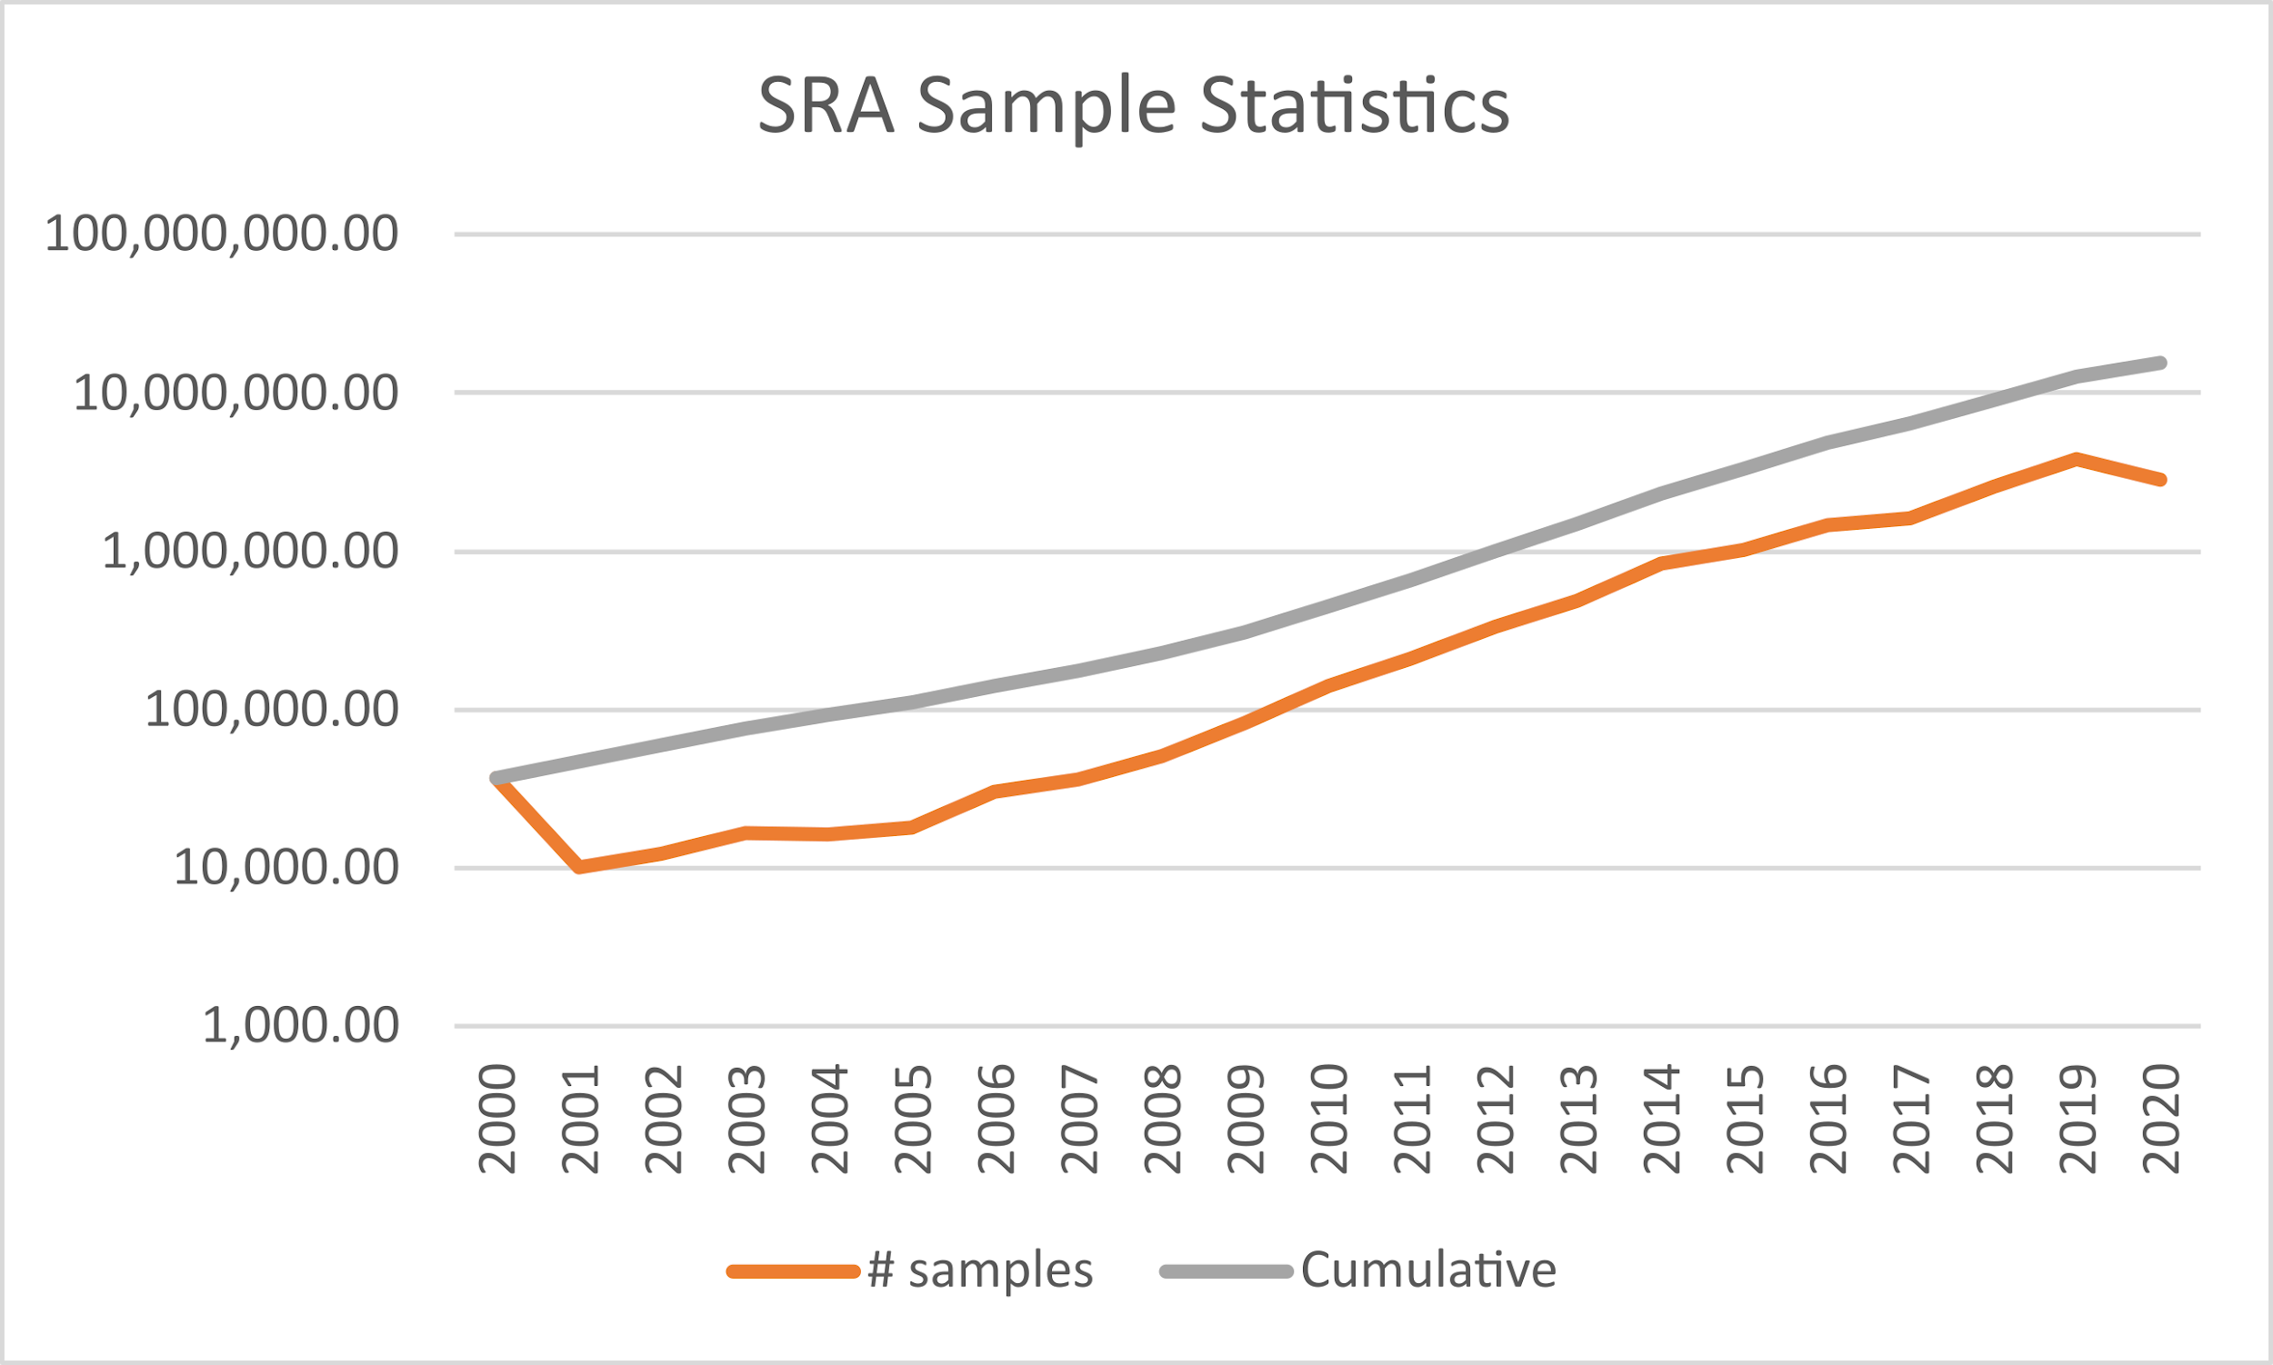
Short Read Archive Sample Repository

Slide 8
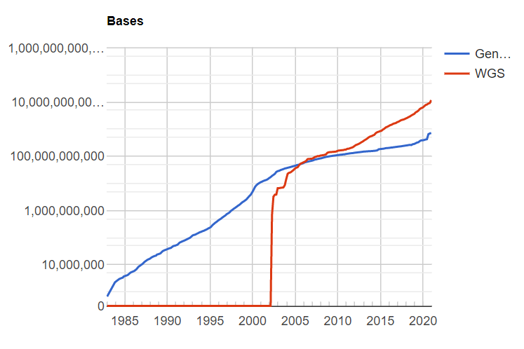
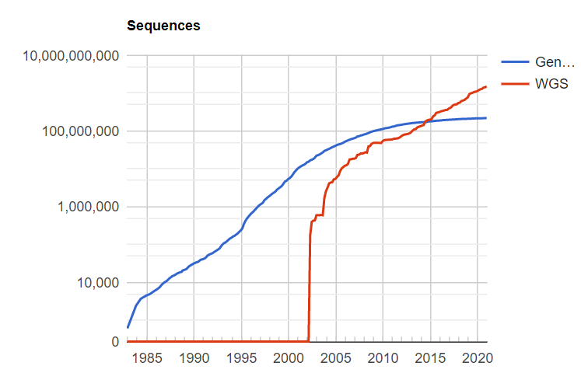
NCBI Genbank Sequences
NCBI GenBank - https://www.ncbi.nlm.nih.gov/genbank/

Slide 9
What is Bioinformatics?
“Bioinformatics is an interdisciplinary field that develops methods and software tools for understanding biological data, in particular when the data sets are large and complex. As an interdisciplinary field of science, bioinformatics combines biology, computer science, information engineering, mathematics and statistics to analyze and interpret biological data.”
Wikipedia - (Accessed 1/18/2021)

Slide 10
What is Bioinformatics?!?
“an interdisciplinary field that develops methods and software tools”?
“an interdisciplinary field of science”?
DEPENDS ON WHO YOU ASK
NB: “Science (from the Latin word scientia, meaning "knowledge") is a systematic enterprise that builds and organizes knowledge in the form of testable explanations and predictions about the universe.” - Wikipedia

Slide 11
What is Bioinformatics?
“Bioinformatics is an interdisciplinary field that develops methods and software tools for understanding biological data, in particular when the data sets are large and complex. As an interdisciplinary field of science, bioinformatics combines biology, computer science, information engineering, mathematics and statistics to analyze and interpret biological data.”
Wikipedia - (Accessed 1/18/2021)

Slide 12
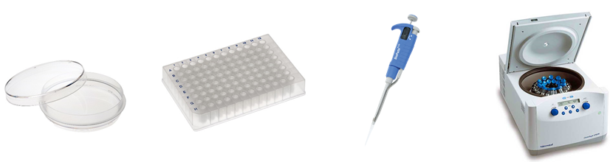
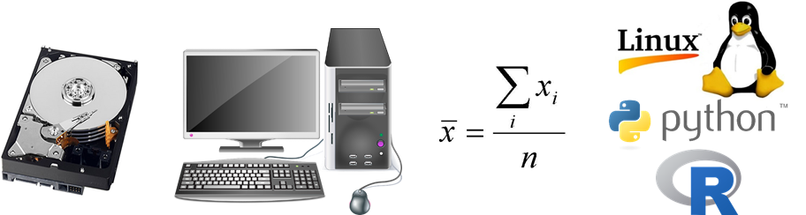
The Biologist’s Tools
Wet lab biologists:
Bioinformaticians:

Slide 13
Conceptual History of Bioinformatics
Biological sequences digitized
Biological databases needed to store sequences
Search tools needed for databases
Tools for analyzing data from searches
New tools required to analyze human genome
Those new tools enable analysis of large amounts of sequencing data
Sequencing data volume explodes, requiring new tools
...

Slide 14
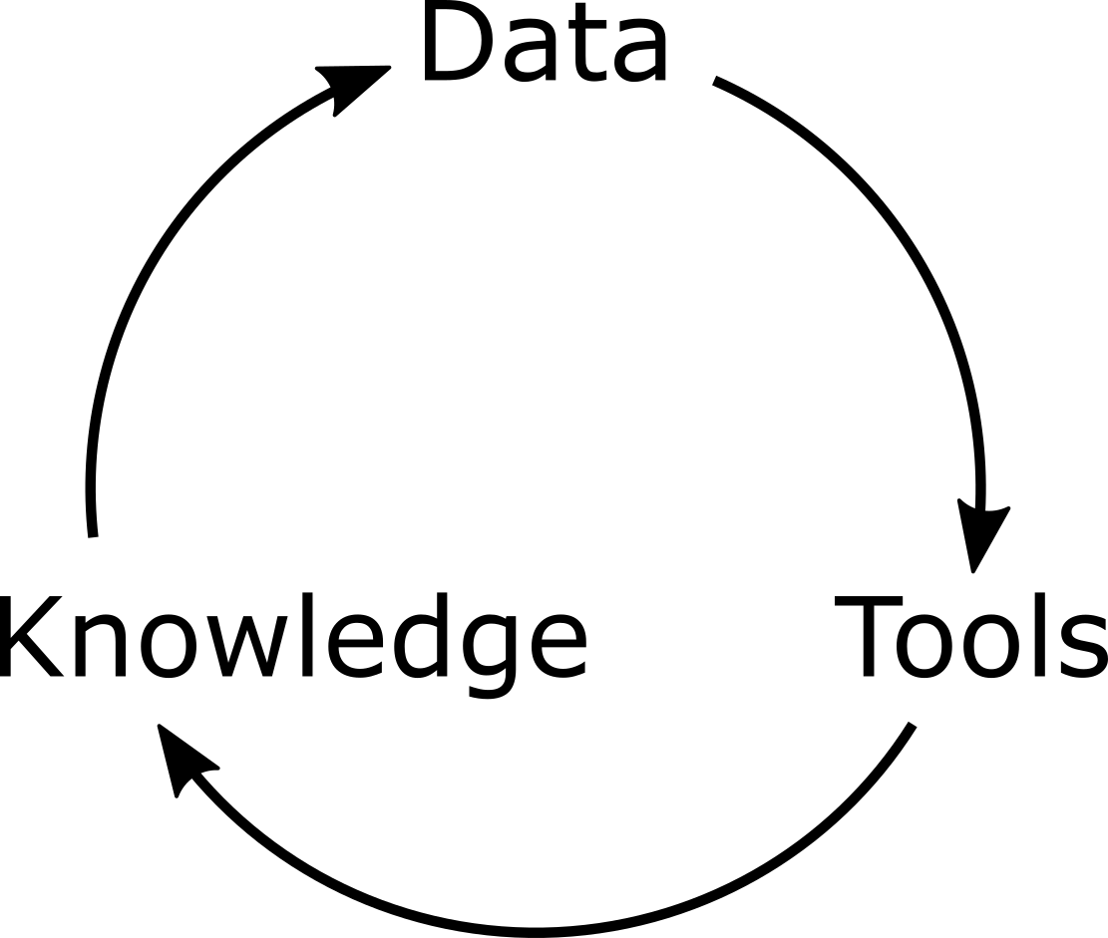
Data → Tools → Knowledge Cycle

Slide 15
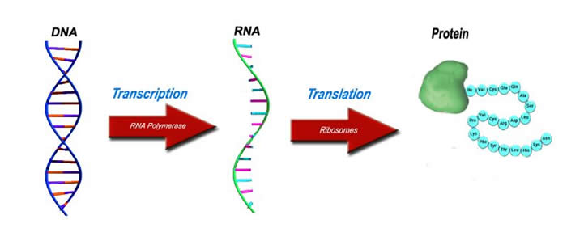
Central Dogma of Biology
Each of these molecules is a sequence
http://www.lhsc.on.ca/Patients_Families_Visitors/Genetics/Inherited_Metabolic/Mitochondria/DiseasesattheMolecularLevel.htm

Slide 16
The Sequence: The Fundamental Datatype
Molecular Sequence
Computer Science
  genome assembly, homology, phylogeny
Physics
  DNA/RNA/protein structure, drug prediction
Statistics
  gene expression, population genetics, biomarkers
Mathematics
  metabolic modeling, synthetic biology, systems biology

Slide 17
Translational Bioinformatics
“Translational Bioinformatics (TBI) is an emerging field in the study of health informatics, focused on the convergence of molecular bioinformatics, biostatistics, statistical genetics, and clinical informatics.”
Wikipedia - (Accessed 1/18/2021)

Slide 18
Instructor Introduction

Slide 19
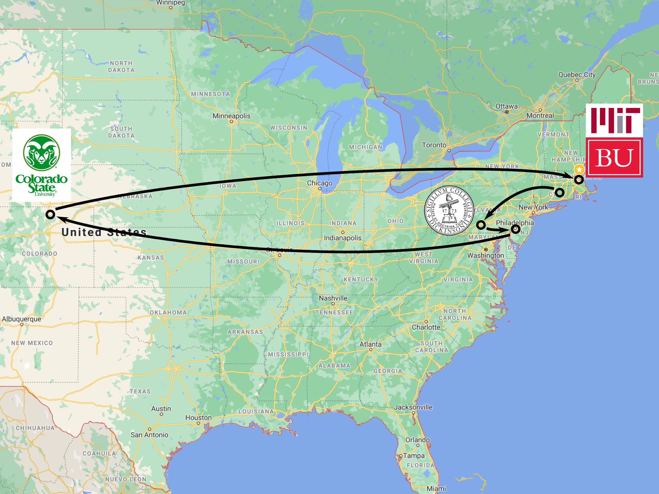

Slide 20
Course Structure

Slide 21
Instructors
Instructor: Adam Labadorf
TAs:
  Gargi Dayama
  Jacquelyn (Jackie) Turcinovic
  Shruthi Bandyadka
  Jing Zhang

Slide 22
Course Organization
http://bf528.readthedocs.io
Lectures are on Zoom WF starting at 2:30
Lectures will be recorded and posted online
  Recordings do not capture Zoom video
5 projects over the course of the semester
  4 group, 1 individual
Some online content early in semester

Slide 23
Course Overview
Survey course in bioinformatics
Focus on high-throughput sequencing data, tools, and techniques
Focus on practical skills
Group work simulates real-world collaborative environment

Slide 24
Course Goals
Survey current bioinformatics techniques in translational studies
Give you hands-on experience working with high-throughput biological data and tools
Read and understand papers that use bioinformatics in translational studies
Develop shared vocabulary between biology and computation

Slide 25
Schedule of Topics
Lecture | Day | Date | Topic | Secondary | Project
1 | W | Jan 27 | Introduction | Command Line Interface
2 | F | Jan 29 | Genomics, Genes, and Genomes | Cluster Usage
3 | W | Feb 3 | Array Technologies | git | 1
4 | F | Feb 5 | Gene sets and enrichment | R+RStudio Primer
5 | W | Feb 10 | 2nd Gen Sequencing
6 | F | Feb 12 | Sequence Analysis Fundamentals
7 | W | Feb 17 | Sequence Analysis - RNA-Seq 1
8 | F | Feb 19 | Sequence Analysis - RNA-Seq 2
9 | W | Feb 24 | Genomic Variation and SNP Analysis |  | 1/2
10 | F | Feb 26 | Sequence Analysis - ChIP-Seq
11 | W | Mar 3 | Biological Data Formats | Something Fancy
12 | F | Mar 5 | Sequence Visualization | Genome Browsers
13 | W | Mar 10 | Biological Databases
14 | F | Mar 12 | Replicability vs Reproducibility Strategies
NB: during weeks without secondary topic, you will meet with your TA during the second half of class

Slide 26
Schedule of Topics cont’d
15 | W | Mar 17 | Computational Environment Management | Conda | 2/3
16 | F | Mar 19 | Computational Pipeline Strategies | Snakemake
17 | W | Mar 24 | Single Cell Techniques
18 | F | Mar 26 | Single Cell Analysis
 | W | Mar 31 | Wellness Day, no class
19 | F | Apr 2 | Microbiome: 16S
20 | W | Apr 7 | Microbiome: Metagenomics |  | 3/4
21 | F | Apr 9 | Proteomics
22 | W | Apr 14 | Metabolomics
23 | F | Apr 16 | Integrative Genomics
 | W | Apr 21 | Schedule adjustment, no class
 | F | Apr 23 | Project work
24 | W | Apr 28 | The Future + retrospective, end of classes |  | 4/5
 | F | May 8 | Final projects due |  | 5
NB: during weeks without secondary topic, you will meet with your TA during the second half of class

Slide 27
Lecture Structure
Days with secondary topic
Days without secondary topic
2:30PM
Main Topic ~50 min
Main Topic ~35 min
3:05PM
3:10PM
~5 min break
Group Block W1/F1 meets TA ~30 min
Others office hours w/ Adam or
Project work
~5 min break
Secondary Topic ~50 min
3:40PM
3:45PM
~5 min break
Group Block W2/F2 meets TA ~30 min
Others office hours w/ Adam or
Project work
4:15PM
Group Block W1/W2 meet on Wednesdays, Group Blocks F1/F2 meet on Fridays

Slide 28
Group Blocks Illustration
Wednesday Groups
Friday Groups
 | Group Block | Gargi | Jackie | Jing | Shruthi
3:10 | W1 | 1 | 2 | 3
3:45 | W2 |  | 4 | 5 | 6
 | Group Block | Gargi | Jackie | Jing | Shruthi
3:10 | F1 | 7 | 8 | 9
3:45 | F2 |  | 10 | 11 | 12

Slide 29
Projects
Reproduce findings from published studies
5 projects over the course of the semester
  Last project is an individual project
Each project has a full writeup
Your writing must be your own, but you may share everything else!
No homeworks or exams

Slide 30
Project Groups
Students assigned into groups of 3 or 4
Each group has a primary TA
You will receive knowledge survey soon
Assigned into groups based on experience
Groups are for the entire semester

Slide 31
Project Groups cont’d
Group members will play one of four roles:
  Data Curator - find, download, and organize data
  Programmer - process data into analyzable form
  Analyst - transform processed data into interpretable form
  Biologist - understand paper and biological context, help interpret results
Roles rotate for each project
Structured class time to help facilitate group work and help each other!

Slide 32
Project Group Meeting
Your group will meet once most weeks with your TA over Zoom
Feel free to bring questions about the lecture material
Discuss project progress:
  “What did I work on since our last meeting?”
  “What challenges did I encounter?”
  “Are there any obstacles to completing my work?”
  “What will I be working on for next meeting?”

Slide 33
Project Report
Organized like a published study
Sections (primary role):
  Intro - background and motivation (Biologist)
  Data - data description (Data Curator)
  Methods - processing and tools (Programmer)
  Results - findings (Analyst)
  Discussion - interpret findings (Biologist)
  Conclusion (all)

Slide 34
Assessment
Each project is 20% of your total grade
Evaluation
  You will receive feedback for each project
  Your work will be assessed in the following areas:
    Accuracy
    Clarity of language
    Figure/table quality
    Report formatting
    Thoroughness
    Cohesion
  Detailed guidance found on course website

Slide 35
Core Course Values
OPENNESS
  Anyone can work together - share code!
  Copy code from Stack Exchange!
ACCEPTANCE
  All backgrounds and beliefs are welcome.
  This class is a safe place for dissent.
PATIENCE
  We are all learning. We all bring value. Be kind!

