Slide 1
BF528 - Genesets and Enrichment

Slide 2
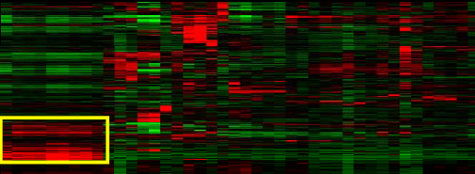
Finding Gene Lists Of Interest
Gene expression experiments often yield genes implicated in some process
Most common method: Get a list of differentially expressed genes
  P‐value and/or fold change?
  Threshold?
Alternatives:
  Define a cluster
  Sort data and/or apply a model to rank genes
Recommendations:
  Try lists of varying length
  Try to maximize signal / noise

Slide 3
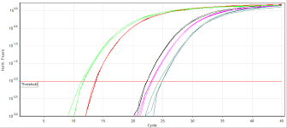
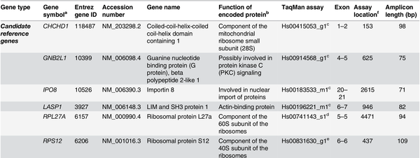
You found interesting genes: now what?
Select some genes for validation
Do some follow-up experiments
Publish a huge table with results
Try to learn about genes from published literature
qPCR

Slide 4
Interpreting Gene Lists
Single gene analysis method instrumental in our understanding of cell-biological process
Many genes work together in the cell in, e.g. pathways
Biologically, gene expression of entire cellular pathways is perturbed as a unit
Individual genes cannot reveal high level patterns
Groups of genes known to relate are organized into genesets

Slide 5
Types of Gene Sets
Genes are organized in different ways:
  Biological process (e.g. cell cycle, inflammation)
  Molecular function (kinase, zinc ion binding)
  Cellular component (nucleus, cell membrane)
  Disease process (transcription in cancer)
  Genome loci (chromosome 1 p32.1)
Does our gene list overlap with a given gene set?
Which gene sets are implicated by our gene list?

Slide 6
Popular Annotation Sources
KEGG Pathways - Kyoto Encyclopedia of Genes and Genomes
REACTOME - curated, peer-reviewed pathway DB
Gene Ontology
Genes sharing a motif or regulated by the same protein/miRNA
Genes found on the same chromosome
Broad’s Molecular Signatures Database (MSigDB)
any grouping that is biologically sensible (e.g. your own)

Slide 7
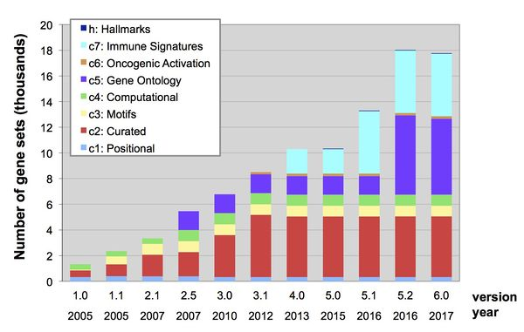
Molecular Signatures Database - MSigDB
The Molecular Signatures Database (MSigDB) gene sets are divided into 8 major collections: http://software.broadinstitute.org/gsea/msigdb
C1: positional gene sets
C2: curated gene sets
C3: motif gene sets
C4: computational gene sets
C5: GO gene sets
C6: Oncogenic signatures
C7: immunogenic signatures
Hallmarks of Cancer genesets

Slide 8
Gene Ontology (GO)
Ontology: “a set of concepts and categories in a subject area or domain that shows their properties and the relations between them”
Gene Ontology: a controlled vocabulary of biological properties and their relationships
GO composed of terms organized into three namespaces

Slide 9
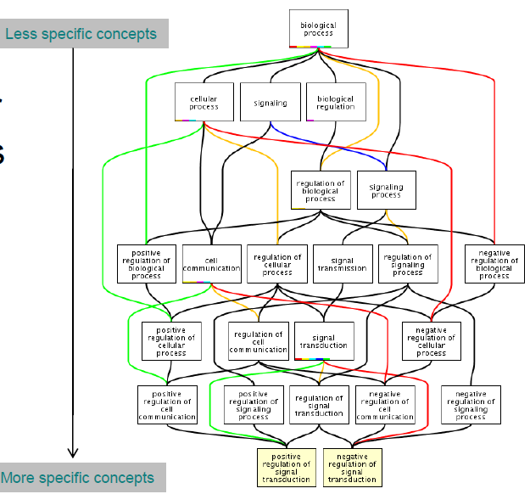
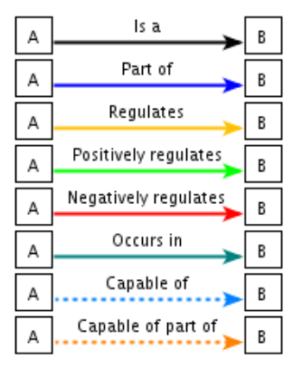
Gene Ontology
Notes:
By centralizing and disseminating a wealth of prior knowledge about known genes, the Gene Ontology database allows to:
Assign attributes to groups of genes that emerge from their experiments or analyses.
The initial group of genes may be some set that was clustered together through expression analysis:
bound by the same transcription factor, or chosen based on prior knowledge.
To identify larger patterns within this group is to seek enrichment - to assess whether some subset of the group shows significant over-representation of some biological characteristic.

Slide 10
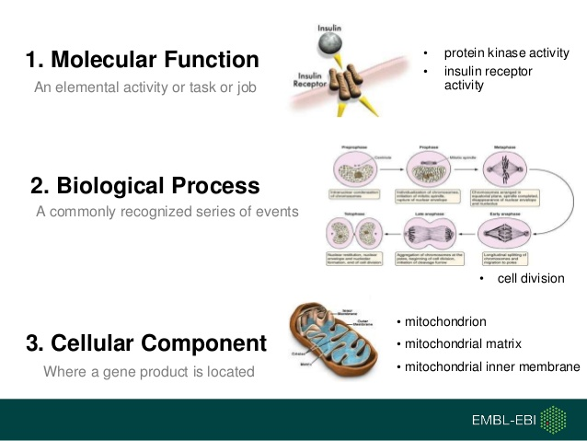
GO Term Namespaces

Slide 11
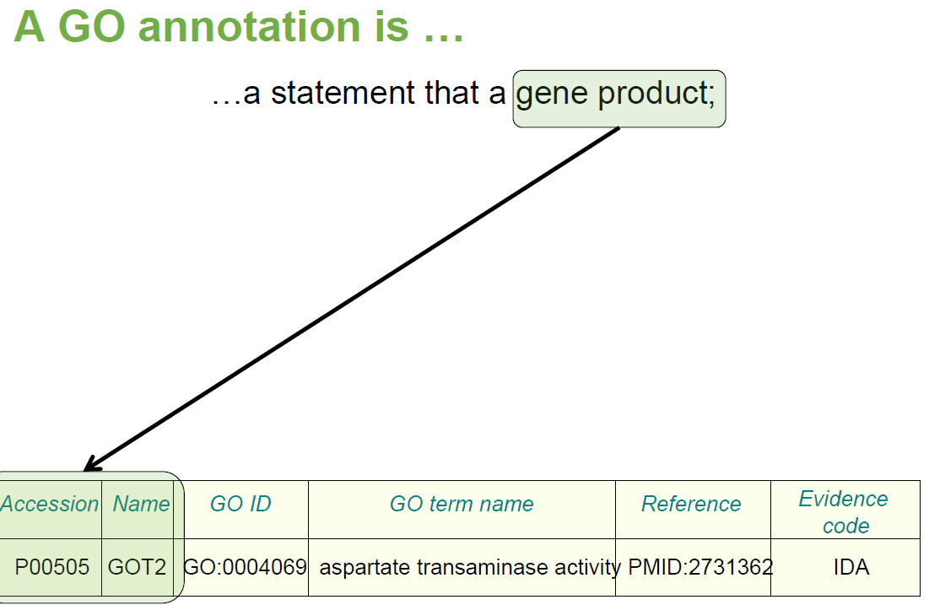

Slide 12
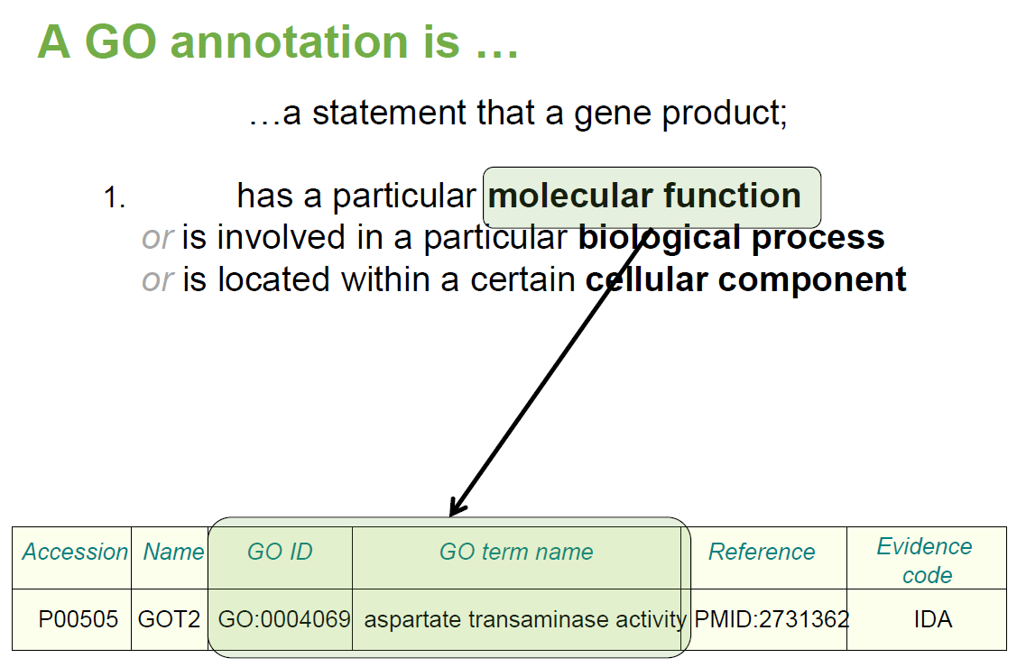

Slide 13
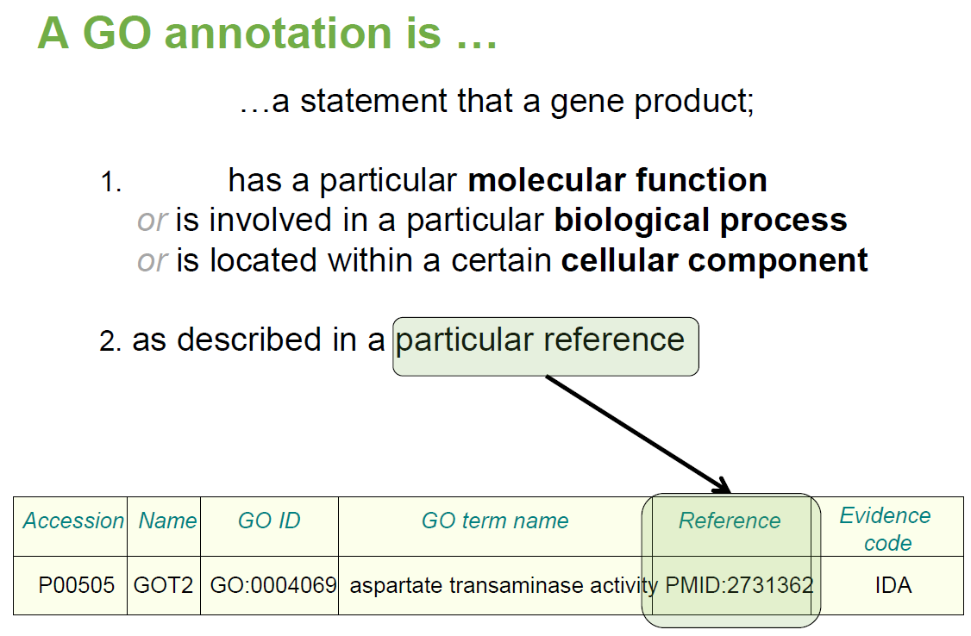

Slide 14
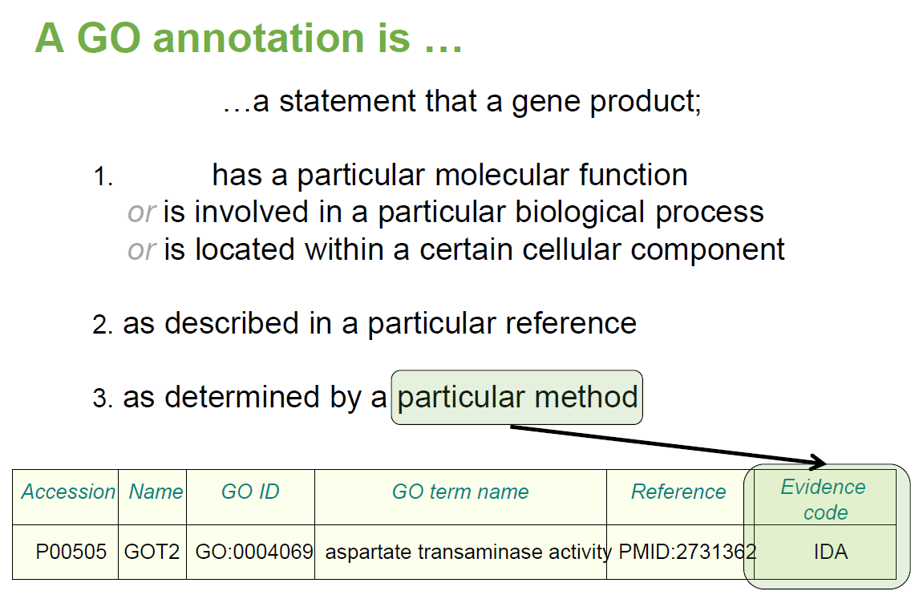

Slide 15
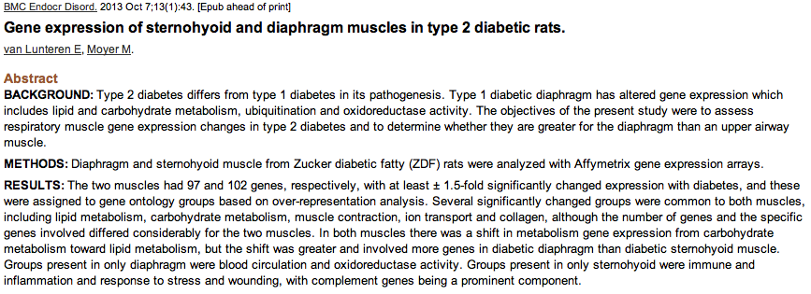
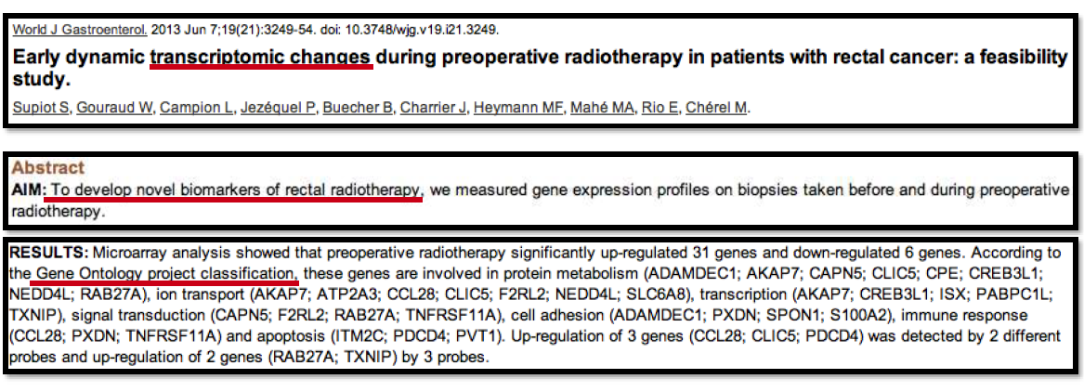
GO can add biological meaning to your data !!

Slide 16

Challenges using GO
Enriched categories are often too general to be useful:
  e.g. GO:0003700 - DNA-binding transcription factor activity
Hierarchical nature of GO creates redundant results
  GO:0003700 - DNA-binding transcription factor activity “IS A”
  GO:0006355 - regulation of transcription, DNA-templated

Slide 17
Enrichment Methods and Tools

Slide 18
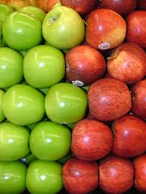
“Enrichment” and Geneset
Enrichment “act of making fuller or meaningful” - (dictionary.com)
Gene Set Enrichment:
Does our gene list overlap a given gene set more than we would expect by chance?
Geneset are enriched if experimental findings are in accordance with set of interest

Slide 19
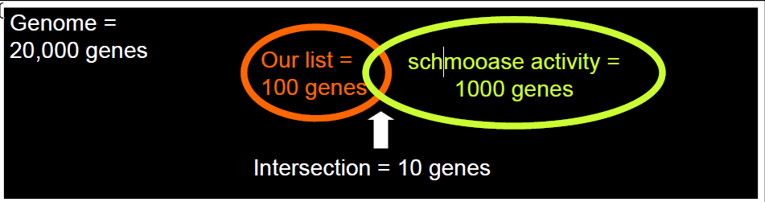
Why do enrichment analysis?
“See the forest for the trees”: High-level biological picture not visible when considering genes one-by-one
Too many genes to examine in detail
  Strong perturbations may yield 1000s of DE genes
  How do we know that what we’re seeing is surprising?

Slide 20
Gene Set Enrichment Analysis
Gene set enrichment analysis:
  Compute a statistic that indicates the degree of similarity between a gene list and a gene set
  Statistic compared to a “null” or “background” distribution to calculate a p-value
Statistic may indicate gene list:
  Has larger overlap with gene set than expected
  Has smaller overlap with gene set than expected
  Has overlapping genes that are more highly or lowly ranked than expected

Slide 21
Main Types of Enrichment Analysis
List‐based: inputs are
  A subset of all genes chosen by some relevant method
  A list of annotations, each linked to genes
Rank‐based: inputs are
  A set of all genes ranked by some metric (ratio, foldchange, etc.)
  A list of annotations, each linked to genes
List‐based with relationships: inputs are
  A subset of all genes
  A list of annotations, each linked to genes, organized in some relationship (e.g., a hierarchy)

Slide 22
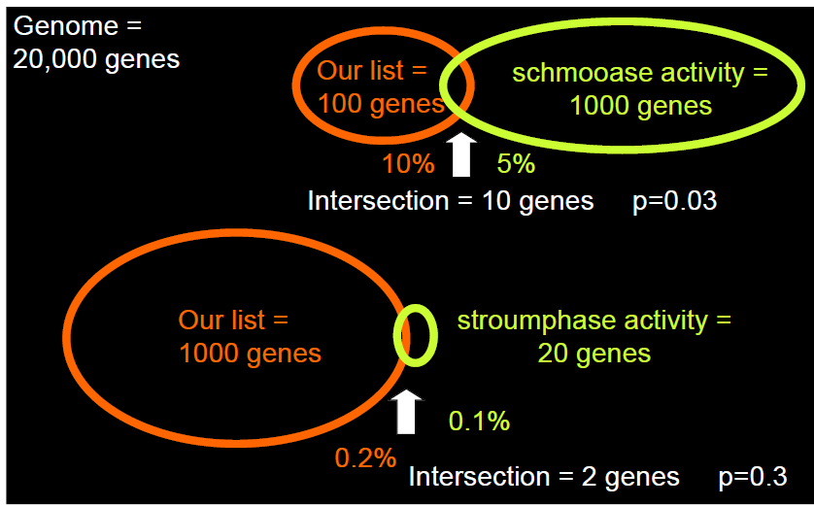
Statistic to test for enrichment
Test for enrichment
  Fisher’s exact
  Hypergeometric
  Binomial
  Chi‐squared
  Kolmogorov‐Smirnov
  Permutation

Slide 23
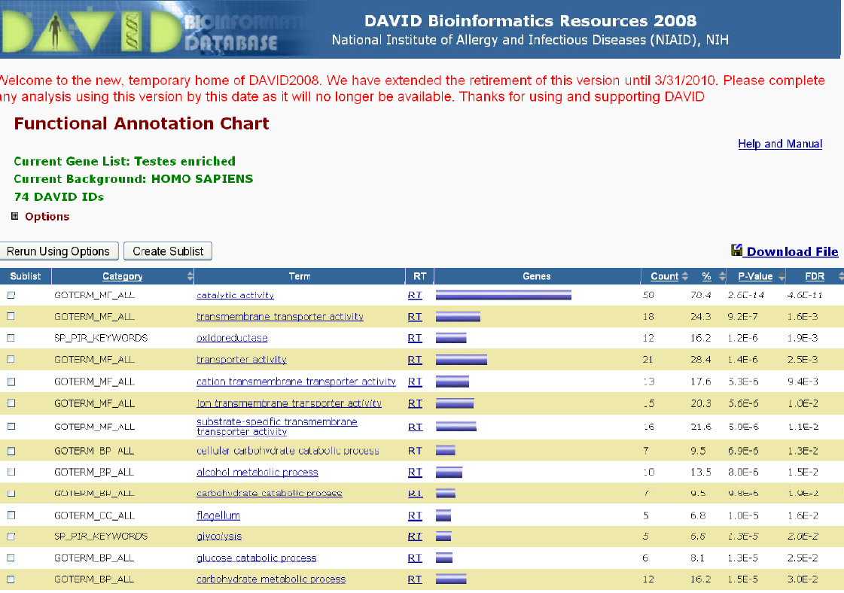
DAVID
Database for Annotation, Visualization and Integrated Discovery (NIAID) http://david.abcc.ncifcrf.gov/
List‐based; Lots of identifiers; lots of species
Allows background definition
Statistic is a modified Fisher exact test

Slide 24
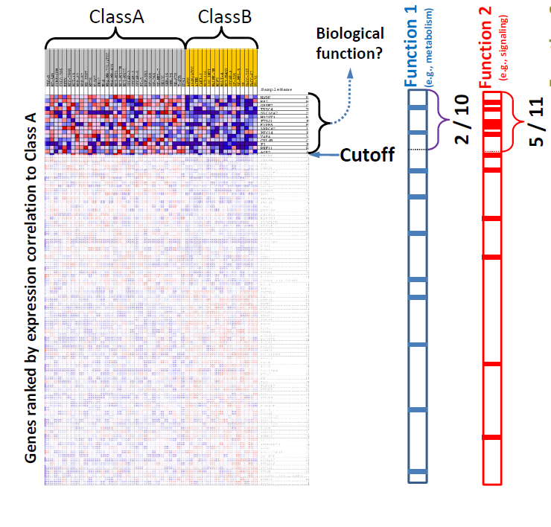
Overrepresentation vs Aggregate score
So far, methods use intuition of “over-representation”
Genes of interest can be defined in many different ways:
  By p-value (which to use?)
  Filtered by fold change?
  Ignores potentially meaningful information on other genes
Aggregate score methods use statistics for all genes in a dataset

Slide 25
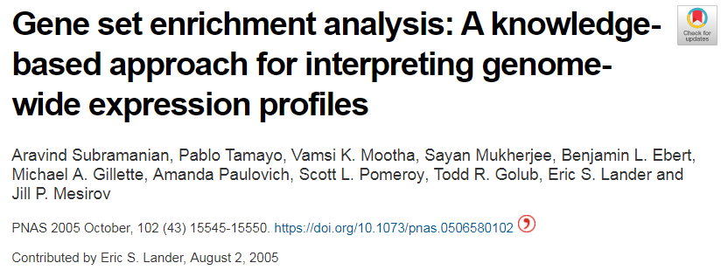

Gene Set Enrichment Analysis (GSEA)
Choosing gene list thresholds is hard and subjective
Expression datasets measure thousands of genes at once
Ideally use all information from an expression
Gene Set Enrichment Analysis: statistical method that uses ranked gene expression statistics to calculate enrichment

Slide 26
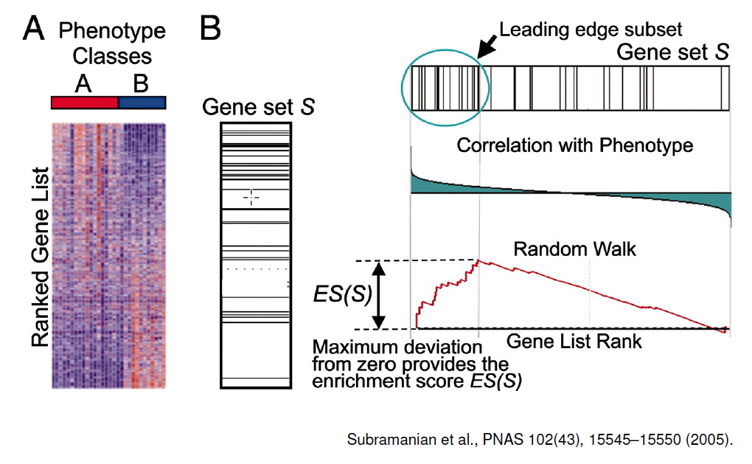
Schematic Overview of GSEA
Notes:
Schematic overview of GSEA.The goal of GSEA is to determine whether any a priori defined gene sets (step 1) are enriched at the top of a list of genes ordered on the basis of expression difference between two classes (for example, highly expressed in individuals with NGT versus those with DM2). Genes R 1,...RN are ordered on the basis of expression difference (step 2) using an appropriate difference measure (for example, SNR). To determine whether the members of a gene set S are enriched at the top of this list (step 3), a Kolmogorov-Smirnov (K-S) running sum statistic is computed: beginning with the top-ranking gene, the running sum increases when a gene annotated to be a member of gene set S is encountered and decreases otherwise. The ES for a single gene set is defined as the greatest positive deviation of the running sum across all N genes. When many members of S appear at the top of the list, ES is high. The ES is computed for every gene set using actual data, and the MES achieved is recorded (step 4). To determine whether one or more of the gene sets are enriched in one diagnostic class relative to the other (step 5), the entire procedure (steps 2−4) is repeated 1,000 times, using permuted diagnostic assignments and building a histogram of the maximum ES achieved by any pathway in a given permutation. The MES achieved using the actual data is then compared to this histogram (step 6, red arrow), providing us with a global P value for assessing whether any gene set is associated with the diagnostic categorization.
Go to publication
Download

Slide 27
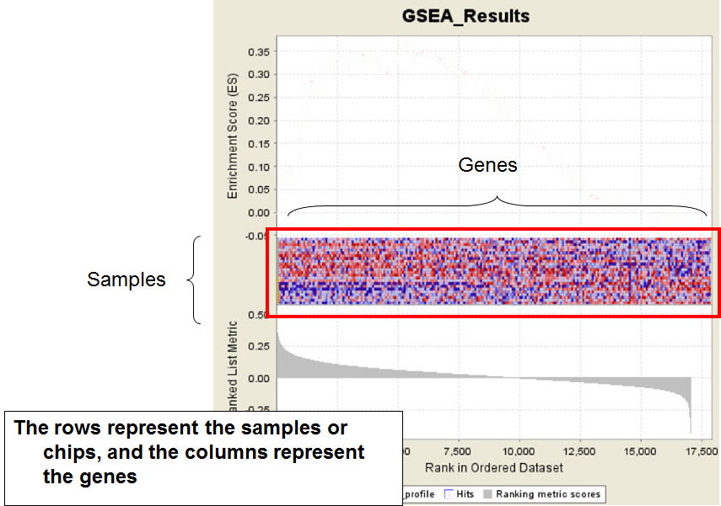

Slide 28
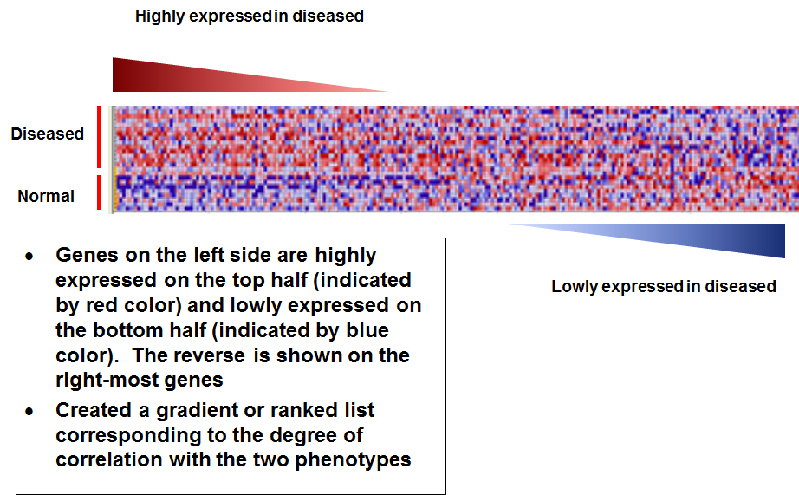

Slide 29
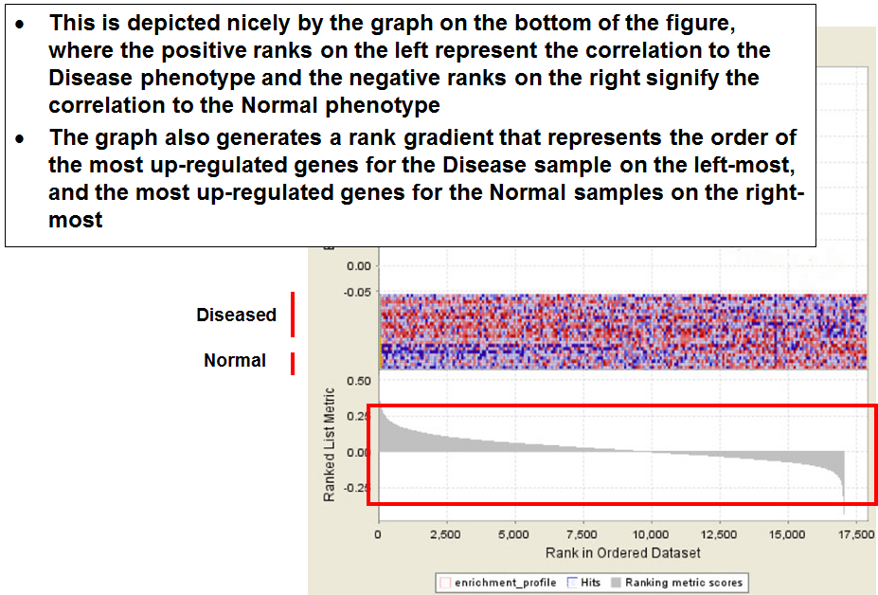

Slide 30
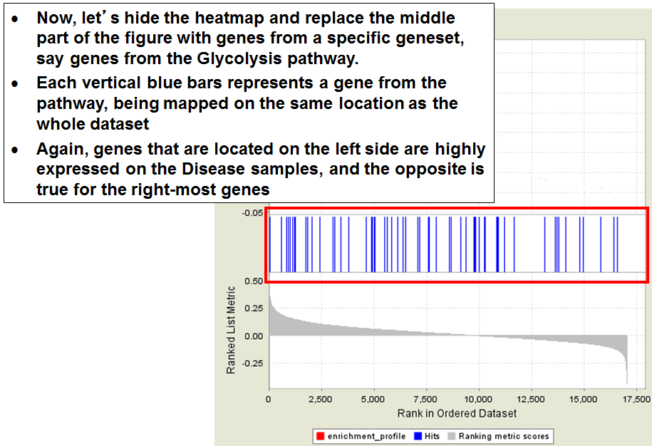

Slide 31
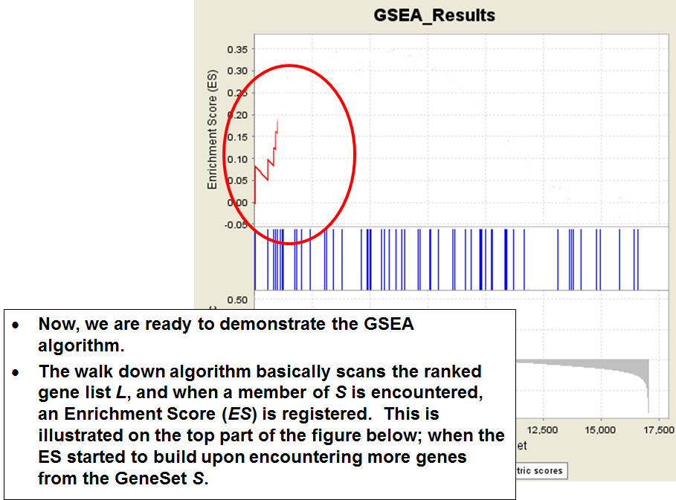

Slide 32
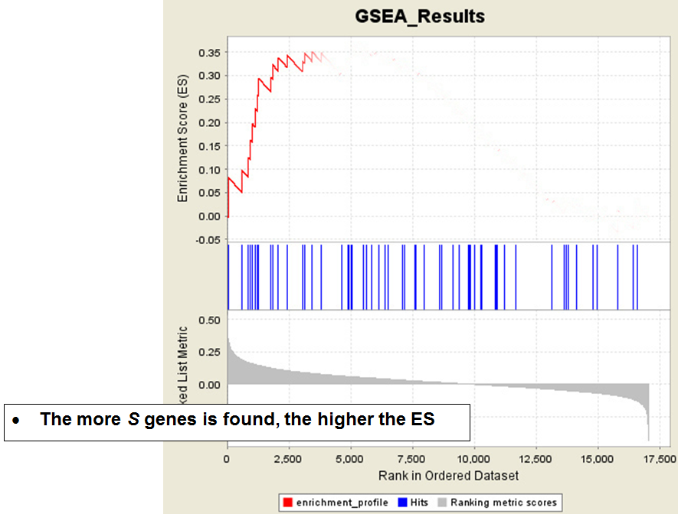

Slide 33
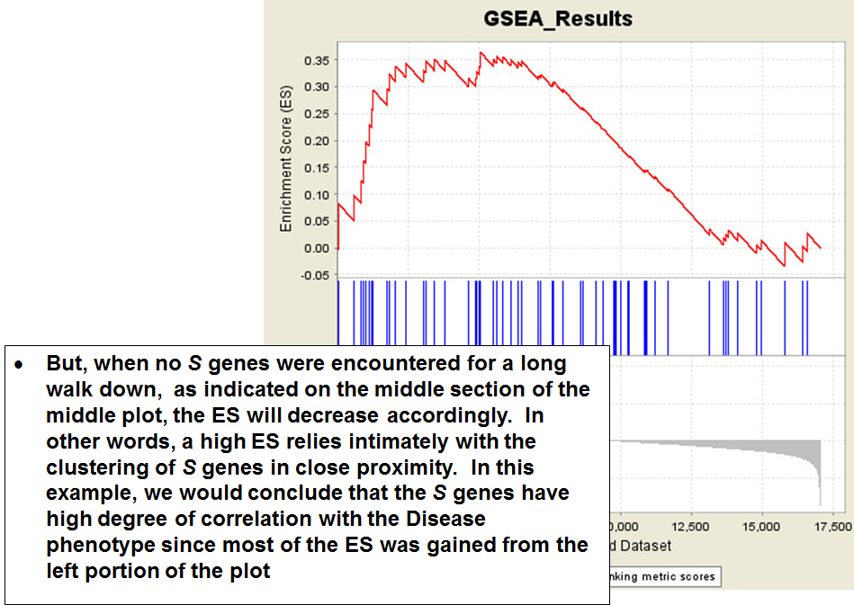

Slide 34
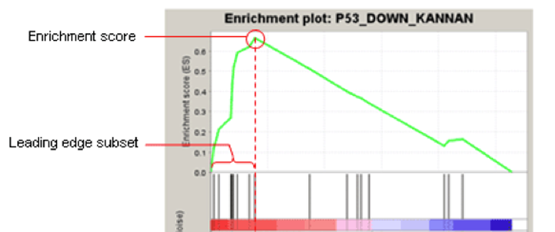
Leading Edge Genes
Leading edge subset of a gene set = the genes that appear in the ranked list before the running sum reaches the max value.
Leading edge analysis = examine the genes that are in the leading edge subsets of the enriched gene sets.
For a negative ES, it is the set of members that appear subsequent to the peak score.
Notes:
The gene set enrichment analysis provides a ‘bird’s eye view’ of the observation relating to the drug treatment and the gene set significantly overrepresented in the phenotype being compared. However, not all the members in the gene set contribute equally to attain significant enrichment. As described by Subramanian et al., (2005), there are leading edge subset of genes within the set that appear in the ranked-list before the point at which the running sum reaches its maximum deviation from zero. These set of genes are called ‘leading edge genes’ as they contribute more to the enrichment score of a gene set during gene set enrichment analysis. A gene that is in many of the leading edge subsets is more likely to be of higher significance or interest than other genes

Slide 35
GSEA Statistic
Enrichment score (ES) is directional:
  positive ES: gene in geneset at the top of the ranked list
  negative ES: gene in geneset at the bottom of the ranked list
Normalized Enrichment score (NES): ES adjusted for gene set size
  can be used to compare analysis results across gene sets
Nominal p-value estimates the statistical significance of the enrichment score for a single gene set
Must correct for multiple hypothesis testing
  Bonferroni
  Benjamini-Hochberg (a.k.a. FDR)
False Discovery Rate (FDR) is the estimated fraction of results expected to be false positives
  e.g. for 100 significant results at FDR < 0.05, 5 are likely to be FP

Slide 36
Advantages of GSEA
Agnostic to the type of gene set and the source of annotation
Operates on any ordered gene list
Does not require the choice of a gene selection threshold or the explicit definition of a statistically significant marker set
Uses distribution-free, non-parametric, permutation-based test procedures with increased statistical power
Incorporates the permutation of phenotype labels thereby preserving the “biological” correlation structure of the markers
Takes into account multiple hypotheses testing of multiple gene sets.

Slide 37
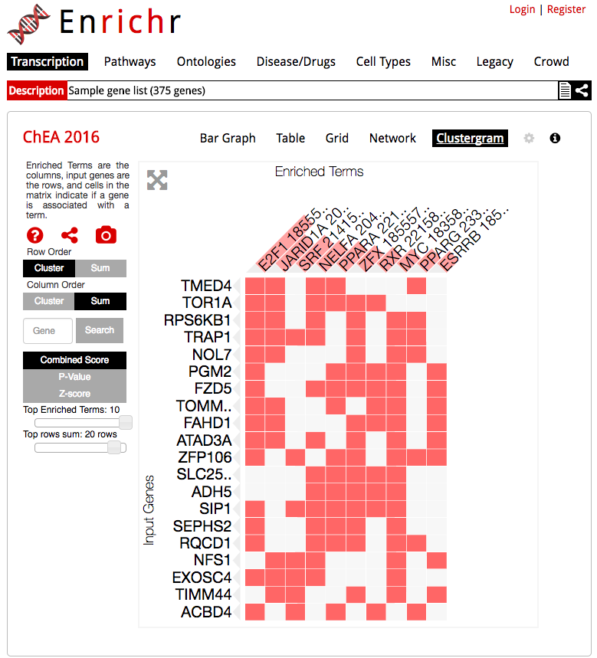
Enrichr
The enrichment analysis tool http://amp.pharm.mssm.edu/Enrichr/
Clustergram to produce dynamic heatmaps of enriched terms as columns and user input genes as rows
helps understand the relationships between their input genes and enriched terms.

Slide 38
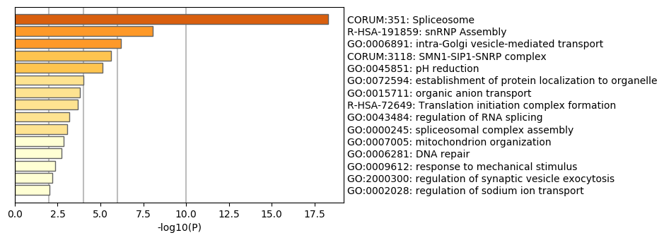
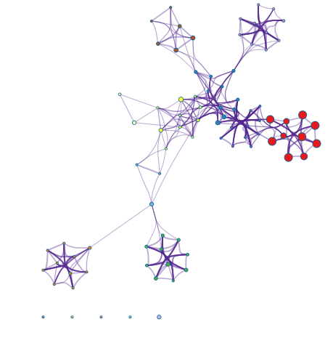
Metascape
metascape.org
Maintains set of curated geneset databases (GO, KEGG, etc)
Computes hyperenrichment
Clusters gene sets by shared gene statistic
Easy to use
Makes nice figures

Slide 39
Considerations and Recommendations
Choose a tool that
  Includes your species
  Includes your gene / probe identifiers
  Has up‐to‐date annotation
  Lets you define your background (if possible)
Try at least a few tools, inspect for agreement
Try different list definitions (e.g. different p-value, log fold change thresholds)

